Slide 1

EDA Project - AMCAT Data Analysis On 2015
Presented by Ganti Shiva
INTERN ID: IN1240983

Slide 2
About me
I’m G. Shiva. I hold a Bachelor's degree in Commerce.
While my background may not be in a technical field like engineering, I am eager to explore the fascinating world of data science.I believe that data science offers incredible opportunities to uncover insights, make informed decisions, and drive innovation across various industries. With the rapid growth of data in today's digital world, I am motivated to acquire the skills and knowledge necessary to leverage data effectively and contribute meaningfully to organizations.
Though I do not have direct work experience in data science, I am enthusiastic about embarking on this learning journey. I am ready to invest my time and effort into acquiring new skills, whether through self-study, online courses, or practical projects.
LinkedIn: [www.linkedin.com/in/shiva-ganti-420067245]
GitHub: [https://github.com/Shiva-Ganti-17]
I'm excited to explore the world of data science and contribute to its growth and innovation

Slide 3
Agenda (This should be the PPT flow)
Business Problem and Use case domain understanding(If Required)
Objective of the Project
Web Scraping – Details (Websites, Processor you followed)
Summary of the Data
Exploratory Data Analysis:
Data Cleaning Steps
Data Manipulation Steps
Univariate Analysis Steps
Bivariate Analysis Steps
Key Business Question
Conclusion (Key finding overall)
Q&A Slide
Your Experience/Challenges working on Web Scraping – Data Analysis Project.

Slide 4
Business Problem and Project Objective.
Business Problem:
The dataset was released by Aspiring Minds from the Aspiring Mind Employment Outcome 2015 (AMEO). The study is primarily limited only to students with engineering disciplines. The dataset contains the employment outcomes of engineering graduates as dependent variables (Salary, Job Titles, and Job Locations) along with the standardized scores from three different areas – cognitive skills, technical skills and personality skills. The dataset also contains demographic features. The dataset contains around 40 independent variables and 4000 data points. The independent variables are both continuous and categorical in nature. The dataset contains a unique identifier for each candidate
Objective:
To Explore and mine the inference from the dataset using salary as the target variable.

Slide 5
Web scraping and process :
Targeted website: amcat.com
Purpose: Extract job listings, job titles, locations, descriptions, etc.
Used Python libraries: BeautifulSoup, requests
Sent GET request to amcat.com using requests library
Parsed HTML content with BeautifulSoup
Located desired data using HTML elements
Extracted data with BeautifulSoup methods
Iterated over multiple pages if needed
Performed data cleaning and preprocessing
Adhered to ethical web scraping practices
Stored extracted data for analysis
Summary of data:
ID: Unique identifier for each candidate
Salary: Annual CTC offered to the candidate (in INR)
DOJ (Date of Joining) and DOL (Date of Leaving): Dates of joining and leaving the company, respectively
Designation: Designation offered in the job
JobCity: Location of the job (city)
Gender: Candidate’s gender
DOB (Date of Birth): Date of birth of candidate
10percentage and 12percentage: Overall marks obtained in grade 10 and grade 12 examinations, respectively
10board and 12board: The school board whose curriculum the candidate followed in grade 10 and grade 12
CollegeID: Unique ID identifying the college which the candidate attended
CollegeTier: Tier of college
Degree: Degree obtained/pursued by the candidate
Specialization: Specialization pursued by the candidate
CollegeGPA: Aggregate GPA at graduation
CollegeCityID: Unique ID to identify the city in which the college is located
CollegeCityTier: The tier of the city in which the college is located
CollegeState: Name of States
GraduationYear: Year of graduation (Bachelor’s degree)
English, Logical, Quant: Scores in AMCAT English, Logical, and Quantitative sections, respectively
Domain: Standardized Scores in AMCAT’s domain module
ComputerProgramming, ElectronicsAndSemicon, ComputerScience, MechanicalEngg, ElectricalEngg, TelecomEngg, CivilEngg: Scores in AMCAT’s various engineering sections
conscientiousness, agreeableness, extraversion, neuroticism, openness_to_experience: Standardized scores in one of the sections of AMCAT’s personality test

Slide 6
Data Cleaning Steps And Analysis
. Converted date columns to datetime format.
Created new columns for 'Experience', 'Tenure', and 'Age' based on date calculations.
Standardized capitalization for string columns.
Corrected spelling errors in job designations and job cities using fuzzy string matching.
Standardized gender values to 'male' and 'female'.
Corrected spelling errors in educational board names and specialization fields.
Rounded 'collegeGPA' to two decimal places.
Removed rows with erroneous graduation years ('0' values).
Replaced invalid domain values with the median.
Replaced invalid values (-1) with NaN for technical skills columns ('ComputerProgramming', 'ElectronicsAndSemicon', 'ElectricalEngg').
Filled missing values in technical skills columns with the median.
Data Quality Check:
Ensured the validity and consistency of data across various columns.
Handled missing, erroneous, and inconsistent data to prepare it for analysis.
Data Standardization:
Ensured uniformity in data representation by standardizing capitalization and correcting spelling errors.
Data Imputation:
Imputed missing values using appropriate strategies such as replacing with mode or median.

Slide 7
Exploratory Data Analysis
These are the steps performed on univariant analysis on numerical columns
Non-Visual Analysis:
Descriptive statistics:
Mean: [mean]
Standard Deviation: [standard deviation]
Minimum: [minimum]
25th percentile: [25th percentile salary]
Median: [median]
75th percentile: [75th percentile salary]
Maximum: [maximum]
Visual Analysis:
Histogram: Distribution of values.
kDE Plot: Kernel Density Estimation plot showing the probability density function of values.
Boxplot: Summary of the distribution's central tendency, dispersion, and presence of outliers.
CDF Plot: Cumulative Distribution Function plot showing the cumulative probability distribution of values.
QQ Plot: Quantile-Quantile plot to assess if the values follow a normal distribution.
Statistical Tests:
Shapiro-Wilk Test: Assesses normality of distribution.
Kolmogorov-Smirnov Test: Tests if the distribution follows a normal distribution.
One-Sample t-test: Compares the mean to a hypothetical population mean (if available).
Outlier Identification:
Using the Interquartile Range (IQR) method:
Lower Bound: [lower bound value]
Upper Bound: [upper bound value]
Identified [number of outliers] outliers.

Slide 8
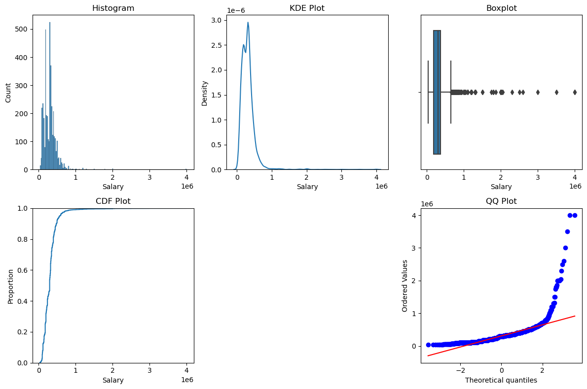
Univariant Analysis on Salary Column
Non-Visual Analysis: count 3.998000e+03
mean 3.076998e+05
std 2.127375e+05
min 3.500000e+04
25% 1.800000e+05
50% 3.000000e+05
75% 3.700000e+05
max 4.000000e+06
Name: Salary, dtype: float64
Statistical Tests: Shapiro-Wilk Test Result: Not normally distributed (p-value: 0.0)
Kolmogorov-Smirnov Test Result: Does not follow normal distribution (p-value: 2.7846681657027337e-39)
One-Sample t-test Result: Significantly different from the population mean (p-value: 0.0)
Identified [number of outliers] in Salary Column is
109

Slide 9
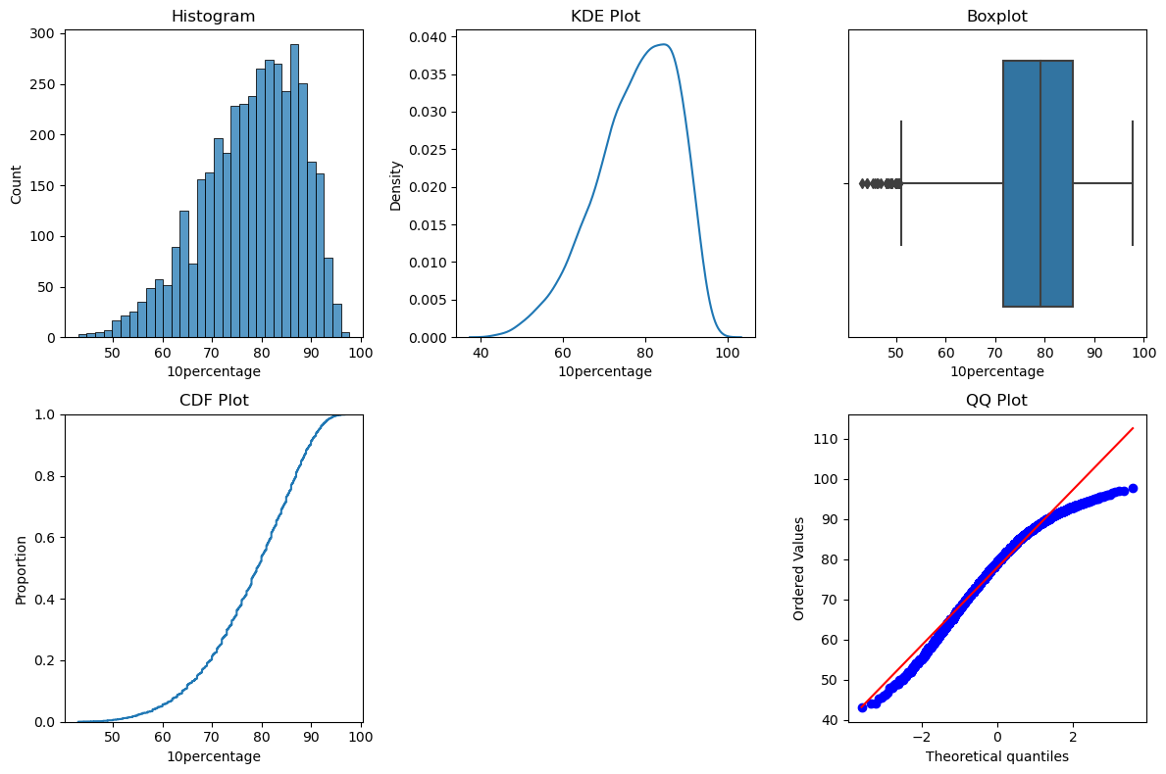
Non-Visual Analysis:
count 3998.000000
mean 77.925443
std 9.850162
min 43.000000
25% 71.680000
50% 79.150000
75% 85.670000
max 97.760000
Name: 10percentage, dtype: float64
Statistical Tests: Shapiro-Wilk Test Result: Not normally distributed (p-value: 3.4374433389073303e-28)
Kolmogorov-Smirnov Test Result: Does not follow normal distribution (p-value: 7.887574242861505e-06)
One-Sample t-test Result: Significantly different from the population mean (p-value: 3.08253368379257e-09)
The no of outliers 10percentage is 30

Slide 10
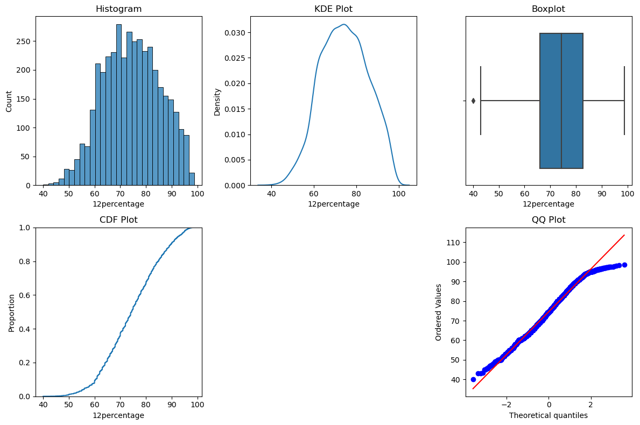
Non-Visual Analysis: count 3998.000000
mean 77.925443
std 9.850162
min 43.000000
25% 71.680000
50% 79.150000
75% 85.670000
max 97.760000
Name: 10percentage, dtype: float64
Statistical Tests: Shapiro-Wilk Test Result: Not normally distributed (p-value: 3.4374433389073303e-28)
Kolmogorov-Smirnov Test Result: Does not follow normal distribution (p-value: 7.887574242861505e-06)
One-Sample t-test Result: Significantly different from the population mean (p-value: 3.08253368379257e-09)
No of outliers is 1

Slide 11
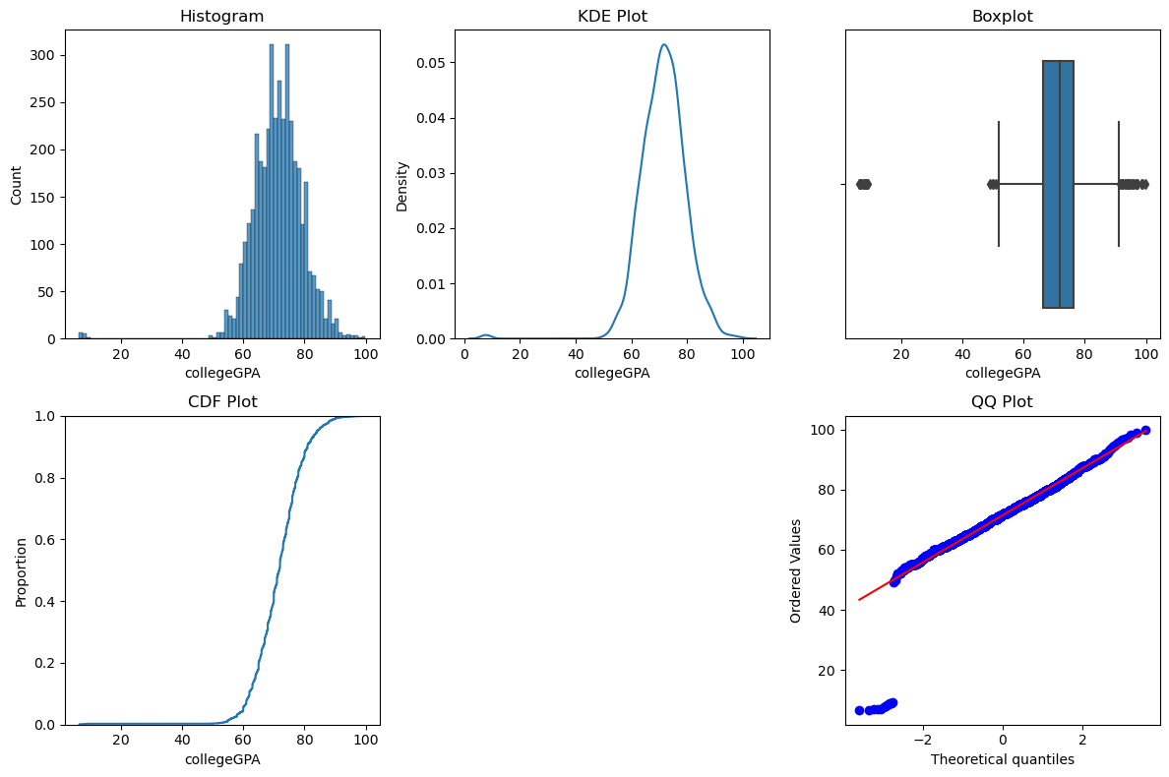
Non-Visual Analysis: count 3998.000000
mean 71.486171
std 8.167338
min 6.450000
25% 66.407500
50% 71.720000
75% 76.327500
max 99.930000
Name: collegeGPA, dtype: float64
Statistical Tests: Shapiro-Wilk Test Result: Not normally distributed (p-value: 8.94630978578893e-41)
Kolmogorov-Smirnov Test Result: Does not follow normal distribution (p-value: 0.004908132697894443)
One-Sample t-test Result: Significantly different from the population mean (p-value: 0.00016973516165209724)
No of outliers is 38

Slide 12
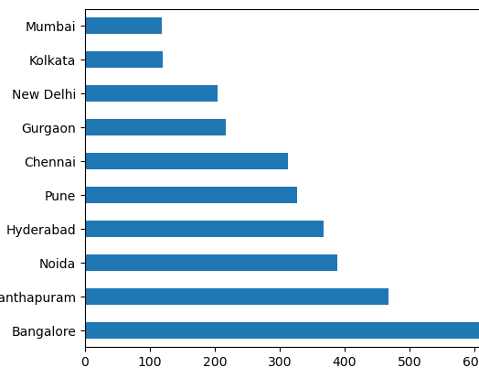
Univariant Analysis on categorical columns
Bangalore has the highest number of job placements followed by Thiruvananthapuram ,Noida,Hyderabad and Pune.
Several cities have only one or a few job placements.

Slide 13
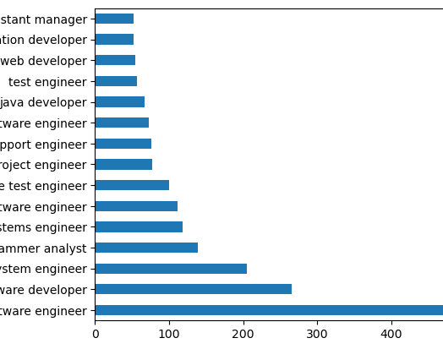
Software engineer, software developer, and system engineer are the most common designations.
Some designations have very few occurrences, indicating they may be specialized roles.

Slide 14
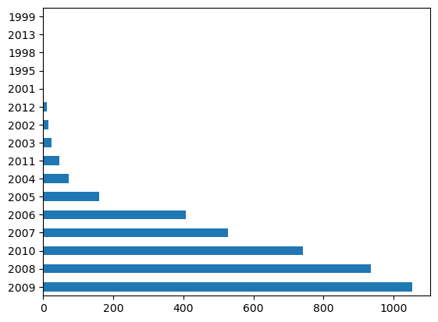
- Most graduates completed their 12th grade between 2007 and 2010.

Slide 15
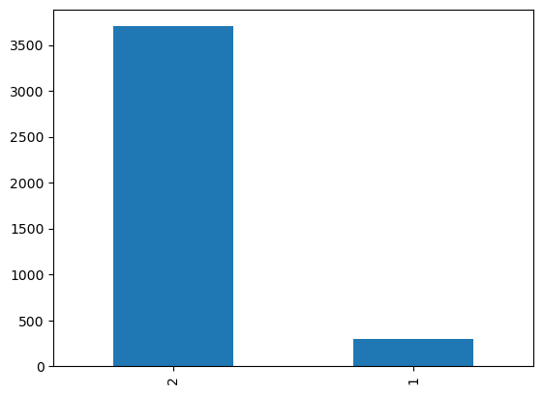
The majority of colleges in the dataset are Tier 2 colleges.

Slide 16
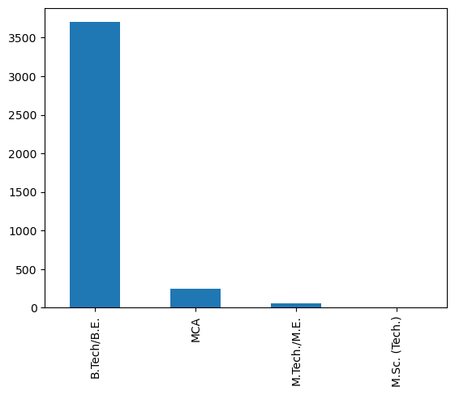
B.Tech/B.E. is the most common degree, followed by MCA and M.Tech./M.E.
M.Sc. (Tech.) has the fewest graduates.

Slide 18
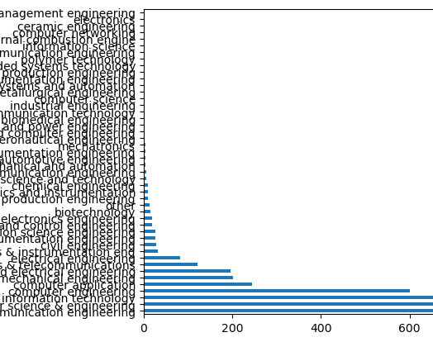
Specializations like electronics and communication engineering, computer science & engineering, and information technology are the most common.
Some specializations have very few graduates

Slide 19
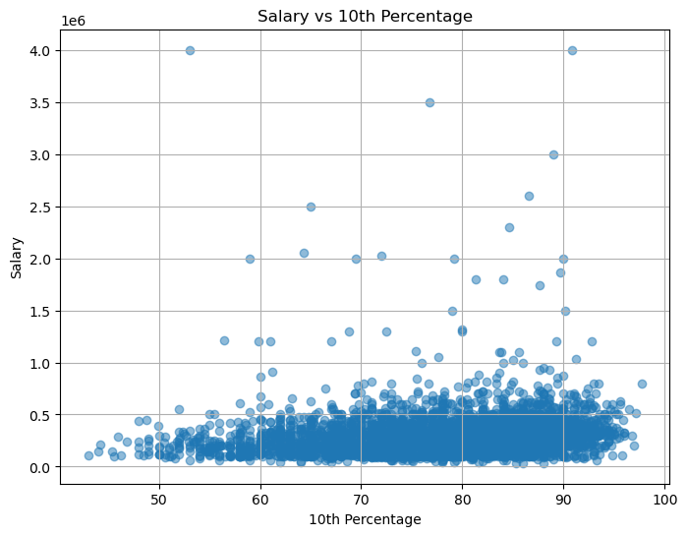
4 - Bivariate Analysis
Numerical Vs Numerical
Discover the relationships between numerical columns using Scatter plots, hexbin plots, pair plots, etc..
Salary vs 10percentage
The analysis reveals a statistically significant, yet weak positive correlation between salary and 10th percentage.
Both Pearson and Spearman correlation tests confirm this finding, with Spearman correlation indicating a slightly stronger association.
While higher 10th percentage tends to be associated with higher salaries, other factors likely play a role in determining salary levels.

Slide 20
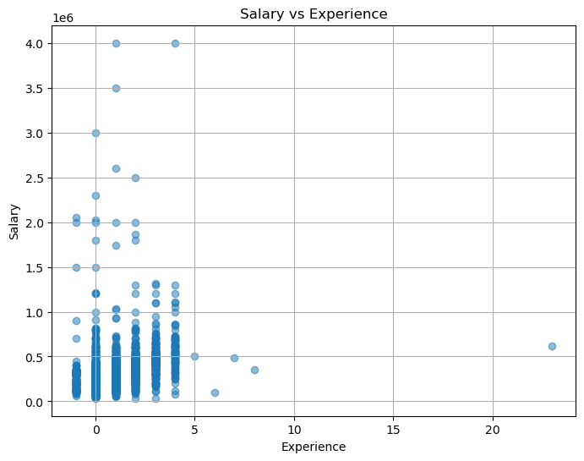
Salary vs Experience
Pearson correlation coefficient: 0.33655685588778356 Pearson correlation p-value: 1.8193244679568838e-106 Spearman correlation coefficient: 0.4413303028075057 Spearman correlation p-value: 3.0291229310803344e-190
The correlation between salary and experience is statistically significant and moderately positive.

Slide 21
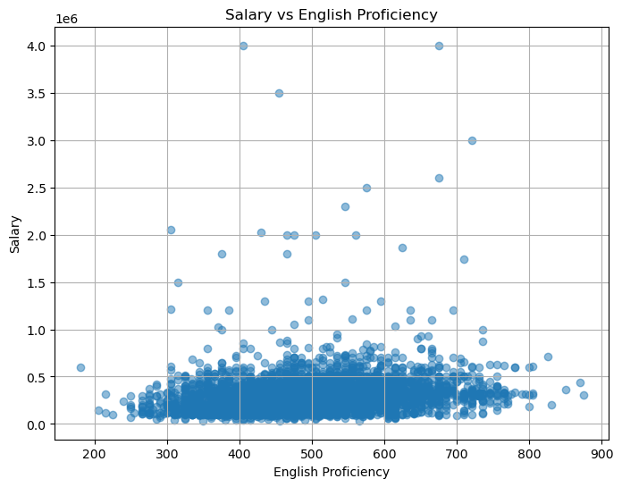
Salary vs English proficiency
Pearson correlation coefficient: 0.17821904497536986 Pearson correlation p-value: 6.90482238028173e-30 Spearman correlation coefficient: 0.26964699563783984 Spearman correlation p-value: 1.4659438514630003e-67
The correlation between salary and English scores is statistically significant but relativelystrong.

Slide 22
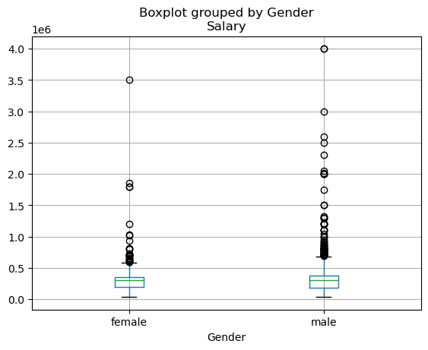
Numerical Vs categorical the patterns between categorical and numerical columns using swarmplot, boxplot, barplot
The salary analysis shows that while males generally earn slightly higher mean salaries, both genders have similar median salaries, indicating comparable midpoints in earnings.
The reported p-values for the two-sample t-test and ANOVA are identical, which is unexpected as these tests evaluate different hypotheses

Slide 23
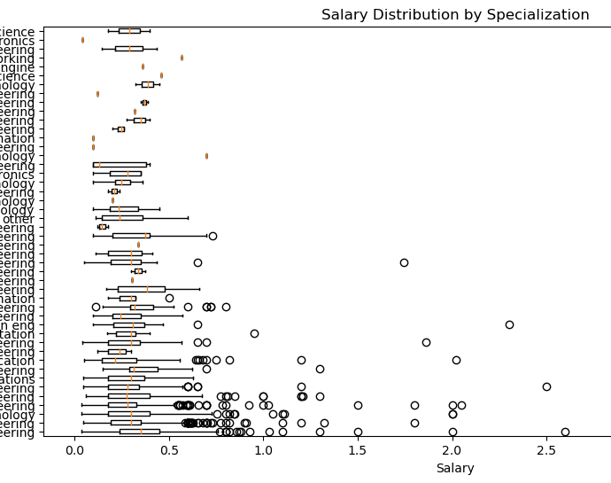
Salary Vs Specialization
Salary Distribution: Salaries vary widely across specializations, with minimums ranging from 35,000 to 1,000,000+ and means from around 100,000 to over 300,000.
Computer Science & Engineering: With 744 data points, this specialization has a relatively large sample size. The mean salary is around 277,439, with a wide range from 35,000 to 2,050,000.
Information Technology: Another field with a substantial number of data points (660), the mean salary is approximately 308,492, with salaries ranging from 35,000 to 2,000,000.
Electronics and Communication Engineering: This specialization has a high number of data points (880) and a mean salary of around 296,813. Salaries vary widely from 45,000 to 3,000,000.
Civil Engineering: With 29 data points, civil engineering has a mean salary of approximately 381,207, with salaries ranging from 110,000 to 800,000.

Slide 24
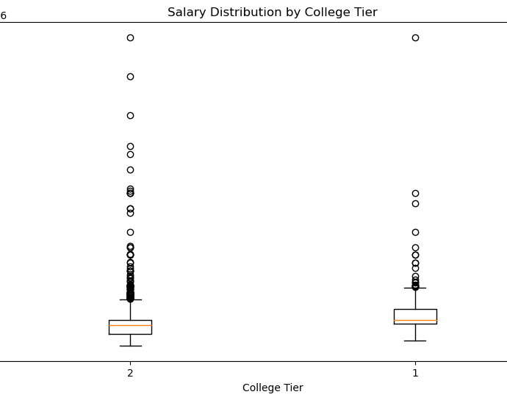
Salary vs College Tier
College Tier 2 has a significantly larger sample size compared to College Tier 1.
Mean Salary:
The mean salary for College Tier 1 is approximately 442,357.
The mean salary for College Tier 2 is approximately 296,894.
College Tier 1 shows a higher mean salary compared to College Tier 2.
Salary Range:
Both College Tiers have the same minimum salary of 35,000.
College Tier 1 has a maximum salary of 4,000,000, while College Tier 2 also has a maximum salary of 4,000,000.

Slide 25
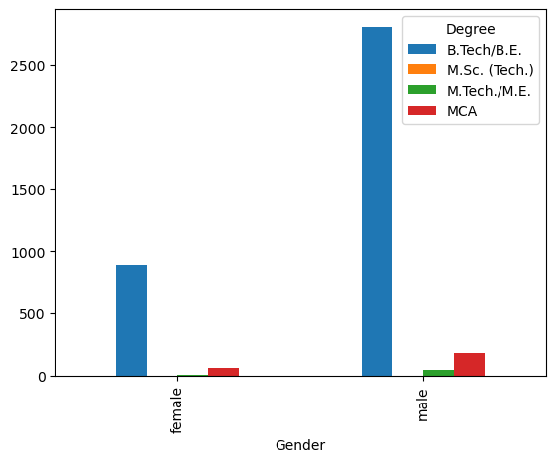
Categorical vs Categorical Identify relationships between categorical and categorical columns using stacked bar plots.
B.Tech/B.E.: The majority of both males (2811) and females (889) have a B.Tech/B.E. degree. However, the number of males is much higher.
M.Sc. (Tech.): There is only one female with an M.Sc. (Tech.) degree, whereas no males have this degree.
M.Tech./M.E.: Both males and females have M.Tech./M.E. degrees, with males again outnumbering females significantly (44 males compared to 9 females).
MCA: There are more males (185) with an MCA degree compared to females (58).

Slide 26
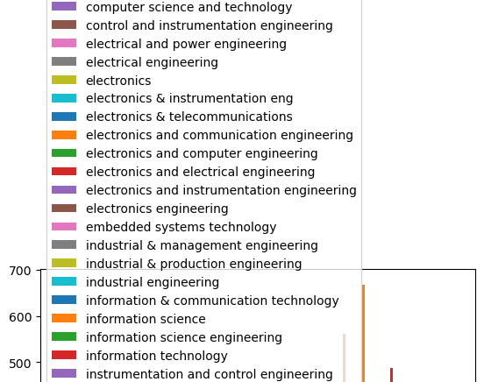
Gender vs Specialization
Gender Disparity: Males dominate across most specializations, with significantly higher numbers in fields like computer engineering, electronics engineering, and mechanical engineering.
Computer Science & Engineering: Both genders are represented, but males outnumber females notably, particularly in computer engineering and information technology.
Electronics & Communication Engineering: Similar to computer science, males are predominant, with a significant gap in numbers.
Mechanical Engineering: Again, males outnumber females, reflecting a common trend in traditional engineering fields.
Biotechnology: More females are represented here compared to some other fields, though still significantly fewer than males.
Industrial & Production Engineering: Males dominate, aligning with traditional perceptions of engineering fields.
Other Fields: Some fields like internal combustion engine, polymer technology, and power systems and automation have minimal or no representation from females.

Slide 27
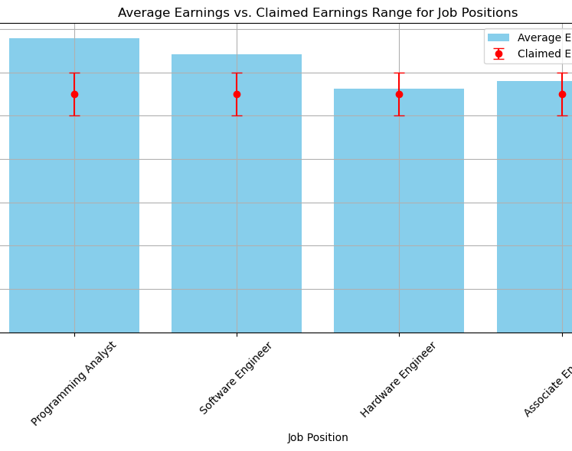
Research Questions Testing the Claim about Earnings
Programming Analyst:
Average Earnings: ₹339,784.17.Claimed Earnings Range: ₹250,000 - ₹300,000.Since the p-value (1.97e-37) is much less than the significance level of 0.05, we reject the null hypothesis. There is a significant difference in earnings for Programming Analysts compared to the claimed range.
Software Engineer:
Average Earnings: ₹320,877.57.Claimed Earnings Range: ₹250,000 - ₹300,000.
Similar to the Programming Analyst, the p-value (7.15e-40) is much less than 0.05, indicating a significant difference in earnings for Software Engineers compared to the claimed range.
Hardware Engineer:Average Earnings: ₹281,250.00.Claimed Earnings Range: ₹250,000 - ₹300,000.
The p-value (0.514) is greater than 0.05, suggesting that there is no significant difference in earnings for Hardware Engineers compared to the claimed range.
Associate Engineer:
Average Earnings: ₹290,000.00.Claimed Earnings Range: ₹250,000 - ₹300,000
Similarly, the p-value (0.540) is greater than 0.05, indicating no significant difference in earnings for Associate Engineers compared to the claimed range.

Slide 28
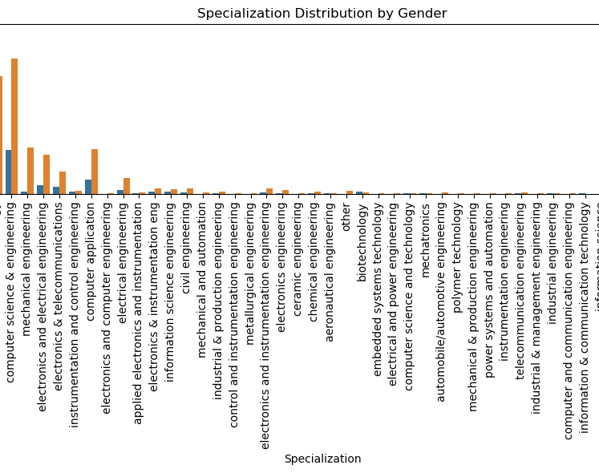
2.Research Questions
By seeing visualization ,we came know that males are more in compared to females in specialization

Slide 29
conclusion
Salary Distribution: The distribution of salaries in the dataset varies widely, with a mean salary of approximately 307,700 rupees and a standard deviation of 212,700 rupees. The salary range spans from 35,000 rupees to 4,000,000 rupees.
Research Question 1: The claim that fresh graduates in specific job roles can earn up to 2.5-3 lakhs is not supported by the data. The average salary in the dataset exceeds this claimed range.
Hypothesis Testing: The simulation under the null hypothesis suggests that the observed average salary is significantly higher than what would be expected by chance under the claimed salary range.
Critical Value Distribution: Visualizing the rejection region on the sample salary distribution indicates that salaries beyond a certain threshold are considered statistically significant, implying that they differ from the claimed range.
Gender and Specialization: There appears to be a relationship between gender and specialization preferences. Further analysis is needed to explore this relationship and determine its significance.
Industry Trends and Job Demand: Certain industries or sectors may offer higher salaries and job demand compared to others. Understanding the skills and qualifications valued in these industries could provide insights for career planning and development.
Personality Traits and Career Success: Personality traits such as conscientiousness, agreeableness, extraversion, neuroticism, and openness to experience may influence career success and salary levels. Analyzing these traits in relation to job performance and satisfaction could provide valuable insights.

Slide 30

THANK YOU

