Slide 1
Project Title: CarDekho Used Car Price Prediction
Domain: Automobile

Slide 2
Problem Statement:
The primary objective of this project is to create a data science solution for predicting used car prices accurately by analyzing a diverse dataset including car model, no. of owners, age, mileage, fuel type, kilometers driven, features and location. The aim is to build a machine learning model that offers users to find current valuations for used cars.

Slide 3
Tools Used
Python -- Programming Language
pandas -- Python Library for Data Visualization
numpy -- Fundamental Python package for scientific computing
streamlit -- Python framework to build and share machine learning and data science web apps
scikit-learn -- Machine Learning library for Python

Slide 4
Approaches
Extracted the data from Given data source
Cleaned the data by handling Null values, duplicate values.
Changing Data types
Finding outliers, skewness
EDA
Feature selection
Model Building

Slide 5
Explotorary Data Analysis
Resale Prices for cars on cities like Bangalore, Chennai, Delhi, Jaipur, Hyderabad and Kolkata which varied by different types of factors, in here I have analysed some important factors like Seats, transmission, Mileage, Top speed, fuel type, KM driven which influenced the re-sale prices.
Lets starts with city wise total re-sale Prices on cars.

Slide 6
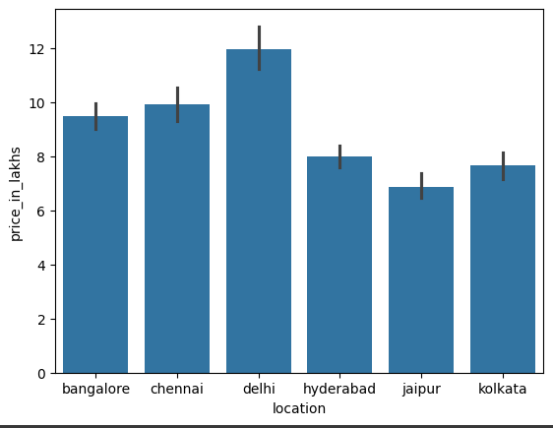
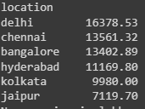
Delhi and Chennai had overall high re-sale Price collection while comparing to other cities.
This was from year range of 1985 to 2023.
In which highest price was around by Delhi was 16378.53 in lakhs and lowest by Jaipur, in the amount of 7119.70 In lakhs.
Detailed information were shown below:

Slide 7
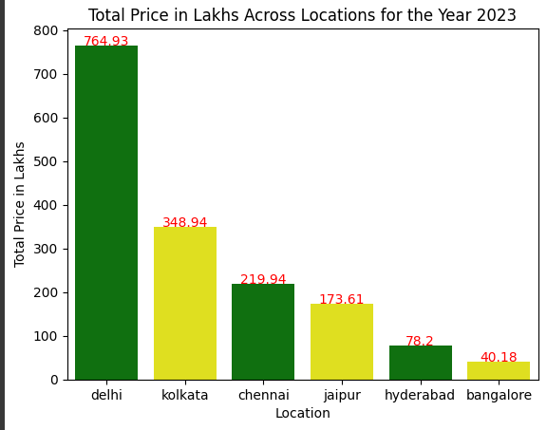
Lets see that Year wise total sales in price for re sale cars and Lets see the latest report of location wise car sales!! which was for the year 2023!!
Latest – Resale Price trends on City wise:
The above graph clearly shown the result for 2023 highest sales across cities.
Yes, Delhi and Kolkata were on 1st and 2nd place and this time, there was slight drop on Chennai car sales, hence it was moved to 3rd place. As Delhi was in 1st place, there are other reasons which may applicable like population in Delhi may high.
There was improvement in Kolkata sales, where it was moved from 4th place to 2nd place.

Slide 8
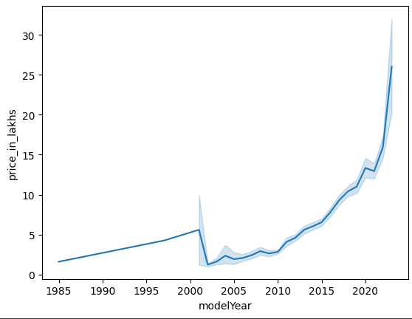
Lets see the Year wise sales trend:
The above line graph shows the trend of Prices from 1985 to 2020. In this, we can see there was a huge drop on 2021 to 2005.
After that, the car resale market had started increasing again and now, it clearly shows that re-sale market for cars in good trend.
By this, we can see that Peoples before 2015, does not shown much interest in selling their used cars.
In our next slide, we can which manufacture had high sales even in dropped years----

Slide 9
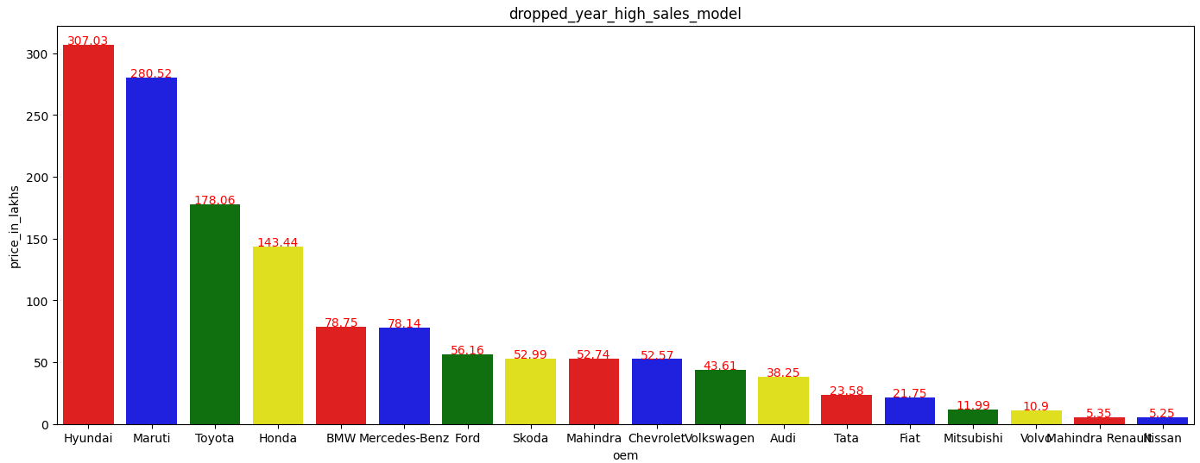
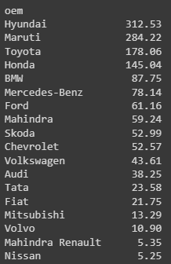
Sales from 2002 to 2010
So, in the dropped years from 2002 to 2010, it seems Hyudai shows high sales even others shows drop in re-sale by this, we can understand that, Hyundai, Maruti, Toyata had high re-sale prices even in some low market conditions.
----Also, we can see that Mahindra, Renault, Nissan had very low in dropped years while comparing to other models
Avg sales of cars by manufacturer as shown in details amount:
By this, we can understand that from 2002 to 2010, Manufacturer like
Mahindra & Nissan had only avgerage of 5.35 lakhs which was very low,
Which means those manufacturer cars like one cars was sold.

Slide 10
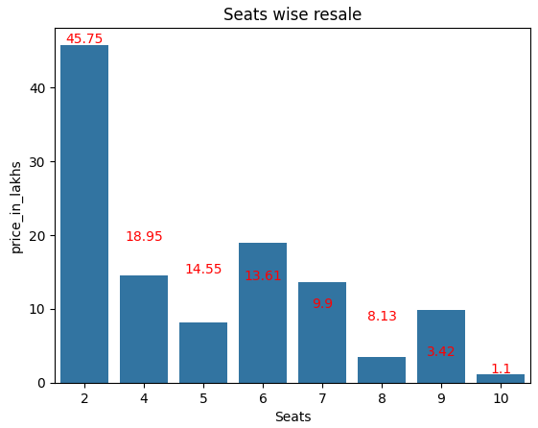
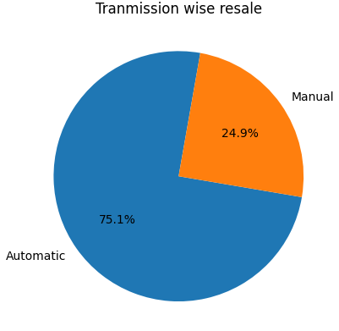
Lets find the factors like Number of seats which affects the re-sale price by below graph:
Lets find the factors like Transmission which affects the re-sale price by below graph:

Slide 11
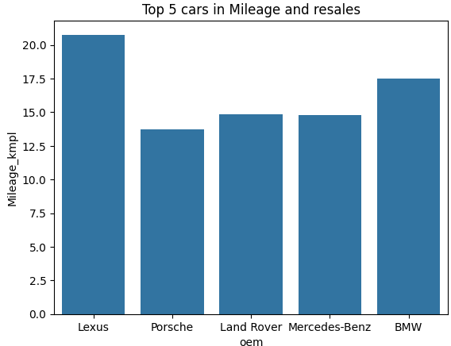
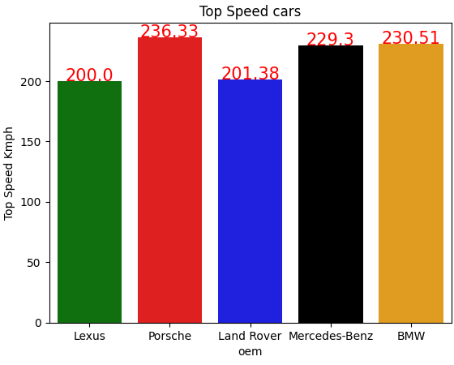
Lets find the factors like Mileage & Top speed which affects the re-sale price by below graph:
Cars like Lexus, Porsche, Land Rover, Mercedes-Benz and BMW were good in resale Price in terms of Mileage and Top speed wise while comparing to other cars.
Lets see about other factors which influence the resale prices like Fuel type, KMS.

Slide 12
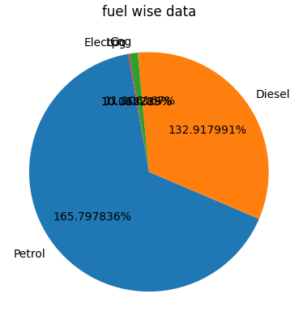

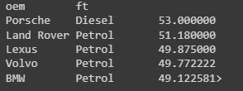
Fuel wise range in sales
It clearly shows, while comparing to other cars, Petrol cars had high re-sale value.
Total cars sold by fuel type:
Avg price in sales by manufacturer wise on Fuel type.

Slide 13

Model Selection
Feature selection:
Considering the important features, after go-through the given data and problem statement, you can find the feature selection as
After selecting features, below models were tried and checked the predicted values.
Decision Tree Regressor
Random Forest Regressor
Linear Regression
GradientBoostingRegressor

Slide 14
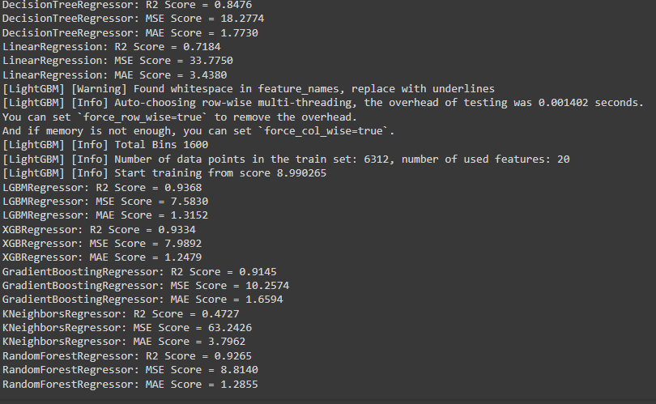
Model Performance:
Upon checking the performance, RandomForest, GradientBoosting, DecisionTree regressor gave above 82 as r2_score.

Slide 15
Conclusion:
As per the problem statement, we can see that many factors had affect the re-sale prices for cars like fuel type, engine, tranmission, KM driven etc. Upon checking with the data and solution which we can suggest was the cars like Porche, Lexus, Land Rover, Benz, BMW had high re-sale value in all terms even in luxurious facilities.

