Slide 1
IBM University Engagement Project Submission
“Exploring the Power of Machine Learning Model with IBM Auto AI ”

Slide 2
Project Title-[Network Intrusion Detection]
Domain of Project – [Cybersecurity / IT ]
Student Name | Recent Passport Photo | Email ID | Mobile number [WhatsApp]
Shiva panda |  | siba0842@gmail.com | 7205358249

Slide 3
Problem Statement -
The Challenge
Modern enterprise networks face an unprecedented surge in sophisticated cyber threats, making the real-time detection of malicious traffic a matter of critical survival for organizations.
Nowadays, identifying network anomalies is just as vital as detecting financial fraud or identity theft, as a single undetected intrusion can compromise sensitive user data, breach privacy, and disrupt global communication infrastructure.
Security teams suffer from severe alert fatigue due to high false-alarm rates, while slow processing speeds in traditional infrastructure prevent the instantaneous analysis of massive, high-velocity data streams.
The Objective
The core goal is to build an intelligent, machine learning-powered Network Intrusion Detection System (NIDS) that acts as an automated security shield to protect communication channels.
The system must meticulously analyze incoming network profiles, safely separating standard operational traffic from dangerous attack vectors like Denial of Service (DoS), Probe scams, unauthorized data exploitation, and privilege escalation frauds.
By deploying a high-reliability model optimized for performance metrics like the F1-score rather than basic accuracy, the project aims to minimize missed attacks and deliver immediate, trustworthy early warnings.
Ultimately, the objective is to establish an enterprise-grade cloud pipeline that surfaces real-time threat intelligence and provides downloadable diagnostic reports to keep modern networks secure.

Slide 4
Technology Used -
Technology Stack (Mandatory)
Cloud Architecture: IBM Watsonx.ai, AutoAI ,IBM Cloud IAM Authentication, Deployment Spaces
AI / ML Engine: IBM Watson AutoAI, IBM Watson Machine Learning Deployment API, KDD Cup Dataset.
Backend Infrastructure: Python, Flask, Requests library, Pandas (for 41-feature dataset parsing).
Frontend Dashboard: HTML5, CSS3, Jinja2 template engine.

Slide 5
Proposed Solution -
The Solution Concept
We propose an intelligent, cloud-integrated Network Intrusion Detection System (NIDS) that leverages IBM Watson AutoAI to automate and accelerate threat discovery.
Instead of relying on human engineers to manually write security rules, this system uses machine learning to study network traffic patterns, learn what "normal" behavior looks like, and flag suspicious anomalies instantly.
Nowadays, cyber fraud and network attacks look highly realistic, so the solution passes the traffic data through an optimized machine learning model to inspect 41 distinct network features (such as protocol types, byte sizes, and connection durations) to spot hidden indicators of compromise.
Core Execution & Capabilities
Automated Machine Learning (IBM AutoAI): The heart of the solution is powered by IBM Watson AutoAI, which automatically handles data preprocessing, feature engineering, and hyperparameter tuning. It builds and tests multiple pipelines, ultimately selecting a model optimized for a high F1-score to ensure dangerous threats and frauds are never missed.
Visual Anomaly Flagging: The system processes the incoming network data and displays the results clearly on a web interface using an easy-to-read, color-coded tracking system.
Attack Highlighting: To help security teams quickly spot dangers without getting overwhelmed, safe everyday user traffic is labeled in green (normal), while malicious hacks and digital fraud are instantly highlighted in red (anomaly).

Slide 6
Technology Stack & IBM Cloud Components Used-
IBM Watson Studio: Serves as the centralized, cloud-based data science workspace where the main cybersecurity project experiments (networking_project_ml / Cybernet_ml_project) are hosted and managed.
IBM Watson AutoAI: The core engine used to fully automate the machine learning pipeline, eliminating the need for manual model code creation.
Automated Feature Engineering Component: A specialized module inside AutoAI that automatically applies feature transformers to extract, combine, and optimize high-priority network traffic characteristics.
Automated Training & Optimization Engine: The AutoAI component that runs hyperparameter optimization (HPO) and ensemble stacking to automatically build and train multiple model pipelines.
IBM Cloud Deployment Spaces: The secure cloud infrastructure (network_security_ml_space) where the champion model is saved, managed, and hosted.

Slide 7
Implementation Workflow -
STEP 1: Environment Setup in IBM Watson Studio
Create a centralized cloud data science workspace by setting up a project experiment within IBM Watson Studio to securely host and manage the cybersecurity assets.
STEP 2: Dataset Loading & Setup
Import the raw network intrusion training dataset (Train_data.csv) into the workspace, ensuring all 41 distinct connection feature attributes are present for traffic pattern analysis.
STEP 3: AutoAI Experiment Configuration
Initialize IBM Watson AutoAI and target the class column as the prediction target to automatically configure the system for binary classification (normal vs. anomaly).
STEP 4: Automated Data Preprocessing & Feature Engineering
Run the AutoAI engine to let it automatically parse the data, handle feature transformations, and apply optimized Feature Transformers to extract high-priority network characteristics.
STEP 5: Model Training, Evaluation, & Selection
Allow AutoAI to train multiple pipelines using advanced algorithms, evaluate them based on the F1-Score (Optimized) metric, and select Pipeline 9 (Snap Random Forest Classifier) as the champion model.
STEP 6: Cloud Deployment Space Creation
Create a dedicated production infrastructure environment (IBM Cloud Deployment Space named network_security_ml_space) to save and store the finalized champion model configuration.

Slide 8
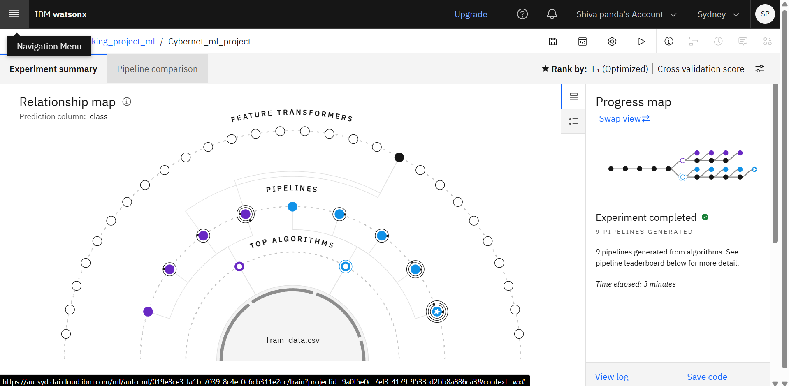
AutoAI Training(Using Different Algorithm)-

Slide 9
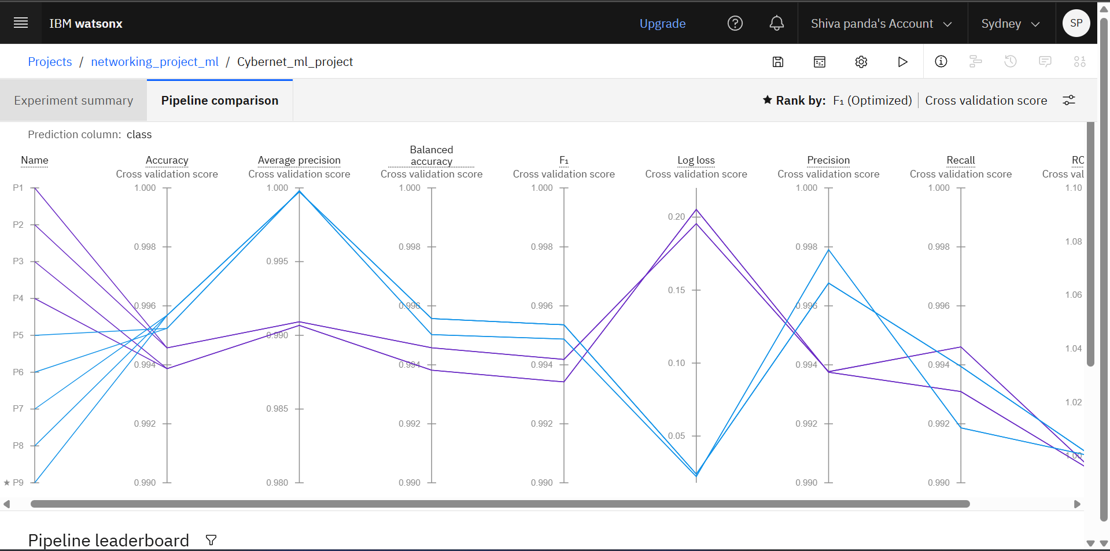
Pipeline Comparison(P1 to P9) -
*Pipeline 9 is top in leaderboard as F1-Score (Optimized) which is important in Network Intrusion Detection

Slide 10
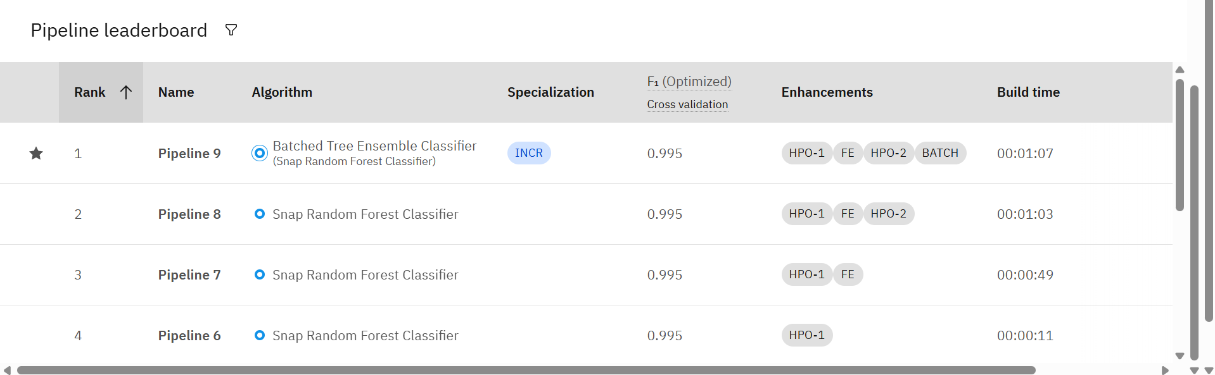
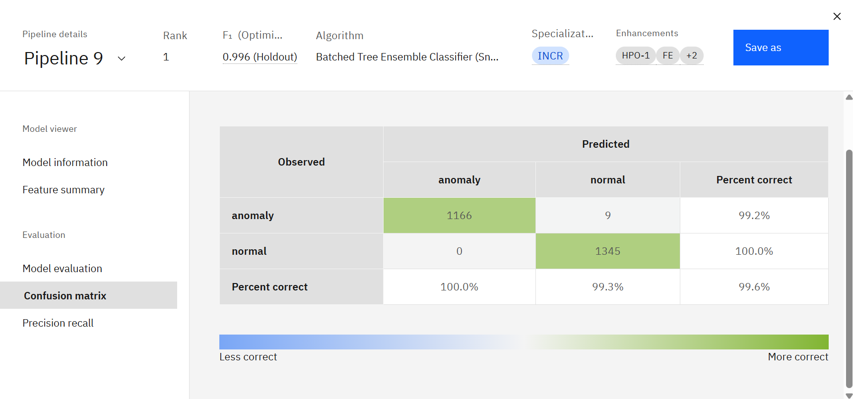

Slide 11
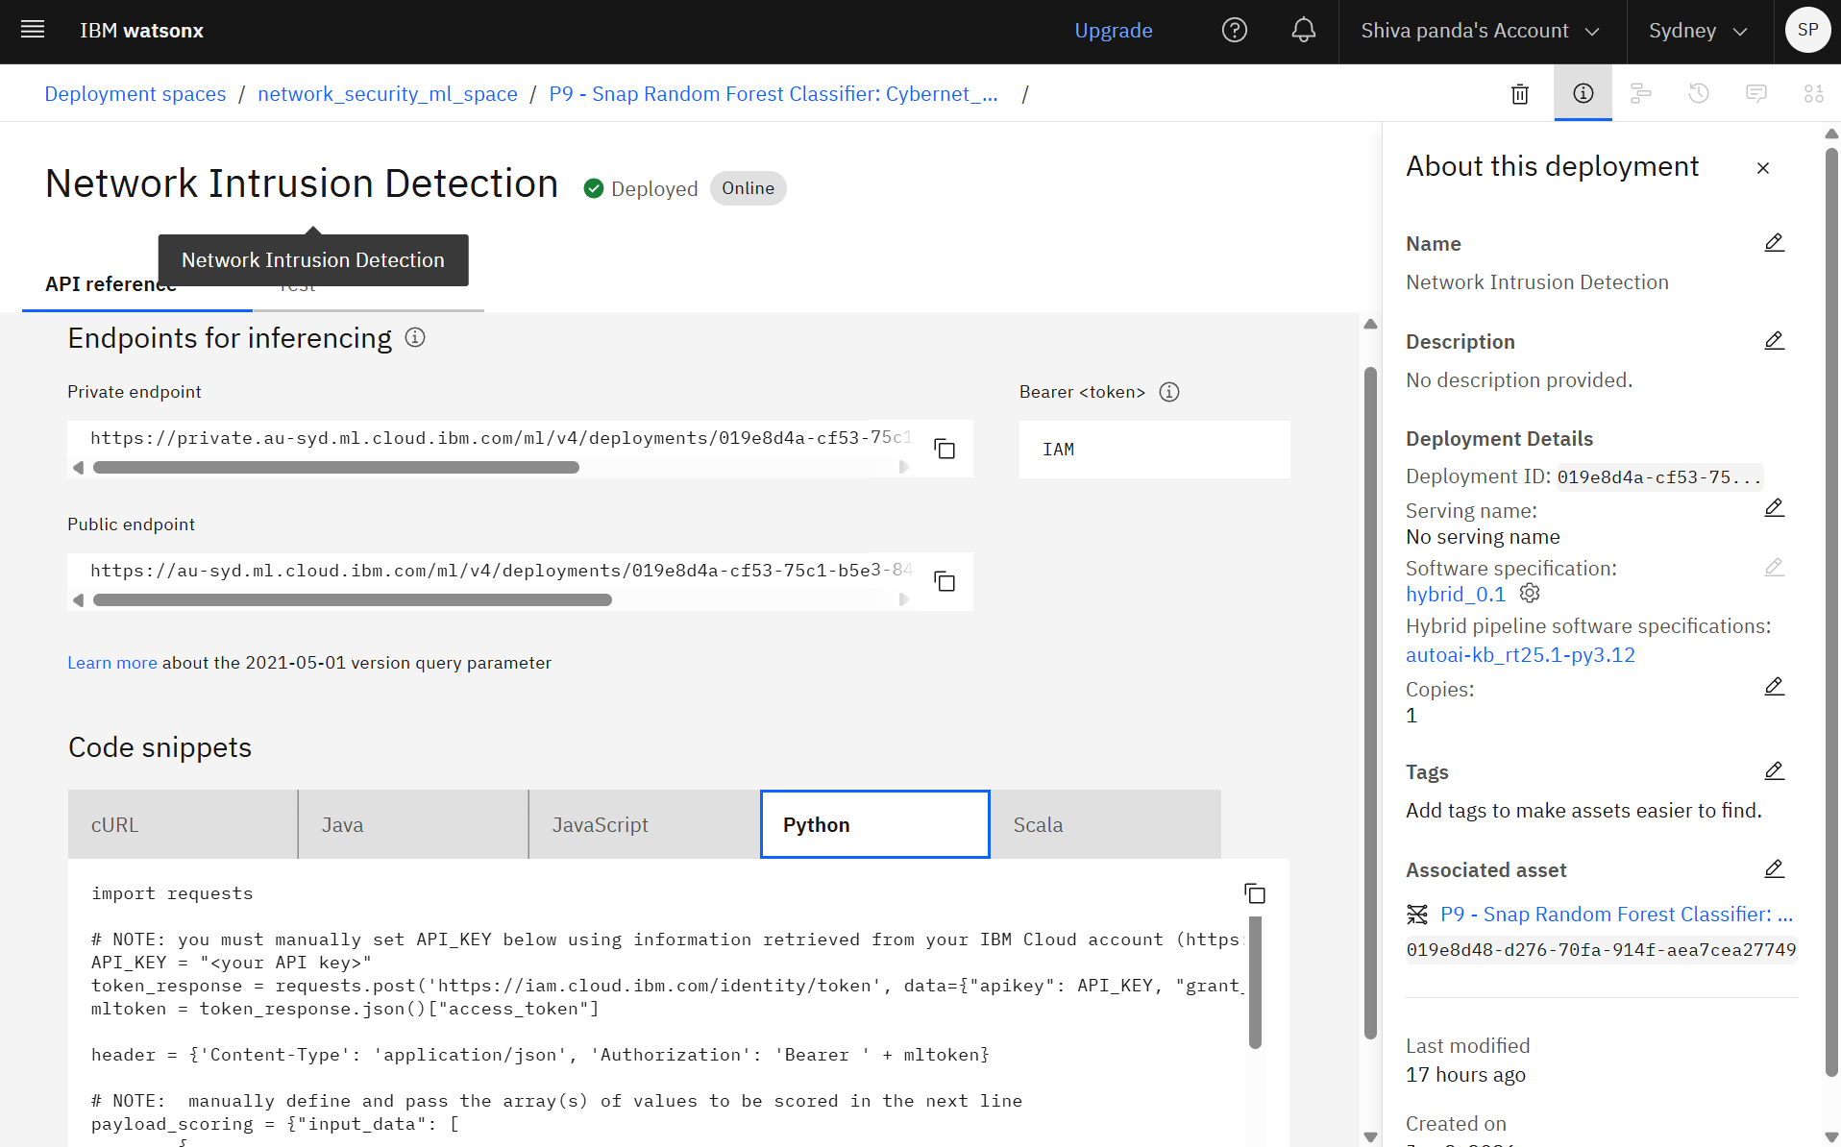
Deploymrnt-

Slide 12
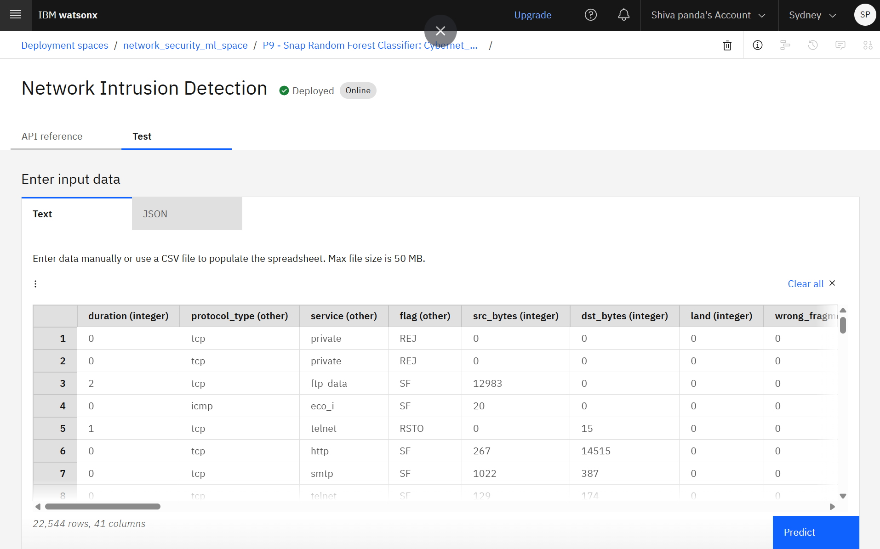
Test data-

Slide 13
Prediction Process-
Method 1: Via IBM Deployment Service (Public Endpoint)
Step 1: Open the Space: Log into IBM Cloud and enter your deployment space (network_security_ml_space).
Step 2: Select the Deployment: Click on your active Network Intrusion Detection online model (powered by Pipeline 9).
Step 3: Go to Test Tab: Click the "Test" tab to open the built-in interactive testing panel.
Step 4: Keep Data Types Same: Enter a network data row ensuring all 41 columns maintain their original data types (numbers as integers, labels as text strings).
Step 5: Click Predict: Press the "Predict" button to send the payload to the public endpoint and see the real-time classification output.
Part 2: Via Frontend Web Application (GitHub Setup)
Step 1: Clone & Pull: Open your terminal, clone the public repository, and pull the latest code infrastructure.
Step 2: Install & Run: Install the necessary python dependencies and launch your local app server.
Step 3: Open Dashboard: Open your web browser and go to your local address (e.g., http://127.0.0.1:5000/).
Step 4: Upload File & Predict: Click the file upload panel, select your 41-column network traffic CSV file, and submit it.
Step 5: View Output Labels: The app passes the data types exactly as-is to the IBM API and displays the results: safe traffic gets a green label (normal), while malicious attacks get a red label (anomaly).

Slide 14
Uniqueness-
No-Code Machine Learning Pipeline: The project utilizes IBM Watson AutoAI to fully automate data preprocessing, feature engineering, and model selection, eliminating human coding errors during the development lifecycle.
F1-Score Optimized Security Core: Unlike standard models that focus strictly on baseline accuracy, this pipeline is engineered to penalize False Negatives, ensuring highly critical threat containment and a reliability score of 0.995.
Production-Ready Enterprise Blueprint: The architecture establishes a direct connection between a live cloud deployment workspace (IBM Watson Machine Learning API) and a responsive user dashboard, simulating real-world Security Operation Center (SOC) environments
Future Scope-
Autonomous Threat Mitigation (Active Response): Upgrading the application to act as an active AI agent that handles threat containment automatically. Instead of just displaying red alerts, the agent will instantly rewrite firewall policies, block malicious IP addresses, or isolate infected network nodes the moment an anomaly is detected.
Real-Time Alarm & Alert Engine: Implementing an automated alert system as the first line of defense. The AI agent will trigger instant notifications across channels like SMS, WhatsApp, or emails immediately upon threat discovery to minimize window-of-breach latency.
Live Packet Ingestion: Upgrading the system components to sniff and process live streaming network traffic patterns in real-time, moving completely away from manual batch uploads.
Biometric Security Integration: Exploring connections to wearable devices and smartwatches to alert security administrators with real-time haptic alarms during high-severity network intrusions.
Multilingual Security Dashboards: Introducing voice-enabled interaction and localized multi-language reporting to ensure accessible system metrics across global security teams.

Slide 15
Git Hub Link
Github URL – https://github.com/Shiva-panda/network_intrusion_ibm_cloud_implent
Train and Test data set - https://www.kaggle.com/datasets/sampadab17/network-intrusion-detection
·
·
·

Slide 16


