Slide 1
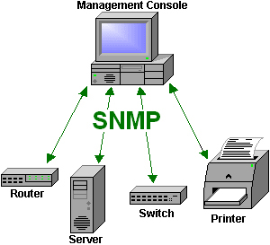
SNMP topologi i nettet

Slide 2
Major components
Management information base (MIB)
Probably the least interesting part of SNMP!
Structure of Management Information (SMI)
data definition language for MIB objects
SNMP protocol
Commands
SNMPv3
Security, administration capabilities

Slide 3
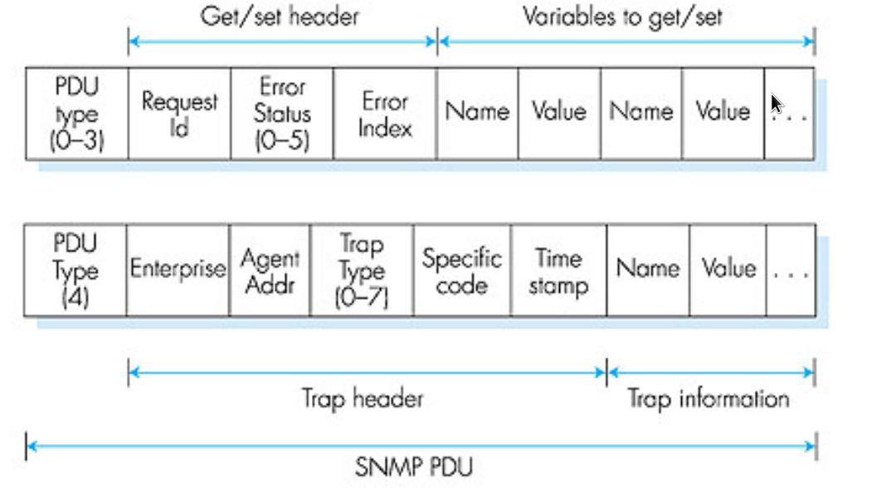
PDU’s
The data exchange
Protocol UDP (port 161, 162)
OSI layer Application
SNMP v1 - type
SNMP v2 & 3 - type
0
Get
0
Get / Set / Notification (trap)
2
Getresponse
2
Getresponse
3
Set
5
Getbulk (optimized getnext)
4
Trap
6
Report
1
GetNext
1
GetNext

Slide 4
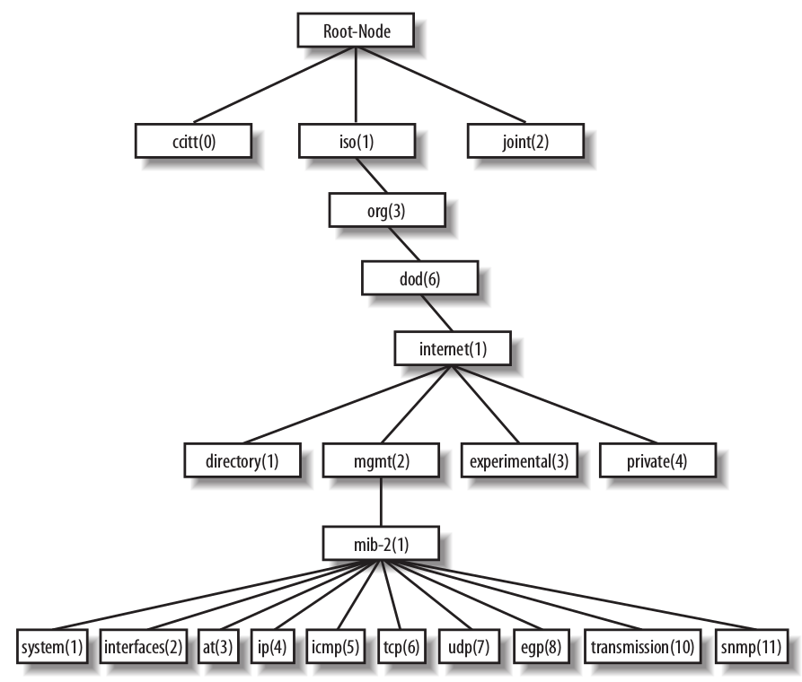

MIB structure
host
host(25)

Slide 5
Demo
SNMP simulator:
sudo snmpsimd --agent-udpv4-endpoint=127.0.0.1:1161 --process-user=nobody \
--process-group=nogroup --logging-method=file:/var/log/snmpsim/snmpsimd.log
Show data
# -c community
# Angives relativt til /usr/snmpsim/data,
snmpwalk -v2c -c recorded/linksys-system 127.0.0.1:1161
iso.3.6.1.2.1.1.1.0 = STRING: "BEFSX41"
iso.3.6.1.2.1.1.2.0 = OID: iso.3.6.1.4.1.3955.1.1
iso.3.6.1.2.1.1.3.0 = Timeticks: (638239) 1:46:22.39
iso.3.6.1.2.1.1.4.0 = STRING: "Linksys"
iso.3.6.1.2.1.1.5.0 = STRING: "isp-gw"
iso.3.6.1.2.1.1.6.0 = STRING: "4, Petersburger strasse, Berlin, Germany"
iso.3.6.1.2.1.1.8.0 = Timeticks: (4) 0:00:00.04
iso.3.6.1.2.1.1.8.0 = No more variables left in this MIB View (It is past the end of the MIB tree)
# Walk host resources
# 1.3.6.1.2.1.25 (iso.org.dod.internet.mgmt.mib-2.host)
# 1. hrSystem 2. hrStorage 3. hrDevice 4. hrSWRun 5. hrSWRunPerf 6. hrSWInstalled
snmpwalk -v2c -c mib2dev/host-resources-mib 127.0.0.1:1161
snmpget -v2c -c mib2dev/host-resources-mib 127.0.0.1:1161 iso.3.6.1.2.1.25.1.1.0

Slide 6
V3
User privs
noAuthNoPriv
No authorisation and no encryption, basically no security at all!
No use of this when you have v3!
AuthNoPriv
Authorisation is required but collected data sent over the network is not encrypted.
AuthPriv
The strongest form. Authorisation required and everything sent over the network is encrypted
V3 example
snmpwalk -v3 -l authPriv -u user3 -a MD5 -A "user3password" -x DES -X "user3encryption" localhost

Slide 7
SMI Syntaks
Vis:
MIB-II_syntaxeksempel.pdf

Slide 8
Nagios og SNMP
Script: 15_check_snmp_synology
Email eksempel:
Nagios: PROBLEM Service Alert: syn151501/Synology is WARNING **
***** Nagios *****
Notification Type: PROBLEM
Service: Synology
Host: syn151501
Address: syn151501
State: WARNING
Date/Time: Mon Nov 13 14:58:45 CET 2017
Additional Info:
WARNING - Synology DS1515+ (s/n: 15A0MQN005500, DSM 6.1-15217), DSM update available

