Slide 1
netflow

Slide 2
What is Netflow
Feature/network protocol that was introduced on Cisco routers
Netflow records the communication between systems. Traffic that enters or exits an interface
Routers/switches that support NetFlow collects IP traffic statistics and export those statistics to a NetFlow collector
By analyzing flow data a picture of network traffic flow, volumne and peak time can be built
Can be used to spot anomalies
Simple IDS capabilities

Slide 3
What is Netflow
Very fast – only takes up about 0,01% of traffic capture
Cons
Does not provide content of the traffic
Only an indication of what has happend

Slide 4
Netflow typical record
Source and destination IP address
Source and destination ports
Transport protocol: TCP, UDP, ICMP, etc.
Type of service (ToS)
Packet and byte counts
Start and end timestamps
Input and output interface numbers
TCP flags
Routing information (next-hop address, source autonomous system (AS) number, destination AS number, source prefix mask, destination prefix mask)

Slide 5
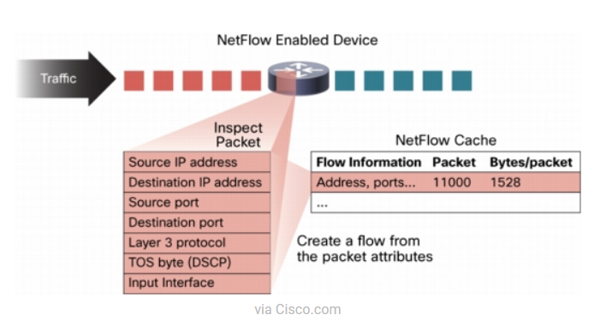
Create netflow data

Slide 6
1 tcp connection => 2 flows
Computer a web browse computer b => 2 flows
Request flow: A: (TCP) 1.2.3.4:3365 -> 4.3.2.1: 80
Reply flow: B: (TCP) 4.3.2.1:80 -> 1.2.3.4:3365

Slide 7
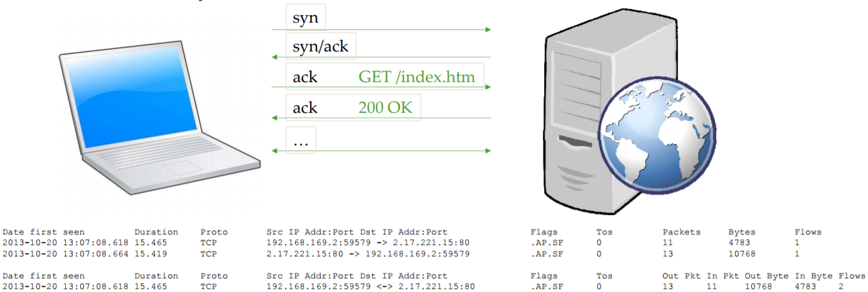
One tcp connection => 2 flows

Slide 8
Netflow limitation of cache
Difficult to read
Only shows recent activity
No automation on devices for analysis
No accounting of flows (besides overall totals)

Slide 9
NetFlow Export of Data
Greatly enhances NetFlow and turns the technology into a analysis tool!
Data sent to external collector(s)
Analyzed by one or more systems
Archived for other concerns
Efficient: Uses multiple records per UDP packet

Slide 10
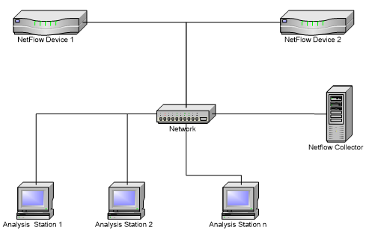
Typical netflow collector setup

Slide 11
Full capture vs netflow
A combination of Netflow and FPC will often be considered the best solution.
Netflow sensors on all routers but only FPC on critical segments.
Rotate FPC after 1 week and netflow after 365 days.

Slide 12
Netflow components
fprobe - This is the exporter that export flows in the form of flow records.
nfcapd - This is the collector. Recieves flow records from 1 or more exporters, parsing and storing the information.
nfdump This is the analysis tool, that enables us to query the netflow data

Slide 13
Setting up netflow
Install fprobe and nfdump
apt-get update
apt-get install fprobe
apt-get install nfdump
Let fprobe export all traffic on eth0 as netflow to collector (running on port 555)
fprobe -i eth0 localhost:555
Collect the netflow data on port 555 and write it to the disk
Mkdir netflow
nfcapd -D -p 555 -S 1 -z -I Linux-Host-1-eth0 -l /root/netflow/
Extract netflow traffic from FPC
nfcapd -r dmp.pcap -S 1 -z -l /root/netflow/

Slide 14
Looking into netflow
root@allan-VirtualBox:/root# mkdir netflow
root@allan-VirtualBox:/root# nfcapd -D -p 555 -S 1 -z -I Linux-Host-1-eth0 -l /root/netflow/
root@allan-VirtualBox:/root/netflow# nfcapd -r dmp.pcap -S 1 -z -l /root/netflow/
root@allan-VirtualBox:/root/netflow# ls
2017 nfcapd.current
root@allan-VirtualBox:/root/netflow/2017/12/11# nfdump -r nfcapd.201712112200 (PING REQUEST)
Date flow start Duration Proto Src IP Addr:Port Dst IP Addr:Port Packets Bytes Flows
2017-12-11 21:59:20.962 0.000 UDP 10.0.2.13:5353 -> 224.0.0.251:5353 1 131 1
2017-12-11 21:59:22.120 0.000 UDP 212.242.40.3:53 -> 10.0.2.18:42430 1 126 1
2017-12-11 21:59:22.119 0.000 UDP 212.242.40.51:53 -> 10.0.2.18:42430 1 126 1
2017-12-11 21:59:22.022 0.000 UDP 10.0.2.18:42430 -> 212.242.40.3:53 1 51 1

