Slide 1


COMPUTER SCIENCE & INFORMATION TECHNOLOGY
Travel Time
Prediction
Using Ridge and Lasso Regression
KLH Bachupally · Academic Year 2026–2027
2520090092 – V. Shiva Venkata Sai ·
2520090097 – Vemulapalli Sathvik
2520080016 – Varshith Comple · Guide/Supervisor: [Insert Name]

Slide 2


02 · CONTEXT
Travel time is shaped by more than distance
Calendar
Route
Conditions
Day-of-week patterns.
Distance and path shape.
Congestion, weather, and time.
Background of the Project
Overview of Intelligent Transportation Systems
Travel estimates help commuters plan journeys.
Duration varies with distance, congestion, weather, departure time, and day of week.
Machine learning can combine route, traffic, weather, and calendar context to support smarter mobility decisions.
Why Travel Time Prediction Is Needed
Distance-only estimates may miss changing travel conditions.

Slide 3
03 · THE PROBLEM
Distance alone cannot explain an unpredictable journey
Changing conditions
Data friction
Traffic congestion, weather, departure time, and weekday patterns create unexpected delays.
External data may be incomplete, delayed, or inconsistent. New routes and unusual events are difficult to model.
Who is affected?
Commuters, students, office workers, delivery services, fleet operators, and travel planners.
Problem statement: Build a data-informed way to estimate journey duration from route and contextual conditions.

Slide 4

04 · MOTIVATION
Better context can make travel planning more informed.
A practical prediction problem for regularized regression.
Combining mapping and environmental context can support more predictable decisions, without guaranteeing delay-free travel.
Ridge and Lasso provide a focused comparison of how regularization behaves with related travel features.

Slide 5
05 · OBJECTIVE
From journey inputs to a useful prediction
Develop a web-based system that predicts expected travel duration using Ridge and Lasso Regression and relevant journey conditions.
01
02
03
Prepare
Collect
Transform
Historical travel-time data and relevant features.
Route distance plus available traffic and weather information.
Preprocess and encode model inputs.
04
05
Compare
Present
Train Ridge and Lasso; evaluate MAE, RMSE, and R² Score.
Display duration, ETA, route, and journey conditions.

Slide 6
06 · Existing System
Existing approaches vary in data depth and freshness
Each approach trades simplicity, explainability, and current context differently.
Existing approach | Strength | Limitation
Distance and speed | Simple and fast | Misses changing conditions
Historical average | Easy to explain | May not reflect current traffic or weather
Routing with live context | Uses route and traffic information | Depends on data availability and provider coverage
Coverage and freshness vary; user-specific departure details and changing conditions may not be modeled consistently.
Common technologies include routing services, traffic feeds, historical travel patterns, and conventional estimation techniques.

Slide 7
07 · PROPOSED SOLUTION
The proposed system connects live context with learned patterns
Combine source, destination, day, departure time, route distance, and available traffic and weather context.
01
02
03
04
05
Collect
Transform
Predict
Compare
Present
Collect journey inputs and contextual data.
Transform inputs into model features.
Generate Ridge and Lasso predictions.
Compare validation or test performance.
Present duration, ETA, route, traffic status, and weather.
It makes assumptions explicit, compares model behavior, and can adapt as better data becomes available.

Slide 8
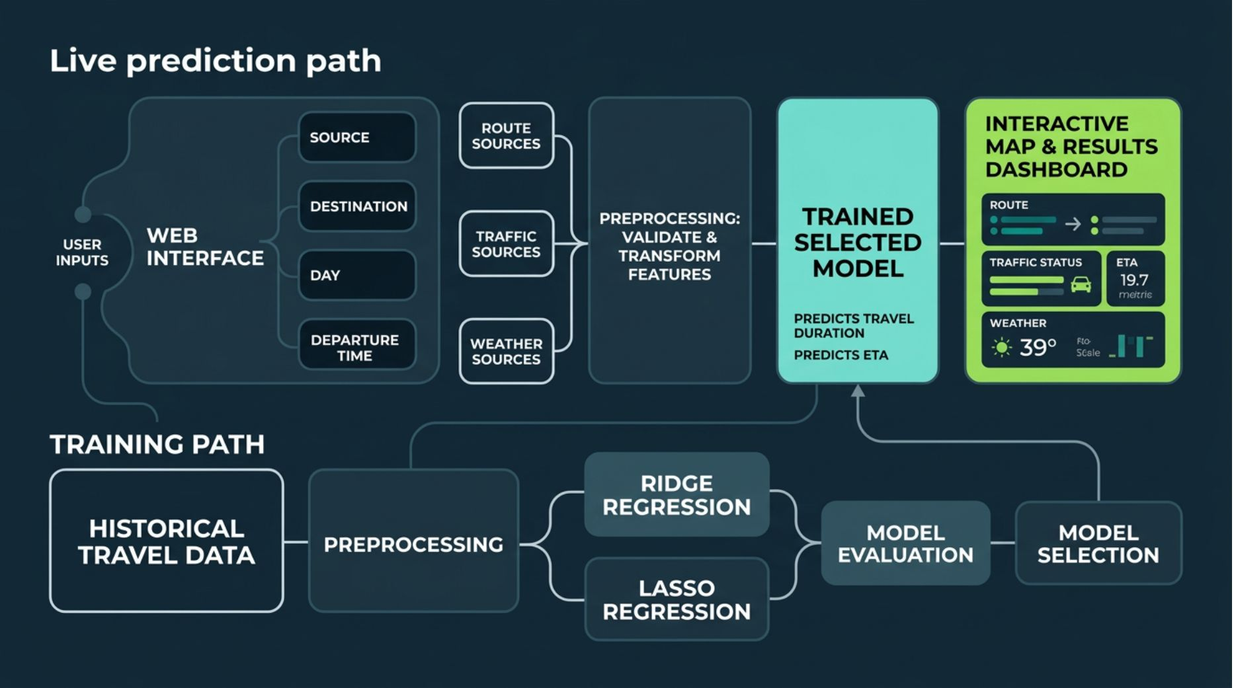
08 · ARCHITECTURE
Architecture separates training from live prediction
Training produces candidate models; live prediction supplies current journey context.

Slide 9
09 · WORKFLOW
A repeatable workflow turns raw journey data into predictions
01
Inspect the data
02
Build the features
Identify a suitable historical dataset; explore missing values, outliers, and inconsistencies.
Select distance, traffic, weather, day, and departure-time features; encode categorical features and scale numerical features where appropriate.
03
Split responsibly
04
Train and tune
Split training, validation, and test data, respecting chronology when appropriate.
Train Ridge and Lasso Regression; tune regularization with validation or cross-validation.
05
Evaluate and integrate
Evaluate with MAE, RMSE, and R² Score; select the better-supported model, then integrate it and visualize predictions.

Slide 10
10 · PROPOSED STACK
A proposed stack keeps the system modular
Build
Serve
Model
Python for machine learning; HTML, CSS, and JavaScript or a suitable frontend framework.
Responsive web interface with Flask or FastAPI as a possible prediction API.
scikit-learn, pandas, NumPy; Matplotlib or Seaborn for exploratory analysis.
Persist
Connect
Collaborate
A suitable database if historical records, preferences, or logs require persistence.
Mapbox or Google Maps, plus traffic and weather providers subject to access and availability.
VS Code, Git, and GitHub are proposed development tools, not proof of implementation.

Slide 11
11 · SYSTEM MODULES / COMPONENTS
Eight modules, one prediction workflow
User Interface Module: accepts source, destination, departure day, and departure time.
Data Collection Module: retrieves route distance and available traffic and weather information.
Data Preprocessing Module: handles missing values, validates inputs, encodes categorical variables, and prepares model features.
Core Machine Learning Module: trains and runs Ridge Regression and Lasso Regression.
Database Module: can store historical journeys, model inputs, predictions, preferences, and logs when persistence is required.
Prediction and Decision Module: converts model output into estimated duration and ETA.
Visualization and Reporting Module: presents route, duration, traffic status, weather context, and model comparison.
Authentication and Security Module: protects user access, validates requests, and limits exposure of stored information.

Slide 12
12 · DATA FLOW
One flow supports both live prediction and historical records
01
02
03
04
05
Capture
Collect
Transform
Predict
Return
Source, destination, day, and departure time.
Route, distance, traffic, and weather context when available.
Validate and convert inputs into the trained feature format.
Generate Ridge and Lasso predictions through the model service.
Duration, ETA, route context, and a concise explanation.
The same flow supports a live prediction request and a stored historical record.

Slide 13

13 · DATASET AND FEATURE DESIGN
Feature design links journey context to observed duration
Journey features
Context features
Source, destination, route distance, departure day, and departure time.
Available traffic indicators, weather conditions, and other route conditions.
Target
Feature preparation
Observed travel duration in the historical data.
Encode categorical inputs, scale numerical inputs where appropriate, and keep training and prediction columns aligned.
Data quality checks
Inspect missing values, outliers, inconsistent units, and unusual journeys before modeling.

Slide 14
14 · PREPROCESSING PIPELINE
One reproducible pipeline should serve every modeling stage
01
02
03
04
05
Validate
Clean
Encode
Scale
Split
Check required fields, ranges, units, and timestamp formats.
Handle missing values and remove or review inconsistent records.
Convert route, weekday, weather, and traffic categories.
Standardize numerical features when the pipeline requires it.
Create training, validation, and test sets; respect chronology when appropriate.
Use the same preprocessing logic for training, validation, testing, and live inference.

Slide 15


15 · RIDGE AND LASSO REGRESSION
Two regularizers control overfitting in different ways
Ridge Regression
Lasso Regression
Adds an L2 penalty to reduce sensitivity to correlated features and stabilize coefficients.
Adds an L1 penalty that can shrink some coefficients to zero and support feature selection.
Shared goal: predict travel duration while controlling overfitting. Tune regularization strength with validation or cross-validation on the prepared feature set.

Slide 16
16 · TRAINING AND EVALUATION
Evaluation turns two candidate models into an evidence-based choice
Train: fit both models on the prepared training data.
Tune: select regularization settings using validation or cross-validation.
Measure: report MAE, RMSE, and R² Score on held-out data.
Inspect: review residuals, large errors, and performance across different journey conditions.
Record: preserve the chosen model, preprocessing steps, feature order, and evaluation results.
Model evaluation comparison
Metric | Ridge | Lasso
MAE | [enter result] | [enter result]
RMSE | [enter result] | [enter result]
R² Score | [enter result] | [enter result]
Replace placeholders with the project's measured results.

Slide 17
17 · MODEL COMPARISON AND DECISION
The final model is the best-supported trade-off, not an assumed winner
Prefer lower error
Prefer stronger fit
Lower MAE and RMSE indicate smaller prediction mistakes.
A higher R² Score indicates more variance explained on the evaluation set.
Check stability
Explain the choice
Compare validation and test behavior, not one score alone.
Select the model with the best supported balance of accuracy, stability, and interpretability.
Final model selection should be based on the project's measured results, not an assumed winner.

Slide 18


18 · USER INTERFACE AND OUTPUT
A clear result card makes the prediction actionable
Inputs
Prediction
Source, destination, departure day, and departure time.
Estimated travel duration and expected arrival time.
Context
Transparency
Route distance plus available traffic and weather information.
Selected model, key inputs, and a note that the estimate depends on data availability.
Reporting should combine route summary, conditions, and optional model-comparison details in a readable result card.

Slide 19
19 · LIMITATIONS AND FUTURE SCOPE
Coverage and changing conditions define the next engineering challenge
Data availability
Unusual events
Traffic and weather coverage may be incomplete, delayed, or provider-dependent.
Accidents, road closures, festivals, and rare conditions may be difficult to represent.
Generalization
Future scope
New routes or changing travel patterns may reduce reliability.
Add richer live feeds, broader historical data, stronger temporal validation, and model-drift monitoring.
Responsible use
Present predictions as estimates, not guarantees.

Slide 20
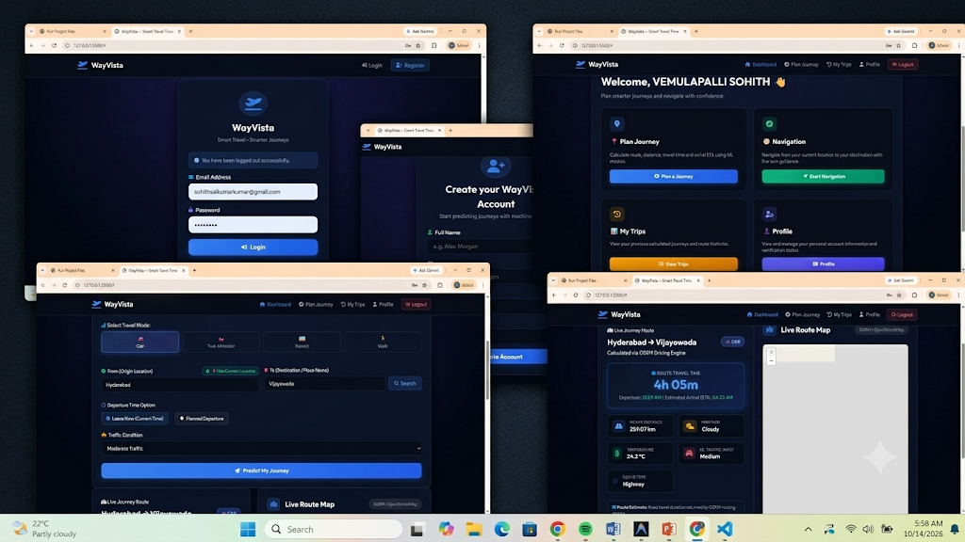
SCREENSHOTS OF IMPLEMENTATION

Slide 21
20 · CONCLUSION
Travel time depends on route, traffic, weather, calendar, and departure context—not distance alone.
The proposed system connects journey inputs and available context to a repeatable prediction workflow.
Ridge and Lasso provide a focused comparison of regularized linear regression for travel-duration prediction.
MAE, RMSE, and R² Score support evidence-based model selection.
The next step is to complete the dataset, run the evaluation, and validate the system with representative journeys.
Project: Travel Time Prediction Using Ridge and Lasso Regression · KLH Bachupally · Academic Year 2026–2027

Slide 22
THANKYOU

