Slide 1

COVID-19 Data Insights: A Visualization of Cases, Deaths, Vaccinations, and Testing Trends
Team Members and Roles:
Shiva – Data Cleaning & Testing Efficiency and Case Fatality Trends Analysis
Maruta – Power BI Report Design & Regional Impact Analysis
Prajna – Report Writing & Vaccine Effectiveness and Coverage Analysis
Neetika – Storytelling & Presentation & Government Policies Impact Analysis
Sagar – Hospital Strain Analysis

Slide 2
Table of Content
Project Overview
Research Methodology
Problem Statement
Data Analysis Toolkit
Data Collection
Data Preparation
Visual Analysis of COVID-19 Trends
Demographic Impact Analysis
Testing Efficiency & Case Fatality Trends Analysis
Vaccine Effectiveness and Coverage Analysis
Hospital Strain Analysis
Government Policies Impact Analysis
Challenges & Limitations
Conclusion
Appendix & References

Slide 3
Project Overview
Project Objective
This project provides a data-driven visual analysis of COVID-19 trends, focusing on how the pandemic impacted different regions.
Target Audience
It enables Healthcare Researchers and Government Agencies to analyze long-term trends and derive actionable insights for future outbreak preparedness
Project Deliverable
The primary goal is to develop an interactive Power BI dashboard that visually explores COVID-19 trends in cases, deaths, vaccinations, and testing across different regions and time periods.

Slide 4

Research Methodology
Defining Problem Statement
Data Cleaning & Preparation
Data Visualization
Data Tools
Data Analysis
Data Collection

Slide 5





Problem Statement
To analyze global COVID-19 trends from 2020 to 2024, focusing on cases, deaths, vaccinations, and testing, and assess how government policies impacted outcomes.
Regional Impact Analysis
The COVID-19 pandemic affected regions differently, making it essential to analyze these disparities.
Testing Efficiency and Case Fatality Trends Analysis
Understanding patterns from past outbreaks can provide valuable insights to enhance future crisis response and preparedness strategies.
Vaccine Effectiveness and Coverage Analysis
There is a need to evaluate the effectiveness of vaccinations and public health measures in reducing transmission and mortality rates.
Government Policies Impact Analysis
The influence of lockdowns and government-imposed restrictions on virus transmission needs to be assessed to determine their role in controlling the pandemic.
Hospital Strain Analysis
Analyzing hospital strain during the COVID-19 pandemic is essential to identify system vulnerabilities and improve preparedness for future health crises.

Slide 6
Data Analysis Toolkit
Tools such as MS Excel and Power BI ensured a seamless workflow from raw data to impactful visual storytelling
MS Excel
Used for initial data cleaning and inspection
Power BI
Helped prepare calculated fields
Handled missing values and formatted columns before importing into Power BI
Enabled filtering by country, date, and other variables for dynamic exploration
Used to analyze trends and visualize data through interactive dashboards

Slide 7
Data Collection
1) Compact COVID-19 Dataset
2) Latitude & Longitude
3) GDP and Population Density
1) Our World in Data (OWID)
2) Kaggle
3) World Bank
Global, with country-wise breakdowns from Year 2020 to 2024
Imported multiple CSV files from various sources and established relationship in Power BI using Country as primary key
Source
Data Coverage
Data Collection

Slide 8
Data Preparation
Handling Null Values
Handled missing and zero values separately to preserve the integrity of the dataset
Cleaning Geographic Inconsistencies
Continent and territory level entries were removed
Countries lacking COVID-19 reporting were removed
Streamlining the Dataset
Dropped unnecessary columns to reduce noise and improve data clarity
Deriving Key Health Metrics
Creating new calculated fields such as Case Fatality Rate (CFR), Mortality Rate, Vaccination Rate and Testing Rate

Slide 9
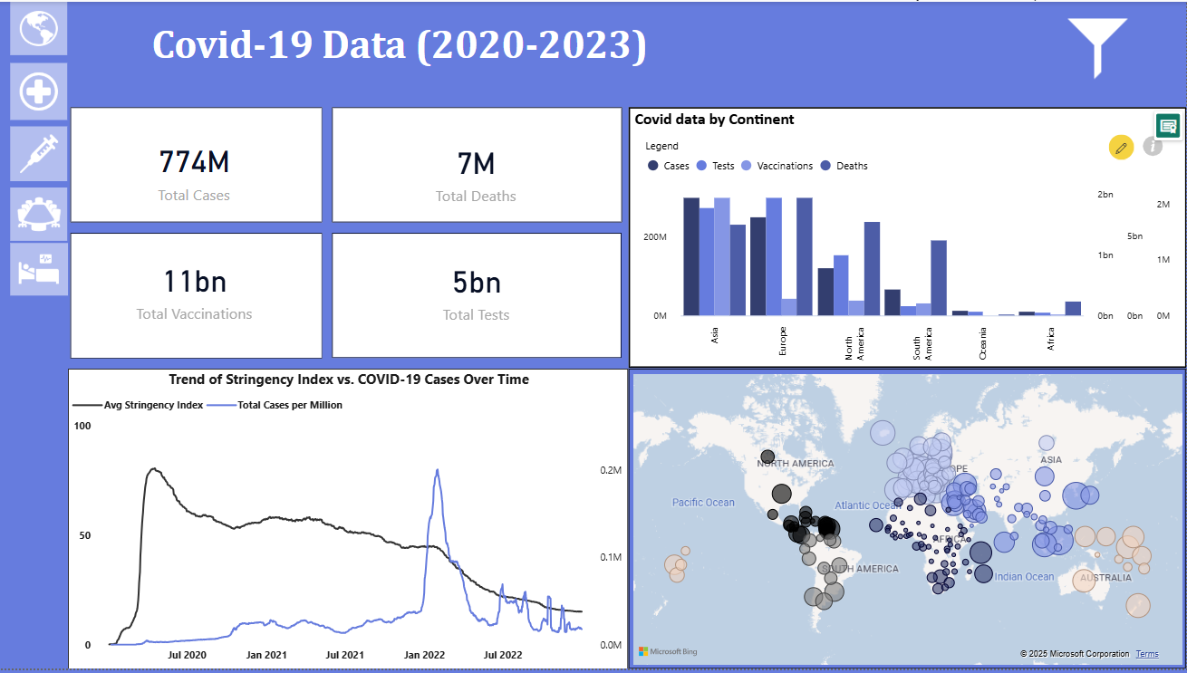
Visual Analysis of COVID-19 Trends
Continental Insights:
Asia leads in total vaccinations and tests
Europe and North America show high testing and death counts
Africa shows low reported figures, possibly due to underreporting
Trend Analysis (Bottom Left Chart):
As Stringency Index (lockdowns/restrictions) decreased, cases per million fluctuated
Major spike in cases occurred post-2021, with declining policy strictness
Geospatial Patterns (Bottom Right Map):
Dense case clusters in Europe, North America, and South Asia
Larger circles = higher case volume

Slide 10
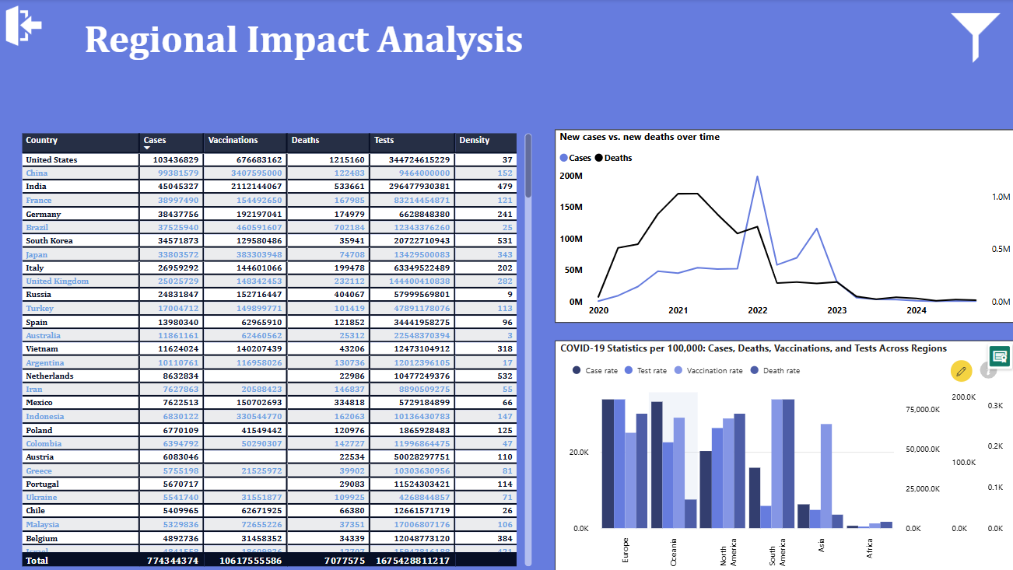
Regional Impact Analysis
USA, Brazil, and India reported the highest total COVID-19 cases and deaths, highlighting the pandemic’s severe impact on densely populated nations.
China, India, and the USA led in global vaccination numbers.
USA, India, and the UK conducted the highest number of tests, reflecting robust testing infrastructure.
There is a sharp increase in cases in 2022 which unfortunately increased number of deaths.
By 2024, both new cases and deaths declined significantly, indicating progress in pandemic control.
Normalized data (per 100K population) shows Asia leads in vaccinations and has lower death and case rates.
A higher vaccination rate correlates with improved COVID-19 outcomes

Slide 11
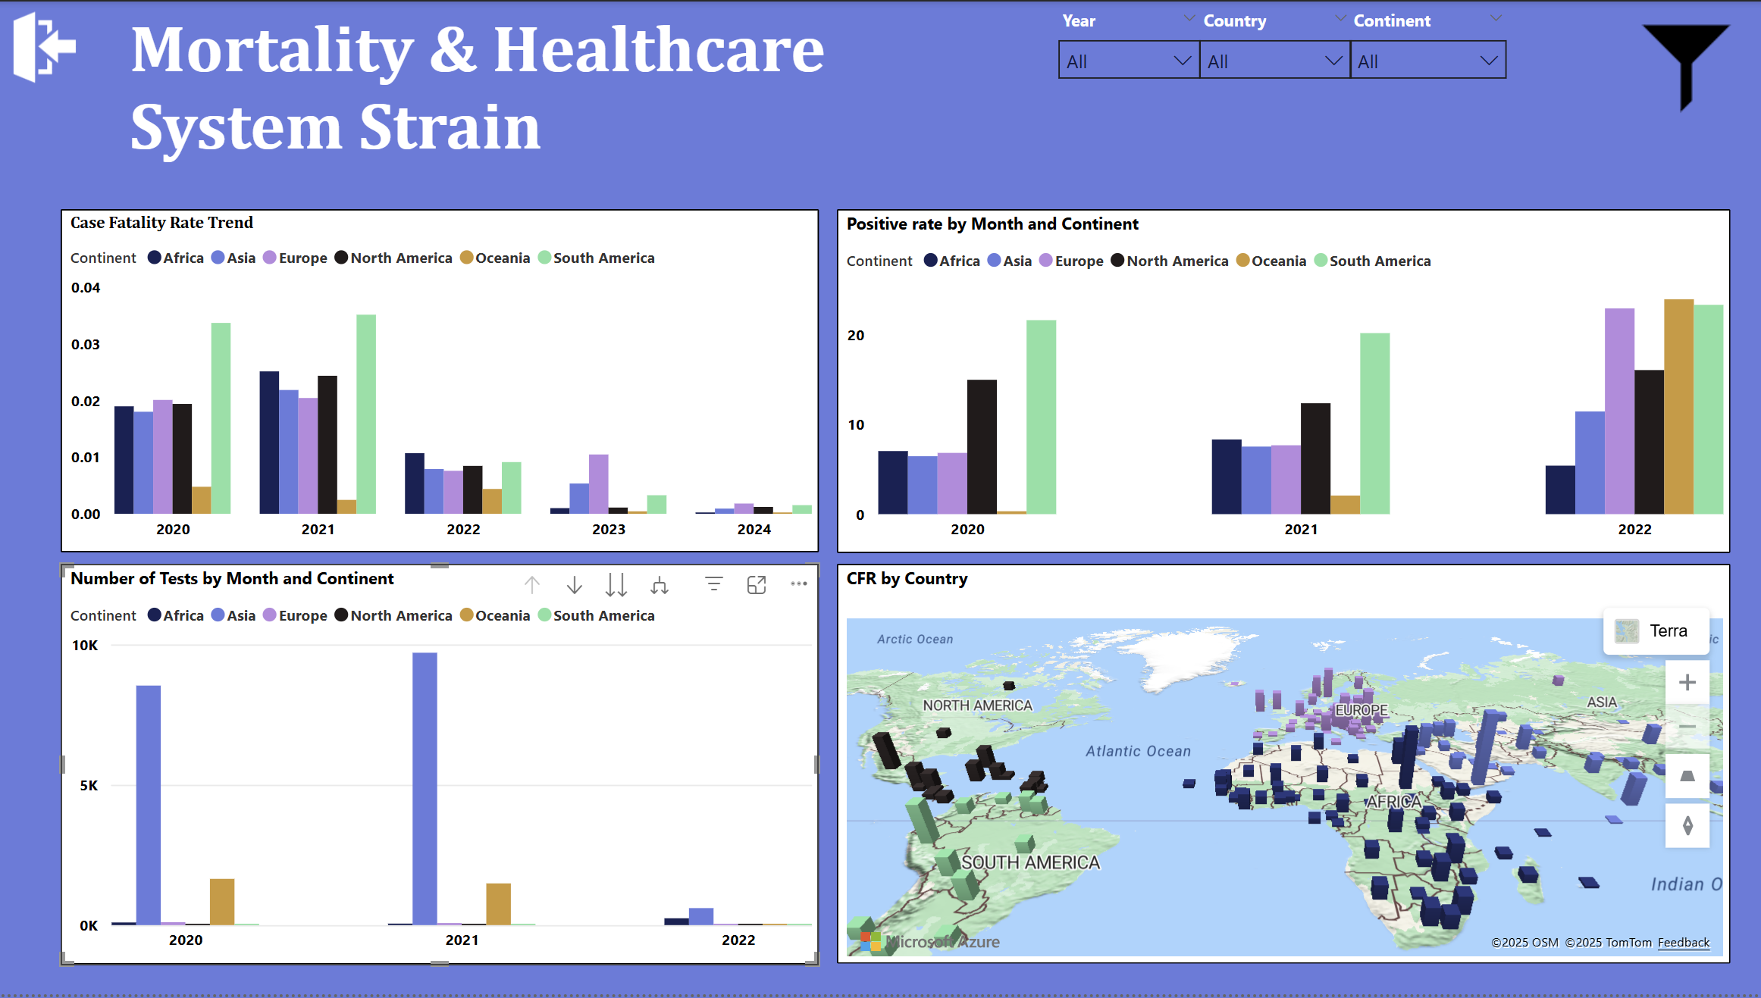
Testing Efficiency & Case Fatality Trends Analysis
In 2021, South America had the highest Case Fatality Rate (CFR), followed by Asia, North America and Europe, indicating significant pressure on healthcare systems.
CFRs declined in 2022 and 2023, likely due to improved treatments and widespread vaccination efforts.
Oceania and Asia saw a spike in tests per case in 2021, reflecting proactive efforts to curb the virus spread.
Africa and South America had lower testing rates, which may have delayed early case detection and response.
Early in the pandemic, South America, Europe, and North America showed high test positivity rates, suggesting widespread infection.
Over time, increased testing and vaccination led to lower fatality rates and better control of the pandemic globally.

Slide 12
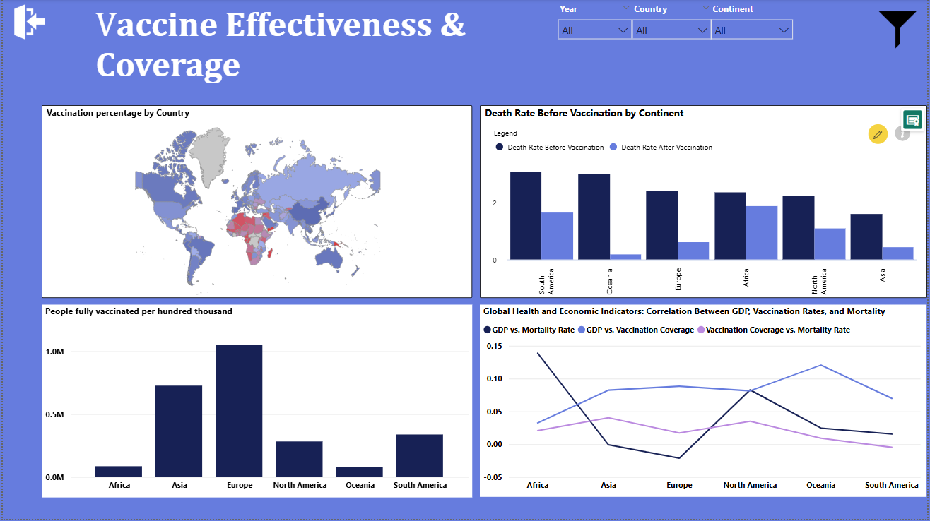
Vaccine Effectiveness and Coverage Analysis
High vaccination rates observed in North America, Europe, and parts of Asia.
Africa and South America lag behind probably due to economic and logistical challenges.
There is a strong correlation between GDP and vaccination coverage — wealthier nations have better access to vaccines.
Mortality rates declined post-vaccination, especially in South America and Oceania.
Disparities remain, highlighting the need for equitable vaccine distribution and stronger healthcare systems in low-income regions.
Outliers identified:
Oceania (high GDP, lower-than-expected vaccination)
Cuba (low GDP, effective vaccination rollout)
Eastern Europe (high vaccine availability, high mortality, may be due to hesitancy)

Slide 13
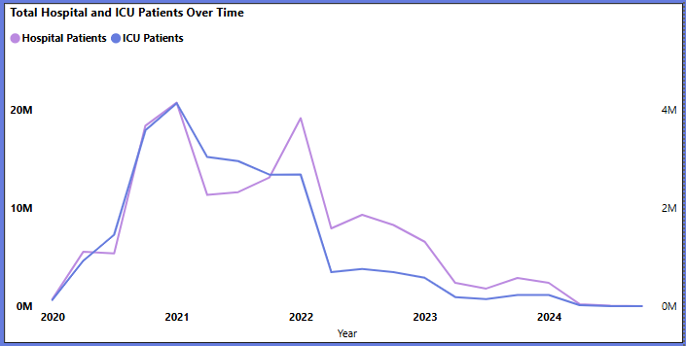
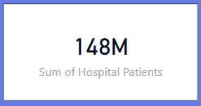
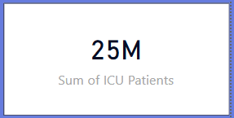
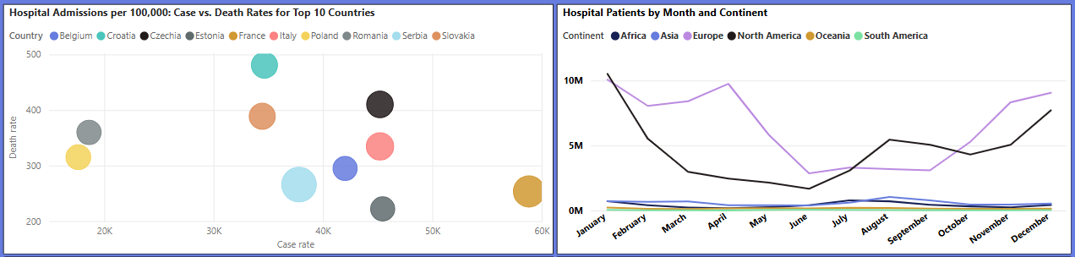
Hospital Strain Analysis
148 million people hospitalized and 25 million admitted to ICUs for COVID over the past five years.
Majority of hospital and ICU admissions occurred between 2020 and 2022.
December and January had the highest monthly admission totals, aligning with seasonal flu trends.
Some countries report zero hospitalization/ICU values, likely due to missing or unreported data.
Europe had a peak in April, and North America in August — suggesting diverse transmission patterns.
No strong correlation between hospital/ICU admission rates and death rates.
Data suggests hospital strain does not directly predict mortality, highlighting the complexity of health system responses.

Slide 14
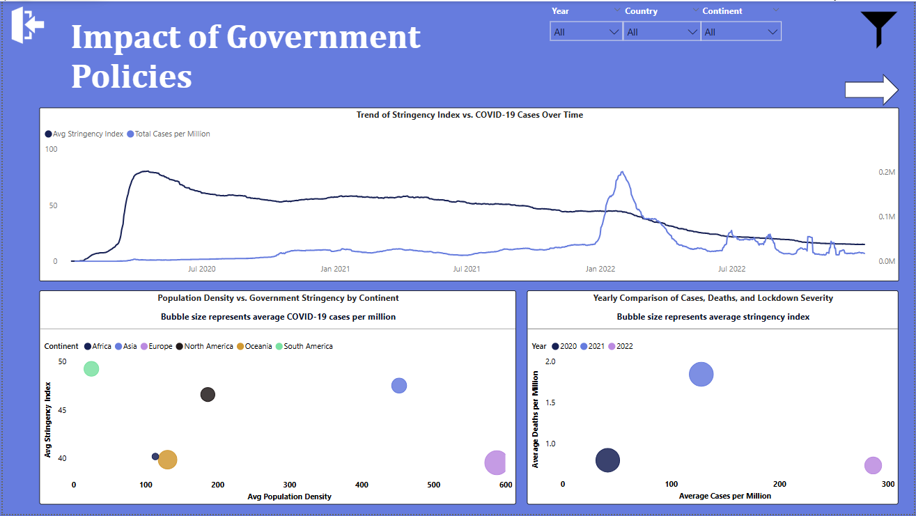
Government Policies Impact Analysis(1)
How Did Government Response Shift as Cases and Deaths Evolved?
Government restrictions peaked in early 2020, helping keep case rates low; by 2022, restrictions dropped while cases surged.
The lack of correlation between population density and stringency suggests that policy decisions were driven more by regional context than structural factors.
Europe, despite higher density, did not always enforce the strictest policies compared to less dense regions like South America.
Over time, there’s a shift from high stringency with low cases (2020) to low stringency with high cases but lower deaths (2022).
Policy impact appears stronger in early stages, while later outcomes reflect vaccine coverage and system adaptation.
*Note: Stringency Index is a composite score based on 9 government policies (e.g., school closures, travel bans, lockdowns). Please refer appendix.

Slide 15
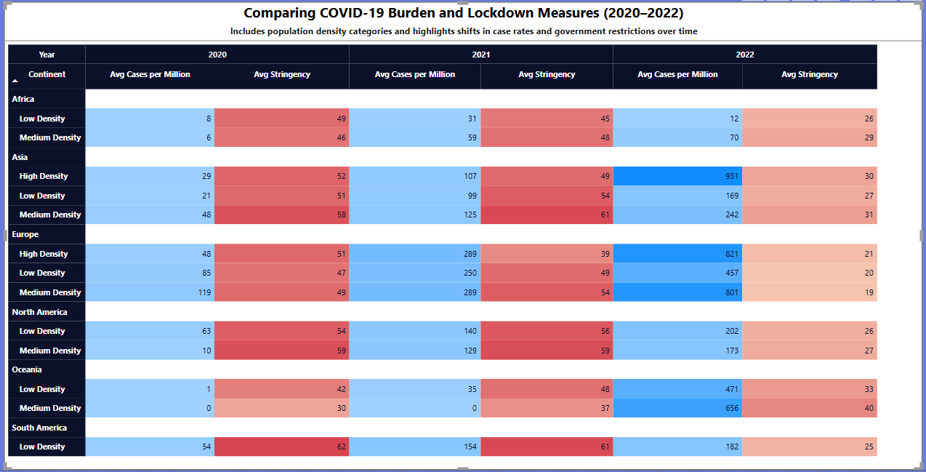
Government Policies Impact Analysis(2)
How Did COVID-19 Policies Vary Across Continents and Density Levels Over Time?
In 2020, most regions enforced high stringency with low case averages, especially in Asia and South America.
2021 showed rising cases with still elevated restrictions in many areas, continuing the cautious approach.
In 2022, case rates were highest, but stringency dropped significantly across all continents, indicating a global policy shift.
The table confirms no consistent correlation between density and policy strictness, reinforcing earlier visuals.
This detailed view supports Slide 1’s findings and highlights how policy response varied by region and year, not just population structure.

Slide 16
Challenges & Limitations
Missing or Incomplete Data
Some countries lacked consistent data
Aggregated vs. Country-Level Data
Continent-level entries had to be removed to prevent double-counting or skewed analysis
Blank vs. Zero Values
Needed to differentiate between missing values and actual zero values to avoid misinterpretation
Calculated Metrics Complexity
Custom metrics like CFR, Tests per Case, and Positivity Rate required careful definitions and consistent formulas
Visual Comparison Challenges
Countries with vastly different population sizes and testing policies made comparisons tricky; needed normalized metrics
Balancing Detail and Clarity
Too many visuals risked overwhelming the audience; had to choose visuals that best conveyed insights

Slide 17
Conclusion
The Project revealed critical patterns in cases, testing, vaccinations, and fatality rates across countries and time.
Regional trends reveal that higher vaccination rates, combined with strong public health responses, contribute to lower COVID-19 cases and deaths, though anomalies still warrant further investigation.
Improved testing efforts and increased vaccinations have led to lower case fatality rates globally, though disparities in testing efficiency highlight ongoing challenges in early detection and healthcare access.
While vaccinations have significantly reduced mortality rates globally, persistent regional disparities underscore the urgent need for equitable access, stronger healthcare systems, and global cooperation.
Hospitalization and ICU trends during the COVID-19 pandemic varied significantly by region and season, with no clear correlation between admission rates and death outcomes across countries.
Government policy stringency showed potential correlation with improved public health outcomes when enforced timely

Slide 18
Appendix & References
The Stringency Index measures the strictness of government policies on a scale of 0 to 100.
It is based on 9 indicators, including school closures, travel restrictions, and stay-at-home orders.
Developed by the Oxford COVID-19 Government Response Tracker (OxCGRT).
Higher values indicate stricter public health measures.
References
Our World in Data. (2025). "Coronavirus (COVID-19) Vaccinations."[Online].Available: https://ourworldindata.org/covid-vaccinations (Accessed: April 2, 2025).
Johns Hopkins University. (2025). "COVID-19 Dashboard." [Online]. Available: https://coronavirus.jhu.edu/map.html (Accessed: April 2, 2025).
Smith, J., & Lee, K. (2023). "Data Visualization in Public Health: A Power BI Approach." Journal of Health Informatics, vol. 12, no. 3, pp. 45-60. DOI: 10.1000/jhi.2023.12345.
World Health Organization. (2024). "Global Vaccination Progress Report." WHO Press, Geneva.
https://ourworldindata.org/covid-hospitalizations
https://www.who.int/news-room/factsheets/detail/influenza-(seasonal)
https://www.cdc.gov/ncird/whats-new/2024-2025respiratory-disease-season-outlook-october-update.html
https://www.sciencenews.org/article/why-covid-notseasonal
Policy Area | Indicator | Examples
Education | School closures | Fully closed, partially open, or fully open
Workplace | Workplace closures | Recommendations vs. mandatory closures
Public Events | Cancellation of public events | Limits on gatherings, cultural/sporting bans
Public Transport | Restrictions on public transport | Closed, reduced service, or open
Stay-at-home | Stay-at-home requirements | Curfews, shelter-in-place, full lockdowns
Movement Control | Restrictions on internal movement | Intercity or interstate travel bans
International Travel | Restrictions on international travel | Entry bans, quarantine, visa suspensions
Gatherings | Limits on gatherings | Number of people allowed to gather
Public Info Campaigns | Public information campaigns | Government messaging, awareness efforts

Slide 19

What’s on Your Mind?

Slide 20

Thank you for your attention!

