Slide 1
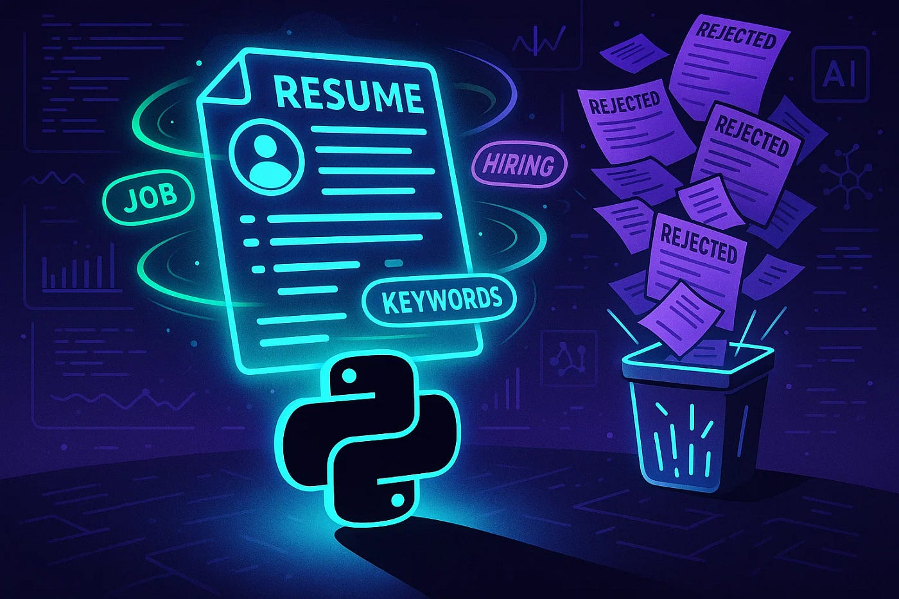
Shiva Shiva
Prajna Ganji
Maruta Zalane
Neetika Upadhyay(T.L)
Talent Miner

Slide 2

Objective
Automate resume data extraction using NLP techniques.
Match candidate skills with job descriptions to identify top-fit profiles efficiently.
Minimize recruiter workload by streamlining the resume screening process.
Visualize key hiring insights through interactive Power BI dashboards.
Develop a user-friendly Streamlit interface for uploading, matching, and tracking resumes.

Slide 3
Technologies & Tools Used
Programming Language: Python
Database: Azure SQL Server
IDE: Visual Studio Code
Deployment Platform: Streamlit Cloud / Localhost
Version Control System: GitHub
Translator: Azure Translator API, Translation Builder
Visualization: Power BI

Slide 4
Source Data Acquisition
Gathered resumes
Collected job descriptions
Converted unstructured files
Ensured dataset diversity
Stored all raw files

Slide 5
System Architecture / Workflow
Resumes
(.docx/.pdf)
Job Descriptions
(.docx/.pdf)
Resume Parser
Job Parser
Extracted Skills/Data
Required Skills
Matcher Logic
Azure SQL Database
Streamlit Web App

Slide 6






System Architecture / Workflow
Scripts
Project Folder Structure
Input
main.py
Run this
Resume
Job Description
Streamlit App
resume_parser.py
Job_parser.py
matcher.py
Parsed Resumes
(parsed_resumes.csv)
Parsed Job Description
(parsed_job_skills.csv)
Matching Score
(resume_match_results.csv)
Power BI
Output
Azure SQL Database

Slide 7

System Architecture / Workflow
Project Folder Structure
Input
Scripts
main.py
Resume
Run this
Streamlit App
Job Description
resume_parser.py
Job_parser.py
matcher.py
Parsed Resumes
(parsed_resumes.csv)
Parsed Job Description
(parsed_jon_skills.csv)
Matching Score
(resume_match_results.csv)
Power BI
Output
Azure SQL Database
Notes:
“This slide illustrates the overall system architecture and workflow of our Resume Parsing and Matching project, structured around three key folders: Input, Scripts, and Output.
On the left, we begin with the Input folder, which holds raw resumes and job descriptions in PDF or DOCX formats. These files are passed into our Scripts folder, where three key modules handle data processing.
resume_parser.py extracts structured information like name, email, skills, and experience from resumes and saves it as parsed_resumes.csv.
job_parser.py reads job descriptions and extracts required skills, saving the results as parsed_job_skills.csv.
matcher.py takes both parsed datasets and calculates a match score between job and resume skills, outputting resume_match_results.csv.
All of these CSVs are stored in the Output folder, and are also uploaded to Azure SQL Database via the main.py orchestrator script, which executes the other three modules in sequence.
On the right side, the Azure database feeds into both a Streamlit App—for real-time filtering and resume exploration—and a Power BI dashboard for deeper visual analysis and reporting.
This architecture ensures an end-to-end automated pipeline from unstructured input files to an interactive visualization platform."

Slide 8
Resume Parsing
Job Parsing
Skill Matching
Data Storage & Integration
Power BI Dashboard
UI Deployment
1.Resume Parsing
2.Skill Matching
3.Data Storage & Integration
4.Power BI Dashboard
5.UI Deployment

Slide 9
Resume Parsing
resume_parser.py
Load Resume
Extracted key information such as names, job titles, skills, and contact details using rule-based logic
Applied regular expressions to detect phone numbers and email addresses
Standardized extracted data into a clean, structured format ready for downstream analysis
Extract information
Name, email, phone, education, job title
Save results
Paresed_Resume_File.csv
Notes:
Thank you, Here is a simple overview of the resume parsing component of the project.
• We start with resume_parser.py, our main script.
It begins by loading resumes, typically in PDF or DOCX format.
• The next step is Extracting Information:
For structured fields like email and phone numbers, we use regular expressions But for more variable fields like job titles and skills, we apply fuzzy string matching the and custom, rule-based logic to handle real-world inconsistencies in job titles and extract relevant skills accordingly
• Finally, we Save the parsed results in a structured format — specifically into a .csv file
This CSV is later used matching resumes to job descriptions.
The goal is to convert messy, unstructured resume content into a clean dataset.

Slide 10

Job Parsing
Parsed job descriptions are used to match candidate resumes based on extracted keywords.
Match % score reflects how closely a resume aligns with the job role.
Interactive filters allow viewing results by job title and skill group.
Enhancements planned
Visualize matched vs. missing keywords
Show parsed job text alongside resumes
Breakdown of match contributors (skills, experience, tools)

Slide 11

Skill Matching
Compared skills extracted from resumes with job description keywords
Calculated match scores for each resume-job pair
Used scoring to rank candidates by match percentage
Enabled recruiters to quickly identify top-aligned profiles
Notes:
We used fuzzy string matching to compare resume skills against job requirements. Each skill in the job description had an associated weight to reflect its importance. Our algorithm computed a match score based on the weighted percentage of matched skills. This enabled us to rank resumes for each job based on the score and could help recruiters quickly focus on the most relevant profiles.

Slide 12
Skill Matching
matcher.py
Load Job Skills
parsed_job_skills.csv
Load Resume Skills
parsed_resumes.csv
Compared skills extracted from resumes with job description keywords
Calculated match scores for each resume-job pair
Used scoring to rank candidates by match percentage
Enabled recruiters to quickly identify top-aligned profiles
Skill Matching
Match resume skills against job skills(fuzzy matching)
Track matched and missing skills
Calculate Match Score
Save Results
resume_match_results.csv
Notes:
“This slide illustrates the logic and flow behind our skill matching engine.
On the right side, the flowchart breaks down the automated process. We first load parsed job skills and resume skills, which have been extracted and saved as structured CSV files in earlier steps.
The matching logic then compares each job skill with each resume skill using fuzzy string matching, allowing for flexible matches even when there's variation in wording. We keep track of which skills match and which are missing.
Based on the weight of the matched job skills, we calculate a match percentage score for each resume-job pair. This score reflects how well the candidate aligns with the job requirements.
Finally, we save the results — including match scores, matched and missing skills — into resume_match_results.csv.
This approach enables recruiters to quickly identify top-aligned profiles by rank, greatly reducing manual screening time and improving accuracy in candidate selection.”

Slide 13
Data Storage & Integration
main.py
Run all core modules
Stored structured resume and job data in Azure SQL Database for centralized access
Connected Streamlit to Azure SQL Database with autorefrresh functionality
Connected Azure SQL to Power BI for data visualization and analysis
Connects to Database
Create Tables in Database
Parsed Resumes
(parsed_resumes.csv)
Load Parsed CSV files
Parsed Job Description
(parsed_jon_skills.csv)
Azure SQL Database
Matching Score
(resume_match_results.csv)
Streamlit App
Power BI Dashboard
Notes:
“This slide explains how we handled data storage and integrated it with downstream applications for access and visualization.
On the right, we can see the automated data pipeline managed by the main.py script. It runs all three core modules — the resume parser, job parser, and matcher — and then connects to our Azure SQL Database.
Once connected, it checks and creates required tables if they don’t already exist. Then, it loads the parsed CSV files: resumes, job descriptions, and match scores — ensuring that all structured data is centralized in the database.
The Streamlit app is connected to the Azure SQL DB with autorefresh functionality, which enables real-time updates to be reflected in the UI.
we connected the same database to Power BI, allowing us to create dynamic dashboards and perform in-depth visual analysis of resume-job alignment scores.
Overall, this setup ensures that both technical and non-technical users can access the most up-to-date data in a centralized, scalable, and user-friendly manner.”

Slide 14
User Interface
Built a Streamlit web app to make resume uploading and skill matching easy for non-technical users
Filter option to choose from skills or from Job title
Provided instant feedback on skill match scores and missing skills
Displayed parsed resume content in a clean, readable layout
Designed with a responsive, minimal UI for fast performance and mobile accessibility
Integrated with backend database to log and track uploads for audit and reporting
Link: talentminer.streamlit.app
Notes:
“This slide showcases the design and functionality of the Streamlit web application that we built as the user-facing layer of our project.
The goal was to ensure that even non-technical users—like recruiters or hiring managers—could interact with the system easily.
First, the app allows users to upload resumes and instantly run skill matching without needing to understand the backend.
I will quickly give you the demo of how to use this app

Slide 15
UI DEMO

Slide 16

Power BI Dashboard
Created dynamic Power BI dashboards to track resume parsing and matching performance
Displayed key KPIs such as total resumes uploaded, % matched above 80%, and incomplete profiles
Added filters for job role, experience level, upload source, and match threshold
Enabled real-time insights to support recruiter decision-making and hiring strategies
Offered bilingual accessibility, with the dashboard available in both English and French

Slide 17
Power BI Demo

Slide 18
Multilingual Dashboard Development
Used Python + Azure Translator API to translate key resume/job fields
Created dedicated columns (e.g., job_title_French, skills_French) in Azure SQL DB
Ensured Power BI reads from translated fields for localization
Enhanced recruiter accessibility for French-speaking users
Notes:
To support both English and French-speaking users, we enabled multilingual functionality in Power BI.
The reason why we decided to implement this feature was to give the users the ability to interact with our dashboard in their preferred language and make it more accessible and user friendly."
We used Azure Translator via Pyhon code to automatically translate important resume and job fields.These translations were saved as new columns like job_title_French and skills_French directly in our Azure SQL Database.
Power BI was then configured to have language specific pages based on the selected language.
In the next slide I will tell you more how we were able to successfully implement translations in our power bi

Slide 19

Implementing Multilingual reports in Power BI
Translations Builder used to manage label & column translations
Azure Translator API integrated in Translations Builder to automate translation process
Field Parameters enabled switching between English & French views
Created a Languages table to filter pages dynamically
Maintained separate .pbix files for English and French
Used ‘Hide Page’ feature to organize language-specific content during development
Published only language-relevant pages to Power BI Service
Notes:
We used combination of features in Power BI to implement multilingual reporting
First, we used the Translations Builder tool to manage all label and column name/measure name translations.
The Azure Translator API was integrated into the tool to automate the translation these labels in the translator builders, not all of the automated translations were successful and had to be translated manually for example field name job_ underscore title would not be properly translated.
In order to implement the translated data from the database we used Field Parameters to control dynamic visuals and labels.
A Languages table was created specifically in Power bi helped us filter content based on the selected language.
We kept English and French pages in one file during the development, the reason for it is to make necessary changes easier tand quicker o maintain for both language dashboards.
Only when we were done with development we used Hide Page feature which allowed us to keep language-specific pages hidden and save as two separate files to publish them on Power bi service.

Slide 20
Challenge
Inconsistent resume structures
Skill keyword variations
Azure quota limitations
Job selection filtering in UI
Solutions
Utilized regex and NLP techniques for adaptable data extraction
Employed fuzzy matching algorithms to align similar skill terms
Optimized vCore settings and configured budget usage alerts
Integrated dynamic dropdown filters using Stream lit for better UX
Development Roadblocks & Solutions

Slide 21

Conclusion
Built a scalable and automated solution for resume screening
Reduced manual workload in shortlisting candidates through skill-based matching
Delivered real-time, data-driven insights using Power BI dashboards
Developed a user-friendly UI with Streamlit to simplify resume uploads and parsing

