Slide 1
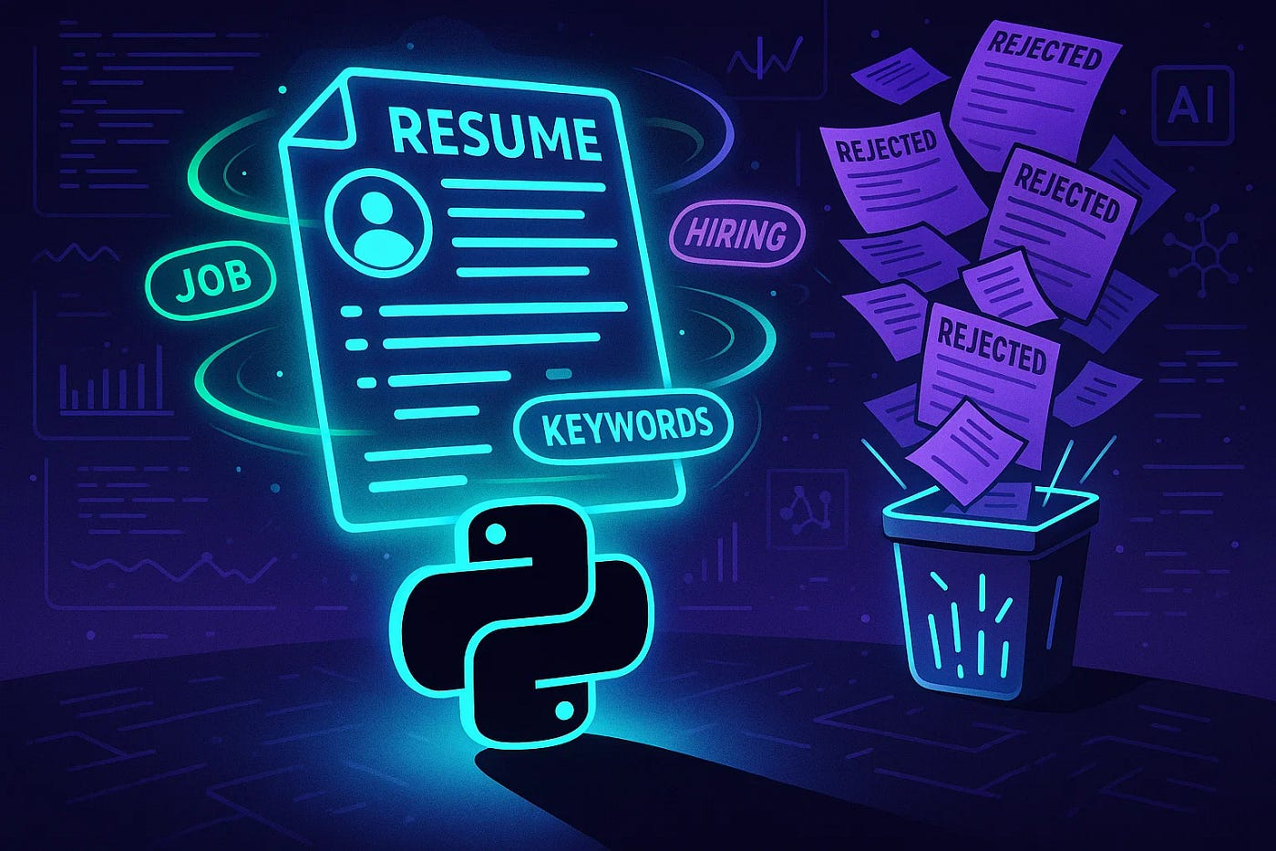
Shiva Shiva
Prajna Ganji
Maruta Zalane
Neetika Upadhyay(T.L)
Talent Miner

Slide 2

Objective
Automate resume data extraction using NLP techniques.
Match candidate skills with job descriptions to identify top-fit profiles efficiently.
Minimize recruiter workload by streamlining the resume screening process.
Visualize key hiring insights through interactive Power BI dashboards.
Develop a user-friendly Stream lit interface for uploading, matching, and tracking resumes.

Slide 3
Technologies & Tools Used
Programming Language: Python
Database: Azure SQL Server
IDE: Visual Studio Code
Deployment Platform: Streamlit Cloud / Localhost
Version Control System: GitHub
Translator: Azure Translator API, Translation Builder
Visualization: Power BI

Slide 4
Source Data Acquisition
Gathered resumes
Collected job descriptions
Converted unstructured files
Ensured dataset diversity
Stored all raw files

Slide 5






System Architecture / Workflow
Project Folder Structure
Input
Scripts
main.py
Resume
Run this
Streamlit App
Job Description
resume_parser.py
job_parser.py
matcher.py
Parsed Resumes
(parsed_resumes.csv)
Parsed Job Description
(parsed_job_skills.csv)
Matching Score
(resume_match_results.csv)
Power BI
Output
Azure SQL Database

Slide 6

4.Data Storage
UI
Step-by-Step Workflow
1.Resume Parsing
2.Job Parsing
Resume Parsing
Job Parsing
Skill Matching
Data Storage & Integration
UI Deployment
Power BI Dashboard
3.Skill Matching
4.Data Storage
5.UI Deployment
6.Power BI Dashboard

Slide 7
Resume Parsing
resume_parser.py
Extracted key information such as names, job titles, skills, and contact details using rule-based logic
Applied regular expressions to detect phone numbers and email addresses
Standardized extracted data into a clean, structured format ready for downstream analysis
Load Resume
Extract information
Name, email, phone, education, job title
Save results
Paresed_Resume_File.csv
Notes:
.

Slide 8
Job Parsing
job_parser.py
Load Keywords
Master CSV File
Automated extraction of job titles, reference numbers, and keywords from job description files (PDF, DOCX, TXT).
Keyword matching engine identifies and counts both required skills and qualifications using a predefined keyword list.
Prevents duplicate processing by checking existing job titles before saving new entries.
Stores all extracted job data in a centralized CSV file (parsed_job_skills.csv) for later matching and analysis
Error handling and logging built-in for traceability and debugging.
Read Job Description
Job Parsing
Extract job title, job reference number, and skills
Assigning weightage which depends on skill frequency
Save Extracted Data
Parsed_job_skills.csv

Slide 9
Skill Matching
matcher.py
Load Job Skills
parsed_job_skills.csv
Load Resume Skills
parsed_resumes.csv
Compared skills extracted from resumes with job description keywords
Calculated match scores for each resume-job pair
Used scoring to rank candidates by match percentage
Enabled recruiters to quickly identify top-aligned profiles
Skill Matching
Match resume skills against job skills(fuzzy matching)
Track matched and missing skills
Calculate Match Score
Save Results
resume_match_results.csv

Slide 10
Data Storage & Integration
main.py
Run all core modules
Stored structured resume and job data in Azure SQL Database for centralized access
Connected Streamlit to Azure SQL Database with autorefrresh functionality
Connected Azure SQL to Power BI for data visualization and analysis
Connects to Database
Create Tables in Database
Parsed Resumes
(parsed_resumes.csv)
Load Parsed CSV files
Parsed Job Description
(parsed_jon_skills.csv)
Azure SQL Database
Matching Score
(resume_match_results.csv)
Streamlit App
Power BI Dashboard

Slide 11
User Interface
Built a Streamlit web app to make resume uploading and skill matching easy for non-technical users
Filter option to choose from skills or from Job title
Provided instant feedback on skill match scores and missing skills
Displayed parsed resume content in a clean, readable layout
Designed with a responsive, minimal UI for fast performance and mobile accessibility
Integrated with backend database to log and track uploads for audit and reporting

Slide 12
UI Demo
Talent Miner

Slide 13

Power BI Dashboard
Created dynamic Power BI dashboards to track resume parsing and matching performance
Displayed key KPIs such as total resumes uploaded, % matched above 80%, and incomplete profiles
Added filters for job role, experience level, upload source, and match threshold
Enabled real-time insights to support recruiter decision-making and hiring strategies
Offered bilingual accessibility, with the dashboard available in both English and French

Slide 14

Power BI Demo
Power BI

Slide 15
Used Python + Azure Translator API to translate key resume/job fields
Created dedicated columns (e.g., job_title_French, skills_French) in Azure SQL DB
Ensured Power BI reads from translated fields for localization
Enhanced recruiter accessibility for French-speaking users
Multilingual Dashboard Development

Slide 16

Implementing Multilingual reports in Power BI
Translations Builder used to manage label & column translations
Azure Translator API integrated in Translations Builder to automate translation process
Field Parameters enabled switching between English & French views
Created a Languages table to filter pages dynamically
Maintained separate .pbix files for English and French
Used ‘Hide Page’ feature to organize language-specific content during development
Published only language-relevant pages to Power BI Service

Slide 17
Power BI Demo- French Version
Power BI

Slide 18
Challenge
Inconsistent resume structures
Skill keyword variations
Azure quota limitations
Job selection filtering in UI
Solutions
Utilized regex and NLP techniques for adaptable data extraction
Employed fuzzy matching algorithms to align similar skill terms
Optimized vCore settings and configured budget usage alerts
Integrated dynamic dropdown filters using Stream lit for better UI
Inconsistent word extraction
Created Master File to extract word consistenly
Development Roadblocks & Solutions

Slide 19

Conclusion
Built a scalable and automated solution for resume screening
Reduced manual workload in shortlisting candidates through skill-based matching
Delivered real-time, data-driven insights using Power BI dashboards
Developed a user-friendly UI with Streamlit to simplify resume uploads and parsing

Slide 20


