Slide 1
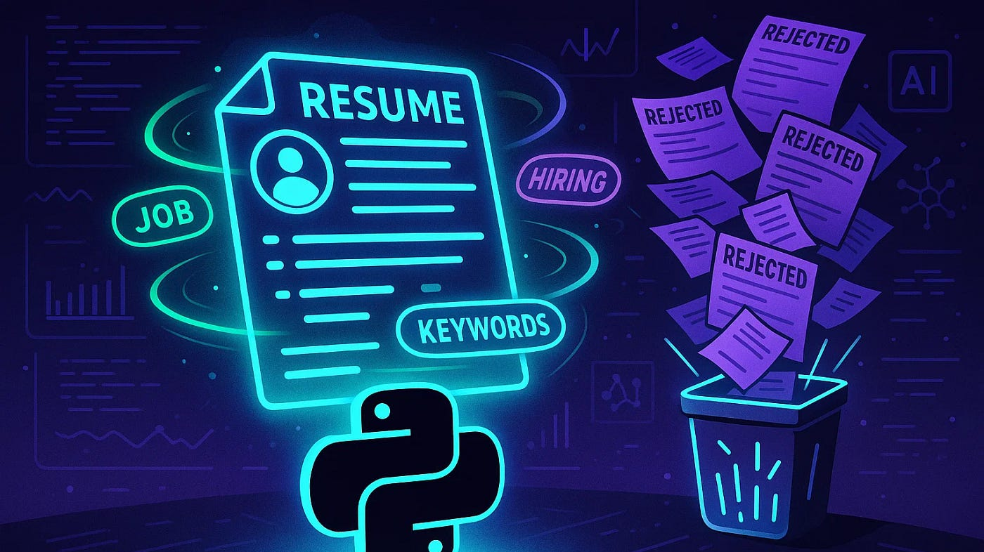
Prajna.Ganji
Neetika.Upadhyay
Shiva shiva
Maruta.zalane
Talent Miner

Slide 2

Objective
Automate resume data extraction using NLP techniques.
Match candidate skills with job descriptions to identify top-fit profiles efficiently.
Minimize recruiter workload by streamlining the resume screening process.
Visualize key hiring insights through interactive Power BI dashboards.
Develop a user-friendly Streamlit interface for uploading, matching, and tracking resumes.

Slide 3
Technologies & Tools Used
Programming Language: Python
Database: Azure SQL Server
Development Environment: Visual Studio Code
Deployment Platform: Streamlit Cloud / Localhost
Version Control System: GitHub
Azure SQL hosted structured data with real-time Power BI access and secure, scalable storage

Slide 4
Python Libraries
Core libraries: pandas, streamlit, pyodbc
NLP and matching: spacy, nltk, sentence-transformers, rapidfuzz, fuzzywuzzy
Document parsing: python-docx, PyMuPDF, pdfplumber
Built-in utilities: re (regex), logging, os, sys
Optional UI enhancement: streamlit-autorefresh

Slide 5
Source Data Acquisition
Gathered resumes
Collected job descriptions.
Converted unstructured files
Ensured dataset diversity.
Stored all raw files.

Slide 6
1. Resume Parsing
2. Skill Matching
3. Data Storage & Integration
4. Power BI Dashboard
5. UI Deployment
1.Resume Parsing
2.Skill Matching
3.Data Storage & Integration
4.Power BI Dashboard
5.UI Deployment

Slide 7
Resume Parsing
Used NLP to extract Name, Skills, Education, and Experience
Cleaned text using tokenization and stop word removal
Detected contact info like phone and email using patterns
Parsed both structured and unstructured resumes
Converted parsed data into structured format for analysis

Slide 8

Skill Matching
Compared skills extracted from resumes with job description keywords
Calculated similarity scores for each resume-job pair
Used scoring to rank candidates by match percentage
Enabled recruiters to quickly identify top-aligned profiles

Slide 9

Data Storage & Integration
Stored structured resume and job data in Azure SQL Database for centralized access
Ensured data consistency through normalization and schema design
Connected Azure SQL to Power BI for real-time data visualization and analysis
Enabled automated refresh and scheduled updates in Power BI service
Facilitated secure and scalable cloud storage with role-based access control

Slide 10

Power BI Dashboard
Created dynamic Power BI dashboards to track resume parsing and matching performance
Displayed key KPIs such as total resumes uploaded, % matched above 80%, and incomplete profiles
Added filters for job role, experience level, upload source, and match threshold
Enabled real-time insights to support recruiter decision-making and hiring strategies
Offered bilingual accessibility, with the dashboard available in both English and French

Slide 11
User Interface
Built a Streamlit web app to make resume uploading and skill matching easy for non-technical users
Enabled drag-and-drop or file browse options to upload resumes in PDF or DOCX formats
Provided instant feedback on skill match scores and missing skills after upload
Displayed parsed resume content in a clean, readable layout
Designed with a responsive, minimal UI for fast performance and mobile accessibility
Integrated with backend database to log and track uploads for audit and reporting

Slide 12
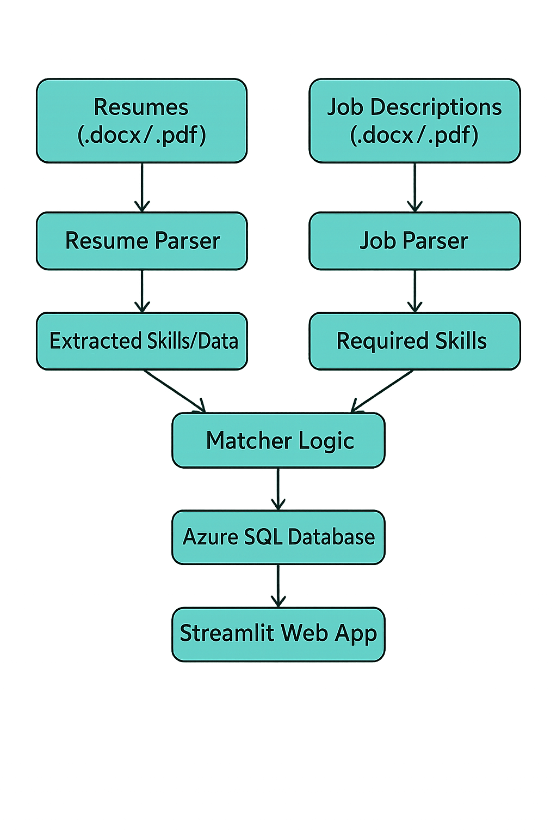
System Architecture / Workflow

Slide 13
Development Roadblocks & Solutions
Challenge | Solution Implemented
Inconsistent resume structures | Utilized regex and NLP techniques for adaptable data extraction
Skill keyword variations | Employed fuzzy matching algorithms to align similar skill terms
Azure quota limitations | Optimized vCore settings and configured budget usage alerts
Job selection filtering in UI | Integrated dynamic dropdown filters using Stream lit for better UX

Slide 14

Conclusion
Built a scalable and automated solution for resume screening
Reduced manual workload in shortlisting candidates through skill-based matching
Delivered real-time, data-driven insights using Power BI dashboards
Developed a user-friendly UI with Streamlit to simplify resume uploads and parsing

Slide 15

Future Technical Improvements
Add multilingual NLP support
Integrate resume upload directly in app
Use machine learning for smarter matching

