Slide 1

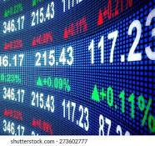



TRADETALK
MADE BY –
SHIVAM SHUKLA (E22CSEU1443)
AKSHAT PANDE (E22CSEU0025)
MEHAK GOYAL (E22CSEU1682)

Slide 2
DATA ANALYSIS

Slide 3
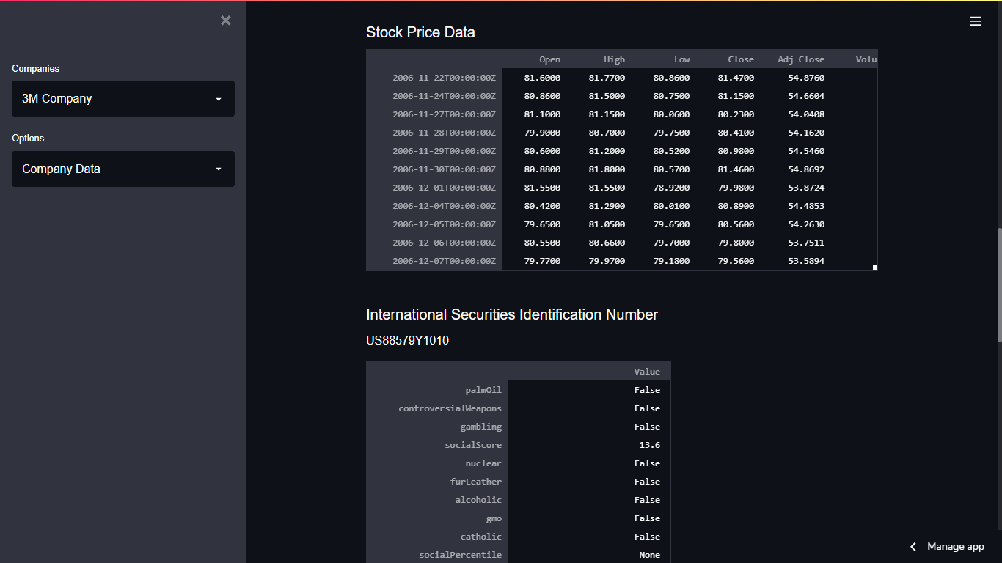
COMPANY INFORMATION

Slide 4
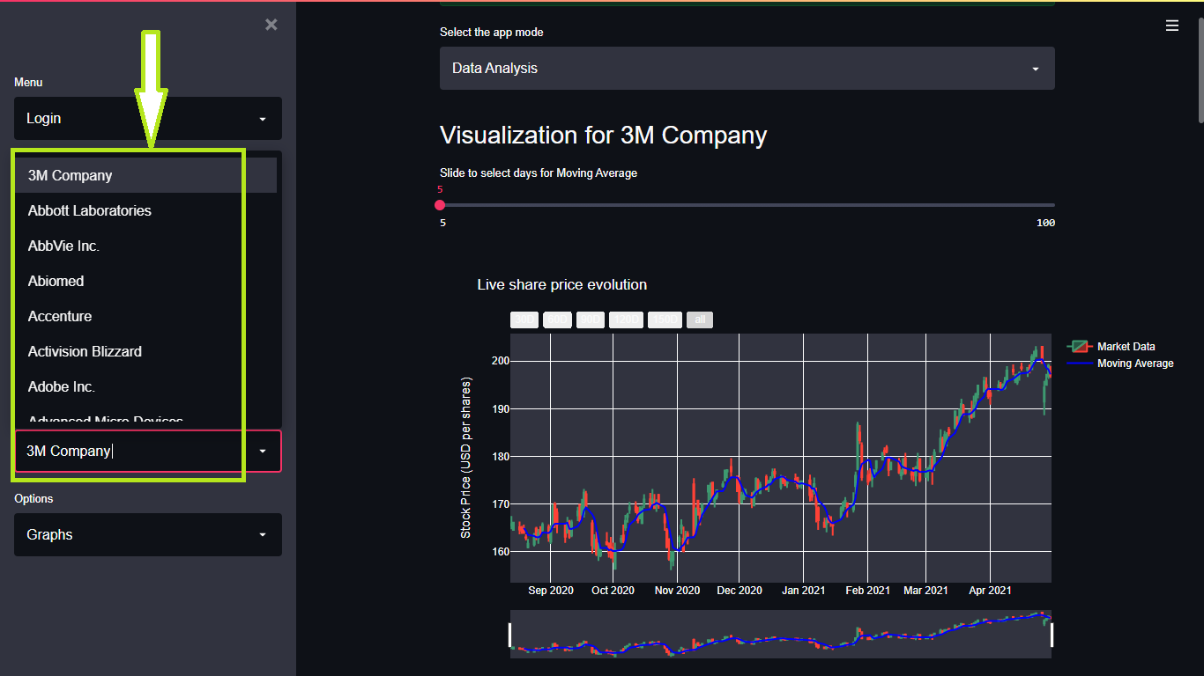
VISUALIZATION OF STOCK DATA

Slide 5
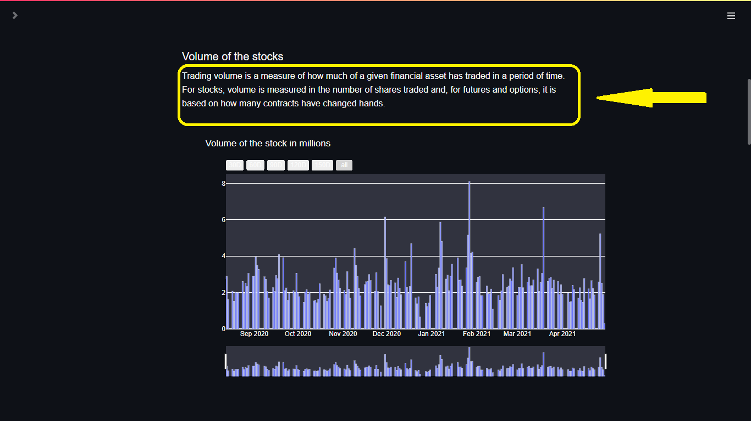
VISUALIZATION OF STOCK DATA

Slide 6
Model Used
ARIMA
The prediction of stock prices is done using an ARIMA (AutoRegressive Integrated Moving Average) model. Here's a brief overview of ARIMA:
ARIMA is a widely used statistical method for time series forecasting. It models the relationship between a dependent variable and its historical values (autoregression), differences of the series (integration), and the moving average of past forecast errors.

Slide 7
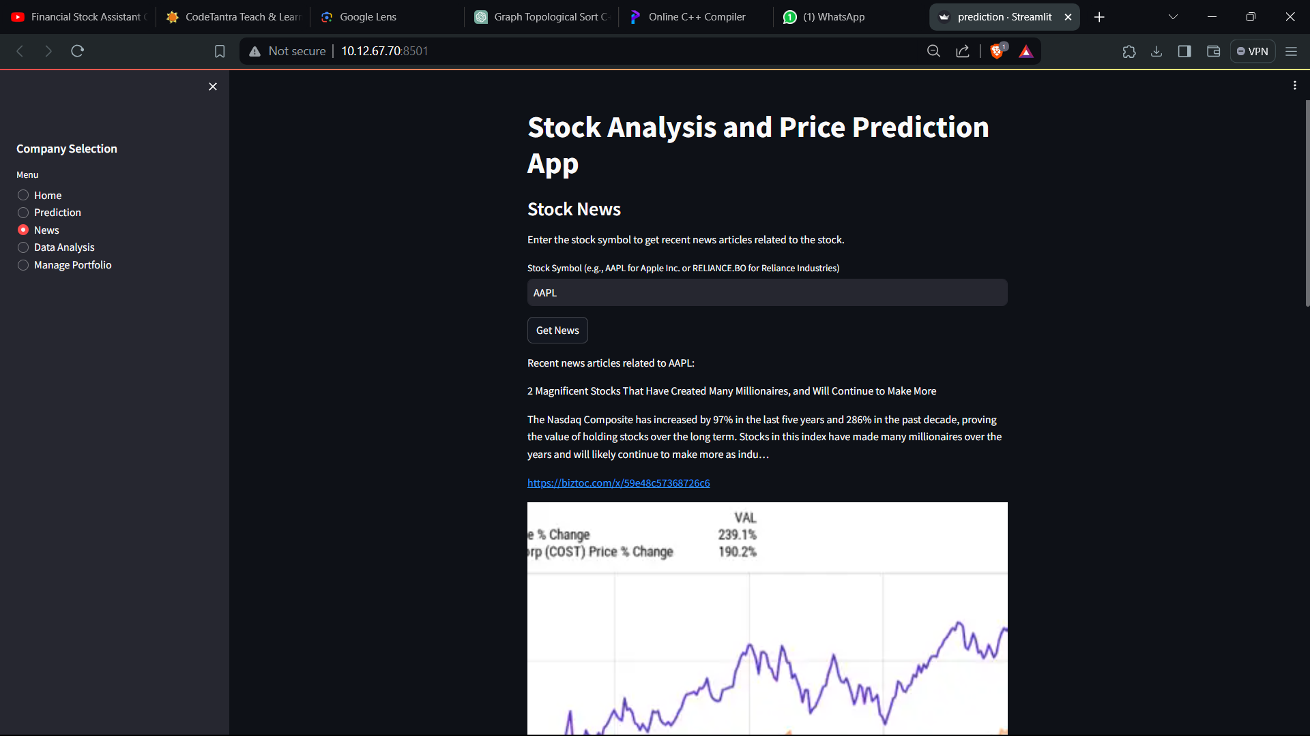
Stocks News

Slide 8
TECHNOLOGIES USED
Technology used
Python
Streamlit
Kaggle

Slide 9
REFERENCES
http://share.streamlit.io/
http://www.heroku.com/
http://github.com/

Slide 10
THANK YOU

