Slide 1


CS1802
Laplace Transform

Slide 2
Newton’s Law of Cooling Using Laplace Transforms
Shivakumar Rs 1RVU23CSE429
Shivanandreddy 1RVU23CSE431
Sharanappa 1RVU23CSE429

Slide 3
Introduction
Newton’s Law of Cooling describes how an object’s temperature decreases over time when placed in a cooler environment.
The rate of cooling is proportional to the temperature difference between the object and its surroundings.
Laplace Transforms offer a systematic method to solve the differential equation involved.
Objectives
To solve the differential equation using Laplace Transforms.
To interpret the physical behavior of the solution.
To visualize the temperature change graphically.
To explore the real-life applications of the model.

Slide 4
Overview of Newton’s Law of Cooling
Describes how a hot object cools over time when placed in a cooler environment.
The rate of temperature change is proportional to the temperature difference between the object and its surroundings.
Represented by a first-order differential equation.
Predicts exponential decay in temperature over time.
Assumes the ambient (surrounding) temperature remains constant.
Commonly applied in: Forensic science (estimating time of death), Food safety and preservation, Engineering (cooling systems), Physics experiments

Slide 5

The Model
Phenomenal Description
Newton’s Law of Cooling models how a hot object cools in a cooler environment.
The cooling rate is proportional to the temperature difference between the object and surroundings.
It follows a first-order linear differential equation.
Mathematical Formulation:
Variables & Parameters: T(t) - Temperature at time t, T₀ - Initial temperature, T∞ - Ambient temperature, k - Cooling constant, dT/dt - Rate of temperature change

Slide 6



Solving the Algebraic Equation (Laplace Domain)
The algebraic equation derived using the Laplace Transform is: ​
Using partial fraction decomposition, the expression is rewritten as:
Taking the inverse Laplace Transform gives the final time-domain solution:

Slide 7
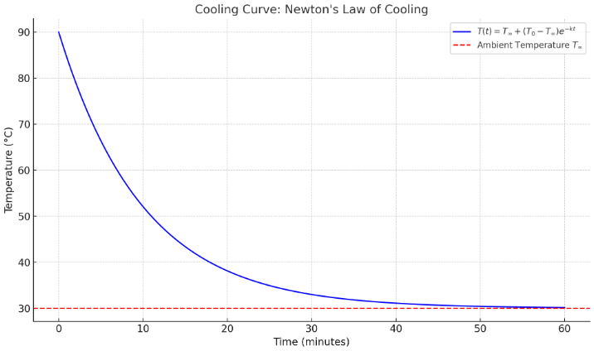
Graph
The temperature-time graph below shows the exponential decay of temperature as the object cools down.

Slide 8
Qualitative Analysis
Initial Behavior: At t=0, the object’s temperature is at T0 (initially hot, e.g., 90°C).
Exponential Decay: The temperature decreases exponentially over time due to heat transfer to the surrounding air.
Asymptotic Behavior: As time increases, e−kt→0, so T(t)→T∞​. The curve approaches the ambient temperature (e.g., 30°C) but never drops below it.
Effect of Cooling Constant k: A larger k results in faster cooling (steeper curve). A smaller k leads to slower cooling (gentle slope).

Slide 9
Conclusion
Newton’s Law of Cooling effectively models the cooling behavior of objects placed in a cooler environment.
By applying Laplace Transforms, the complex differential equation becomes easier to solve algebraically.
The final solution T(t)=T∞​+(T0​−T∞​)e−kt closely mirrors real-world cooling behavior observed in daily life and various scientific domains.
Newton’s Law of Cooling effectively models the cooling behavior of objects placed in a cooler environment.
By applying Laplace Transforms, the complex differential equation becomes easier to solve algebraically.
The final solution T(t)=T∞+(T0−T∞)e−ktT(t) = T_\infty + (T_0 - T_\infty)e^{-kt}T(t)=T∞​+(T0​−T∞​)e−kt closely mirrors real-world cooling behavior observed in daily life and various scientific domains.

Slide 10
Thank you

