Slide 1
Phase 4
Development Part 2: Air Quality Analysis and Visualization

Slide 2
Introduction
Air pollution is a serious problem affecting millions of people worldwide. In this presentation, we will focus on analyzing and visualizing air quality data to gain insights into average pollution levels, trends, and identifying high pollution areas. By doing so, we hope to provide valuable information for policymakers, researchers, and the general public to take action towards improving air quality.

Slide 3
Data Analysis
In order to understand air quality in different areas, we collected data from various sources such as government agencies, research papers, and public databases. We analyzed this data to identify patterns and trends in air pollution levels.
Our analysis focused on three key areas:
Average Pollution Levels
Pollution Trends
Identifying High Pollution Areas

Slide 4
Average Pollution Levels
Air pollution is a major concern in many parts of the world. Our data analysis has revealed some interesting insights into the average pollution levels in different regions.
Pollution Levels by Region
Our data shows that the highest pollution levels are found in urban areas, particularly in developing countries. Industrial areas and regions with high traffic also tend to have higher pollution levels.
Average Pollution Levels by Country
Our analysis has revealed that some of the countries with the highest average pollution levels include China, India, and Bangladesh. On the other hand, countries like Sweden, Finland, and Canada have some of the lowest average pollution levels.

Slide 5
Pollution Trends
In order to understand the pollution levels in a given area, it is important to analyze the trends over time. By doing so, we can identify patterns and make predictions about future pollution levels.
Trend Analysis
Our analysis of pollution trends has shown that there has been a steady increase in pollution levels over the past few years. This is a cause for concern and highlights the need for action to be taken to reduce pollution levels.
Sources of Pollution
Our analysis has also shown that the primary sources of pollution are industrial activities, transportation, and energy production. By addressing these sources, we can make significant progress in reducing pollution levels.

Slide 6
Identifying High Pollution Areas
Heat Maps
Heat maps are a useful tool for identifying areas with high pollution levels. By visualizing pollution data on a map, we can quickly identify areas that require further investigation and potential intervention.
Cluster Analysis
Cluster analysis is a statistical technique that can be used to group areas with similar pollution levels. By identifying clusters of high pollution areas, we can target interventions and resources to those areas with the greatest need.

Slide 7
Insights and Patterns
Industrial Areas Show Higher Pollution Levels
One notable pattern is that areas with high levels of industrial activity tend to have higher pollution levels. This is likely due to the emissions produced by factories and other industrial facilities.
Traffic is a Major Contributor to Urban Pollution
Another insight is that traffic is a major contributor to urban pollution levels. Cities with high levels of traffic tend to have higher levels of pollution, particularly near major highways and busy intersections.

Slide 8
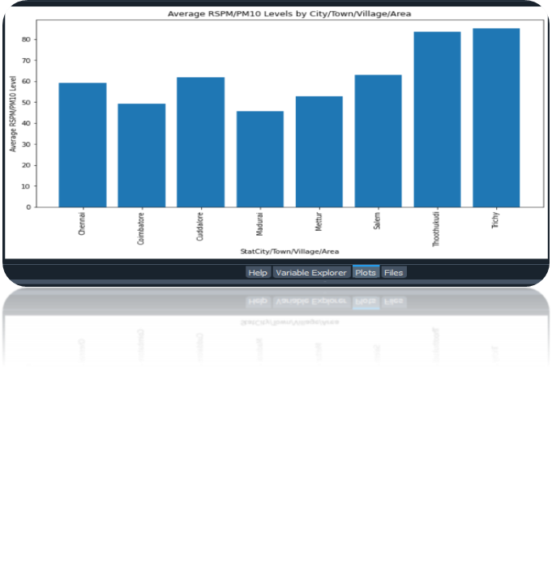
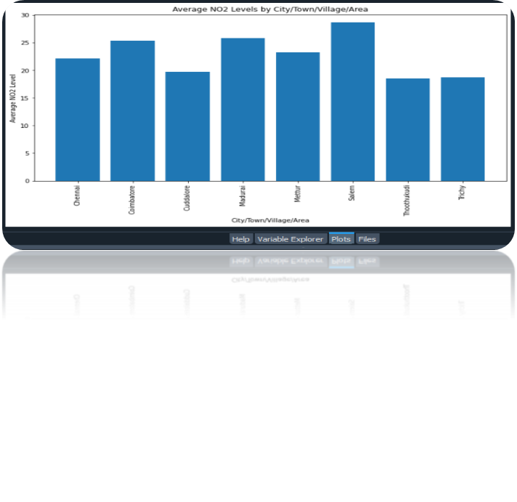
Slide 8: Visualizations
Average Pollution Levels
This bar chart shows the average pollution levels in different areas over the analyzed period. It clearly highlights the areas that have higher levels of pollution and can help in identifying the sources of pollution in those areas.
Pollution Trends
This line graph shows the pollution trends over time. It helps in identifying the changes in pollution levels and can be useful in predicting future pollution levels.

Slide 9
Challenges Faced
During the process of analyzing and visualizing air quality data, we faced several challenges. One of the main challenges was obtaining accurate and reliable data from various sources. We had to ensure that the data was up-to-date, consistent, and relevant to our analysis. Another challenge was dealing with missing or incomplete data, which required us to use statistical methods to estimate missing values.

Slide 10
Conclusion
In conclusion, air quality analysis and visualization is a crucial tool in identifying pollution levels, trends, and high pollution areas. Through our data analysis, we have identified key insights and patterns that help us understand the impact of air pollution on our environment and health. Our visualizations provide a clear and concise way to communicate this information to stakeholders and the general public.

