Slide 1
Air Q Assessment TN:
Phase 5: Project Documentation & Submission

Slide 2
Project Objectives
Air pollution is a serious problem affecting millions of people worldwide. In this presentation, we will focus on analyzing and visualizing air quality data to gain insights into average pollution levels, trends, and identifying high pollution areas. By doing so, we hope to provide valuable information for policymakers, researchers, and the general public to take action towards improving air quality.

Slide 3
Analysis Approach:
The Approaches that are made during the Project Development are:-
Data Collection
Data Cleaning and Preprocessing
Exploratory Data Analysis (EDA)
Time-Series Analysis
Correlation Analysis

Slide 4
Visualization Techniques
In our air quality analysis project, we employed popular Python libraries for data visualization, including Matplotlib and Seaborn.
These libraries provide powerful and flexible tools for creating a wide range of visualizations, allowing us to effectively communicate complex patterns and insights from our data analysis.
Some Other Libraries Like- Pandas, Numpy & Sklearn are also used during the development.
Pandas And Numpy are used for Data Collection and Data Correction.

Slide 5
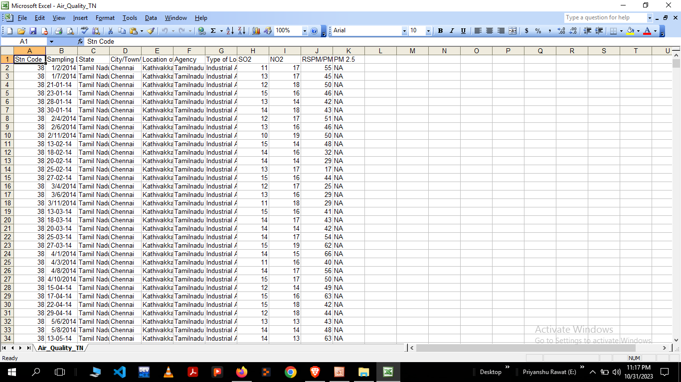
Datasets
Link-https://tn.data.gov.in/resource/location-wise-daily-ambient-air-quality-tamil-nadu-year-2014

Slide 6
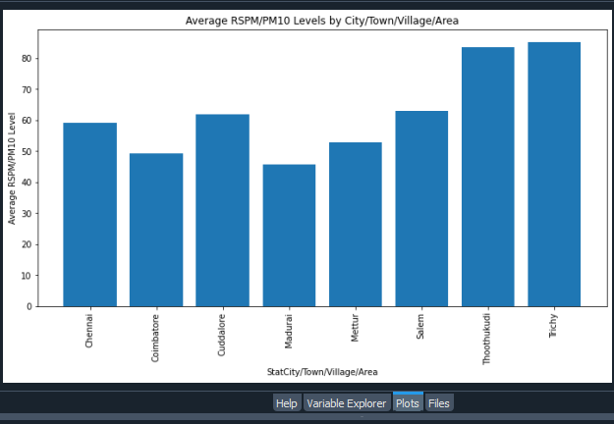
Example Outputs

Slide 7
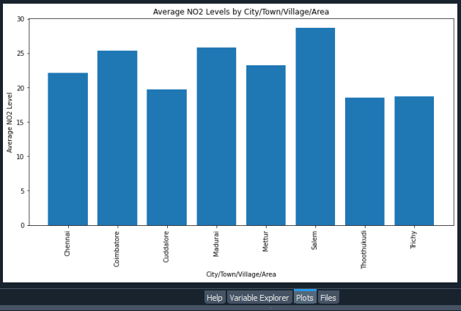
Example Outputs

Slide 8
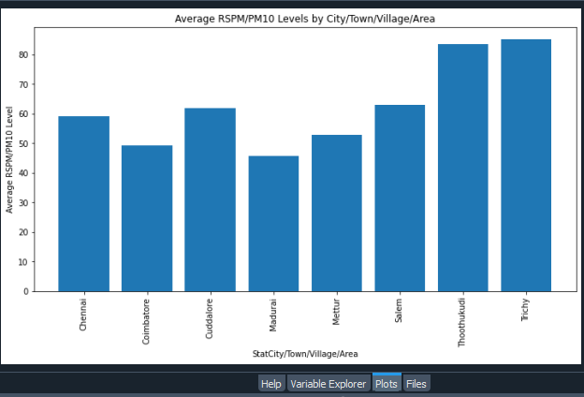
Example Outputs

Slide 9
Conclusion
Our air quality analysis project has successfully achieved its objectives of analyzing air pollution trends and identifying pollution levels in Tamil Nadu. Through rigorous data analysis, visualization, and predictive modeling, we have gained valuable insights into the patterns and correlations within air quality data. We've successfully processed complex datasets, applied advanced statistical techniques, and developed accurate predictive models to enhance our understanding of air pollution dynamics in the region.

