Slide 1


MADANAPALLE INSTITUTE OF TECHNOLOGY & SCIENCE (UGC-AUTONOMOUS INSTITUTION) Affiliated to JNTUA, Ananthapuramu & Approved by AICTE, New Delhi NAAC Accredited with A+ Grade, NIRF India Rankings 2021 - Band: 201-250 (Engg.) NBA Accredited - B.Tech. (CIVIL, CSE, ECE, EEE, MECH), MBA & MCA
Department of Computer Science & Engineering ( Data Science)
Optimizating Skin Cancer Detection Using The MobileNet Deep Learning Model: A Lightweight and Efficient Approach
Team Members Guided By
B. Praveen - 21691A3269 Mr. T. Balaji , M. Tech,( Ph. D)
C. Revanth - 21691A3278 Assistant Professor
G. Sai Haritha - 21691A3286
D. Siva Kumar Goud - 21691A32A2

Slide 2
Abstract
Early and accurate detection of skin cancer is critical for effective treatment. This project explores the use of MobileNet, a lightweight CNN, for classifying skin lesions using the HAM10000 dataset. MobileNet achieves high training accuracy (92.86%) and validation accuracy (98.96%) while significantly reducing computational cost, making it suitable for real-time, resource-constrained environments like mobile and edge devices. The results highlight MobileNet's potential as an efficient, scalable solution for AI-assisted skin cancer diagnosis, contributing to faster clinical decisions and improved patient care.

Slide 3
Introduction
Skin cancer diagnosis is complex due to variability in lesion appearance and similarity between benign and malignant types.
Traditional diagnosis methods using dermoscopic image inspection are time-consuming, subjective, and error-prones
The increasing incidence of skin cancer highlights the need for automated, accurate diagnostic tools.
Deep learning, especially Convolutional Neural Networks (CNNs), has shown significant success in medical image analysis.
In this project, we use MobileNet, a lightweight and efficient CNN, to classify skin lesions from the HAM10000 dataset.
MobileNet offers high accuracy with low computational cost, making it suitable for real-time, mobile, and edge-based medical applications.

Slide 4
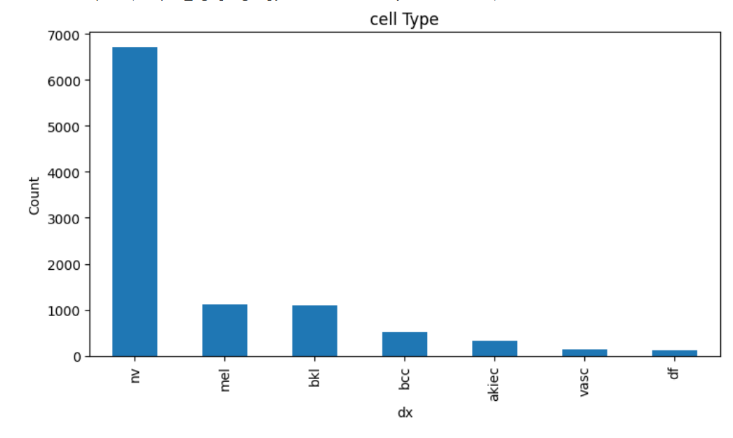
Different Types of Classes

Slide 5
Hardware Requirements
Processor: Intel Core i5 or higher
RAM: Minimum 8GB
Storage: At least 500GB HDD or SSD
Other Peripherals: Mouse, keyboard, monitor
Software Requirements
Operating System: Windows 10 or Linux (Ubuntu recommended)
Programming Language: Python 3.x
Development Environment: Google Colab or Jupyter Notebook
Libraries:
NumPy, Pandas for data manipulation
scikit-learn for machine learning algorithms
Matplotlib and Seaborn for data visualization
Deap for implementing Genetic Algorithms
Version Control: Git for source code management

Slide 6
Literature Survey
S.No | PAPER TITLE | AUTHORS | OBSERVATIONS
1 2 3 | Skin cancer diagnosis using CNN features with Genetic Algorithm and Particle Swarm Optimization method An ensemble-based convolutional neural network model powered by a genetic algorithm for melanoma diagnosis A precise model for skin cancer diagnosis using hybrid U-Net and improved MobileNet-V3 with hyperparameters optimization | Erdal Başaran and Yüksel Çelik(2024) Eduardo Pérez, Sebastián Ventura (2021) Umesh Kumar Lilhore, Sarita Simaiya, Yogesh Kumar Sharma, Kuldeep Singh Kaswan, K. B. V. Brahma Rao(2024) | This study uses the EfficientNetB0 model to extract deep features from skin cancer images, optimized through Particle Swarm Optimization and Genetic Algorithm. These features were classified using support vector machines, achieving an accuracy of 89.17%, proving the model's effectiveness in skin cancer detection. This study proposes a CNN architecture for melanoma diagnosis, optimized using genetic algorithms and ensemble learning, which enhances prediction accuracy and mitigates overfitting. Tested on sixteen skin image datasets, it outperformed state-of-the-art models by 11% and 13% in dermoscopic and non-dermoscopic images This reference introduces an optimized MobileNet-V3-based model for skin cancer detection, achieving 98.86% accuracy on the HAM10000 dataset through architectural enhancements and hyperparameter tuning..

Slide 7
S.No | PAPER TITLE | AUTHORS | OBSERVATIONS
4 5 6 | Skin cancer classification based on an optimized convolutional neural network and multicriteria decision-making A novel CNN-ViT-based deep learning model for early skin cancer diagnosis Fusion of Transformer Attention and Cnn Features for Skin Cancer Detection | Neven Saleh, Mohammed A. Hassan, Ahmed M. Salaheldin(2024) Ishak Pacal , Burhanettin Ozdemir , Javanshir Zeynalov , Huseyn Gasimov Catal Reis, H. and Turk, V. | This study developed 51 models for skin cancer classification using CNNs and the Grey Wolf Optimizer, with AlexNet and classical GWO achieving the best accuracy of 94.5% on the ISIC 2017 dataset. Feature reduction improved performance, and the RAPS method effectively selected the optimal model. This study introduces a MetaFormer-based deep learning model with focal self-attention, enhancing skin cancer diagnosis with high accuracy. Tested on ISIC 2019 and HAM10000, it outperforms existing models while remaining lightweight for real-time clinical use. This study presents MABSCNET, a hybrid deep learning model combining depthwise separable convolution and transformers for skin cancer detection. Using image enhancement techniques and metaheuristic-optimized traditional ML algorithms, the model achieved 92.74% accuracy, outperforming other methods.

Slide 8
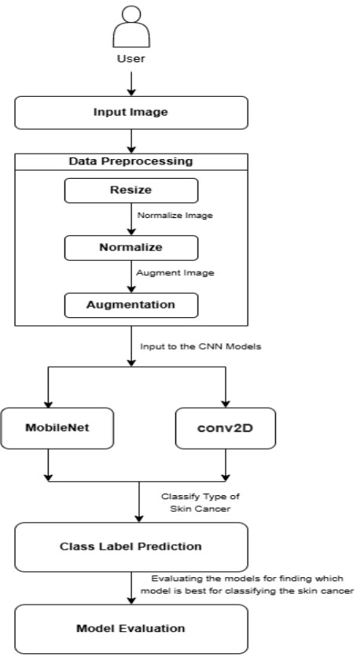
Architecture Diagram

Slide 9
Modules
Data Preprocessing
Data Visualization
Feature Engineering
Deep LearningModels for Skin Cancer Detection
Model Evaluation

Slide 10
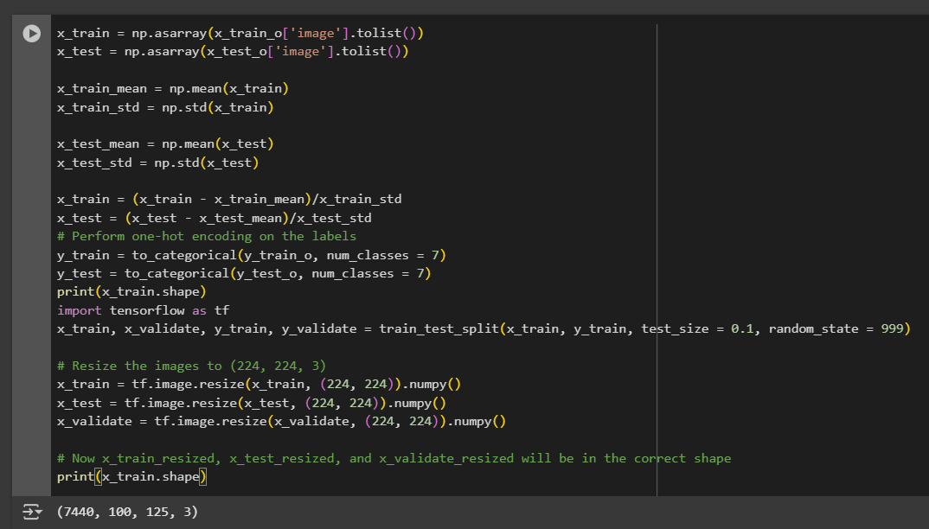
Module Description
1. Data Preprocessing
The images were resized to fit the input dimensions required by MobileNet. Label encoding was applied to convert categorical lesion types into numerical form. The dataset was also split into training, validation, and test sets, and normalization was performed to scale pixel values for better model convergence.

Slide 11
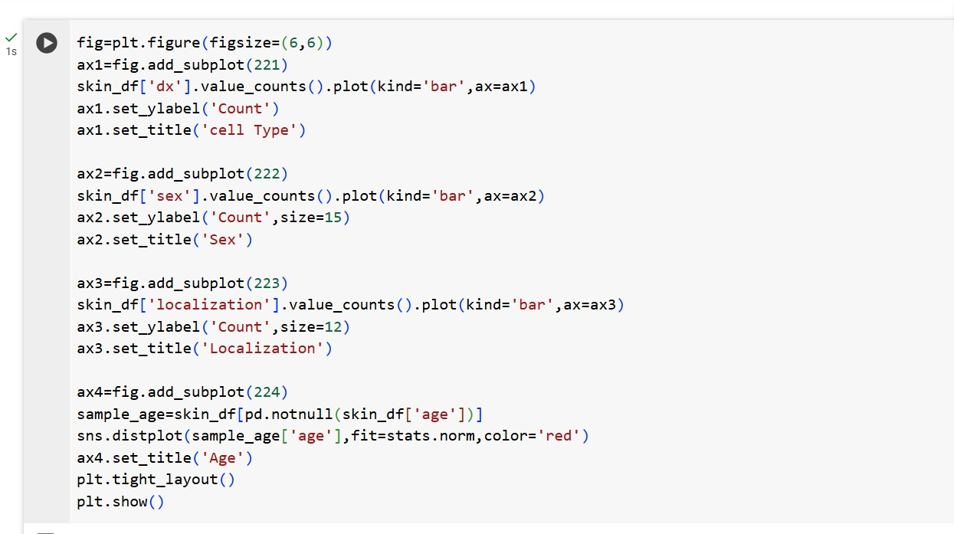
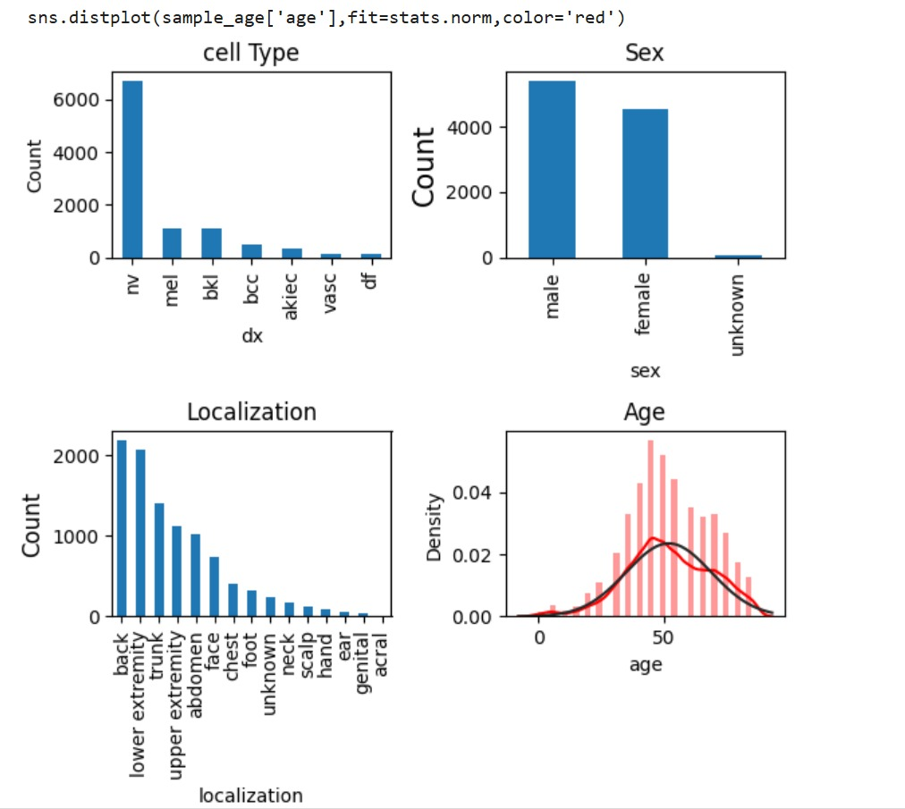
2.Dataset Visualization
Various graphs were plotted to understand the dataset distribution, including:
Age and gender distribution of patients
Lesion location on the body
Class distribution of skin diseases
This step helped identify class imbalances and guided data handling decisions.

Slide 12
3. Feature Engineering
Since deep learning models automatically learn features, manual feature extraction was not required. However, data augmentation techniques such as rotation, zoom, flipping, and shifting were used to artificially expand the training set and help the model generalize better.
4. Deep Learning Models for Skin Cancer Detection
We implemented MobileNet, a lightweight and efficient CNN model, optimized for resource-constrained environments. MobileNet was fine-tuned using transfer learning on the HAM10000 dataset. It achieved 92.86% training accuracy and 98.56% validation accuracy, showing excellent performance with lower computational overhead.

Slide 13
5. Model Evaluation
The model was evaluated using metrics such as:
Accuracy
Confusion Matrix to visualize class-wise performance
Training/Validation accuracy and loss curves
This evaluation demonstrated MobileNet’s reliability in real-world diagnostic scenarios.

Slide 14
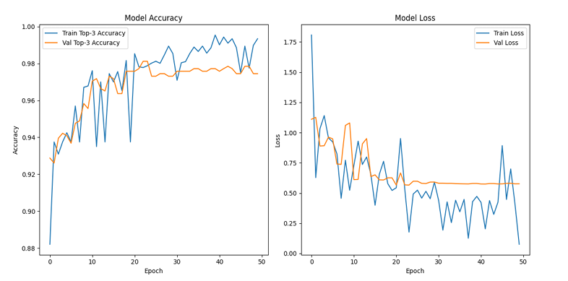
MobileNet Model Performance Metrics

Slide 15
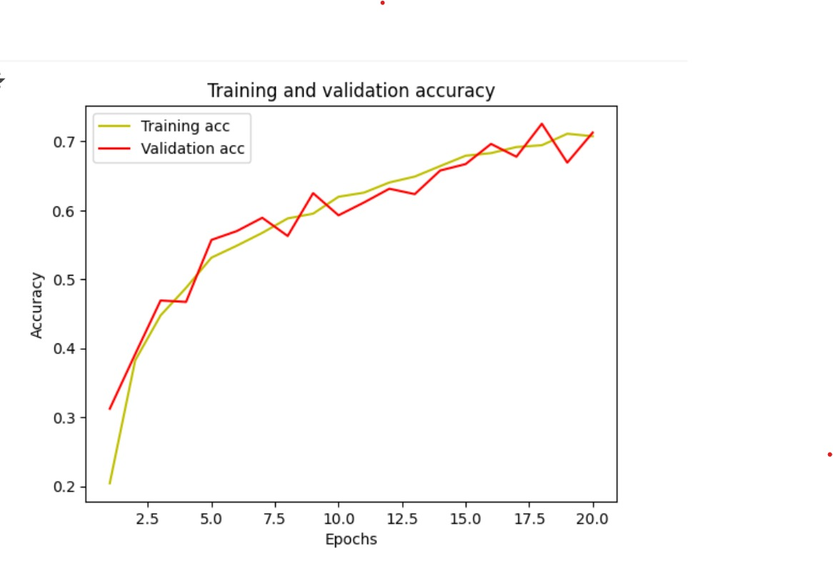
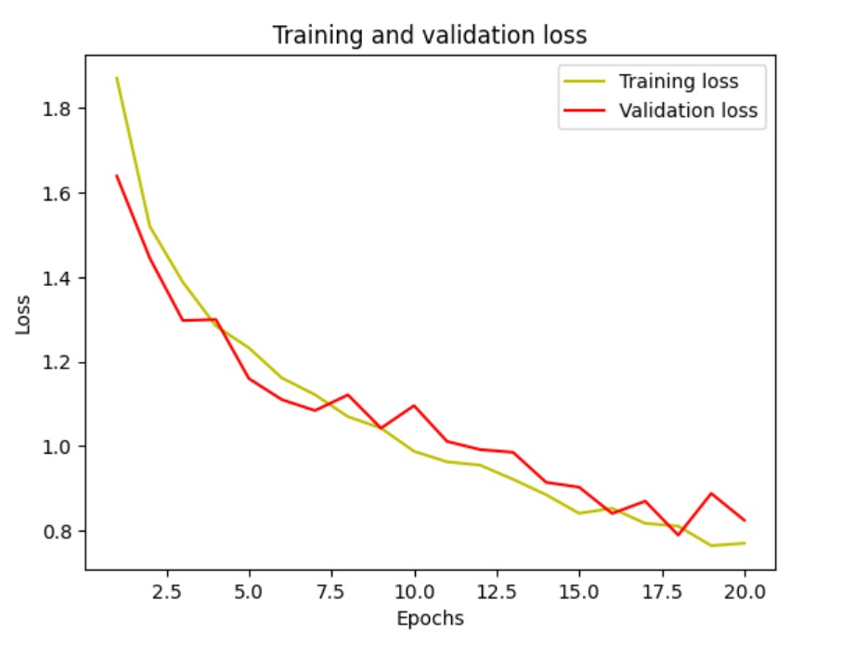
Convolutional Model Performance Metrics

Slide 16
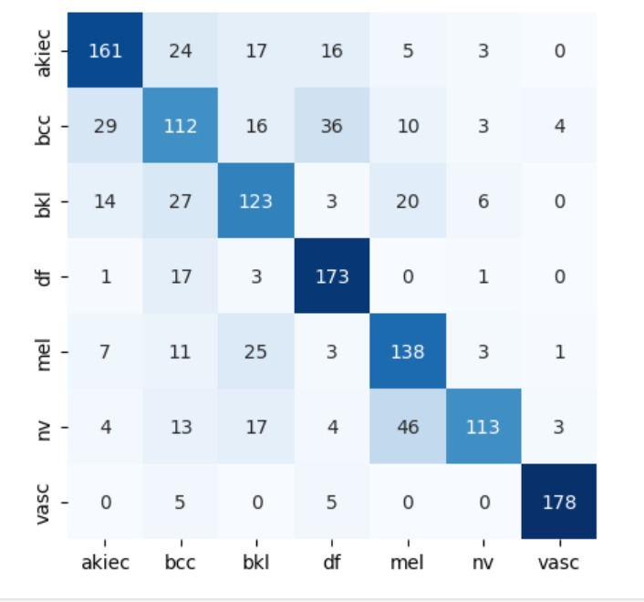

Slide 17
Conclusion
The project successfully demonstrates the effectiveness of using MobileNet, a lightweight convolutional neural network, for accurate and efficient skin cancer detection based on dermoscopic images from the HAM10000 dataset. MobileNet achieved a high training accuracy of 92.86% and a validation accuracy of 98.56%, showing strong generalization to unseen data. Various preprocessing techniques such as image resizing, normalization, and augmentation were applied to improve performance and reduce overfitting.
Compared to a traditional Sequential CNN, MobileNet proved to be faster, more memory-efficient, and better suited for deployment in real-time and resource-constrained environments like mobile devices or rural healthcare setups. Performance evaluation using accuracy metrics and the confusion matrix confirmed the model’s reliability across different lesion types. In conclusion, this project highlights the potential of deep learning, particularly MobileNet, in advancing accessible and scalable AI-driven diagnostic tools for dermatology.

Slide 18
Future Work and Enhancement
Integration of Clinical Metadata: Combine dermoscopic images with patient data
(age, gender, medical history) to enhance diagnostic accuracy and reliability.
Real-Time Mobile and Web Application:Develop a mobile or web app for real-time
skin lesion analysis, increasing accessibility in remote and underserved regions.
Explainability & Interpretability: Integrate explainable AI (XAI) techniques to
provide transparent and trustworthy predictions for dermatologists.

Slide 19
References
K. Mridha, M. M. Uddin, J. Shin, S. Khadka and M. F. Mridha, "An Interpretable Skin Cancer Classification Using Optimized Convolutional Neural Network for a Smart Healthcare System," in IEEE Access, vol. 11, pp. 41003-41018, 2023, doi: 10.1109/ACCESS.2023.3269694.
A. Imran, A. Nasir, M. Bilal, G. Sun, A. Alzahrani and A. Almuhaimeed, "Skin Cancer Detection Using Combined Decision of Deep Learners," in IEEE Access, vol. 10, pp. 118198-118212, 2022, doi: 10.1109/ACCESS.2022.3220329.
R. Schiavoni, G. Maietta, E. Filieri, A. Masciullo and A. Cataldo, "Microwave Reflectometry Sensing System for Low-Cost in-vivo Skin Cancer Diagnostics," in IEEE Access, vol. 11, pp. 13918-13928, 2023, doi: 10.1109/ACCESS.2023.3243843.
M. N. Hamza, M. Tariqul Islam, S. Lavadiya, S. Koziel, I. Ud Din and B. Cavalcante de Souza Sanches, "Designing a High-Sensitivity Dual-Band Nano-Biosensor Based on Petahertz MTMs to Provide a Perfect Absorber for Early-Stage Nonmelanoma Skin Cancer Diagnostic," in IEEE Sensors Journal, vol. 24, no. 11, pp. 18418-18427, 1 June1, 2024, doi: 10.1109/JSEN.2024.3391347.
N. Shafi et al., "A Portable Non-Invasive Electromagnetic Lesion-Optimized Sensing Device for the Diagnosis of Skin Cancer (SkanMD)," in IEEE Transactions on Biomedical Circuits and Systems, vol. 17, no. 3, pp. 558-573, June 2023, doi: 10.1109/TBCAS.2023.3260581.

Slide 20
Thank You

