Slide 1

Simulation Project
Shivadharshini C

Slide 2

Data Cleaning
Handling Missing Values
Removing Duplicates
Handling Inconsistent Data Types
Correcting Typos and Inconsistencies
Handling Inconsistent Units
Checking for Data Skewness
Handling Outliers
Checking Date and Time Formats

Slide 3

Data Harmonization for Dimensions
Standardizing Dimension Names
Aligning Dimension Values
Reference Data Alignment for Dimensions
Delimiting Data in Dimensions using "_"
Finding Data Patterns in Dimension Names

Slide 4

Data Harmonization for KPIs and Metrics
Consistent Units for KPIs and Metrics
Handling Missing Values in KPIs and Metrics
Aligning Time Frames for KPIs and Metrics
Establishing Metric Hierarchies
Handling Derived Metrics Consistently
Applying Common Calculation Methods

Slide 5
Data Visualization
Understand Your Data
Identify Key Metrics
Choose the Right Visualization Tool
Data Cleaning and Preprocessing
Select Appropriate Visualization Types
Create Initial Visualizations
Enhance Visualizations
Interactive Elements (if applicable)
Design Principles
Evaluate and Iterate

Slide 6
Excel Charts
Explore Data in Excel
Identify Key Metrics
Select Appropriate Chart Types in Excel
Data Cleaning and Formatting in Excel
Create Initial Excel Charts
Enhance Excel Charts
Design Principles for Excel Charts
Evaluate and Iterate in Excel

Slide 7
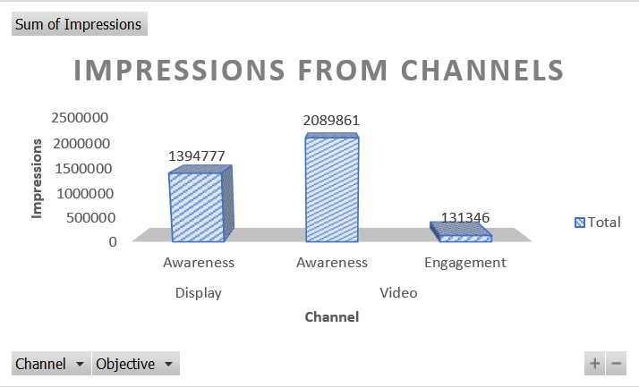
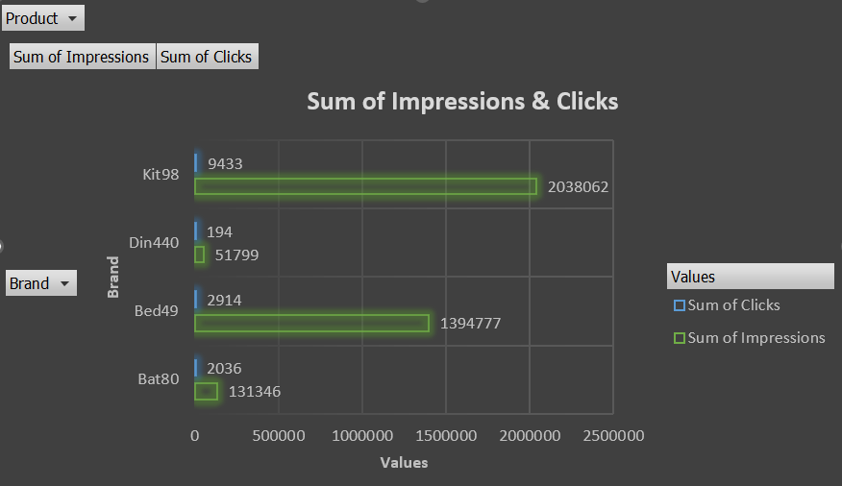
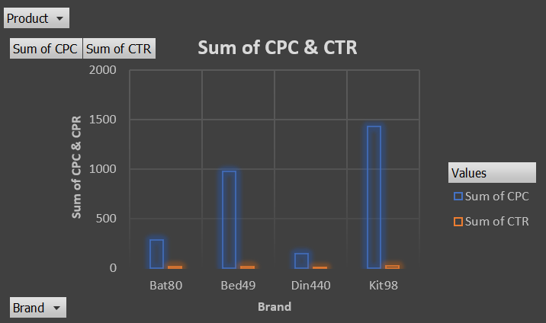
DBM Excel Charts

Slide 8
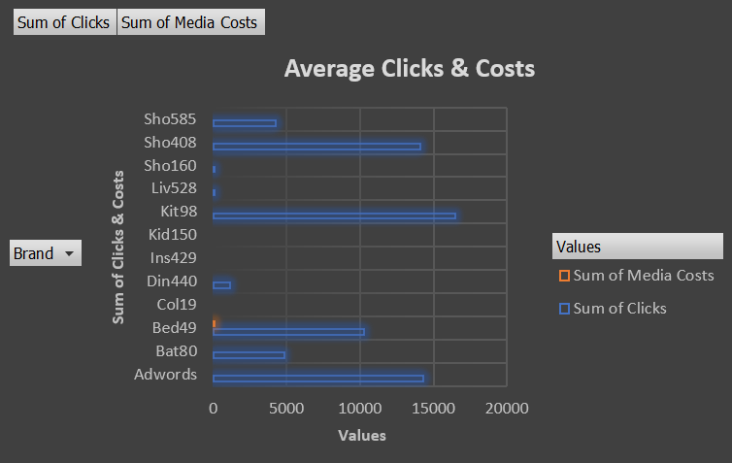
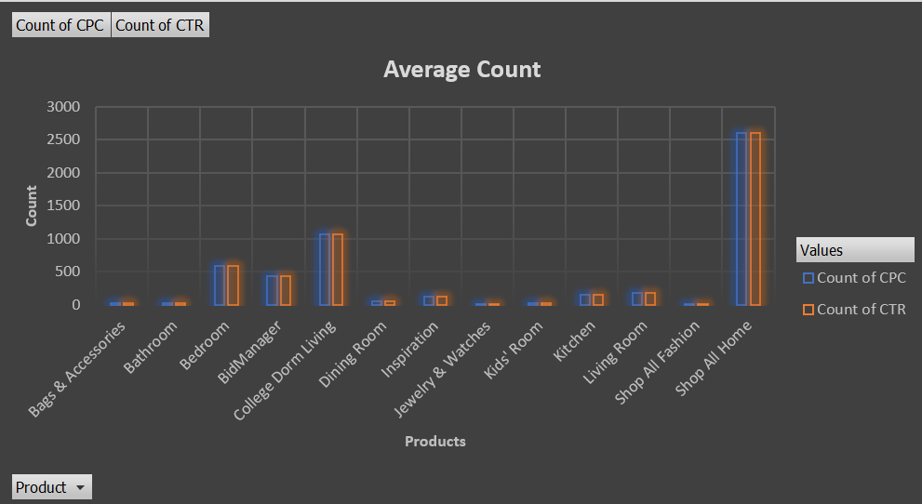
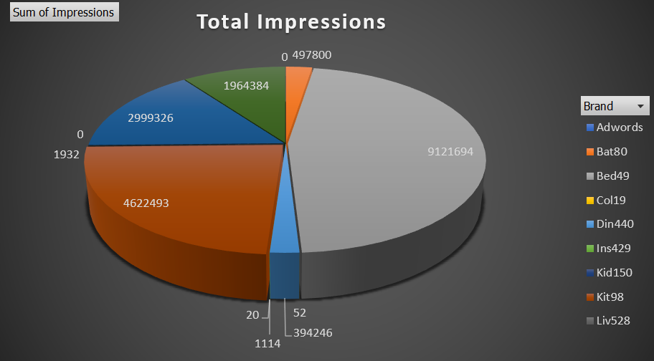
DCM Excel Charts

Slide 9
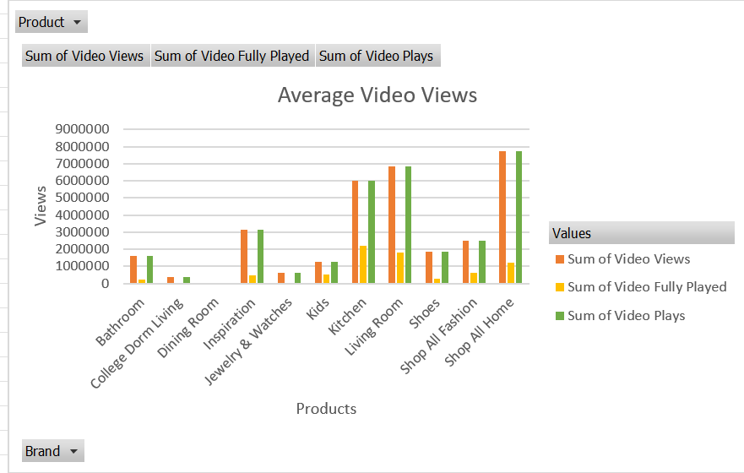
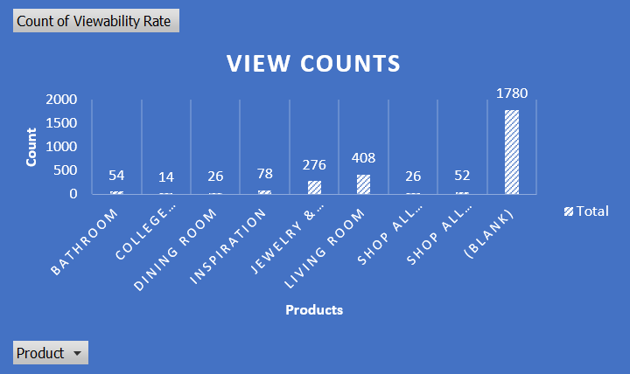
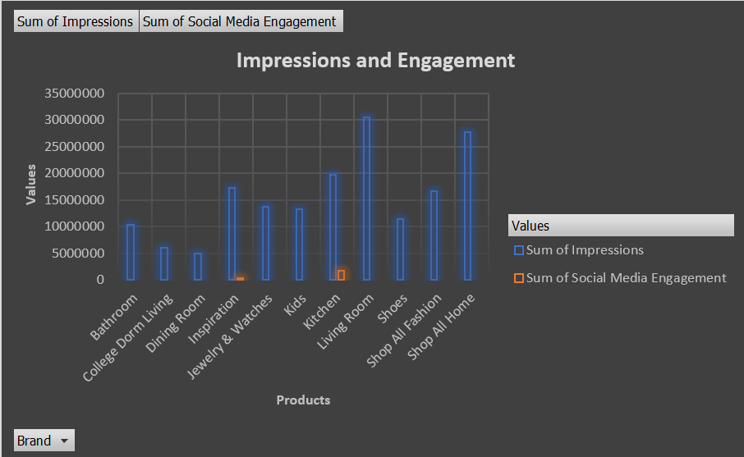
FB Excel Charts

Slide 10
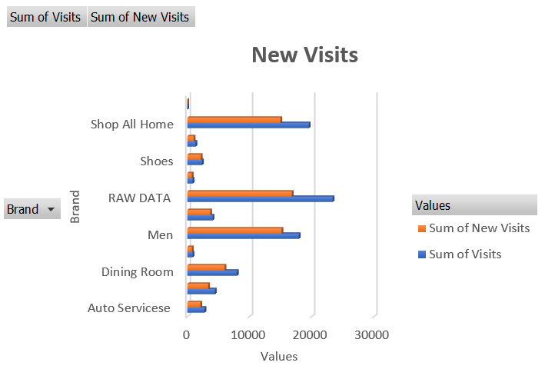
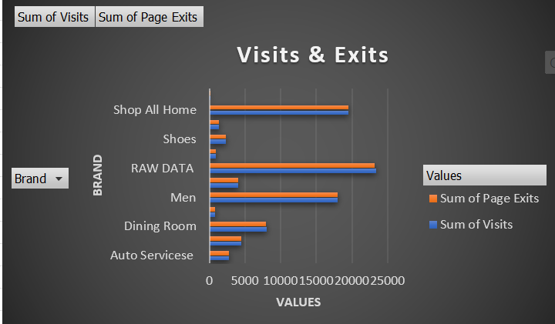
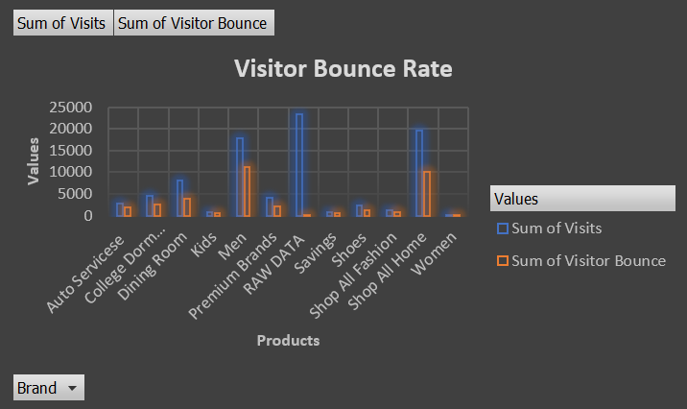
GA Excel Charts

Slide 11
Tableau Dashboard
Connect to Data in Tableau
Identify Key Metrics in Tableau
Choose the Right Visualization Types in Tableau
Data Cleaning and Preprocessing in Tableau
Create Initial Tableau Visualizations
Enhance Tableau Visualizations
Add Interactive Elements in Tableau
Design Principles for Tableau Dashboards
Publish and Share Tableau Dashboards
Evaluate and Iterate in Tableau

Slide 12
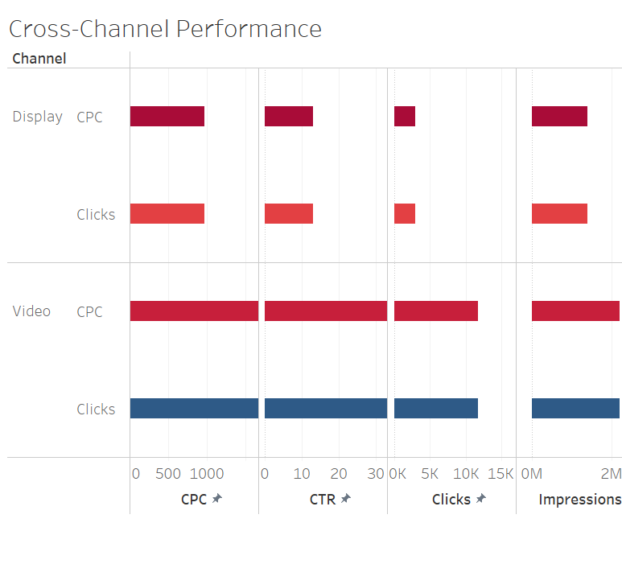
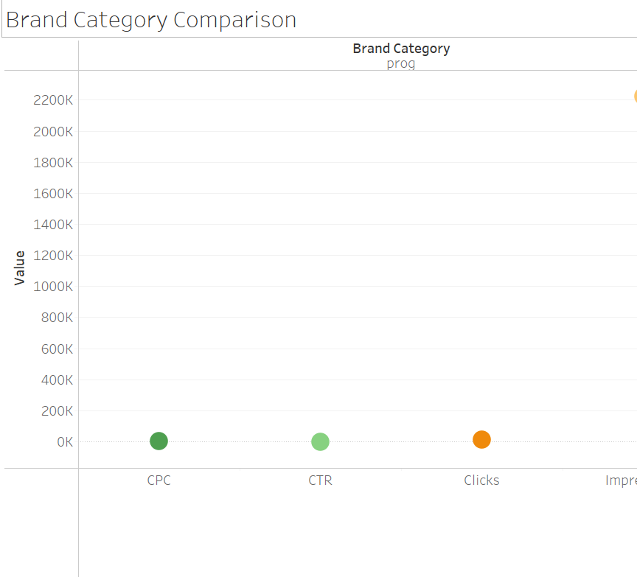
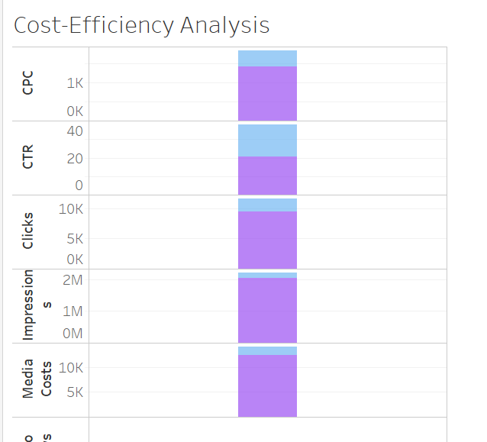
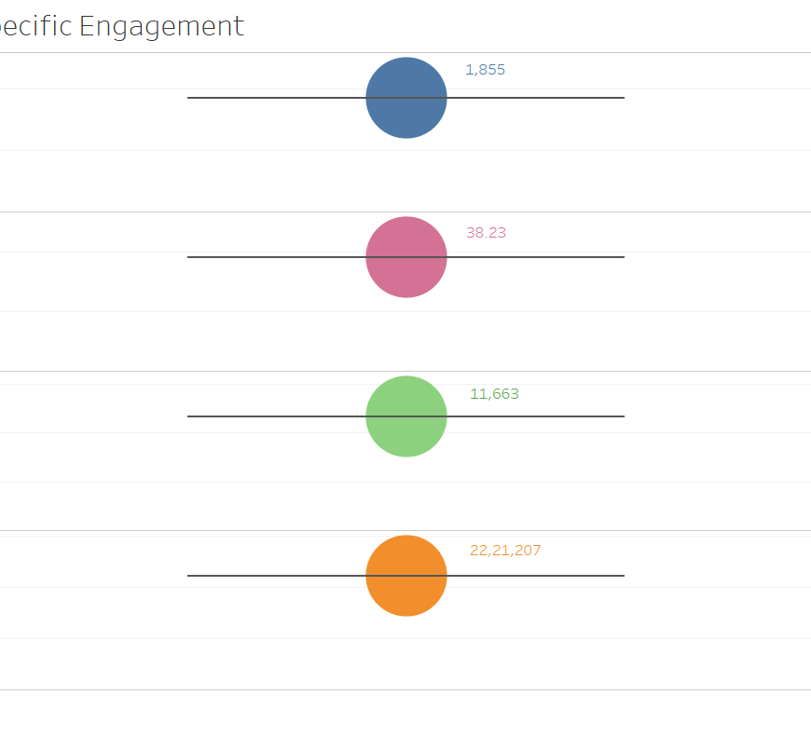
DBM Tableau Dashboard

Slide 13
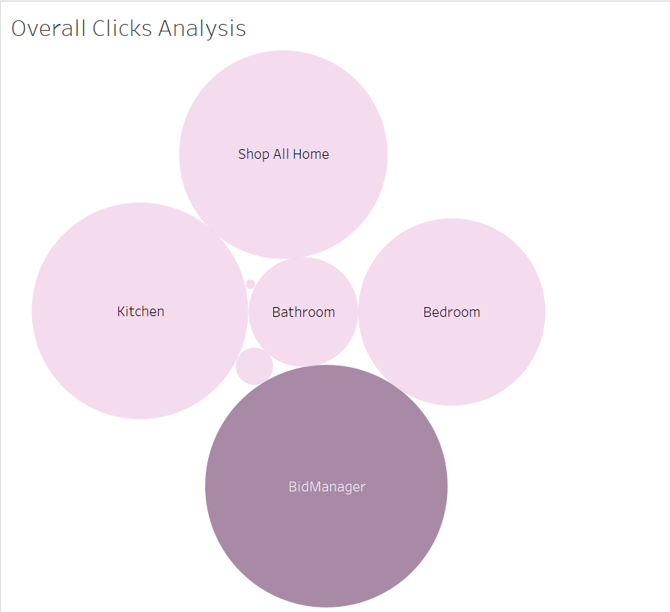
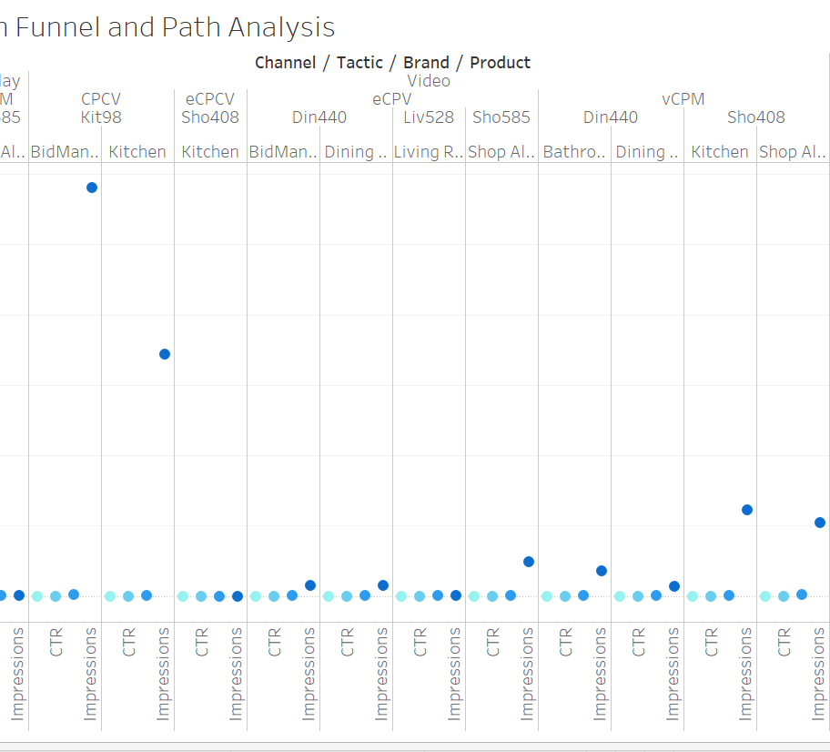
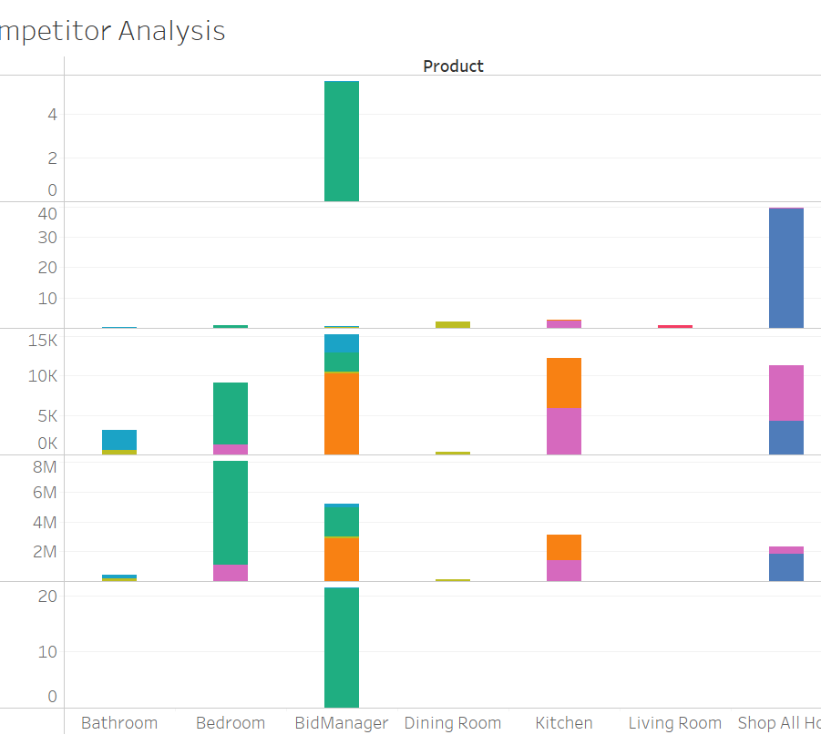
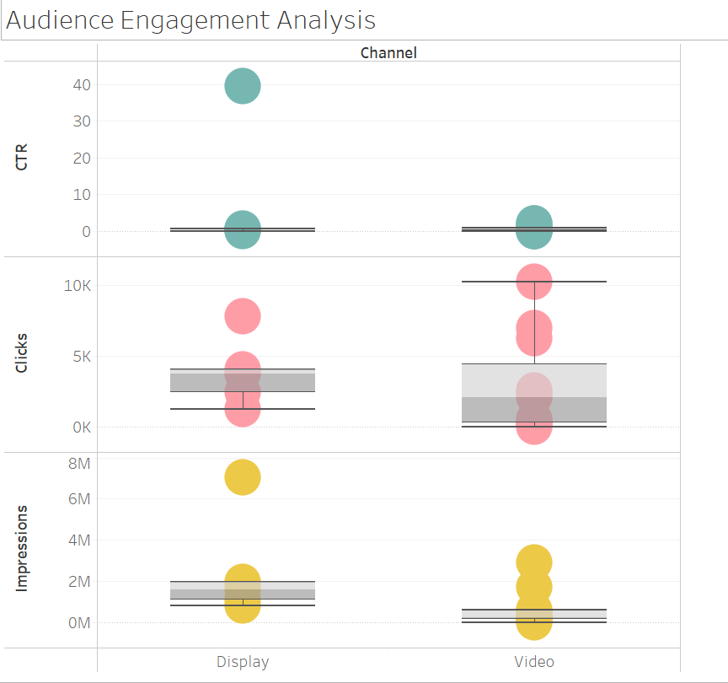
DCM Tableau Dashboard

Slide 14
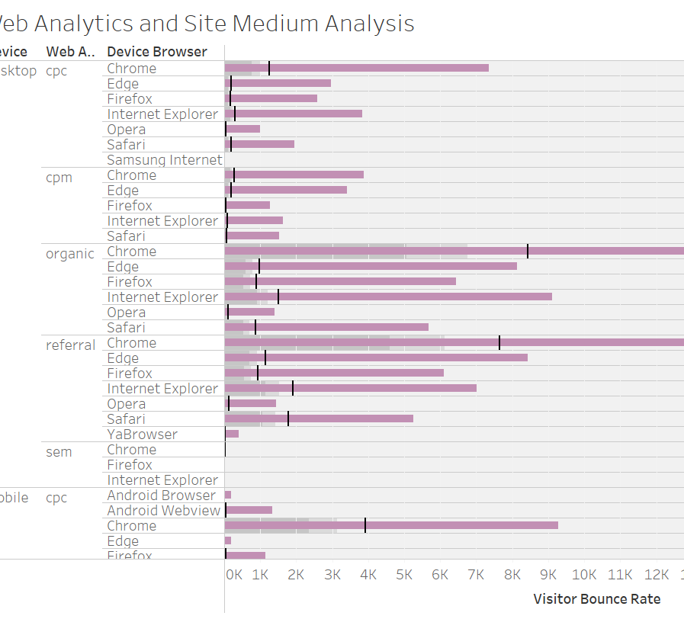
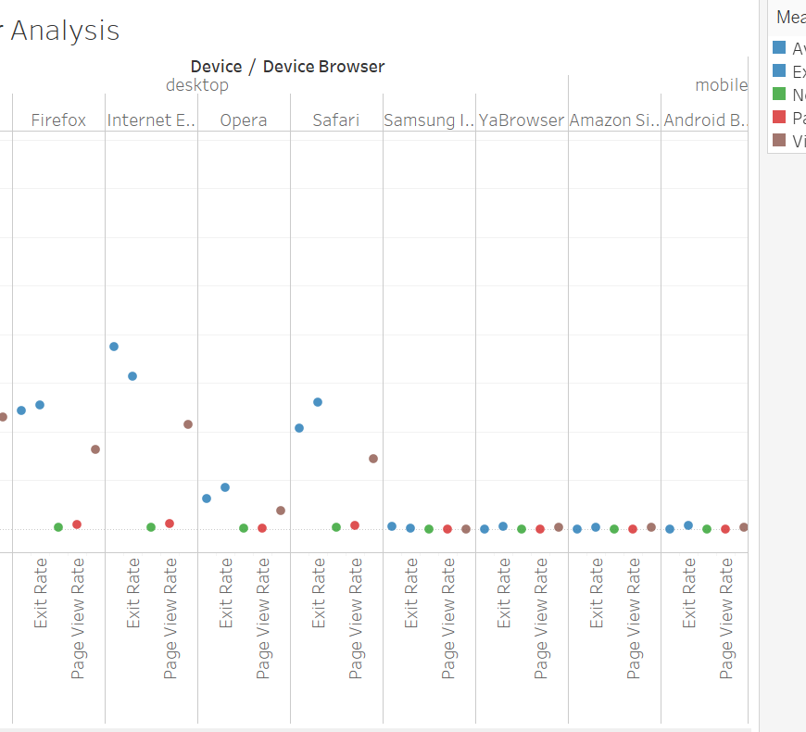
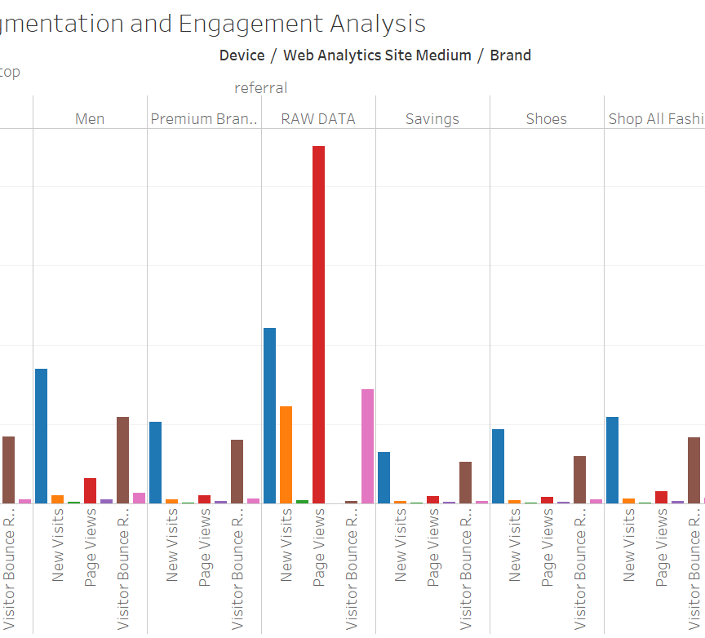
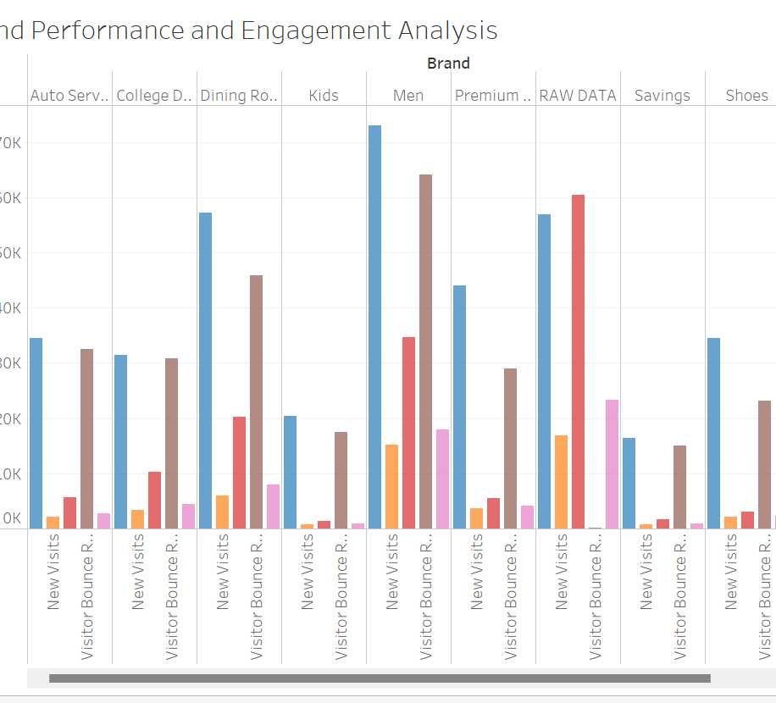
GA Tableau Dashboard

Slide 15
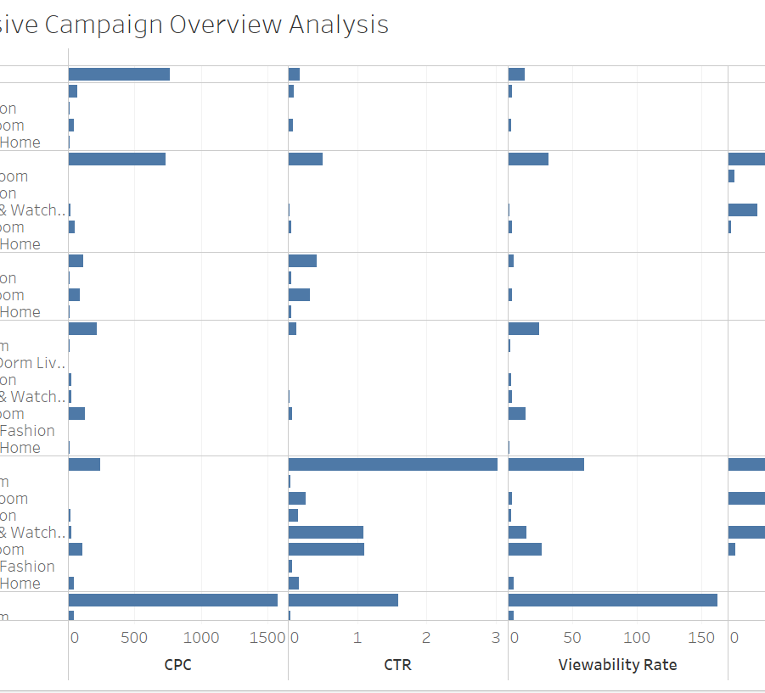
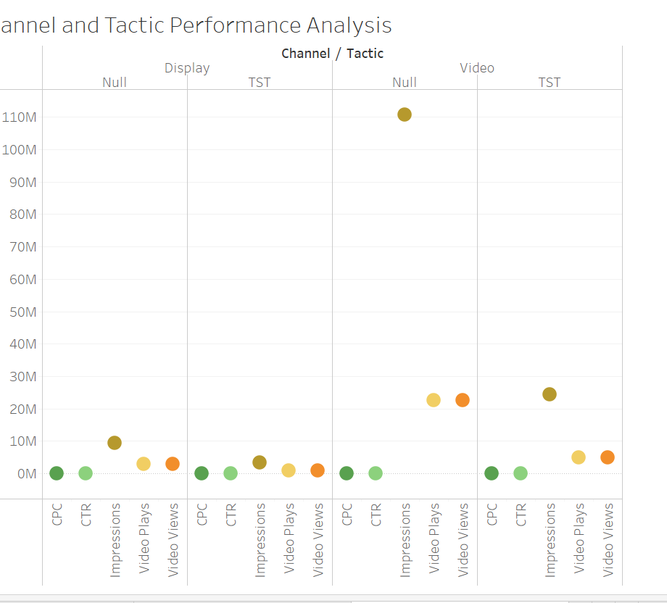
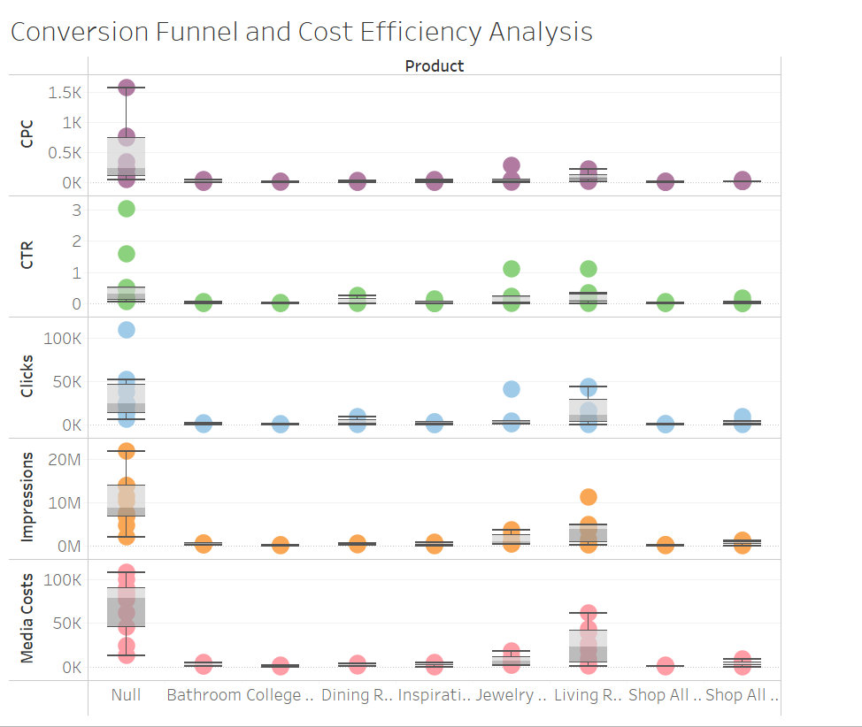
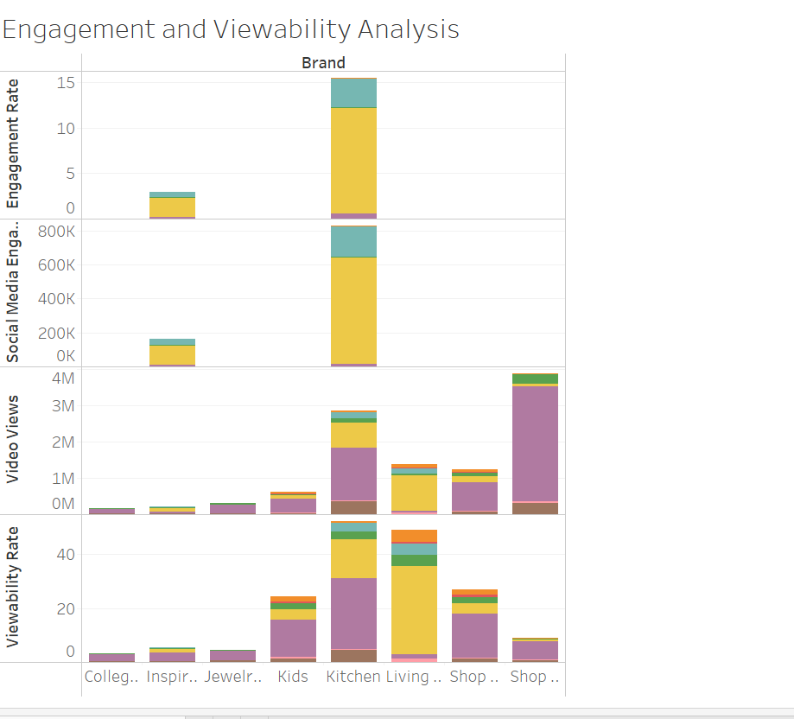
FB Tableau Dashboard

Slide 16

Thank you

