Slide 1
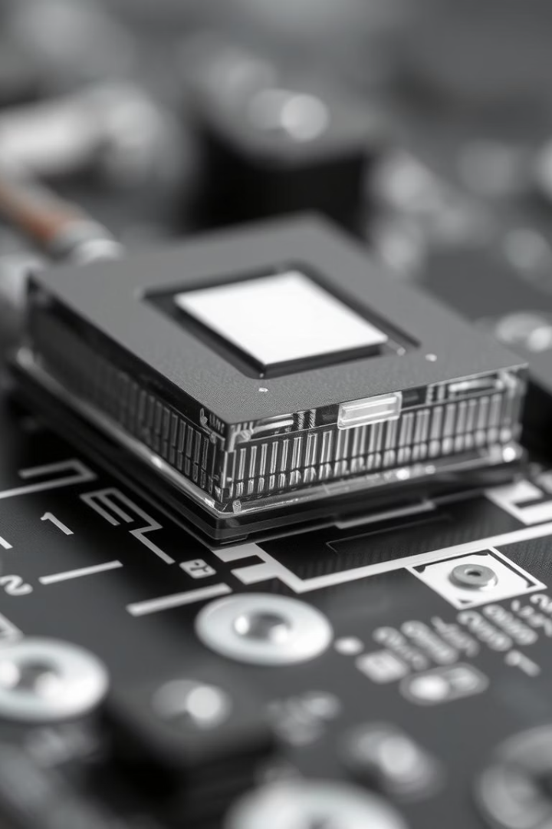
PN Junction Diode: The Basics
The PN junction diode is a fundamental electronic device. It controls current flow in circuits. Silicon and Germanium are common semiconductor materials. Diodes are used in rectifiers, signal processing, and LEDs.
B. Priyal
24bd1a26687
CSM -E

Slide 2
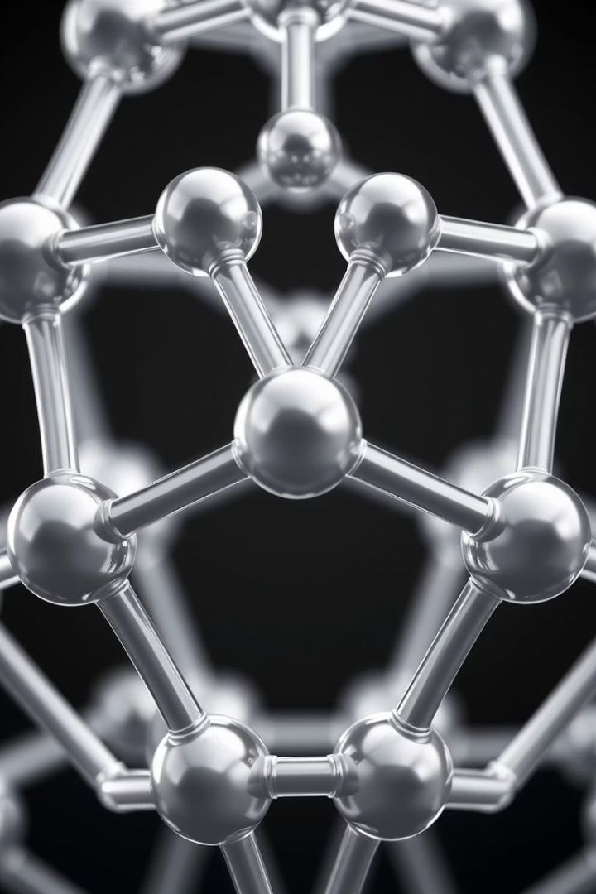
Semiconductors: Intrinsic Materials
Silicon Structure
Intrinsic Silicon
Each silicon atom bonds covalently with four neighbors.
Pure silicon with equal electrons and holes.
Electrical Properties
Limited conductivity at room temperature due to low carrier density.

Slide 3

Doping: Creating N-Type Semiconductor
What is Doping?
N-Type Semiconductor
Adding impurities to change electrical behavior of semiconductors.
Doped with pentavalent elements like phosphorus.
Extra free electrons
Electron concentration from 10¹⁵ to 10¹⁹ atoms/cm³
Increased conductivity

Slide 4
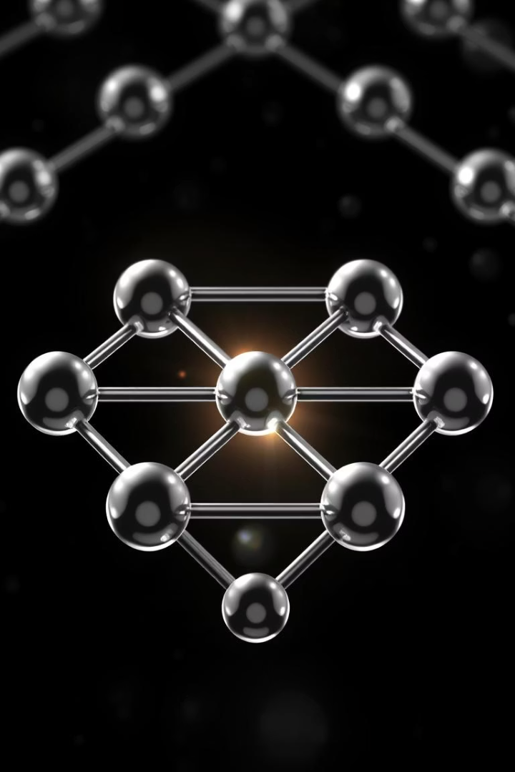
Doping: Creating P-Type Semiconductor
P-Type Semiconductor
Holes as Carriers
Electron vacancies act as positive charge carriers increasing conductivity.
Doped with trivalent impurities such as boron and gallium.
Hole Concentration
Ranges from 10¹⁵ to 10¹⁹ atoms/cm³.

Slide 5
The PN Junction Formation
Formation Process
Carrier Diffusion
P-type and N-type materials joined together form the PN junction.
Electrons diffuse from N to P side
Holes diffuse from P to N side
Recombination neutralizes carriers near the junction.

Slide 6
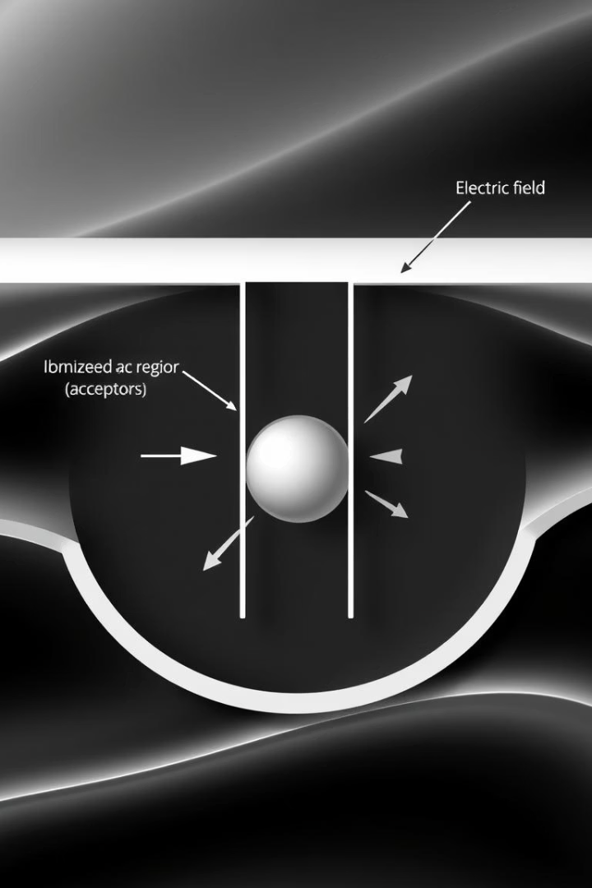
Depletion Region
Carrier-Free Zone
Electric Field
The depletion region lacks free charge carriers.
Created by ionized donor and acceptor atoms.
Barrier Potential & Width
Voltage: 0.7V for silicon, width ~0.5-1 µm.

Slide 7
Forward Bias
Connecting Voltages
1
Positive to P-side, negative to N-side.
Depletion Region Narrows
2
Current can now flow through the diode easily.
Turn-On Voltage
3
Starts significant conduction at ~0.7V for silicon.
Exponential Current Increase
4
Current rises exponentially with applied voltage.

Slide 8

Reverse Bias
Voltage Polarity
Negative to P-side, positive to N-side.
Depletion Region Widens
Current flow is effectively blocked.
Reverse Saturation Current
Small leakage due to minority carriers.
Breakdown Voltage
Voltage at which diode conducts in reverse direction.

Slide 9
Diode Characteristics Curve
Forward Region
Reverse Region
Temperature Effects
Current rises exponentially after turn-on voltage.
Small leakage current until breakdown voltage.
Leakage current increases, forward voltage drop decreases.

Slide 10





Applications of PN Junction Diodes
Rectifiers
Convert AC to DC power.
Signal Diodes
Handle small signals in circuits.
LEDs
Emit light when forward biased.
Voltage Regulation
Zener diodes control voltage levels.
Solar Cells
Convert light energy to electricity.

