Slide 1
Task Manager in various Operating Systems
By
D.Prateek (C9)
G. Abhinandan(CD)
G. Shivaram(CJ)
G.Sparshitha (CG)
G. Preethi (CH)

Slide 2
Introduction to Task Manager
A Task Manager is a software or feature found in operating systems such as Windows, macOS, and Linux, as well as in some mobile operating systems like Android and iOS
Its primary function is to provide users with a centralized interface to monitor and manage the various processes, applications, and services running on their computer or device.
It gives the information about the running application in the computers. Task manager which shows the running software status which includes CPU, Memory, Disk, Network, and power usage.
It serves as a valuable tool for troubleshooting system issues, optimizing performance, and managing system resources efficiently.

Slide 3

Windows - Task Manager
Shortcut: Ctrl + Shift + Esc
View and manage applications and processes.
Monitor CPU, RAM, disk, network, and GPU usage.
Start or terminate tasks.
Manage startup programs and logged-in users.

Slide 4
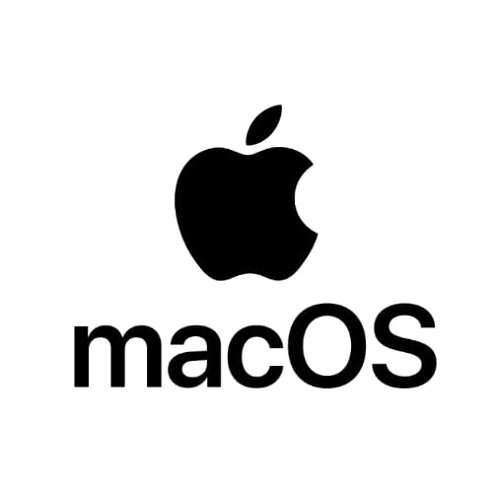
MacOS - Activity Monitor
Located in Applications → Utilities → Activity Monitor.
Monitors CPU, memory, energy, disk, and network usage.
Force quit unresponsive applications.
Provides real-time system resource monitoring.

Slide 5
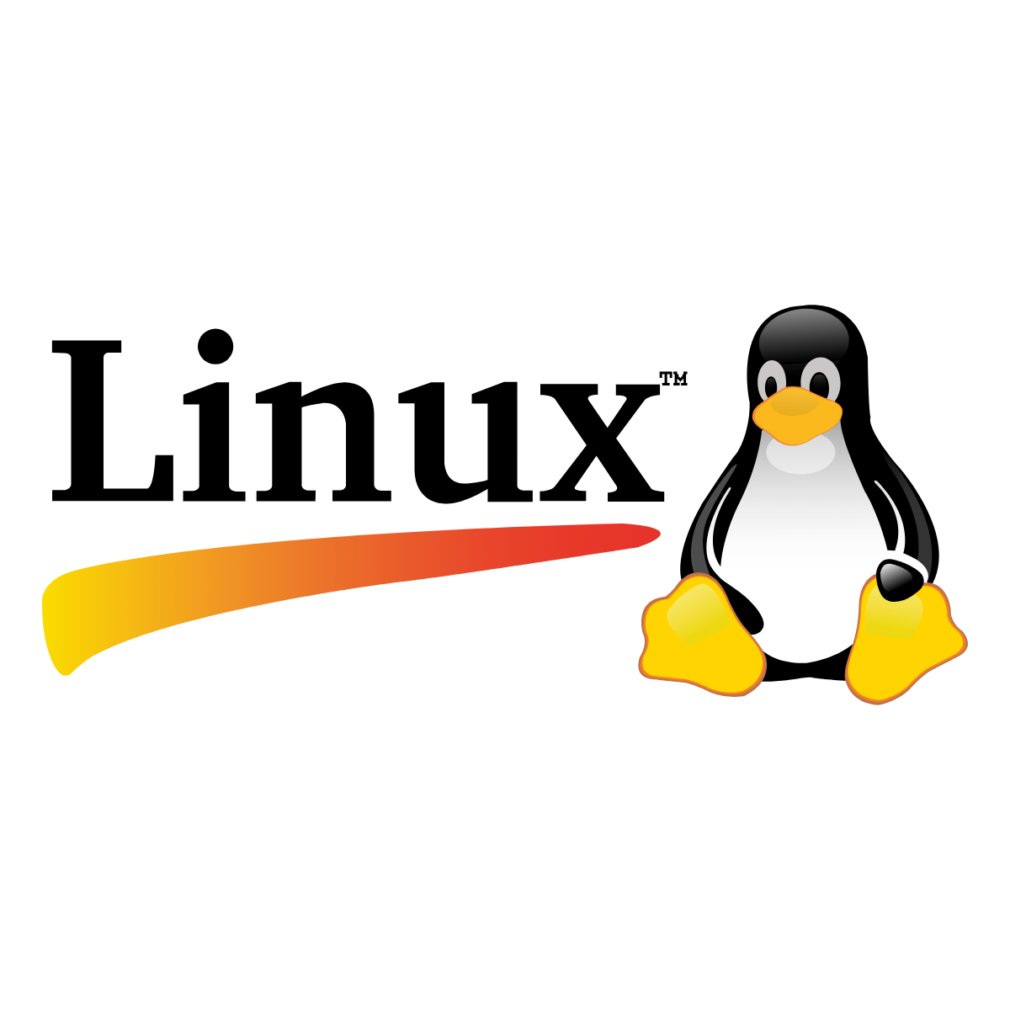
Linux - System Monitor/htop/top
GUI-based System Monitor for easy process management.
- htop (terminal-based) offers interactive monitoring.
- top (default terminal tool) lists running processes.
Start or terminate tasks.
- Install htop with: sudo apt install htop (Ubuntu).

Slide 6

Android - Developer Options Task Manager
Location: Settings → Developer Options → Running Services
Displays running apps and services.
Shows RAM usage per app.
Allows stopping background processes

Slide 7
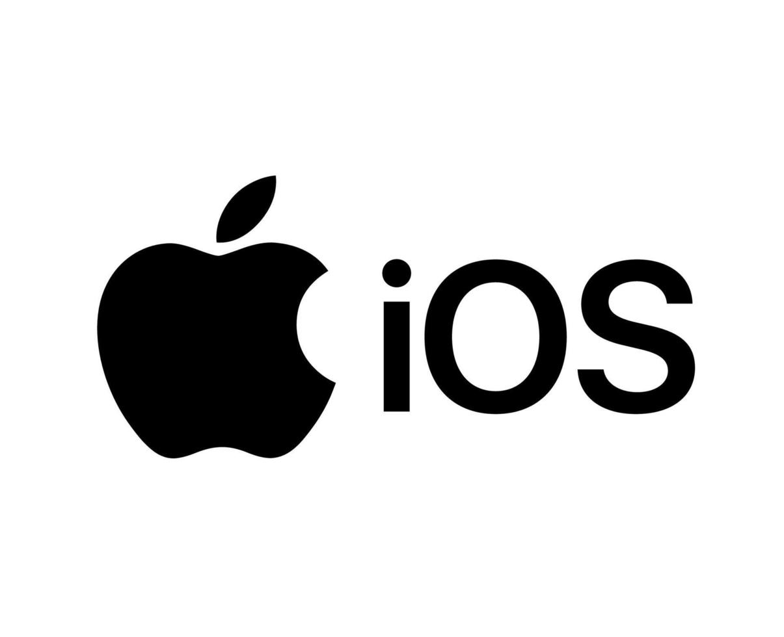
iOS - App Switcher & Battery Usage
No direct Task Manager, but App Switcher closes apps
Access App Switcher: Swipe up & hold or Double press Home Button
Battery Usage (Settings → Battery) shows background activity of apps
Battery Usage helps in identifying battery-draining applications

Slide 8
Comparison of Task Managers
Windows: Advanced with detailed system insights.
macOS: Clean interface with essential monitoring.
Linux: Best for advanced users via terminal tools.
Android: Limited app management via Developer Options.
iOS: Minimal user control, system handles optimization.

Slide 9
Conclusion
Task Managers help monitor and optimize system performance.
Different OS have their own task managers (Windows, macOS, Linux).
Common features include process control, resource monitoring, and force-stop.
Useful for both users (troubleshooting) and admins (advanced control).
Essential for optimizing performance and preventing crashes.
Knowing task managers helps in better system management.

