Slide 1


NEXT GEN EMPLOYABILITY PROGRAM
CREATING A FUTURE-READY WORKFORCE
Student Name :
Shiva Krishna Beeraboina
Student ID :
College Name :
STU642190e85137e1679921384
SR University

Slide 2
CAPSTONE PROJECT SHOWCASE
Project Title
P11: Voting Web Application using Django Framework
Abstract | Problem Statement | Project Overview | Proposed Solution | Technology Used | Modelling & Results | Conclusion | Q&A

Slide 3
Abstract
1
Traditional voting systems face numerous challenges, including security vulnerabilities, inefficiency, and limited accessibility.
2
Utilize web-based technologies and enhance voter participation and trust in the electoral system by leveraging modern technology.
3
Provide easy-to-use tools for administrators to handle tasks like voter registration, candidate profiles Management.
4
Overall the development of a modernized digital voting system represents a crucial step towards fostering democracy, transparency, and inclusivity in the electoral process.

Slide 4


Problem Statement
Current voting systems like ballot box voting or electronic voting has many faults like:
Vote Manipulation and Altering
Long queues during Elections
No Transparency
Time Consuming
High Expenditure and Energy
Consider an eligible voter goes to polling booth to cast his vote using EVM. Since, it is an electronic device one can easily tampers votes by installing malware in it. Also, the voter never knows whether his vote was recorded or not. Thus, there is no tracing back of our vote.
If elections are held by using ballot boxes then it requires lot of paper work, and consumes more time also cost expenditure is very high.

Slide 5


Project Overview
ADMIN(EC)
Allow administrators to add candidates with their details such as name, age, gender, education, photo, party name, party symbol, start time, and end time.
Provide functionality to delete candidates if needed.
VOTING INTERFACE
Display list of candidates to the voters.
Allow voters to caste vote to their preferred candidate.
Ensuring voting process happens in stipulated time.
Live Updates
Display live updates of election results, including vote count for each candidate.
Admin
Add Candidates
Delete Candidates
Name: XYZ
Password:
********
Vote for:
TRS
BJP
VOTE

Slide 6
Proposed Solution
GOAL
We aim to address the shortcomings of traditional voting methods by leveraging modern technologies to ensure the integrity of the electoral process.
APPROACH
Develop an online voting platform accessible to eligible voters via web or mobile devices.
Provide a user-friendly interface for voters to cast their votes securely from anywhere with internet access.
Allow Admin(EC) to add and delete the candidates and provide stipulated time for Election.
Display the vote count for each candidate publicly, allowing voters to verify the accuracy of the election outcome
HOW DOES IT OVERCOME EXISTING PROBLEM
Online voting enables voters to cast their votes remotely, reducing the need for physical presence at polling booths and minimizing waiting times.
Real-time election results and public vote counts provide transparency and accountability, allowing voters to trust the integrity of the electoral process.
Streamlined voting processes and efficient technologies minimize the time required for casting and counting votes, ensuring timely election results.
By transitioning to a digital voting system, we eliminate the need for paper-based materials and physical infrastructure, reducing costs and environmental impact.

Slide 7
Technology used
FRONT-END
HTML-5
CSS-3
BootStrap
TailWind CSS
Java Script
BACK-END
Python Django FrameWork
MYSQL DataBase

Slide 8

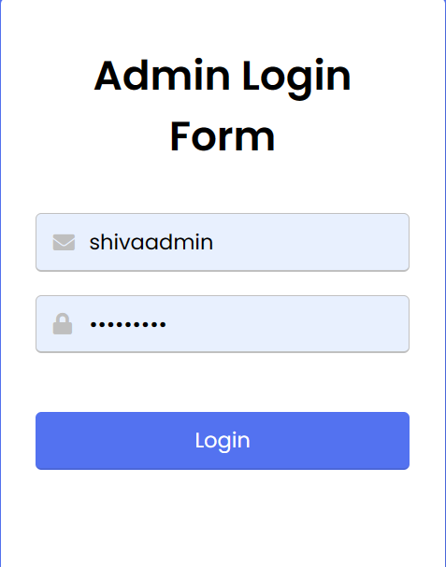
Modelling & Result

Slide 9
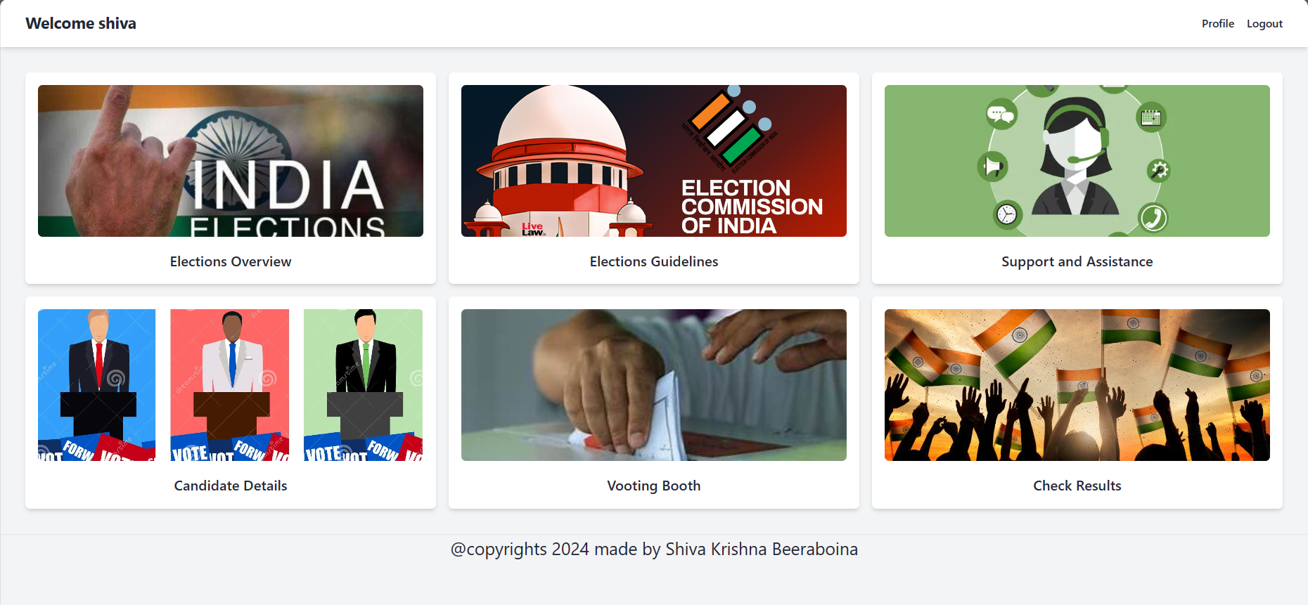

Modelling & Result

Slide 10
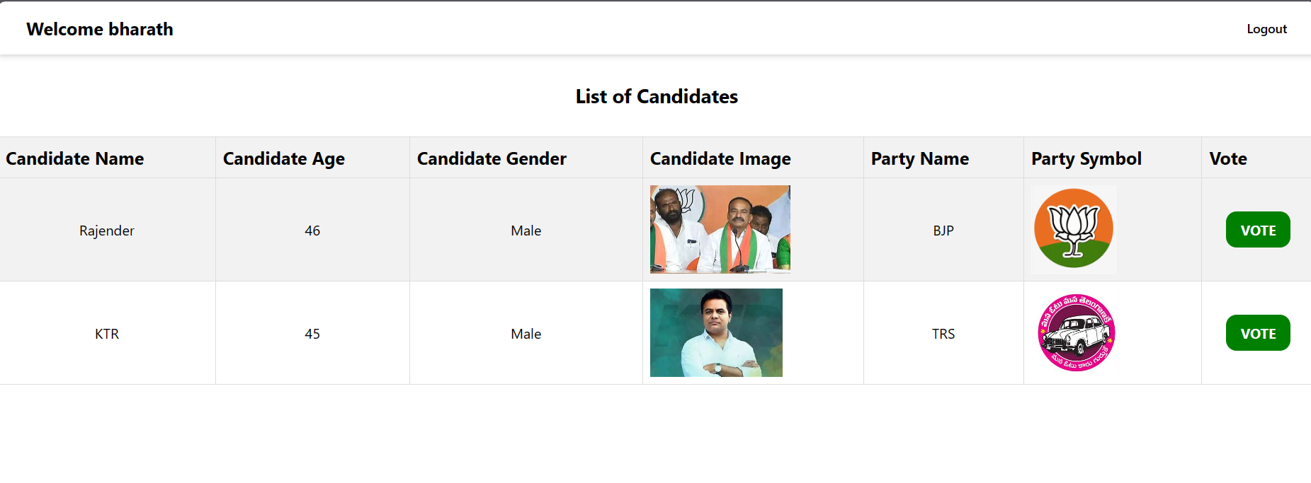
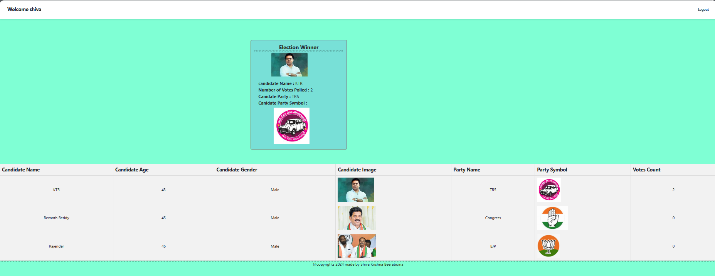
Modelling & Result

Slide 11

Conclusion
By enabling online voting, we enhance accessibility for voters, allowing them to cast their votes conveniently from any location with internet access, thereby increasing voter participation.
Real-time tracking of election results and public verification of vote counts promote transparency and trust in the electoral process, while streamlined procedures reduce administrative burdens and costs.
FUTURE SCOPE
1. Integration with Biometric Authentication: Implementing biometric authentication, such as fingerprint or facial recognition, can further enhance the security and reliability of the voting system, ensuring that only eligible voters can participate.
2. Expansion to Mobile Voting: Developing mobile applications for voting can broaden accessibility, especially among younger demographics who are more accustomed to using smartphones for various activities.
3. Enhanced Data Analytics: Leveraging data analytics and machine learning algorithms can provide deeper insights into voter behavior and preferences, enabling more informed decision-making and targeted outreach campaigns in future elections.

Slide 12


Notes:
Thank You !!

