Slide 1
Forecasting GDP of USA
ECON M524 – Financial Econometrics
By Shiva Kumar Pendem
INDIANA UNIVERSITY BLOOMINGTON

Slide 2
Introduction
GDP (Gross Domestic Product) is the overall market value of all the goods and services a country produces.
Measures Economy*
Rising GDP indicates the economy is growing

Slide 3

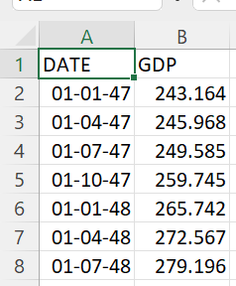
Data Description
Data Description
Data Source: https://fred.stlouisfed.org/series/GDP
‘GDP.csv’ has 2 columns DATE and GDP
DATE - Every quarter from Jan ‘47 to July ’22
GDP - GDP of every quarter

Slide 4
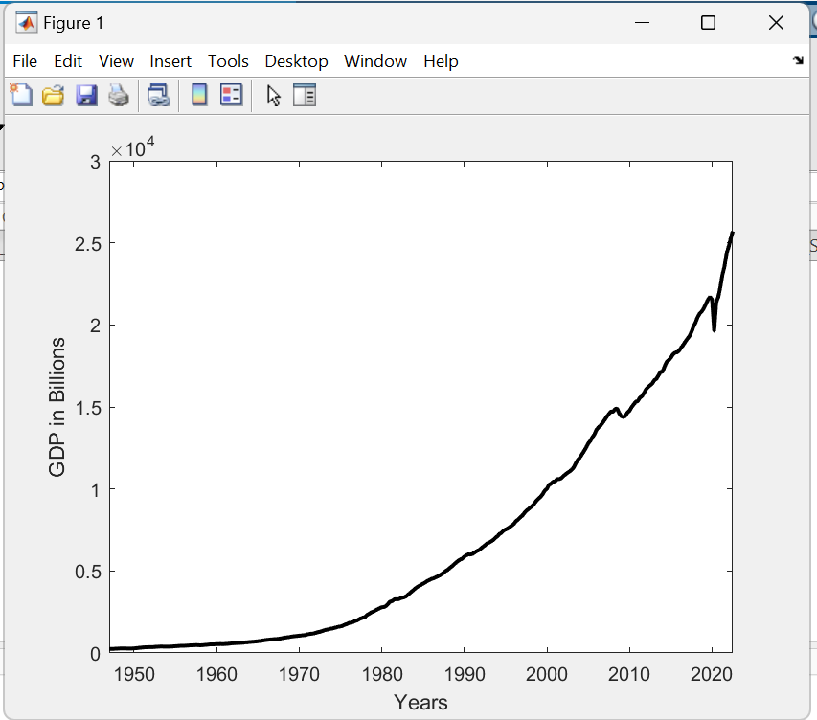
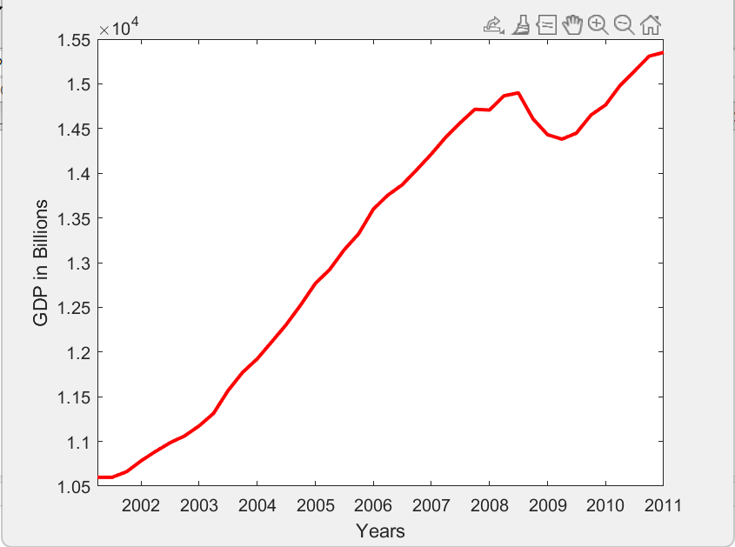
Research Method
EDA

Slide 5
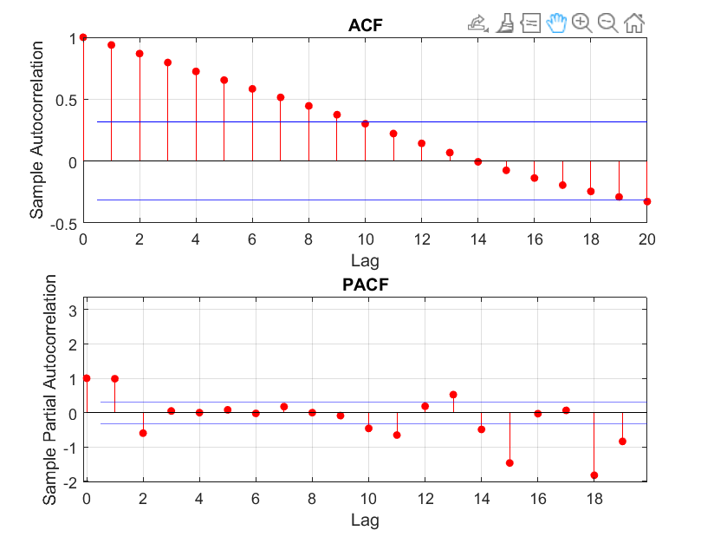
Research Method

Slide 6
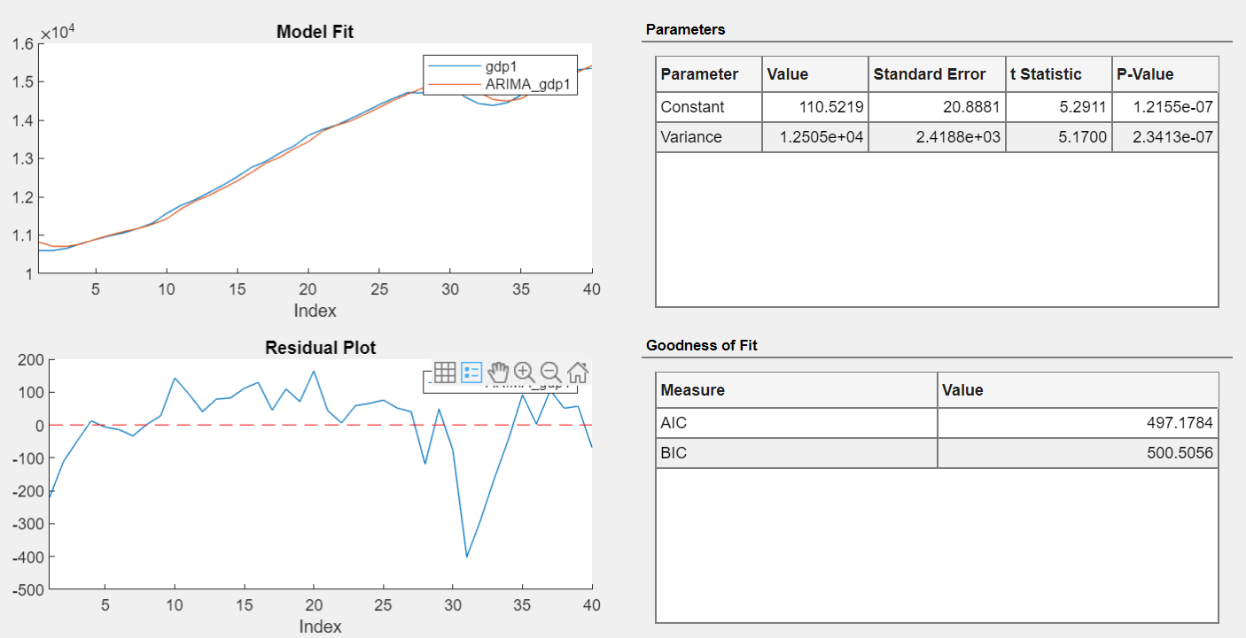

Slide 7
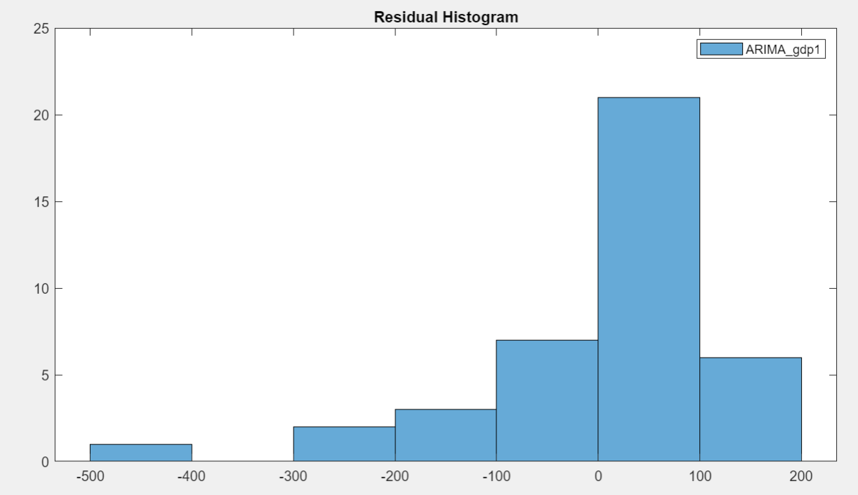
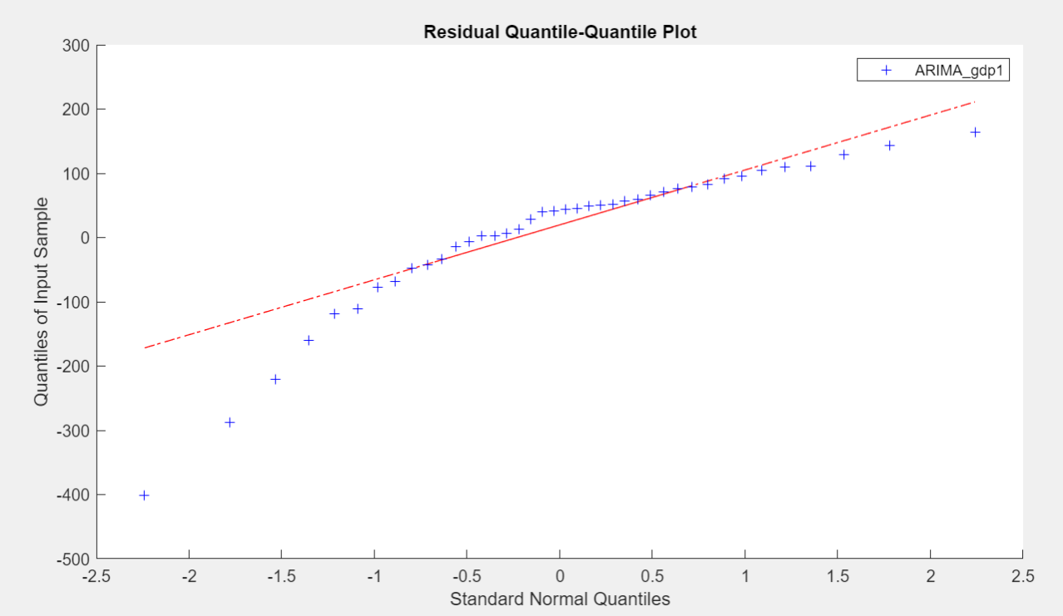

Slide 8
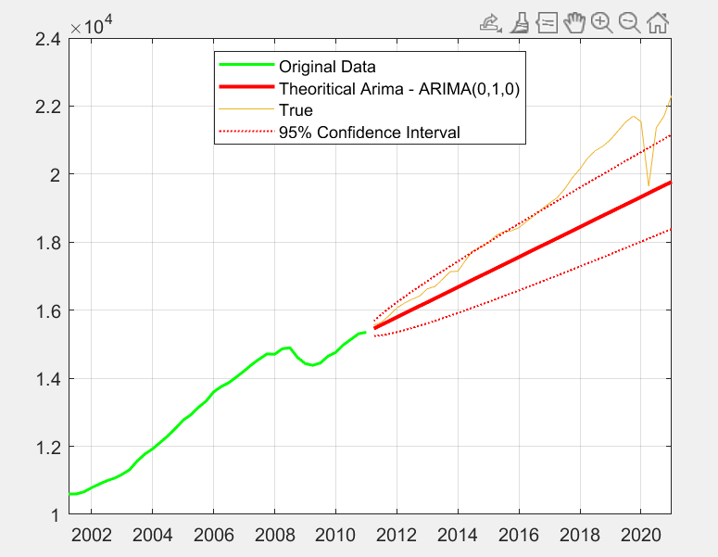
Research Method

Slide 9
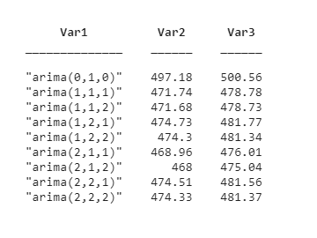
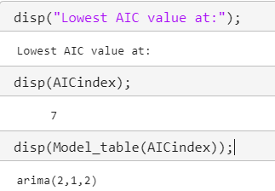
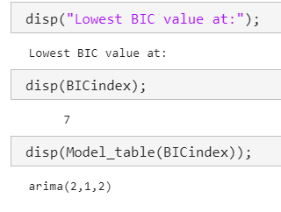
Research Method

Slide 10
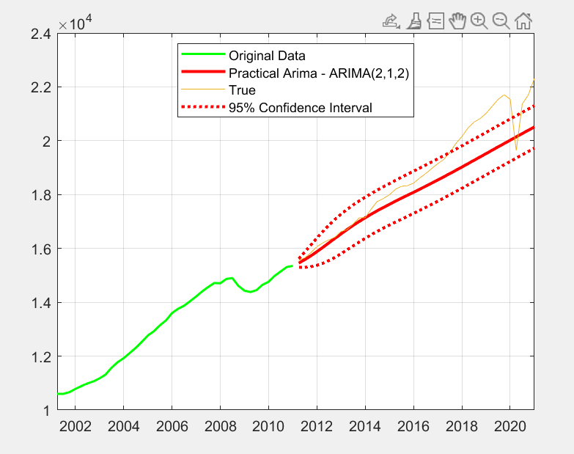
Research Method

Slide 11
Research Method

Slide 12
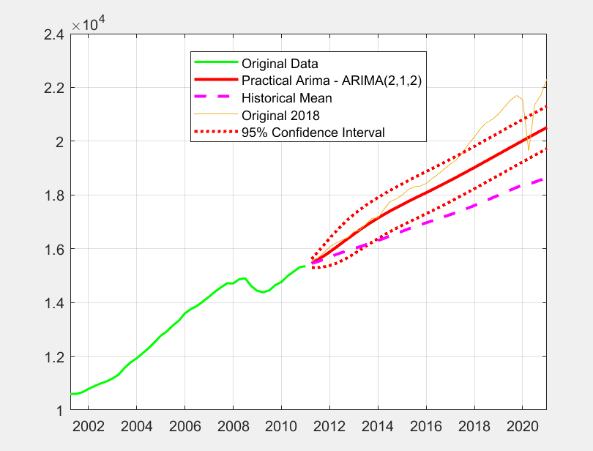
Research Method

Slide 13
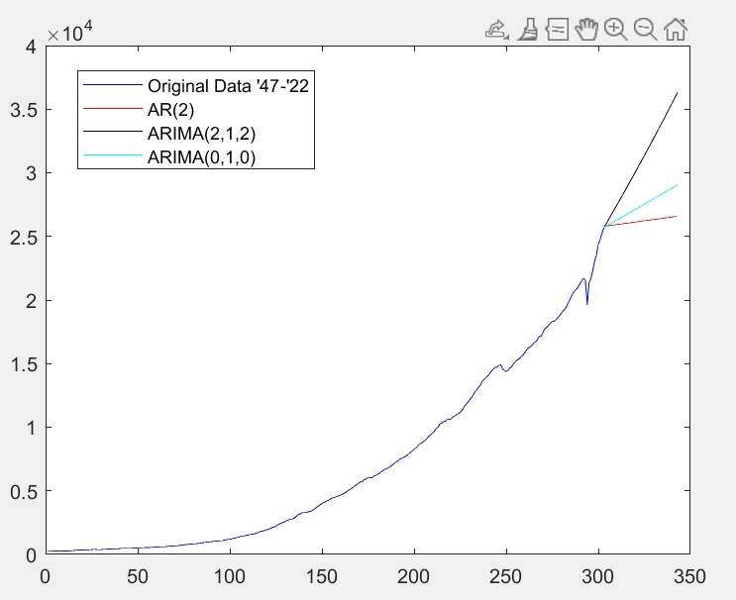
Research Method

Slide 14
Conclusion
ARIMA models are easy and versatile to use.
Lot of Data, Lot of Computation → For accurate results
Facebook’s Prophet Library → More accurate

Slide 15
Thank you

