Slide 1
Eka Automation Application
User Guide & Demo Walkthrough

Slide 2
Overview
The Eka Automation Application is designed to significantly reduce repetitive engineering workload through intelligent, centralized automation.
Daily Image Loading - Automated, zero-touch batch processing of VS testing images replacing manual CLI operations.
Batch Runs - Streamlined execution of multiple test configurations defined via YAML testbeds.
Advanced Regression Testing:
Parallel Execution: Run multiple SpyTest scripts simultaneously against discrete topologies.
Optimized DUT Usage: The system automatically manages Device Under Test (DUT) allocation and prevents resource conflicts.
Centralized Logging: Real-time streaming and storage of raw execution logs for rapid debugging and RCA.

Slide 3
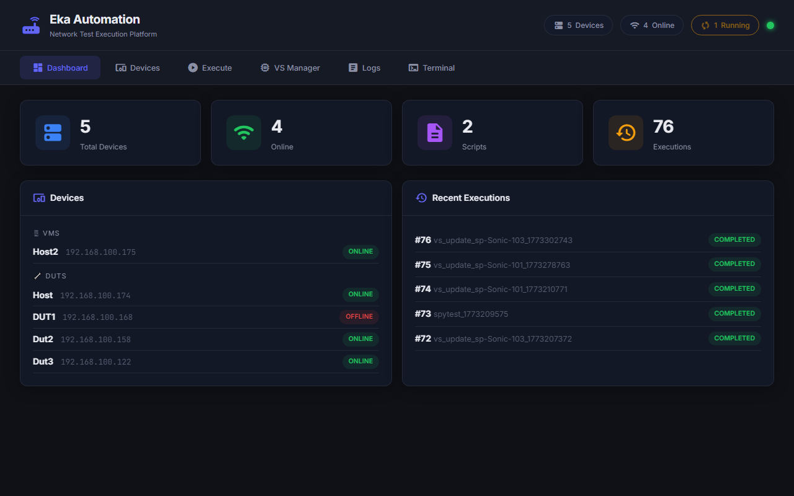
Dashboard
Total Devices Dashboard: The central control plane landing page providing an immediate pulse check on your lab infrastructure.

Slide 4
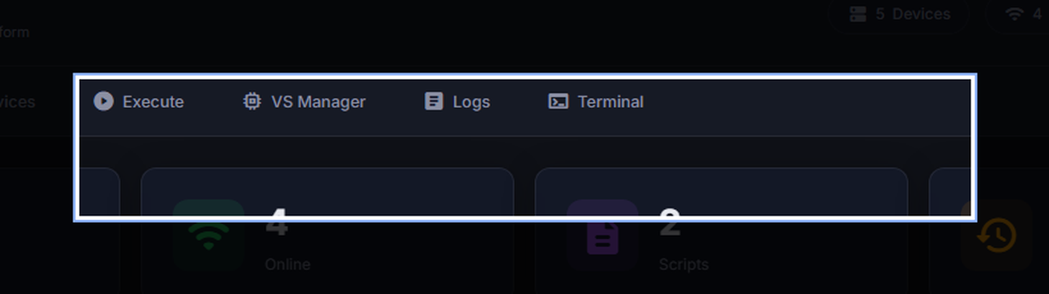
Dashboard: Core Metrics
4 Core Metrics:
Total Devices: Total sum of registered IPs/Hostnames in the application database.
Online: Result of the live background heartbeat ping checking node reachability.
Scripts: Total test case scripts discovered from the connected Git Spytest repositories.
Executions: Lifelong test runs triggered through the platform.

Slide 5
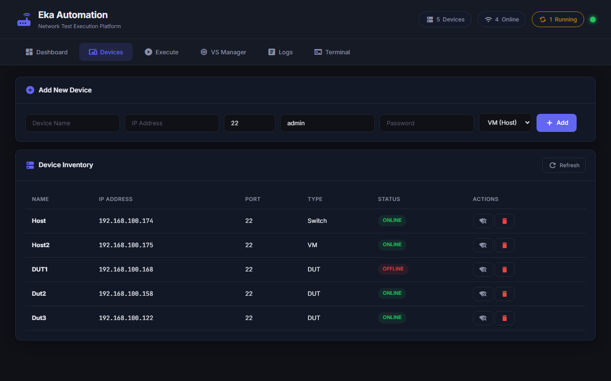
Devices
Manage the entire testing infrastructure inventory from this single pane of glass.

Slide 6
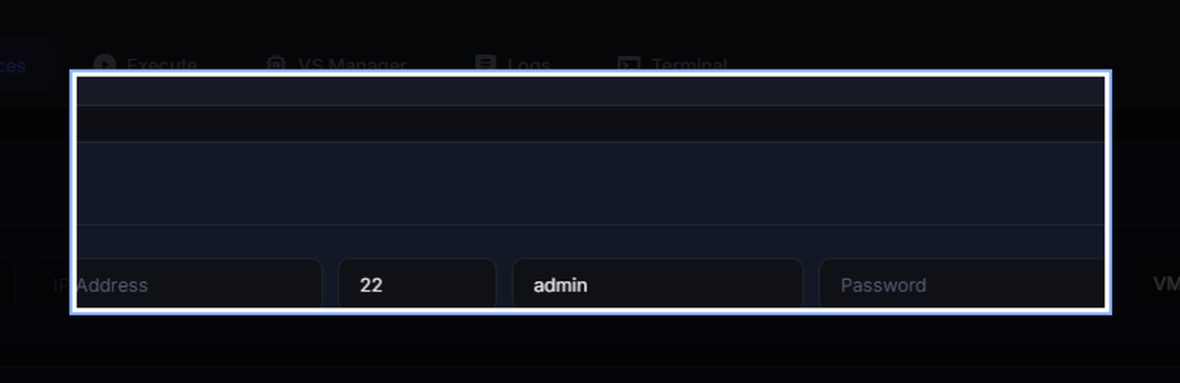
Devices: Provisioning
Adding a New Device: This top section handles the secure ingestion of new testbed members into the database.
Name / IP / Port: System requires unique Device Name string. IP Validated. Port field auto-defaults to 22.
Credentials: Standard login parameters. Passwords encrypted at rest.
Type Selection Dropdown: VM (Host), DUT, or Switch/Router.

Slide 7
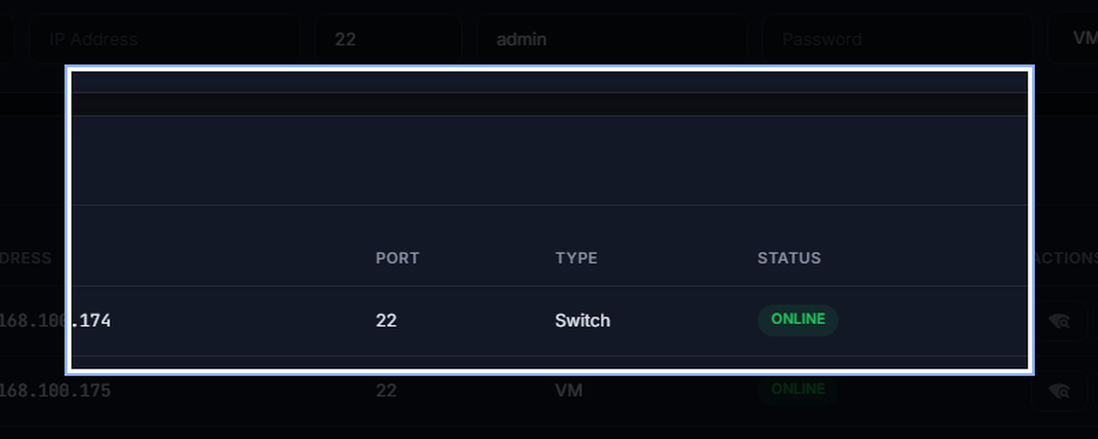
Devices: Management
Inventory & Operations: The lower grid provides a comprehensive, filtered layout of the entire mapped lab topology.
Live Status Checks: The Status column represents the last known heartbeat. Wi-Fi icon triggers on-demand validation.
Decommissioning: Trash bin instantly purges records.

Slide 8
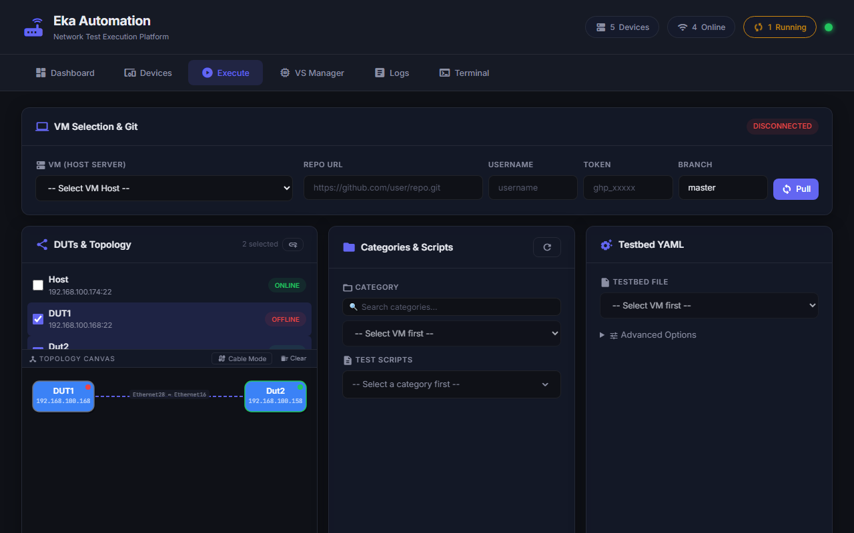
Execution
The core engine room. Configure, map, and dispatch complex testing pipelines.

Slide 9
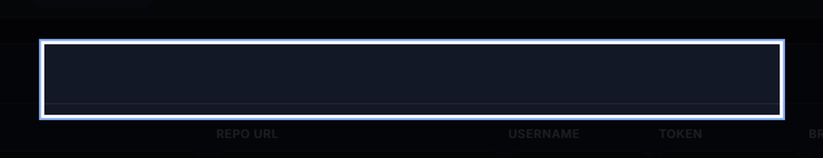
Execution: Git Sync
Host Server Selection: Bind the script to a physical host before proceeding.
Git Orchestration Layer: Provide Git Clone URL, Access Token, and Branch. Trigger backend worker to SSH, clone, and index scripts.

Slide 10
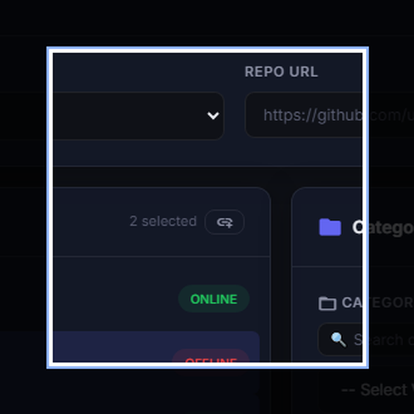
Execution: Topologies
Dynamic Mapping: Selected DUTs spawn as draggable interface nodes on the canvas.
Cable Mode Routing: Enter linking state, drag from source port to destination port to draw a physical link line, resetting as needed.

Slide 11
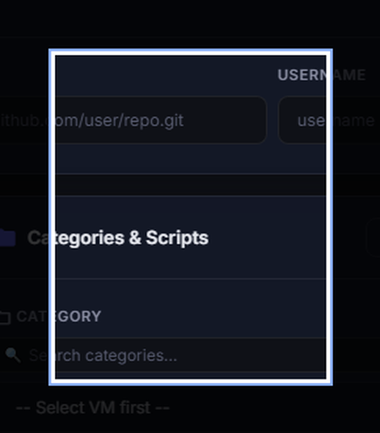
Execution: Target Setup
Script Selection (Center Panel): Select Category to auto-fill Test Scripts. Check multiple scripts to batch regression test queue.
Testbed Definition (Right Panel): Select the YAML Testbed file instructing the SpyTest engine on layout.

Slide 12
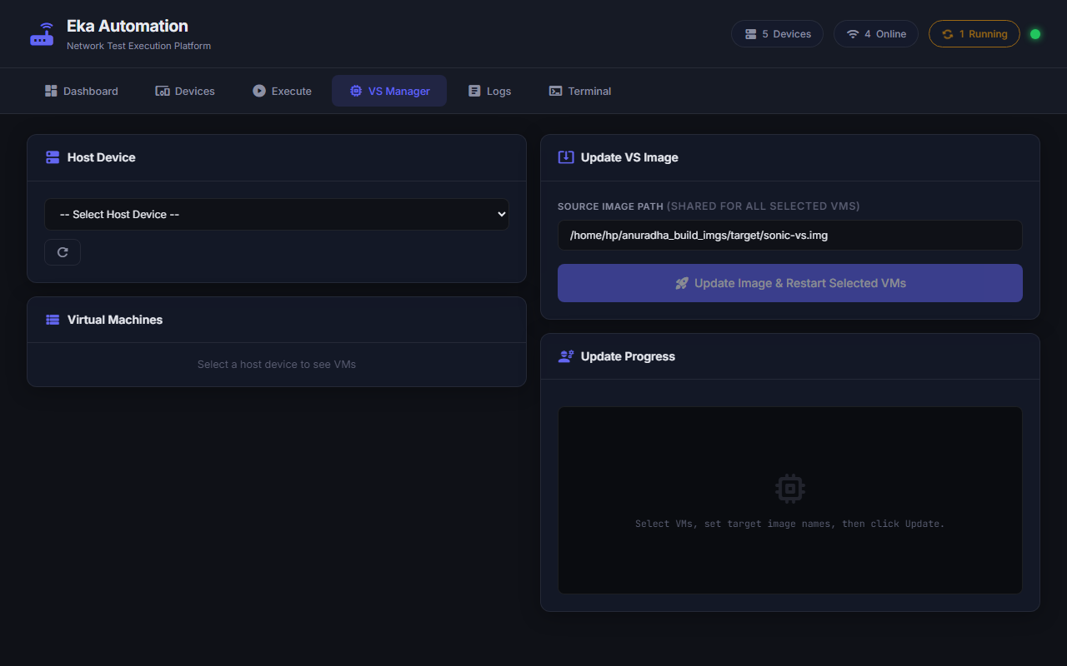
VS Manager
Automates the painful process of updating firmware images across massive virtual simulation banks.

Slide 13
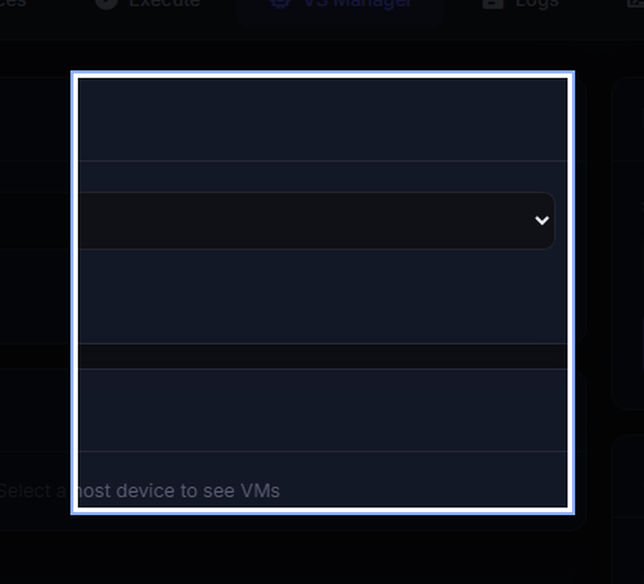
VS Manager: Update Workflow
Discovery & Targeting: Queries the host server and spins up a list of all active Virtual Machines detected. Select VMs.
Update Lifecycle Workflow: Enter the absolute file path to the fresh image, and the system halts, copies, and re-initializes the VMs securely.

Slide 14
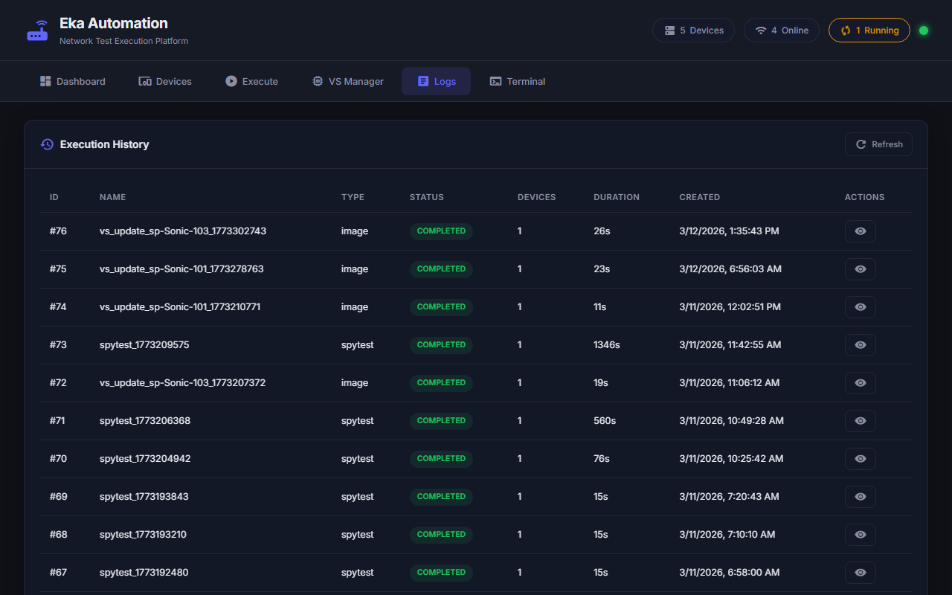
Logs
The permanent system-of-record for every automated event in the platform.

Slide 15
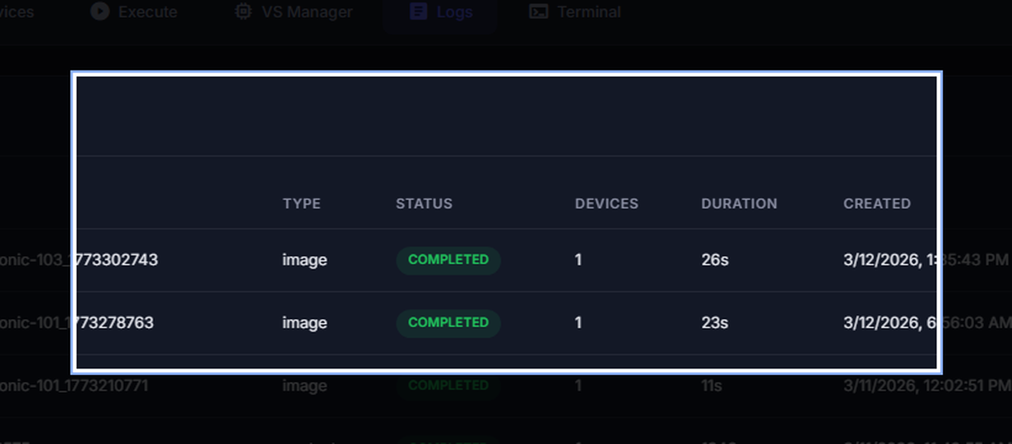
Logs: Forensic Inspection
Execution History Matrix: Grid of iterations tracking duration, targets, timestamps, and pass/fail outcomes.
Deep Dive Inspection: Clicking a row pulls the raw console output trace for Engineering RCA.
Export Utility: Download packages the raw logs safely for Jira/Emails.

Slide 16
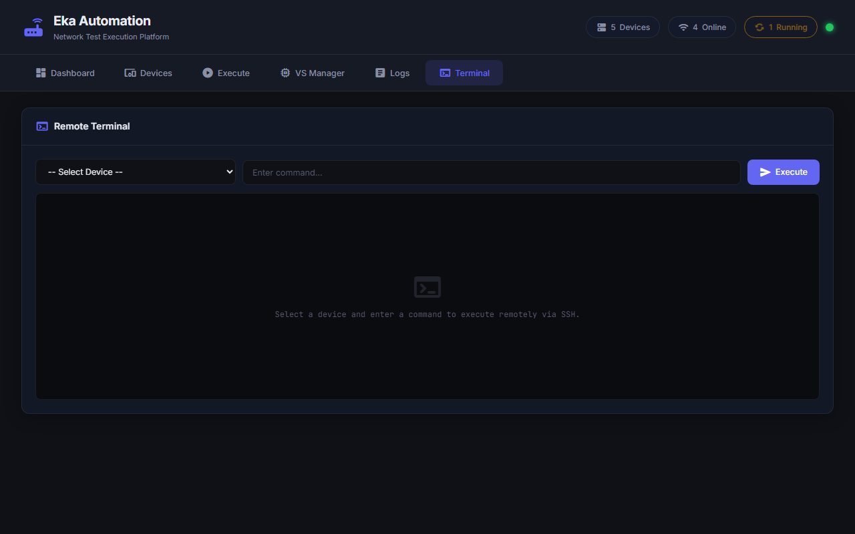
Terminal Integration
Integrated Remote bash Web CLI bridges the gap without breaking workflow.

Slide 17
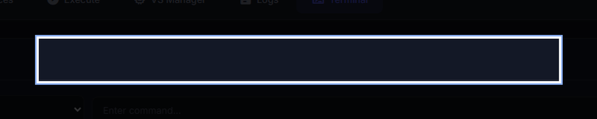
Terminal: Direct Dispatch
Direct Routing: Select target device to asynchronously broker a direct SSH tunnel.
Command Dispatch: Type raw shell statements (ifconfig, show run). Pipeline returns near instantaneous results verifying switch state.

