Slide 1
PBL - JAVA PROGRAMMING
VEHICLE RENTAL SYSTEM
TEAM – 7
Shiva Naga Chander R - 22EG105A63
Nihal B - 22EG105A62
Dheeraj Sai S - 22EG105A54
Nikhil Reddy M - 22EG105A37

Slide 2
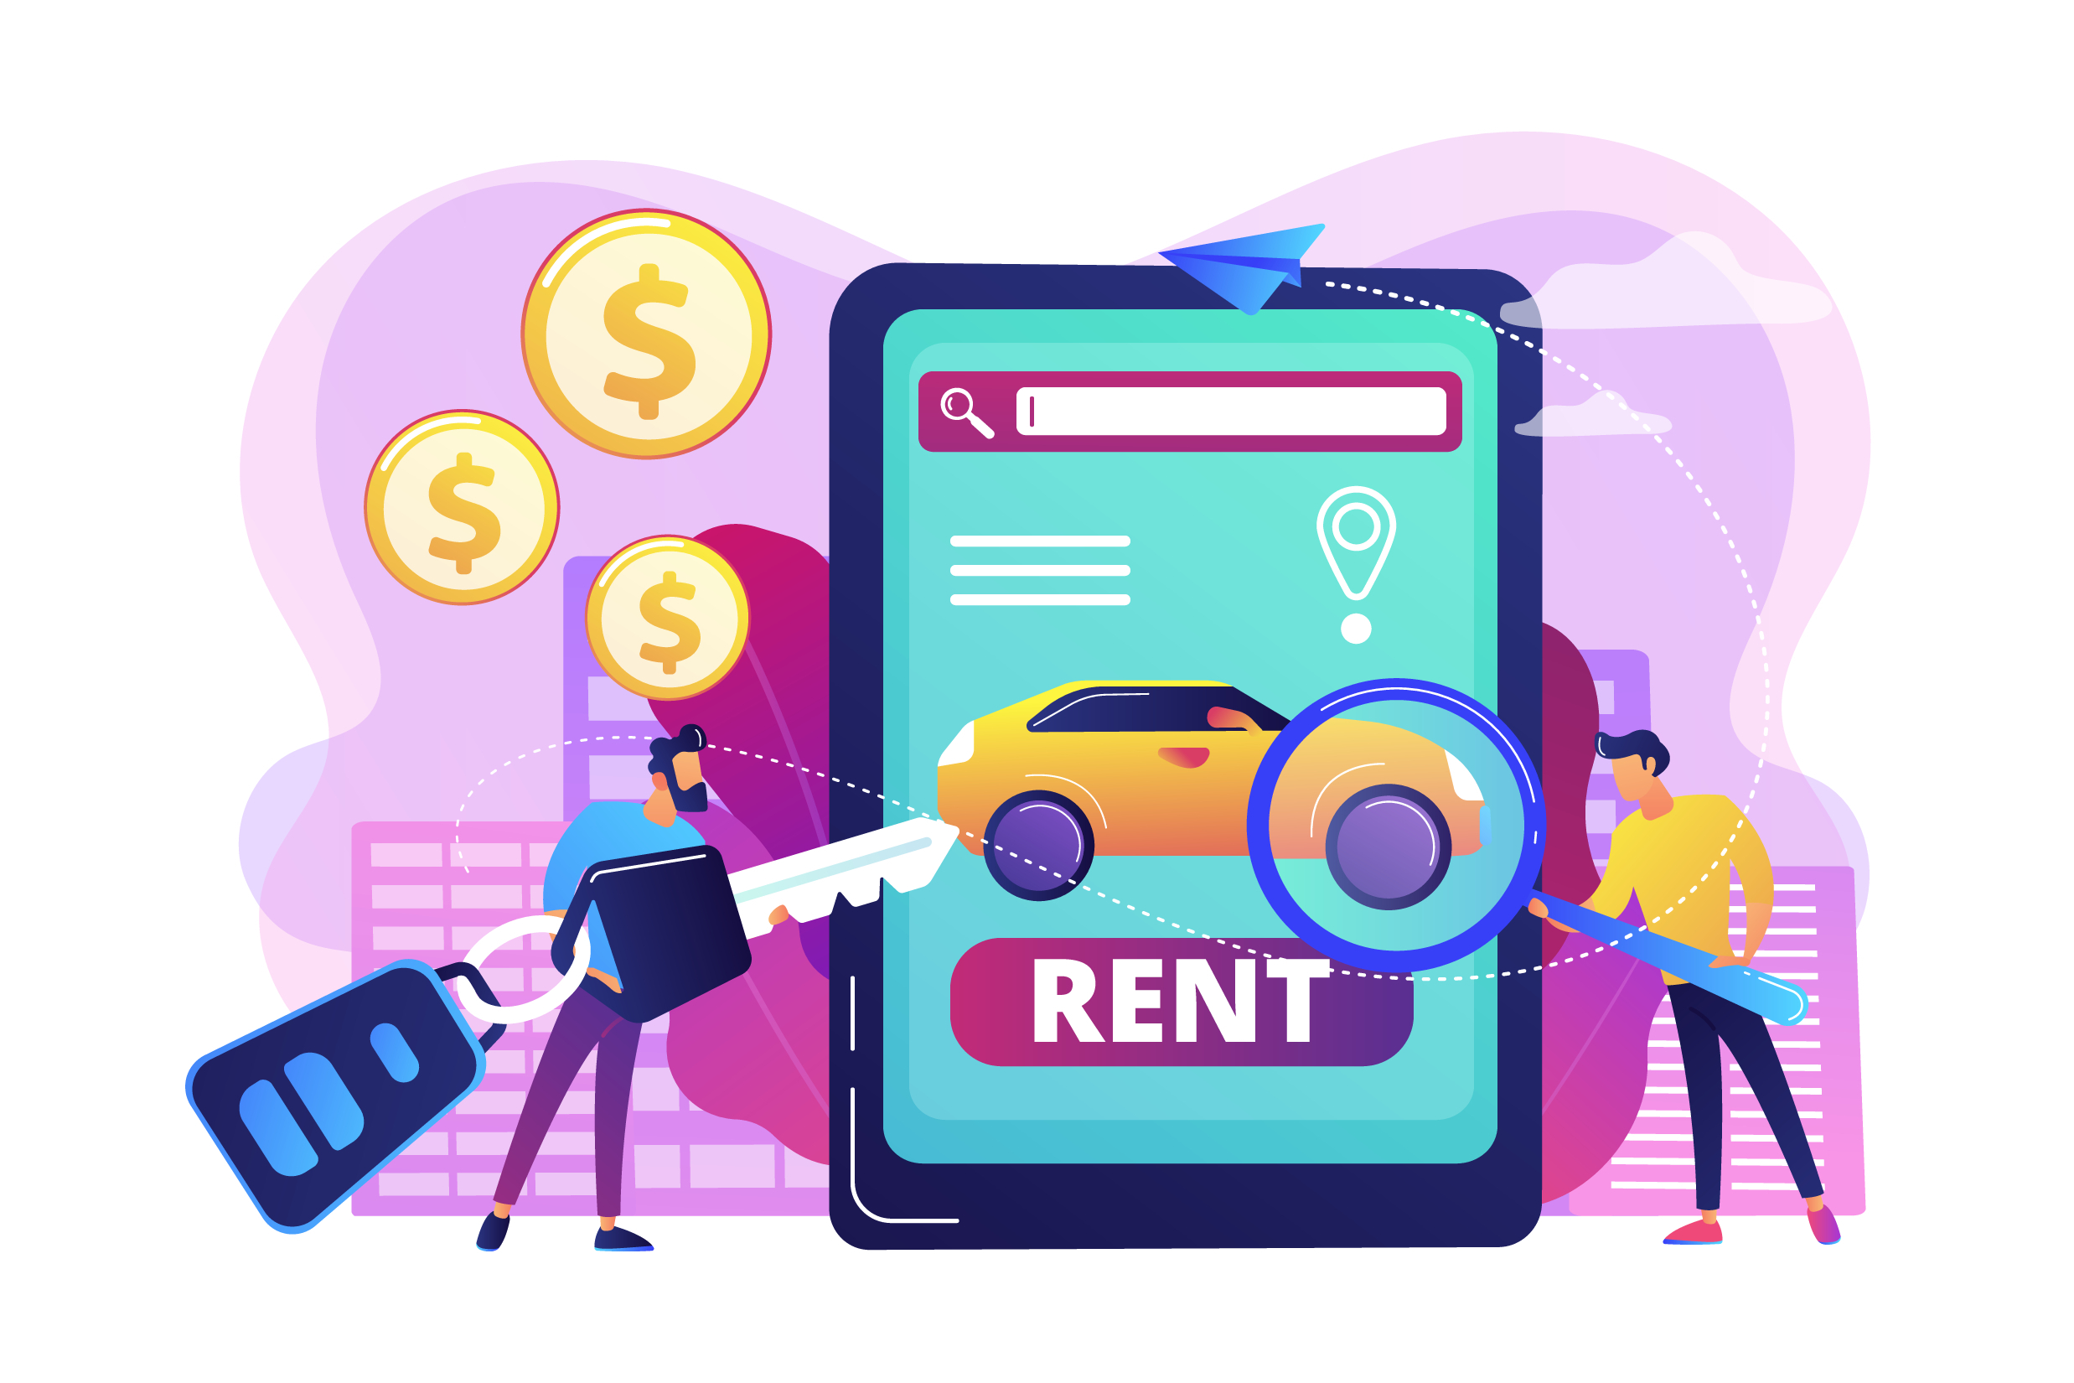
PROJECT DESCRIPTION:
Our project is a Vehicle Rental System designed to facilitate the renting of two-wheelers and four-wheelers. It allows users to view available vehicles and book them for a specified duration , and add new vehicles to the system.
PURPOSE:
The purpose of this project is to provide a convenient and efficient platform for users to rent vehicles for various purposes such as commuting, leisure, or travel.

Slide 3
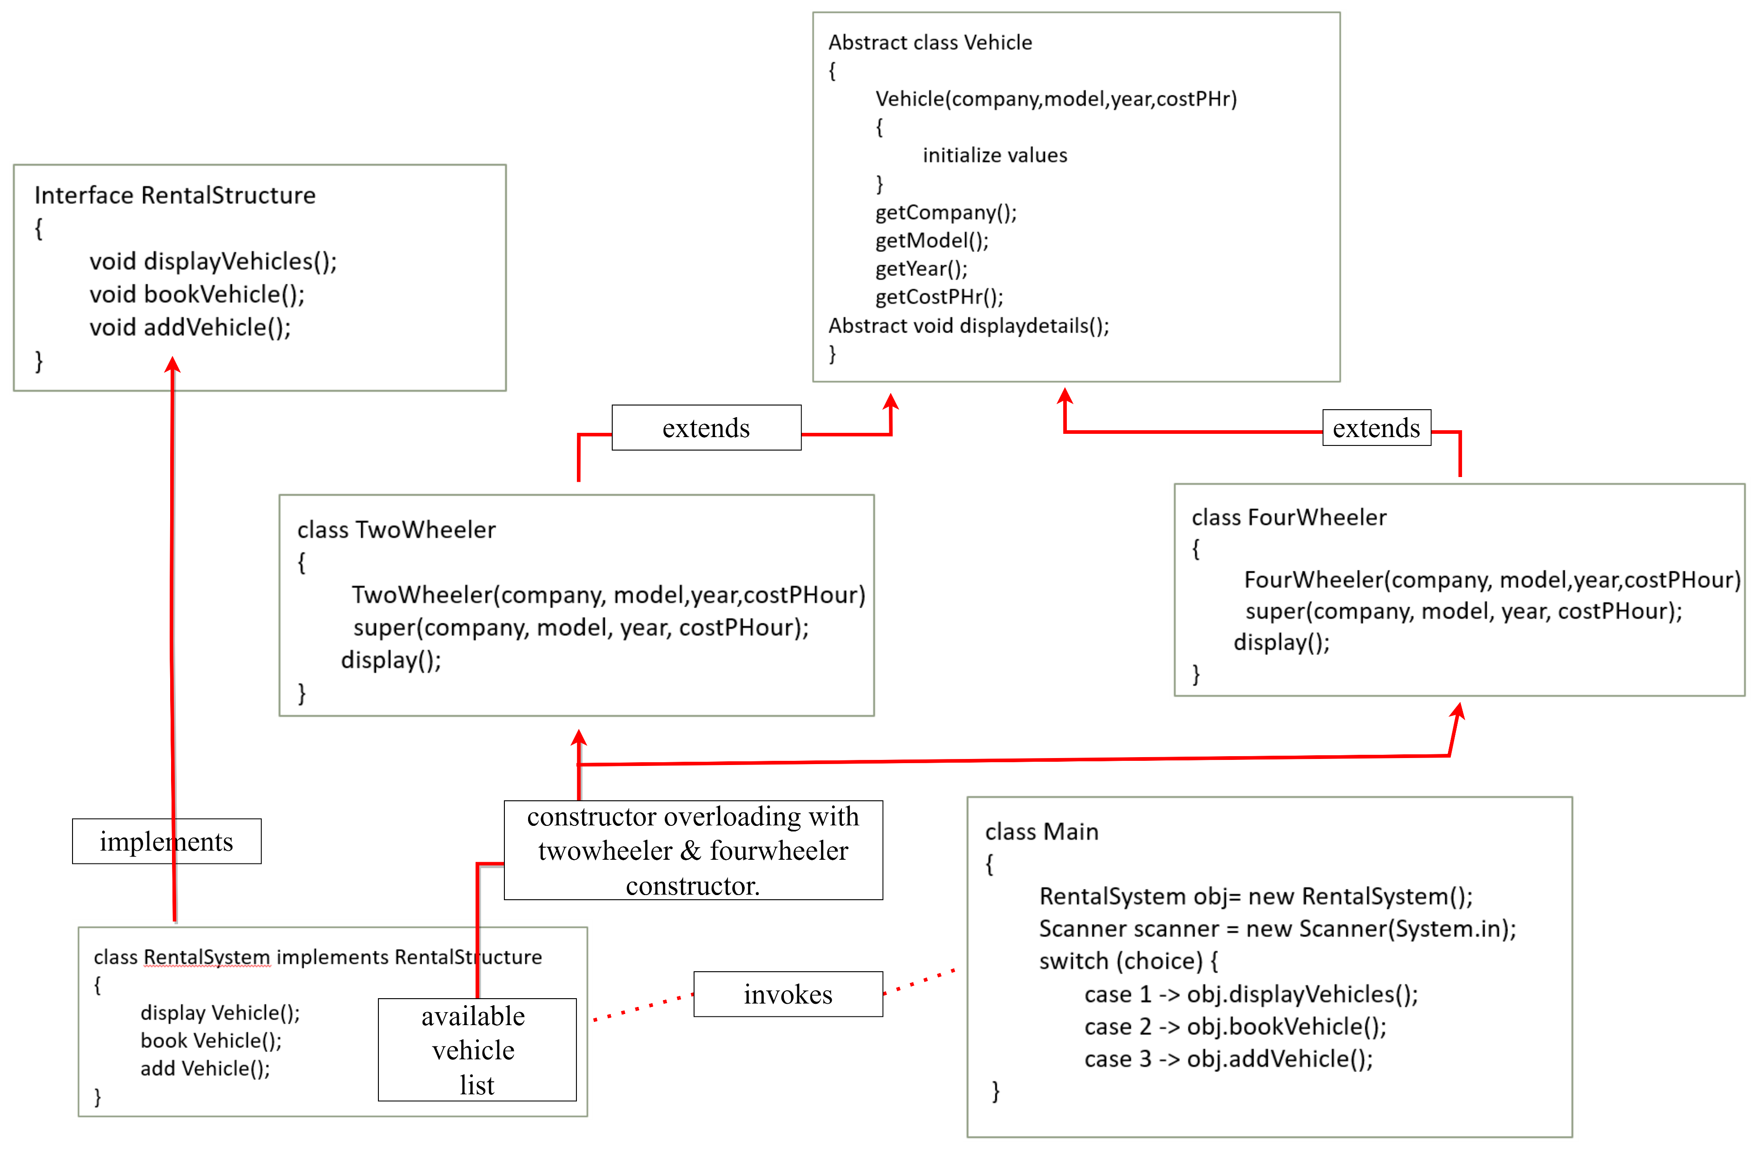
FLOWCHART

Slide 4
CODE STRUCTURE :
TwoWheeler Class
Inherits from: Vehicle
Constructor:
TwoWheeler(String company, String model, int year, int costPHour)
Methods:
displayDetails(): void
FourWheeler Class
Inherits from: Vehicle
Constructor:
FourWheeler(String company, String model, int year, int costPHour)
Methods:
displayDetails(): void
RentalSystem Class
Implements: RentalStructure
Attributes:
availableVehicles: List<Vehicle>
Constructor:
RentalSystem()
Methods:
displayVehicles(): void
bookVehicle(): void
addVehicle(): void
Main Class
RentalStructure Interface
Methods:
displayVehicles(): void
bookVehicle(): void
addVehicle(): void
Vehicle Abstract Class
Attributes:
company: String
model: String
year: int
costPHour: int
available: boolean
Constructor:
Vehicle(String company, String model, int year, int costPHour)
Methods:
getCompany(): String
getModel(): String
getYear(): int
getCostPHour(): int
isAvailable(): boolean
setAvailable(boolean available): void
abstract displayDetails(): void

Slide 5
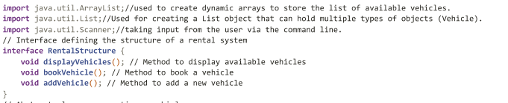
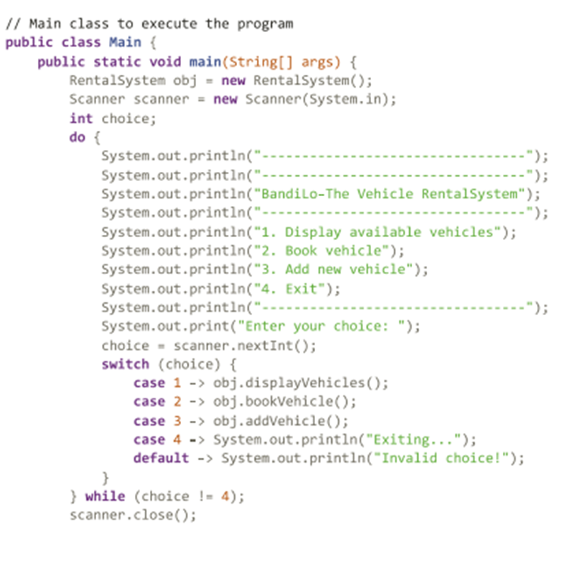
Main and RentalStructure Interface
RentalStructure Interface: Defines methods for displaying, booking, and adding vehicles.
Main Class: Creates a RentalSystem object and handles user interaction via a menu-driven interface.
Object Creation: A RentalSystem object named 'obj' is created to manage vehicle operations.
User Interaction: Users can choose to display available vehicles, book a vehicle, add a new vehicle, or exit the system.
Loop: The program runs in a loop until the user chooses to exit, ensuring continuous interaction
java.util.ArrayList is used to create dynamic arrays to store the list of available vehicles.
java.util.List isUsed for creating a List object that can hold multiple types of objects (Vehicle).
java.util.Scanner is taking input from the user via the command line.

Slide 6
Abstract class Vehicle
This code defines an abstract class `Vehicle` representing common attributes and behaviors of vehicles.
1. Attributes: It encapsulates properties such as company, model, year, cost per hour, and availability status.
2. Constructor: Initializes the vehicle details when an object is created.
3.Getter and Setter Methods: Allow access to and modification of the vehicle attributes.
4. Abstract Method: Declares an abstract method `displayDetails()` to be implemented by subclasses for displaying vehicle-specific details.
5. TwoWheeler and FourWheeler Classes:
Subclasses of `Vehicle` representing specific types of vehicles. They implement the `displayDetails()` method to provide details specific to their type.
6. Inheritance Implementation:
The `TwoWheeler` and `FourWheeler` classes inherit from the `Vehicle` class, inheriting its attributes and methods.(hierarchial)
7. Constructor Overloading: Overloading occurs in the `TwoWheeler` and `FourWheeler` constructors, where they invoke the superclass constructor `Vehicle` with specific parameters for each vehicle type.
8. Initialization: The overloaded constructors initialize the attributes of each vehicle subclass with the provided company, model, year, and cost per hour parameters.

Slide 7
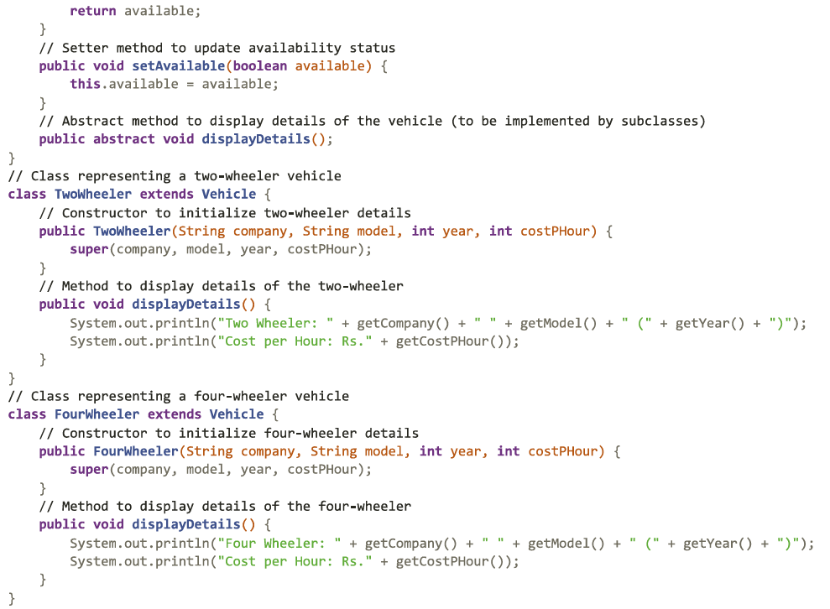
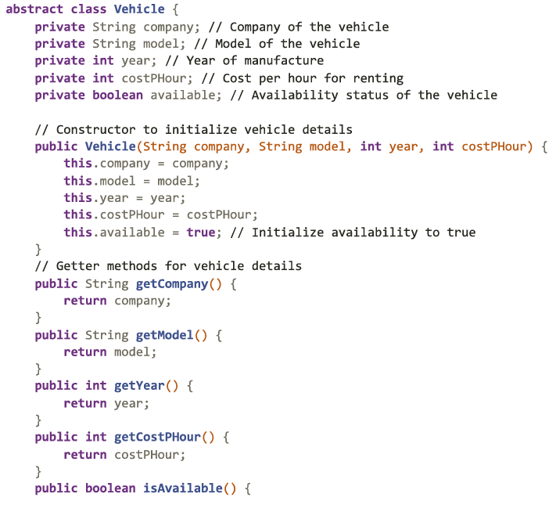

Slide 8
RentalSystem class
1. RentalSystem Class Overview:
- Represents the core rental system and implements the RentalStructure interface.
- Manages a list of available vehicles (availableVehicles) using the ArrayList data structure.
2. Constructor Initialization:
- Initializes the availableVehicles list with default vehicles of both TwoWheeler and FourWheeler types.
3. Display Vehicles Method (displayVehicles()):
- Iterates through the availableVehicles list.
- Calls the displayDetails() method for each vehicle to display its details.
4. Book Vehicle Method (bookVehicle()):
- Displays available vehicles using the displayVehicles() method.
- Prompts the user to select a vehicle and enters booking details such as hours, name, mobile, pickup, and return points.
- Calculates the total cost based on the selected vehicle's cost per hour and booking duration.
- Updates the availability status of the selected vehicle and displays the booking details.
5. Add Vehicle Method (addVehicle()):
- Prompts the user to enter details for a new vehicle, including type (Two Wheeler or Four Wheeler), company, model, year, and cost per hour.
- Based on the user's input, creates a new TwoWheeler or FourWheeler object and adds it to the availableVehicles list.
6. List Functionality:
- Utilizes the ArrayList data structure to store vehicle objects dynamically.
- Provides flexibility for adding, removing, and accessing vehicle objects efficiently within the rental system.
7. Subclasses: TwoWheeler and FourWheeler:
- Concrete subclasses of the Vehicle abstract class.
- Provide specific implementations for the displayDetails() method, allowing each type of vehicle to display its details appropriately.
8. Constructor Overloading:
- Takes place in the RentalSystem class during initialization of default vehicles.
- Overloaded constructors of TwoWheeler and FourWheeler classes are invoked to create instances with specific details (company, model, year).

Slide 9
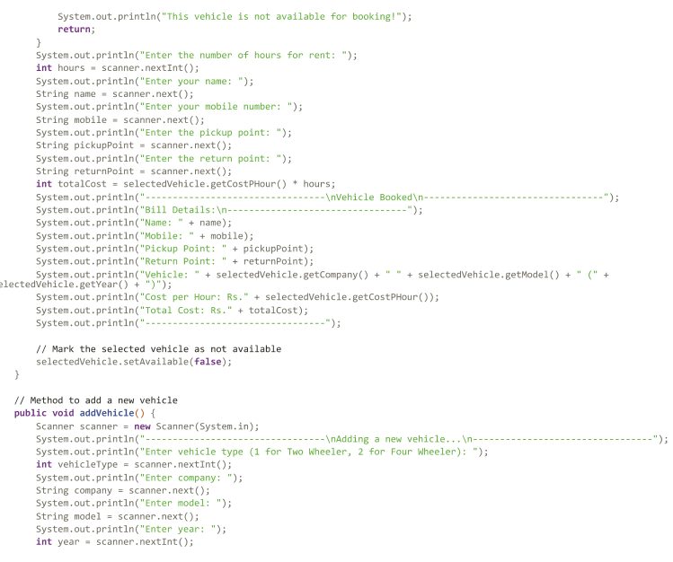
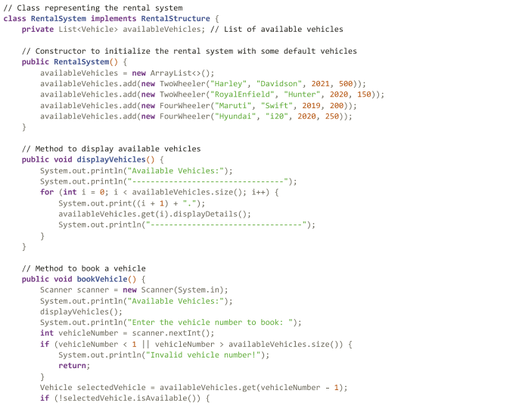
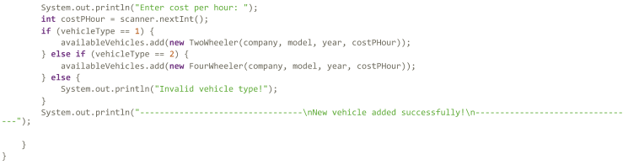

Slide 10
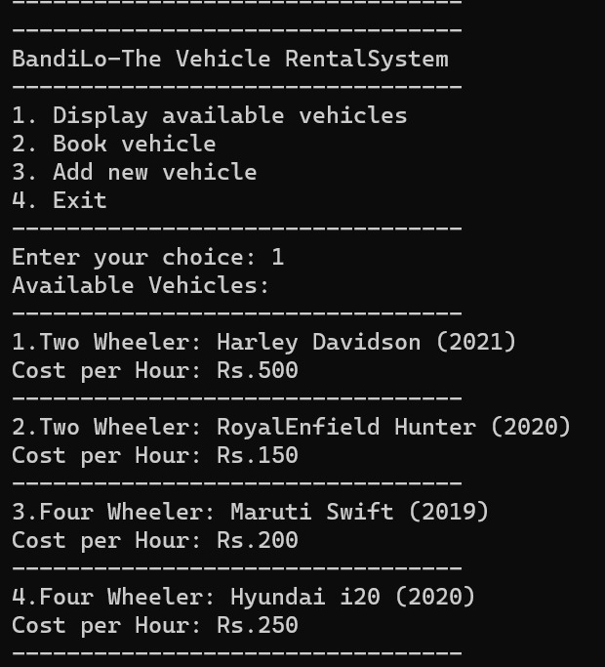
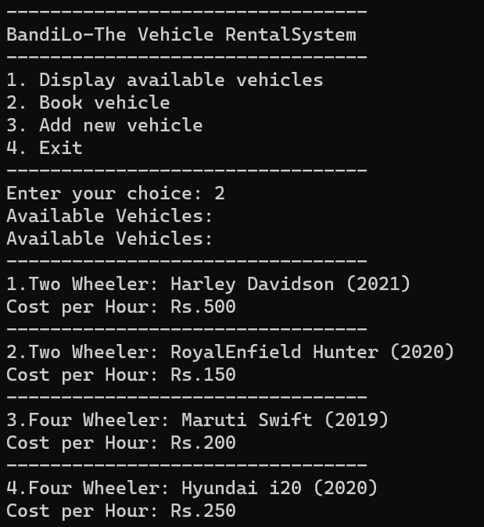
OUTPUT

Slide 11
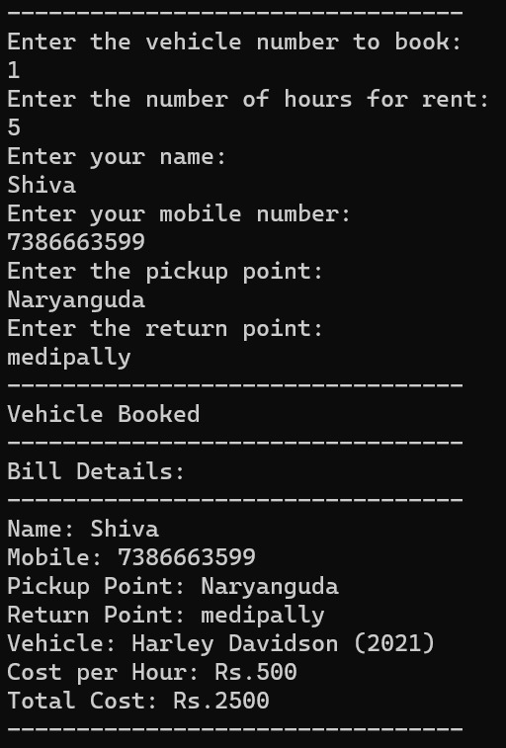
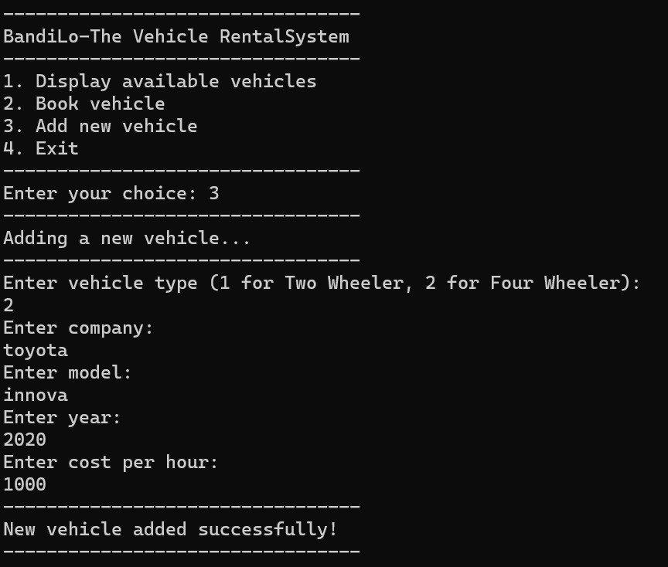

Slide 12
THANK YOU

