Slide 1

Machine learning system design
Error metrics for skewed classes

Slide 2



Cancer classification example
Train logistic regression model . ( if cancer, otherwise) Find that you got 1% error on test set.
(99% correct diagnoses)
Only 0.50% of patients have cancer.
function y = predictCancer(x)
y = 0; %ignore x!
return

Slide 3
Precision/Recall
in presence of rare class that we want to detect
Precision
(Of all patients where we predicted , what fraction actually has cancer?)
Recall
(Of all patients that actually have cancer, what fraction did we correctly detect as having cancer?)

Slide 4
Machine learning system design
Trading off precision and recall

Slide 5
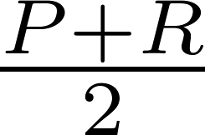
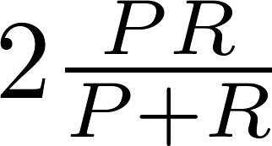
F₁ Score (F score)
How to compare precision/recall numbers?
 | Precision(P) | Recall (R) | Average | F₁ Score
Algorithm 1 | 0.5 | 0.4 | 0.45 | 0.444
Algorithm 2 | 0.7 | 0.1 | 0.4 | 0.175
Algorithm 3 | 0.02 | 1.0 | 0.51 | 0.0392
Average:
F₁ Score:

Slide 6
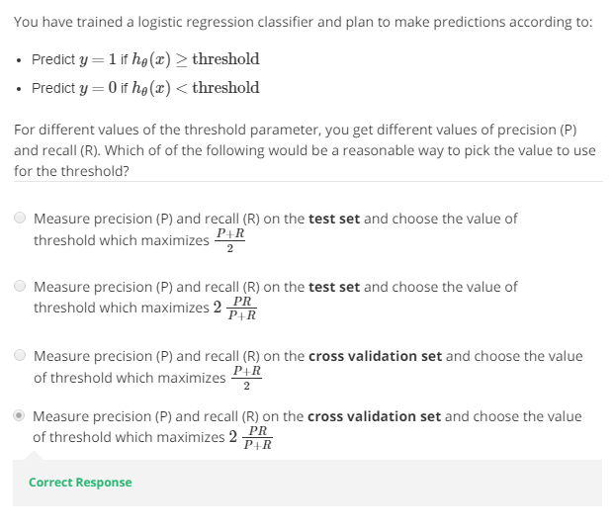

Slide 7
Machine learning system design
Data for machine learning

Slide 8
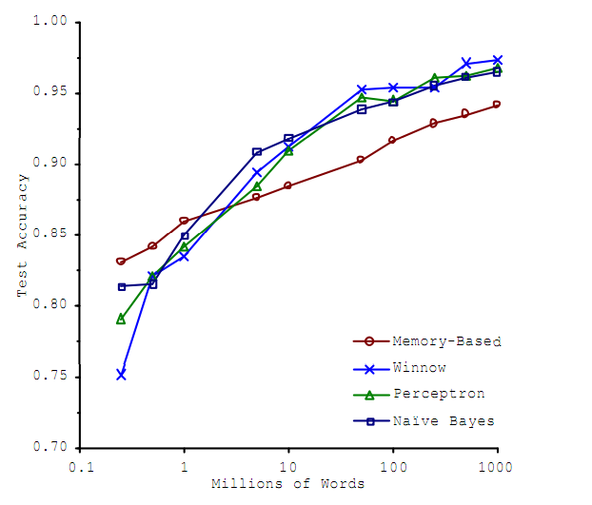
Designing a high accuracy learning system
E.g. Classify between confusable words.
{to, two, too}, {then, than}
For breakfast I ate _____ eggs.
Algorithms
Perceptron (Logistic regression)
Winnow
Memory-based
Naïve Bayes
Accuracy
Training set size (millions)
“It’s not who has the best algorithm that wins.
It’s who has the most data.”
_{[Banko and Brill, 2001]}

Slide 9
Large data rationale
Use a learning algorithm with many parameters (e.g. logistic regression/linear regression with many features; neural network with many hidden units).
Use a very large training set (unlikely to overfit)

Slide 10
Advice for applying machine learning
Deciding what to try next

Slide 11
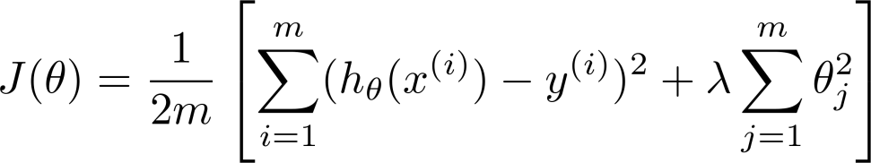
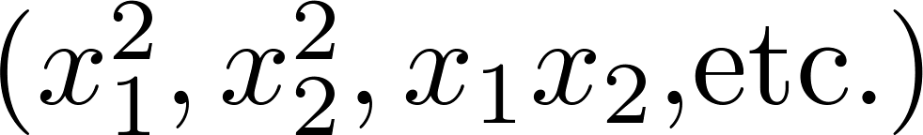
Debugging a learning algorithm:
Suppose you have implemented regularized linear regression to predict housing prices.
However, when you test your hypothesis on a new set of houses, you find that it makes unacceptably large errors in its predictions. What should you try next?
Get more training examples
Try smaller sets of features
Try getting additional features
Try adding polynomial features
Try decreasing
Try increasing

Slide 12
Machine learning diagnostic:
Diagnostic: A test that you can run to gain insight what is/isn’t working with a learning algorithm, and gain guidance as to how best to improve its performance.
Diagnostics can take time to implement, but doing so can be a very good use of your time.

Slide 13
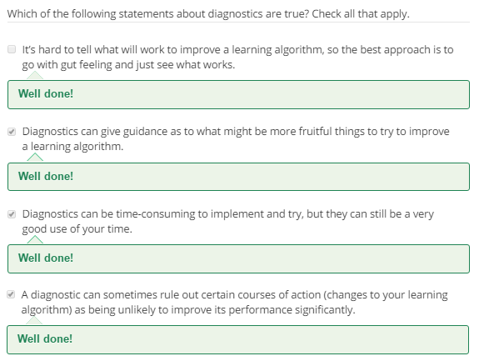

Slide 14
Advice for applying machine learning
Evaluating a hypothesis

Slide 15




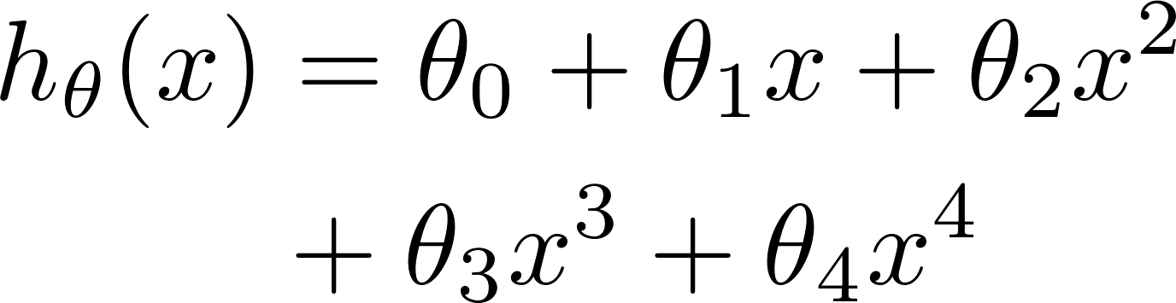


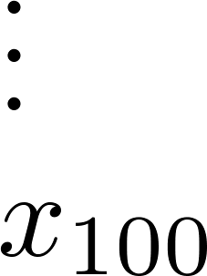
Evaluating your hypothesis
Fails to generalize to new examples not in training set.
price
size of house
no. of bedrooms
no. of floors
size
age of house
average income in neighborhood
kitchen size

Slide 16






Evaluating your hypothesis
Dataset:
Size | Price
2104 | 400
1600 | 330
2400 | 369
1416 | 232
3000 | 540
1985 | 300
1534 | 315
1427 | 199
1380 | 212
1494 | 243

Slide 17

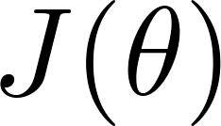
Training/testing procedure for linear regression
Learn parameter from training data (minimizing training error )
Compute test set error:

Slide 18
Training/testing procedure for logistic regression
Learn parameter from training data
Compute test set error:
Misclassification error (0/1 misclassification error):

Slide 19
Advice for applying machine learning
Model selection and training/validation/test sets

Slide 20
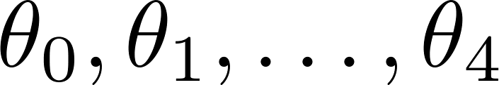
Overfitting example
Once parameters
were fit to some set of data (training set), the error of the parameters as measured on that data (the training error xxxxx) is likely to be lower than the actual generalization error.
price
size

Slide 21
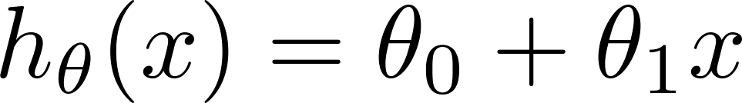
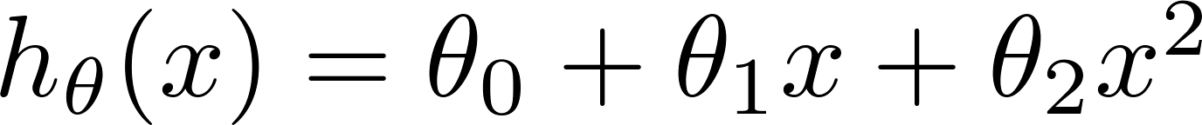
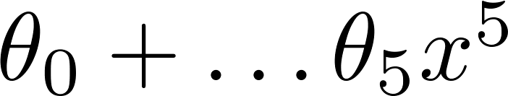
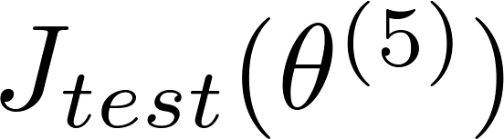

Model selection
1.
2.
3.
10.
Choose
How well does the model generalize? Report test set error .
Problem: is likely to be an optimistic estimate of generalization error. I.e. our extra parameter ( = degree of polynomial) is fit to test set.

Slide 22





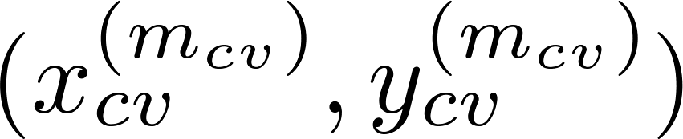
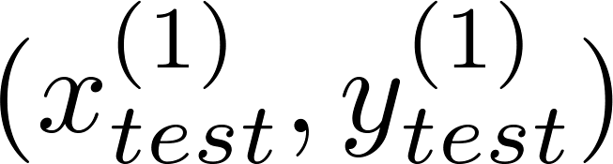
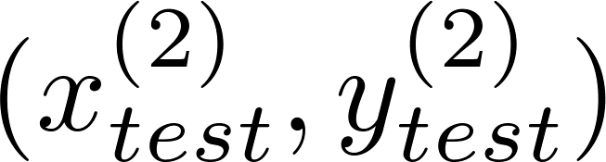
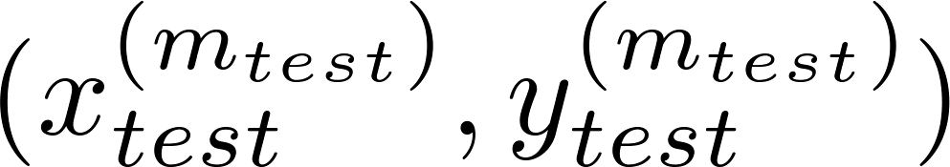
Evaluating your hypothesis
Dataset:
Size | Price
2104 | 400
1600 | 330
2400 | 369
1416 | 232
3000 | 540
1985 | 300
1534 | 315
1427 | 199
1380 | 212
1494 | 243

Slide 23
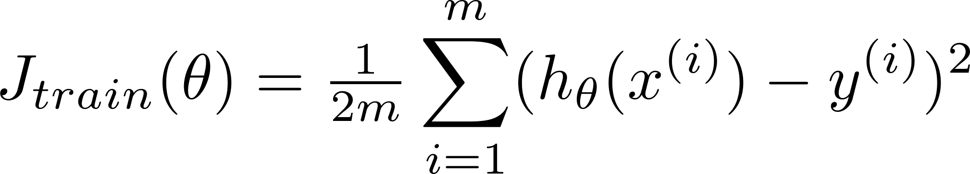
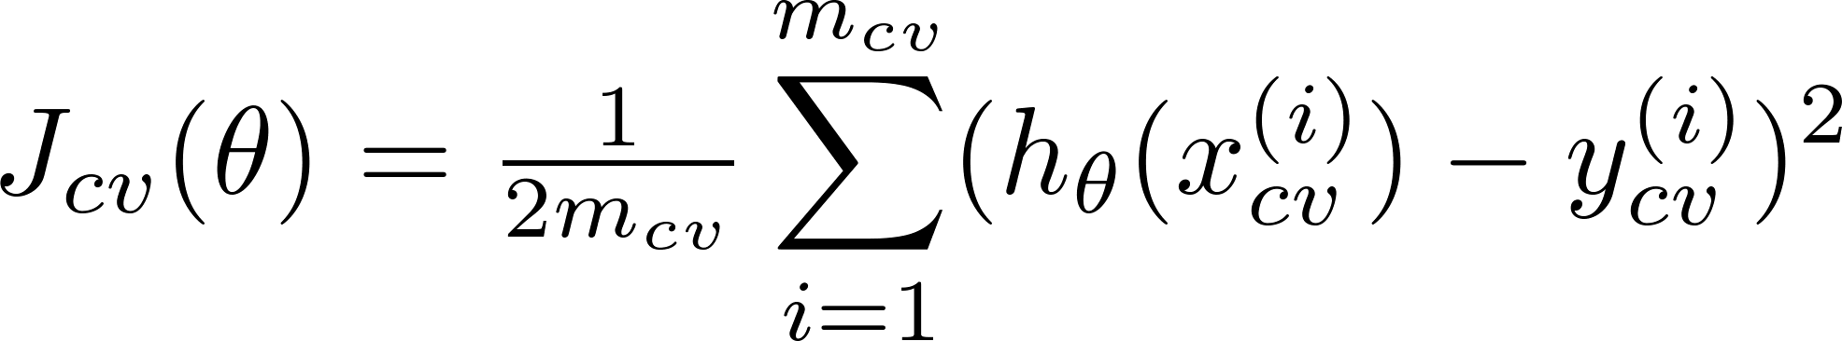
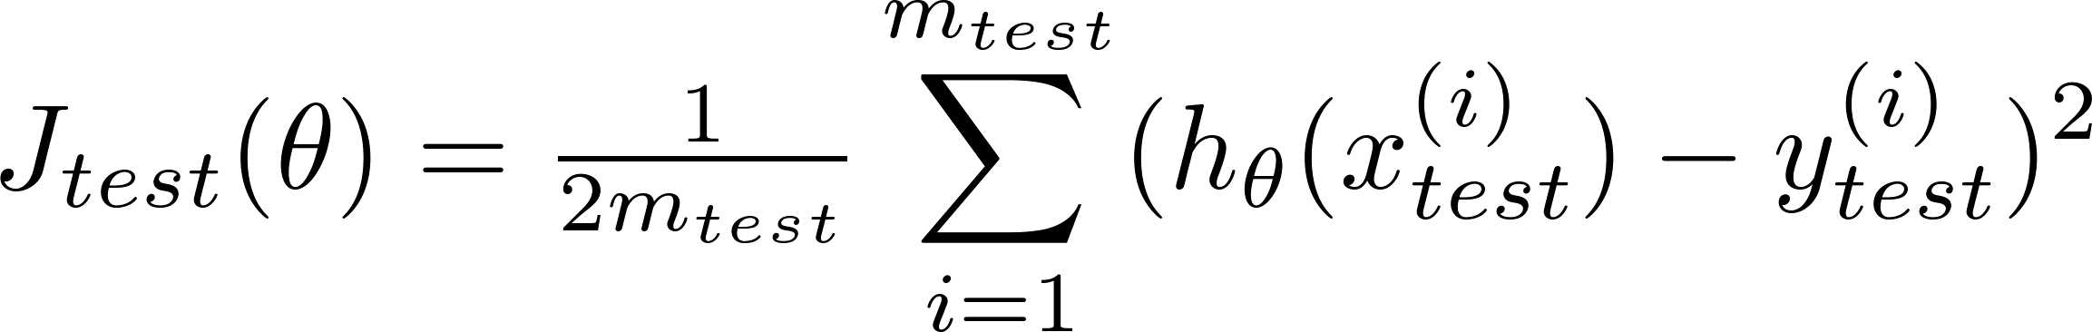
Train/validation/test error
Training error:
Cross Validation error:
Test error:

Slide 24
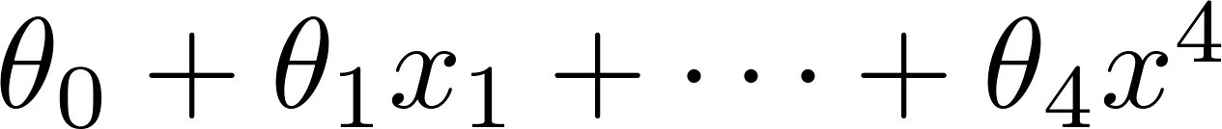
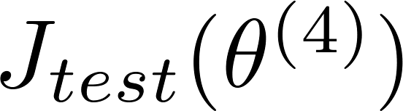
Model selection
1.
2.
3.
10.
Pick
Estimate generalization error for test set

Slide 25
Advice for applying machine learning
Diagnosing bias vs. variance

Slide 26
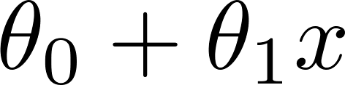
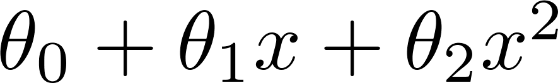
Bias/variance
Price
Price
Price
Size
Size
Size
High bias
(underfit)
“Just right”
High variance
(overfit)

Slide 27
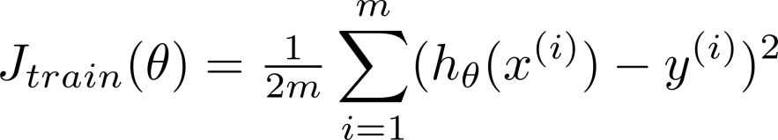
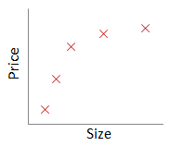
Bias/variance
Training error:
Cross validation error:
price
error
size
degree of polynomial d

Slide 28
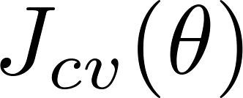
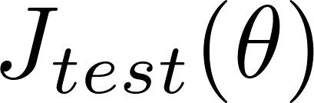


Diagnosing bias vs. variance
Suppose your learning algorithm is performing less well than you were hoping. ( or is high.) Is it a bias problem or a variance problem?
Bias (underfit):
(cross validation
error)
error
Variance (overfit):
(training error)
degree of polynomial d

Slide 29
Advice for applying machine learning
Regularization and bias/variance

Slide 30
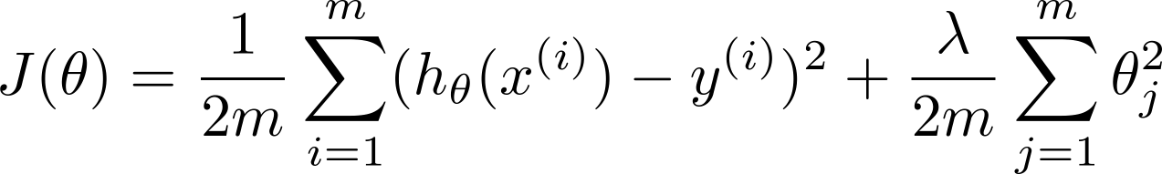


Linear regression with regularization
Model:
Price
Price
Price
Size
Size
Size
Large xx
High bias (underfit)
Intermediate xx
“Just right”
Small xx
High variance (overfit)

Slide 31
Choosing the regularization parameter

Slide 32
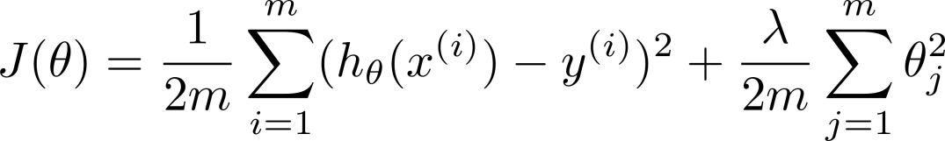







Choosing the regularization parameter
Model:
Try
Try
Try
Try
Try
Try
Pick (say) . Test error:

Slide 33
Bias/variance as a function of the regularization parameter

Slide 34
Advice for applying machine learning
Learning curves

Slide 35
Learning curves
error
(training set size)

Slide 36

High bias
price
error
size
(training set size)
price
If a learning algorithm is suffering from high bias, getting more training data will not (by itself) help much.
size

Slide 37
Thank you

