Slide 1
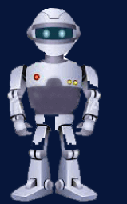
Unsupervised learning introduction
Clustering

Slide 2


Supervised learning
Training set:

Slide 3
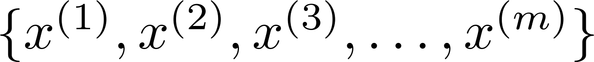
Unsupervised learning
Training set:

Slide 4


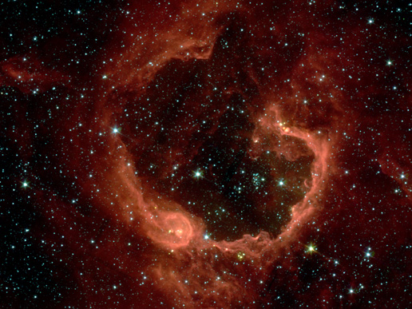
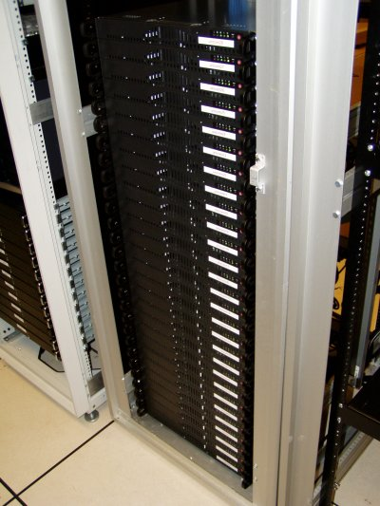
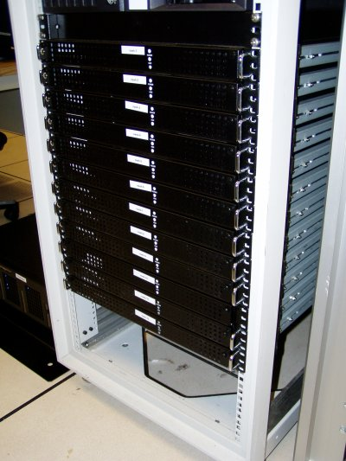
Applications of clustering
Market segmentation
Social network analysis
Image credit: NASA/JPL-Caltech/E. Churchwell (Univ. of Wisconsin, Madison)
Organize computing clusters
Astronomical data analysis
Notes:
Swap: market seg and organize clusters

Slide 5
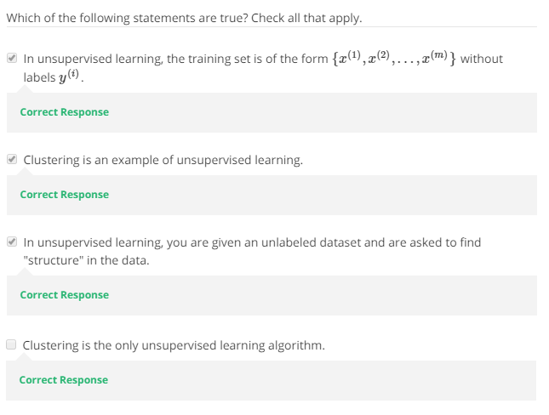

Slide 6
K-means algorithm
Clustering

Slide 7
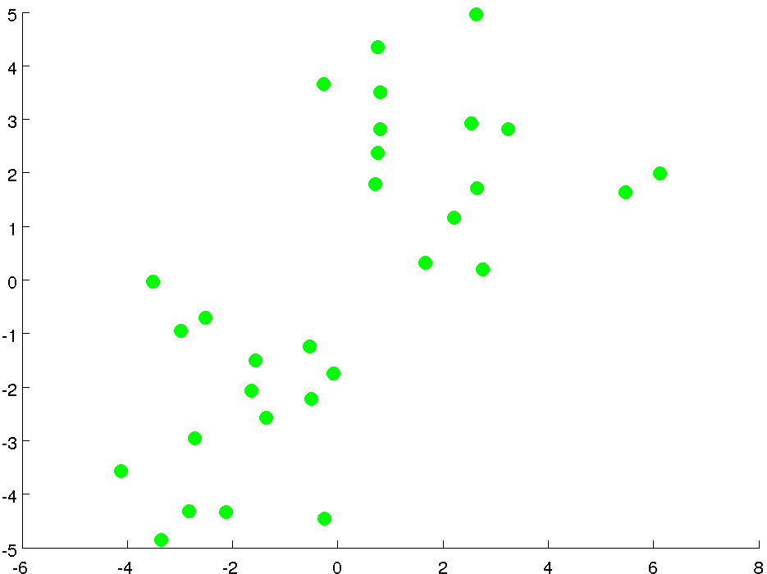

Slide 8
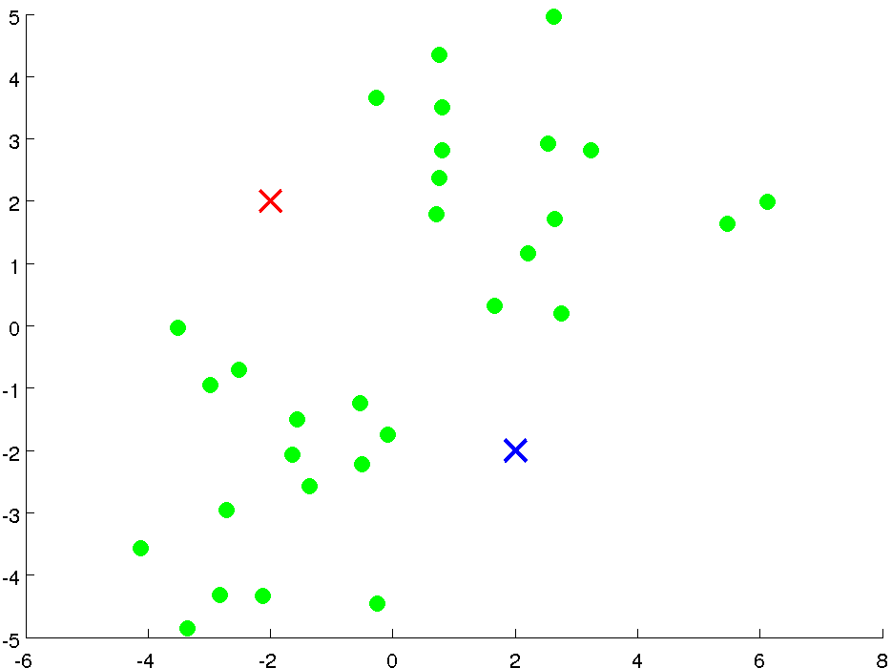

Slide 9
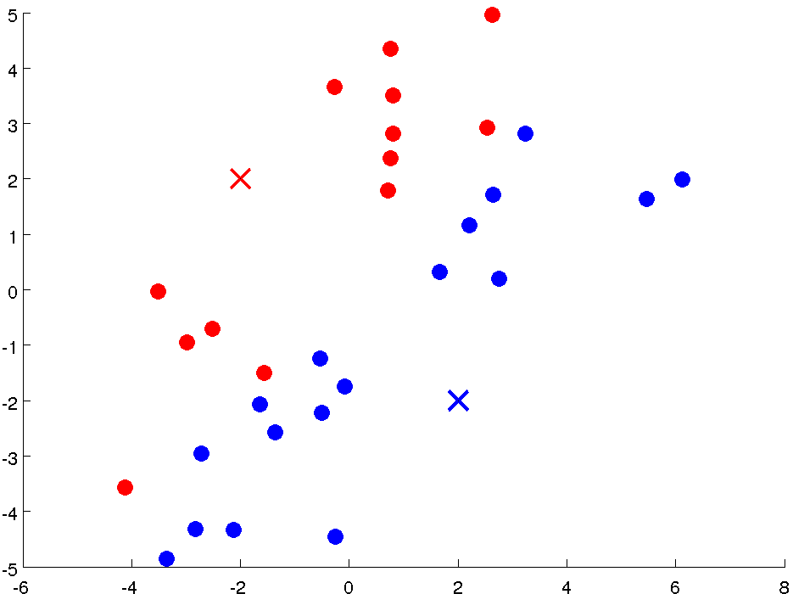

Slide 10
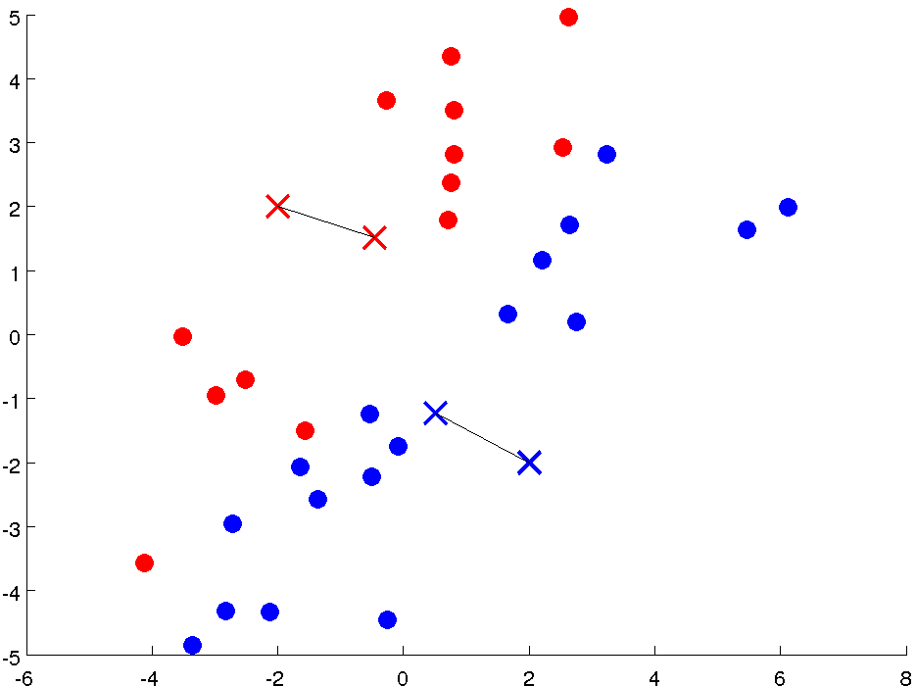

Slide 11
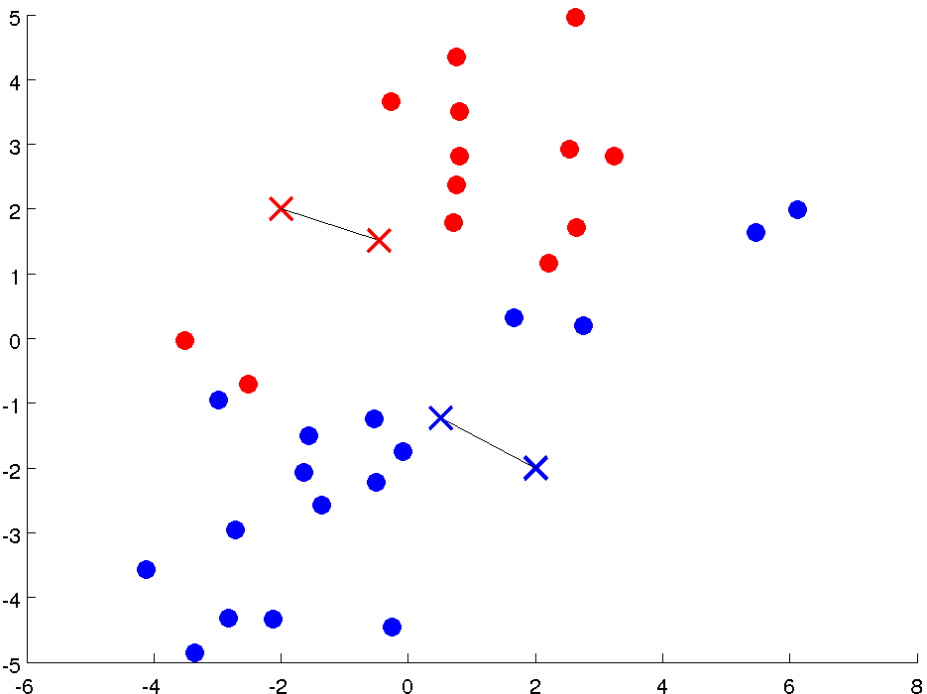

Slide 12
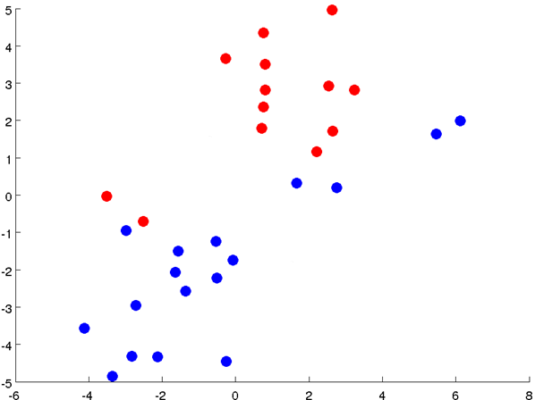

Slide 13
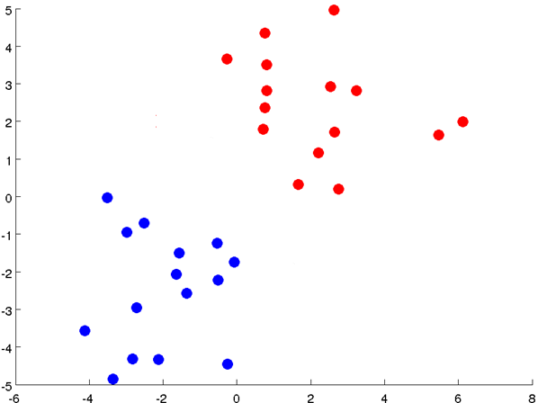

Slide 14
Notes:
Get rid of the legacy points

Slide 15
Notes:
Get rid of the legacy points

Slide 16

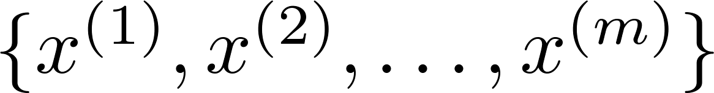
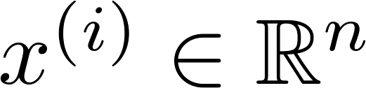
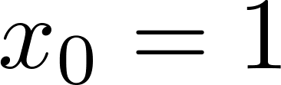
K-means algorithm
assumption
Input:
(number of clusters)
Training set
(drop convention)

Slide 17

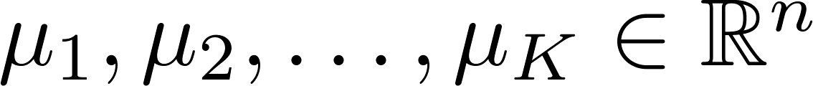
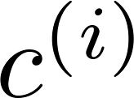
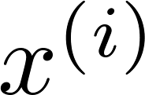

K-means algorithm
Randomly initialize cluster centroids
Repeat {
for = 1 to
:= index (from 1 to ) of cluster centroid
closest to
for = 1 to
:= average (mean) of points assigned to cluster
}
Notes:
Replace with normal text, size with LATEX fonts

Slide 18
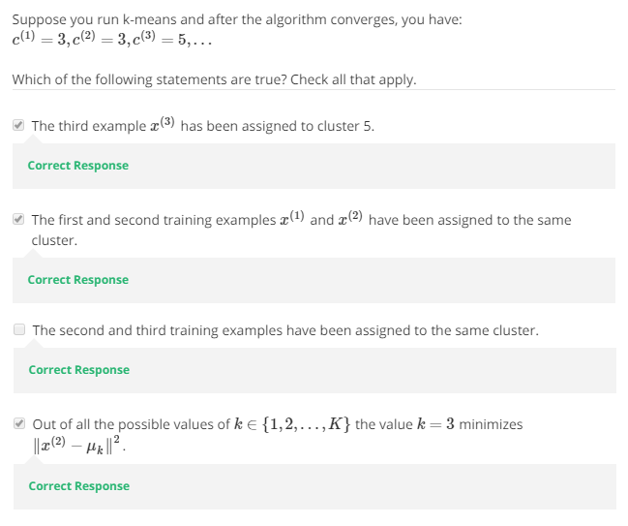

Slide 19
Optimization objective
Clustering

Slide 20

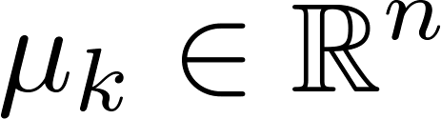

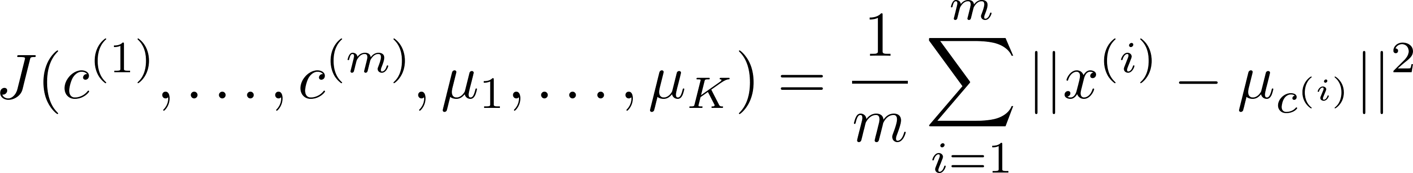
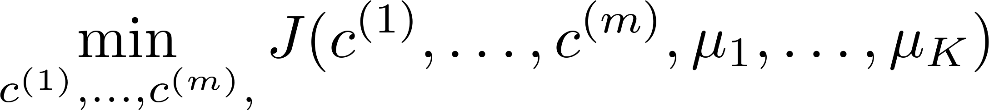

K-means optimization objective
= index of cluster (1,2,…, ) to which example is currently assigned
= cluster centroid ( )
= cluster centroid of cluster to which example has been assigned
Optimization objective:
Notes:
Change numbers to LATEX as well

Slide 21


K-means algorithm
Randomly initialize cluster centroids
Repeat {
for = 1 to
:= index (from 1 to ) of cluster centroid
closest to
for = 1 to
:= average (mean) of points assigned to cluster
}
Notes:
Replace as previous; change spacing to fill page

Slide 22
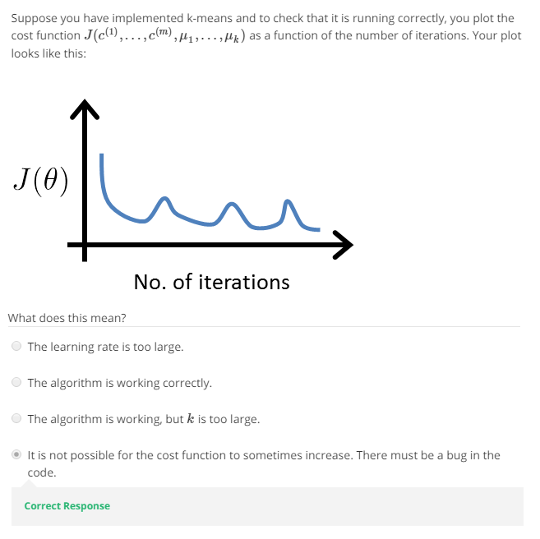

Slide 23
K-means algorithm
Randomly initialize cluster centroids
Repeat {
for = 1 to
:= index (from 1 to ) of cluster centroid
closest to
for = 1 to
:= average (mean) of points assigned to cluster
}
Notes:
Replace as previous; change spacing to fill page

Slide 24

Random initialization
Should have
Randomly pick training
examples.
Set equal to these
examples.
Notes:
LATEX font

Slide 25
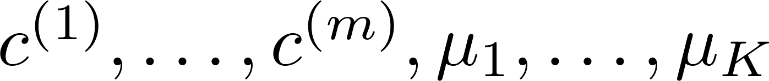
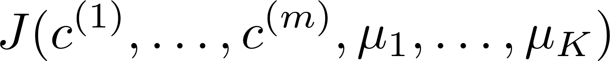
Random initialization
For i = 1 to 100 {
Randomly initialize K-means.
Run K-means. Get .
Compute cost function (distortion)
}
Pick clustering that gave lowest cost

Slide 26
What is the right value of K?

Slide 27

Choosing the value of K
Elbow method:
Cost function
Cost function
(no. of clusters)
(no. of clusters)

Slide 28
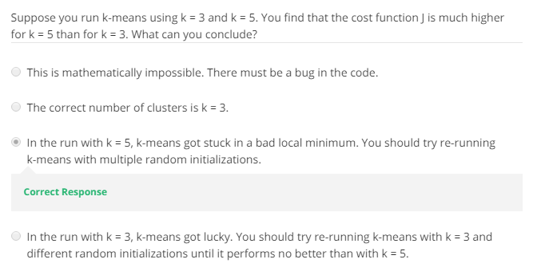

Slide 29
Choosing the value of K
Sometimes, you’re running K-means to get clusters to use for some later/downstream purpose. Evaluate K-means based on a metric for how well it performs for that later purpose.
E.g.
T-shirt sizing
T-shirt sizing
Weight
Weight
Height
Height

Slide 30
Thank you

