Slide 1

Logistic Regression
Machine Learning

Slide 2

Classification
Email: Spam / Not Spam?
Online Transactions: Fraudulent (Yes / No)?
Tumor: Malignant / Benign ?
0: “Negative Class” (e.g., benign tumor)
1: “Positive Class” (e.g., malignant tumor)

Slide 3

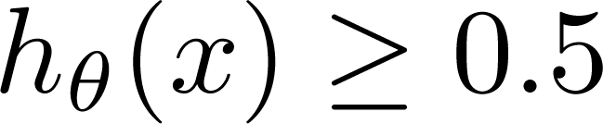
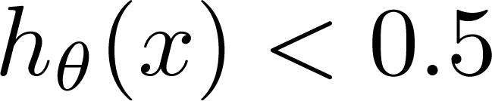
(Yes) 1
Malignant ?
(No) 0
Tumor Size
Tumor Size
Threshold classifier output at 0.5:
If , predict “y = 1”
If , predict “y = 0”

Slide 4
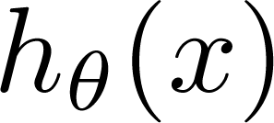
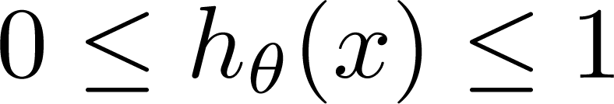
Classification: y = 0 or 1
can be > 1 or < 0
Logistic Regression:

Slide 5
Logistic Regression
Hypothesis Representation

Slide 6
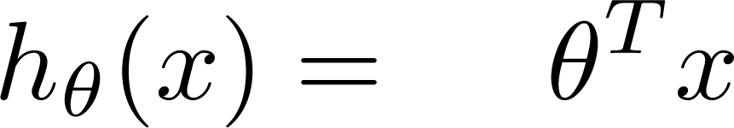
Logistic Regression Model
Want
1
0.5
Sigmoid function
Logistic function
0

Slide 7

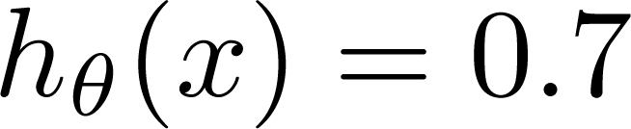
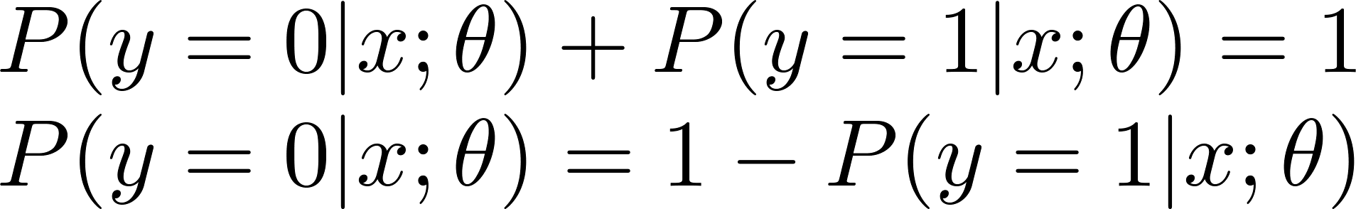
Interpretation of Hypothesis Output
= estimated probability that y = 1 on input x
Example: If
Tell patient that 70% chance of tumor being malignant
“probability that y = 1, given x,
parameterized by ”

Slide 8
Logistic Regression
Cost function

Slide 9
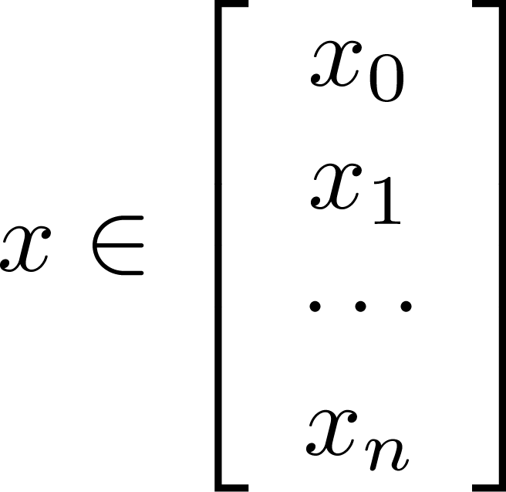
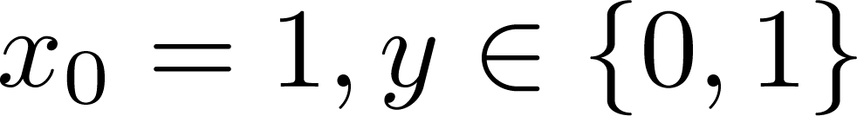
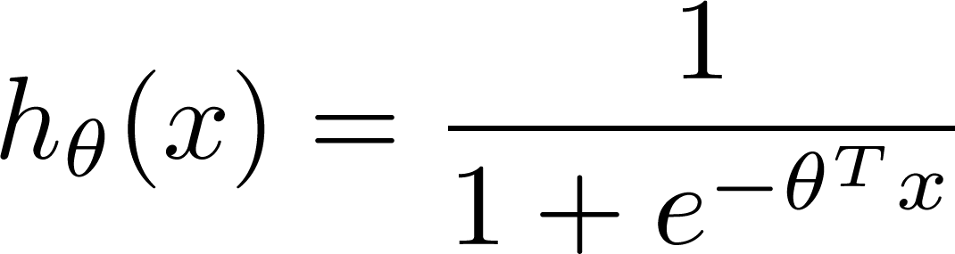

Training set:
m examples
How to choose parameters ?

Slide 10
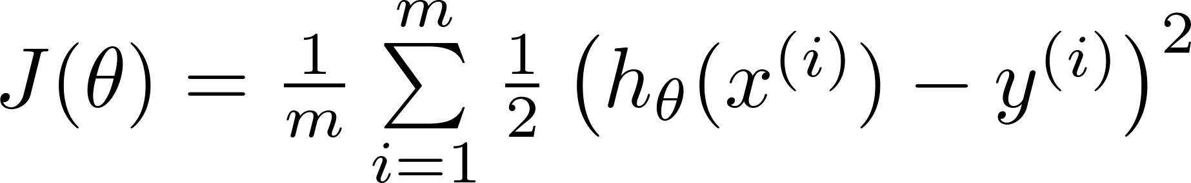

J(θ) is non-linear beacause of the
presence of non-linear sigmoid function
Cost function
Linear regression:
Non-Linear
Function
“non-convex”
“convex”
We want J(θ) to
behave like this

Slide 11
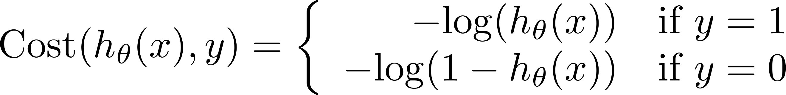
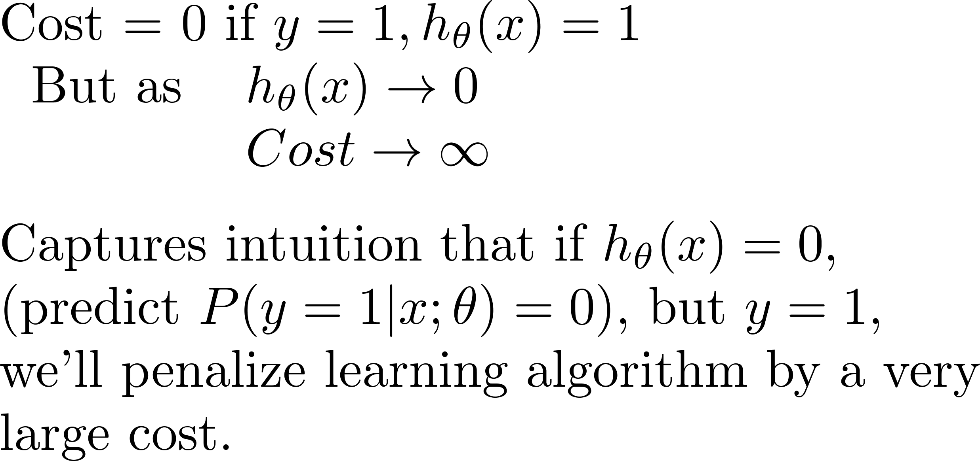
Logistic regression cost function
Different
Cost Function
If y = 1
0
1

Slide 12
Logistic regression cost function
If y = 0
0
1

Slide 13
Logistic Regression
Simplified cost function and gradient descent

Slide 14


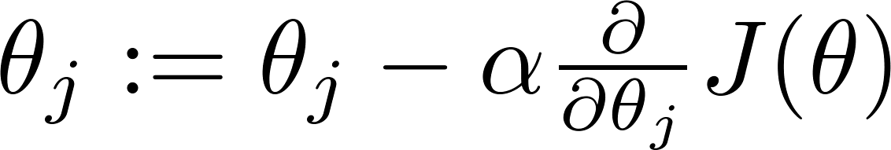


Gradient Descent
Want :
Repeat
(simultaneously update all )

Slide 15
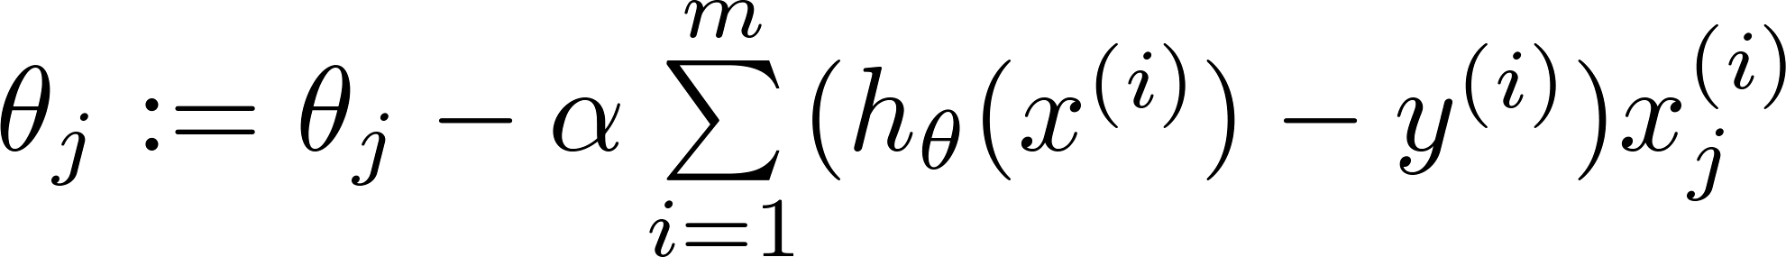
Gradient Descent
Want :
Repeat
(simultaneously update all )
Algorithm looks identical to linear regression!

Slide 16
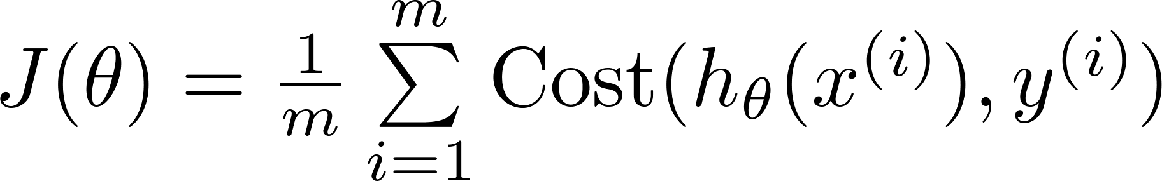
Logistic regression cost function

Slide 17
Logistic Regression
Multi-class classification: One-vs-all

Slide 18
Binary classification:
Multi-class classification:
x₂
x₂
x₁
x₁

Slide 19
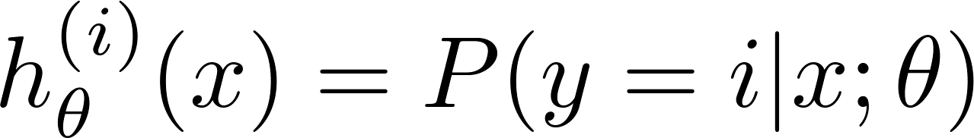

x₂
One-vs-all (one-vs-rest):
x₁
x₂
x₂
x₁
x₁
Class 1:
Class 2:
Class 3:
x₂
x₁

Slide 20
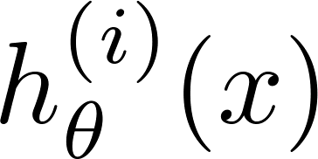

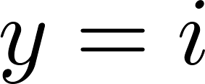

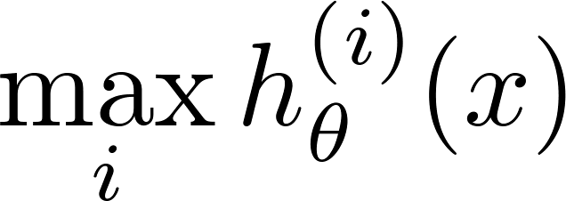
One-vs-all
Train a logistic regression classifier for each class to predict the probability that .
On a new input , to make a prediction, pick the class that maximizes

Slide 21
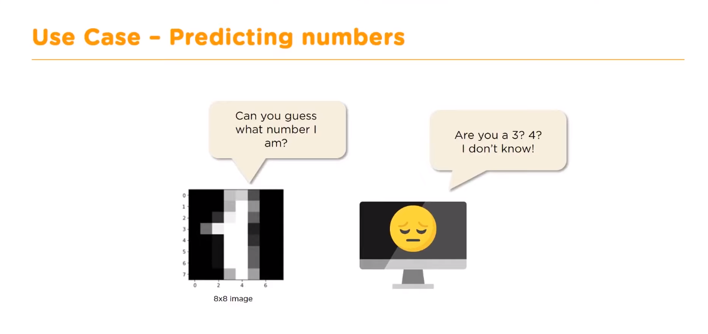

Slide 22
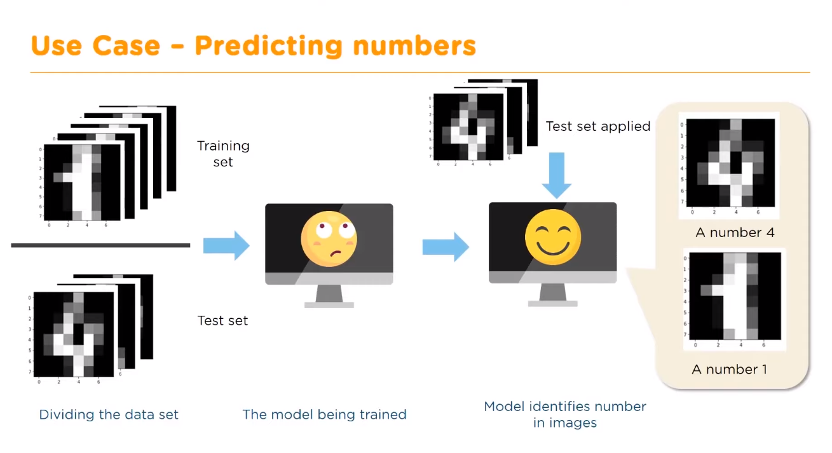

Slide 23
Thank you

