Slide 1
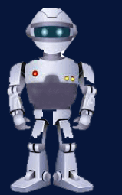
Introduction
Machine Learning

Slide 2
Introduction….
Arthur Samuel (1959). Machine Learning: Field of study that gives computers the ability to learn without being explicitly programmed.
Tom Mitchell (1998) Well-posed Learning Problem: A computer program is said to learn from experience E with respect to some task T and some performance measure P, if its performance on T, as measured by P, improves with experience E.

Slide 3
Machine Learning algorithm
Machine learning algorithms:
Supervised learning
Unsupervised learning
Others: Reinforcement learning, recommender systems.
Also talk about: Practical advice for applying learning algorithms.

Slide 4
Supervised Learning
Machine Learning

Slide 5

Housing price prediction.
Price
Size in ${feet}^{2}$
Supervised Learning
“right answers given”
Regression: Predict Continuous Valued Output

Slide 6
Harmful
Not Harmful
Breast cancer (malignant, benign)
Classification
Discrete valued output (0 or 1)
1(Y)
Malignant?
0(N)
Tumor Size
[Feature 1]
Another way of representing above graph
Tumor Size

Slide 7
You’re running a company, and you want to develop learning algorithms to address each of two problems.
Problem 1: You have a large inventory of identical items. You want to predict how many of these items will sell over the next 3 months.
Problem 2: You’d like software to examine individual customer accounts, and for each account decide if it has been hacked/compromised.
Should you treat these as classification or as regression problems?
A. Treat both as classification problems.
B. Treat problem 1 as a classification problem, problem 2 as a regression problem.
C. Treat problem 1 as a regression problem, problem 2 as a classification.
D. Treat both as regression problems.

Slide 8
UNSupervised Learning
Machine Learning

Slide 9
Supervised Learning
x₂
x₁

Slide 10
Unsupervised Learning
x₂
x₁

Slide 11
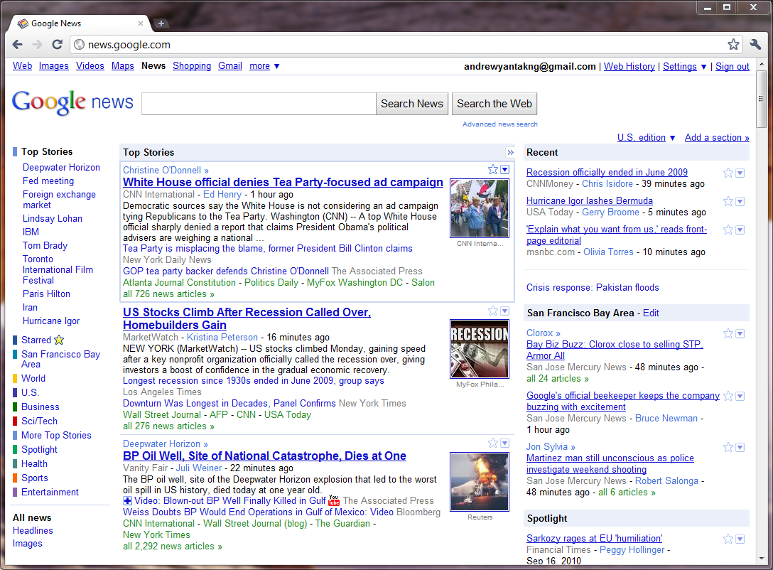

Slide 12
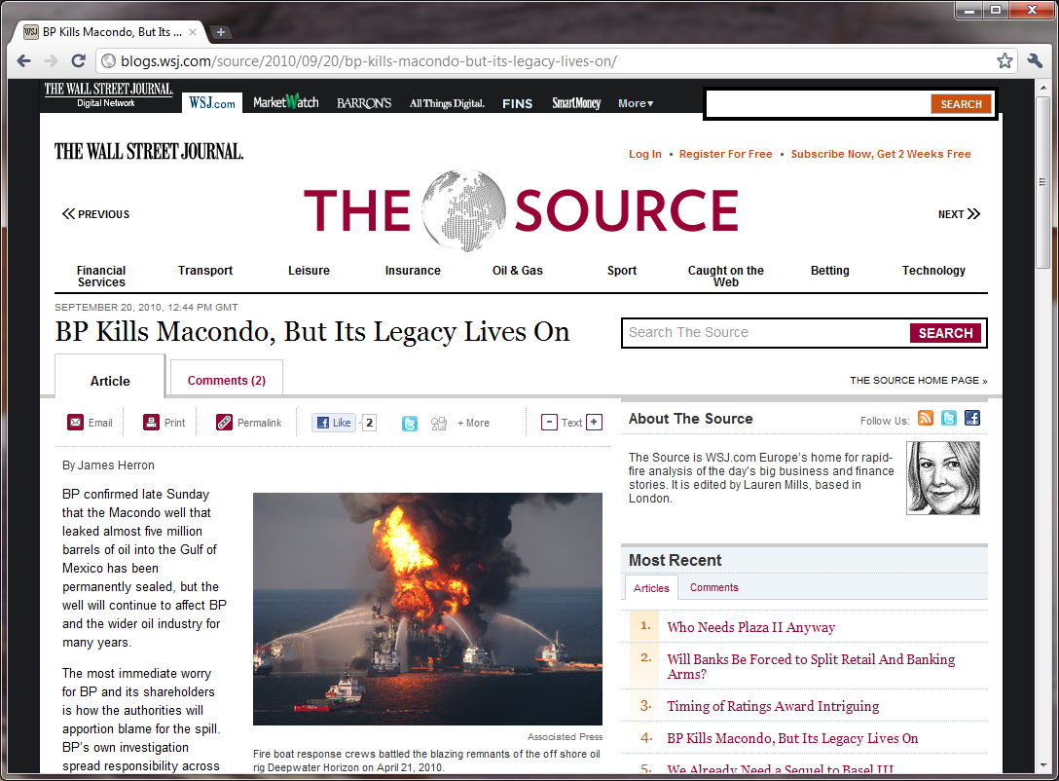
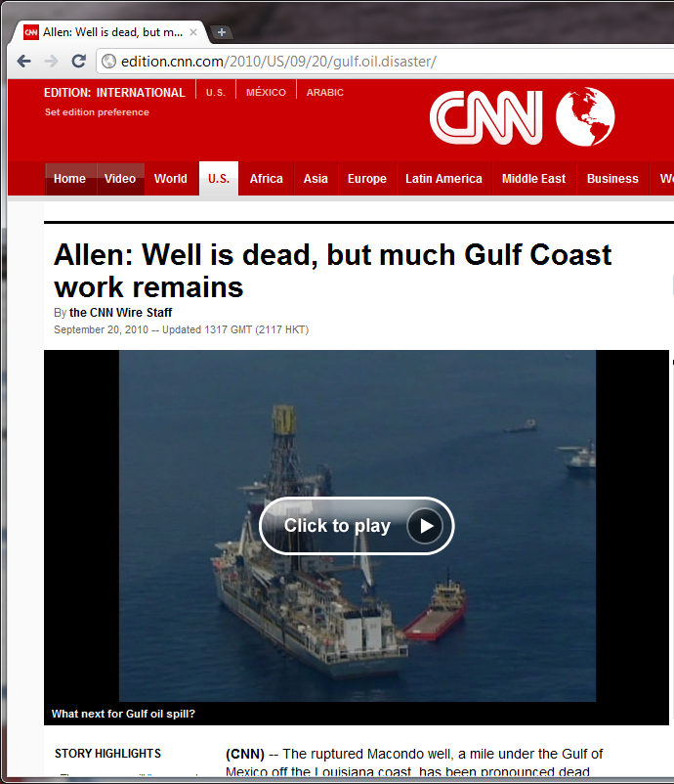
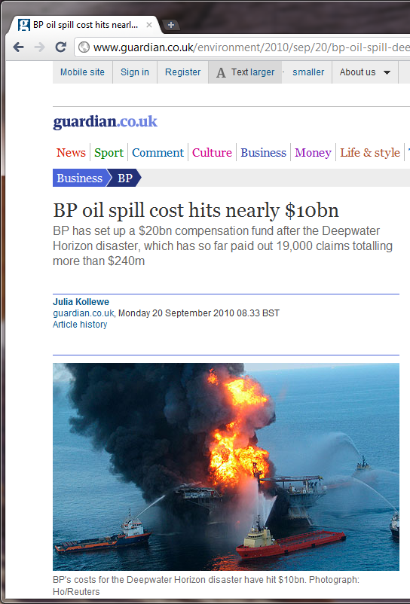

Slide 13
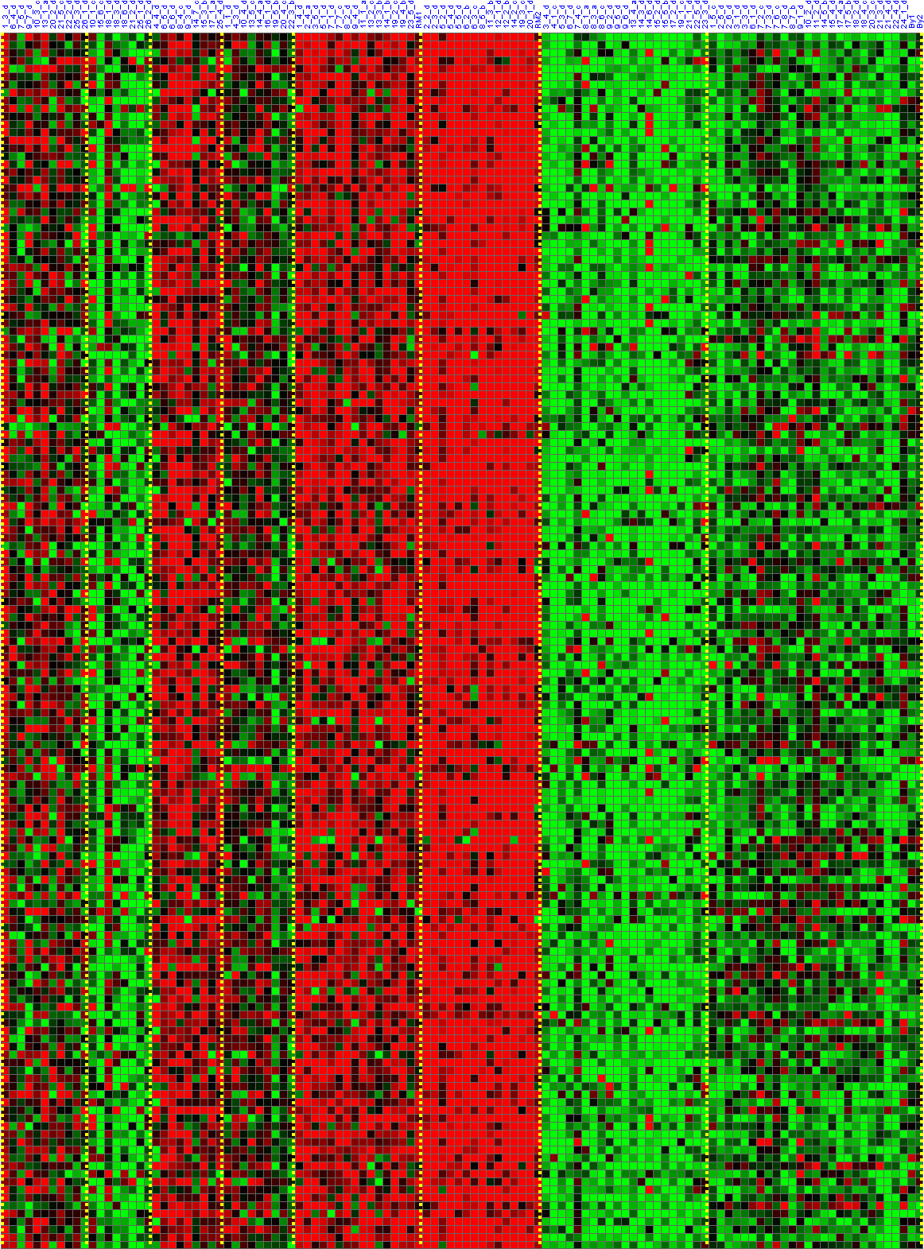
Genes
Individuals

Slide 14

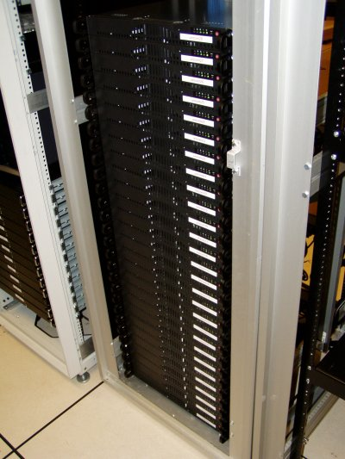
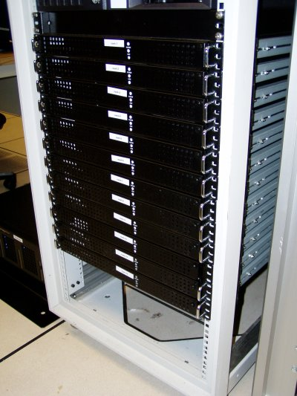

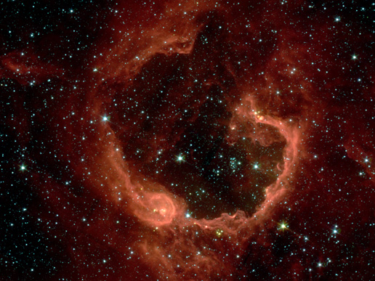
Organize computing clusters
Social network analysis
Image credit: NASA/JPL-Caltech/E. Churchwell (Univ. of Wisconsin, Madison)
Market segmentation
Astronomical data analysis
Notes:
Astronomical data analysis image obtained from NASA website.
http://www.nasa.gov/multimedia/imagegallery/image_feature_874.html
RCW 79 is seen in the southern Milky Way, 17,200 light-years from Earth in the constellation Centaurus. The bubble is 70-light years in diameter, and probably took about one million years to form from the radiation and winds of hot young stars. The balloon of gas and dust is an example of stimulated star formation. Such stars are born when the hot bubble expands into the interstellar gas and dust around it. RCW 79 has spawned at least two groups of new stars along the edge of the large bubble. Some are visible inside the small bubble in the lower left corner. Another group of baby stars appears near the opening at the top. NASA's Spitzer Space Telescope easily detects infrared light from the dust particles in RCW 79. The young stars within RCW79 radiate ultraviolet light that excites molecules of dust within the bubble. This causes the dust grains to emit infrared light that is detected by Spitzer and seen here as the extended red features. Image credit: NASA/JPL-Caltech/E. Churchwell (Univ. of Wisconsin, Madison)
--------------------
From NASA use guidelines:
http://www.nasa.gov/multimedia/guidelines/index.html
Using NASA Imagery and Linking to NASA Web Sites 10.13.05 Still Images, Audio Files and Video
NASA still images, audio files and video generally are not copyrighted. You may use NASA imagery, video and audio material for educational or informational purposes, including photo collections, textbooks, public exhibits and Internet Web pages. This general permission extends to personal Web pages.
This general permission does not extend to use of the NASA insignia logo (the blue "meatball" insignia), the retired NASA logotype (the red "worm" logo) and the NASA seal. These images may not be used by persons who are not NASA employees or on products (including Web pages) that are not NASA sponsored.
If the NASA material is to be used for commercial purposes, especially including advertisements, it must not explicitly or implicitly convey NASA's endorsement of commercial goods or services. If a NASA image includes an identifiable person, using the image for commercial purposes may infringe that person's right of privacy or publicity, and permission should be obtained from the person. Any questions regarding application of any NASA image or emblem should be directed to:
Photo Department NASA Headquarters 300 E St. SW Washington, DC 20546 Tel: (202)358-1900 Fax: (202)358-4333
Linking to NASA Web Sites
NASA Web sites are not copyrighted, and may be linked to from other Web sites, including individuals' personal Web sites, without explicit permission from NASA. However, such links may not explicitly or implicitly convey NASA's endorsement of commercial goods or services.
NASA images may be used as graphic "hot links" to NASA Web sites, provided they are used within the guidelines above. This permission does not extend to use of the NASA insignia, the retired NASA logotype or the NASA seal.
Restrictions
Please be advised that:
1) NASA does not endorse or sponsor any commercial product, service, or activity.
2) The use of the NASA name, initials, any NASA emblems (including the NASA insignia, the NASA logo and the NASA seal) which would express or imply such endorsement or sponsorship is strictly prohibited.
3) Use of the NASA name or initials as an identifying symbol by organizations other than NASA (such as on foods, packaging, containers, signs, or any promotional material) is prohibited.
4) NASA does permit the use of the NASA logo and insignia on novelty and souvenir-type items. However, such items may be sold and manufactured only after a proposal has been submitted to and approved by a Visual Identity representative from the Public Outreach Division (Phone: 202/358-1750) in accordance with 14 CFR (Code of Federal Regulations) Part 1221. Permission is granted on a nonexclusive basis as it is not NASA's policy to grant exclusive rights to use any of the agency identities.
5) No approval for use is authorized by NASA when the use can be construed as an endorsement by NASA of a product, service or activity.
6) NASA emblems should be reproduced only from original reproduction proofs, transparencies, or computer files available from NASA Headquarters. Please be advised that approval must be granted by a Visual Identity representative from the Public Outreach Division ( Tel: 202/358-1750) before any reproduction materials can be obtained.

Slide 15
Of the following examples, which would you address using an unsupervised learning algorithm? (Check all that apply.)
Given email labeled as spam/not spam, learn a spam filter.
Given a set of news articles found on the web, group them into set of articles about the same story.
Given a database of customer data, automatically discover market segments and group customers into different market segments.
Given a dataset of patients diagnosed as either having diabetes or not, learn to classify new patients as having diabetes or not.

Slide 16
Linear regression
Model Representation

Slide 17
Housing Prices
(Portland, OR)
Price
(in 1000s of dollars)
Size (feet²)
Supervised Learning
Given the “right answer” for each example in the data.
Regression Problem
Predict real-valued output

Slide 18
Training set of
housing prices
(Portland, OR)
Size in feet² (x) | Price ($) in 1000's (y)
2104 | 460
1416 | 232
1534 | 315
852 | 178
… | …
Notation:
m = Number of training examples
x’s = “input” variable / features
y’s = “output” variable / “target” variable

Slide 19
Training Set
How do we represent h ?
Learning Algorithm
Size of house
h
Estimated price
Linear regression with one variable.
Univariate linear regression.

Slide 20
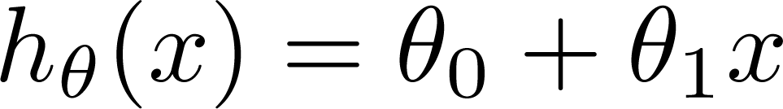

Training Set
Size in feet² (x) | Price ($) in 1000's (y)
2104 | 460
1416 | 232
1534 | 315
852 | 178
… | …
Hypothesis:
‘s: Parameters
How to choose ‘s ?

Slide 21
Linear regression
Cost Function

Slide 22
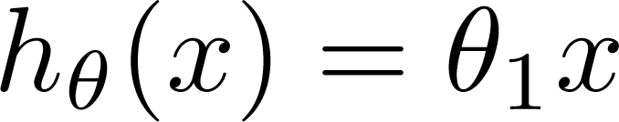


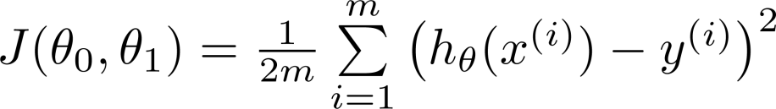
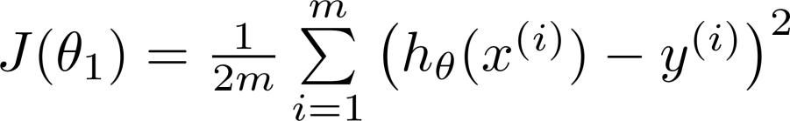


Simplified
Hypothesis:
Parameters:
Cost Function:
Goal:

Slide 23






(for fixed , this is a function of x)
(function of the parameter )
y
x

Slide 24

(for fixed , this is a function of x)
(function of the parameter )
y
x

Slide 25

(for fixed , this is a function of x)
(function of the parameter )
y
x

Slide 26
Linear regression
Gradient Descent

Slide 27

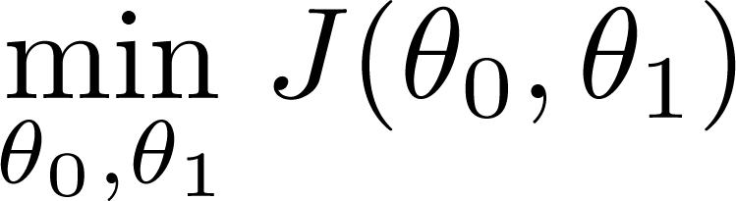
Have some function
Want
Outline:
Start with some
Keep changing to reduce until we hopefully end up at a minimum

Slide 28
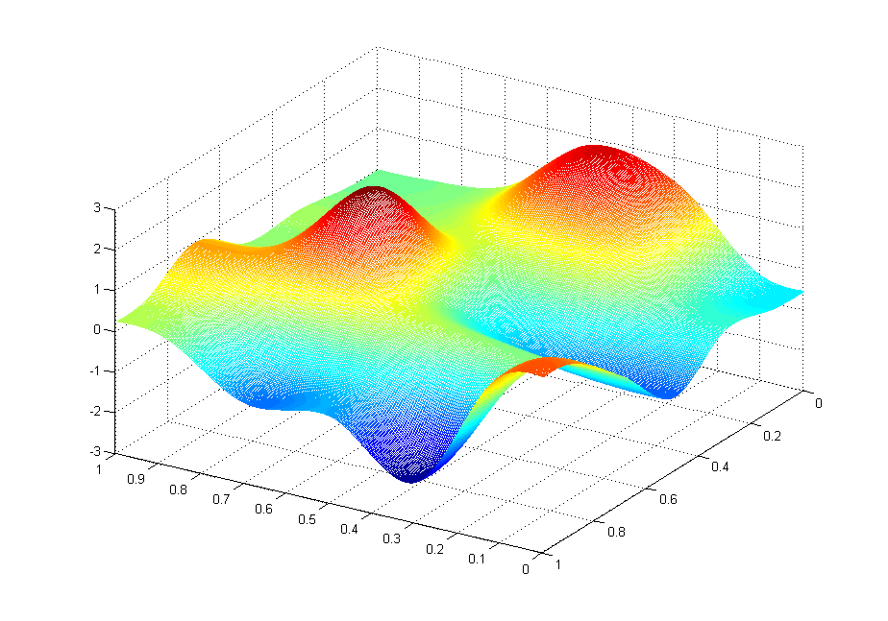
J(θ₀,θ₁)
θ₁
θ₀

Slide 29
J(θ₀,θ₁)
θ₁
θ₀

Slide 30
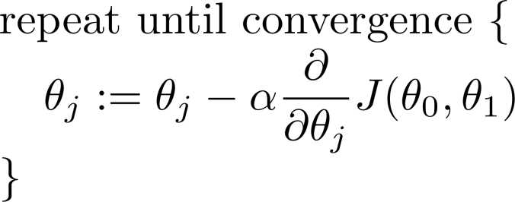

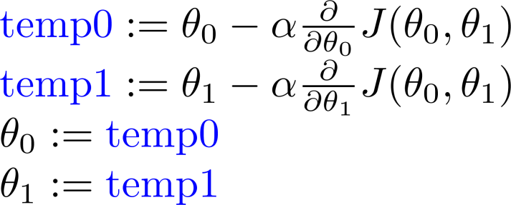
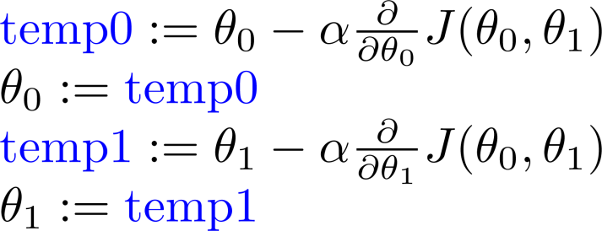
Gradient descent algorithm
Correct: Simultaneous update
Incorrect:

Slide 31
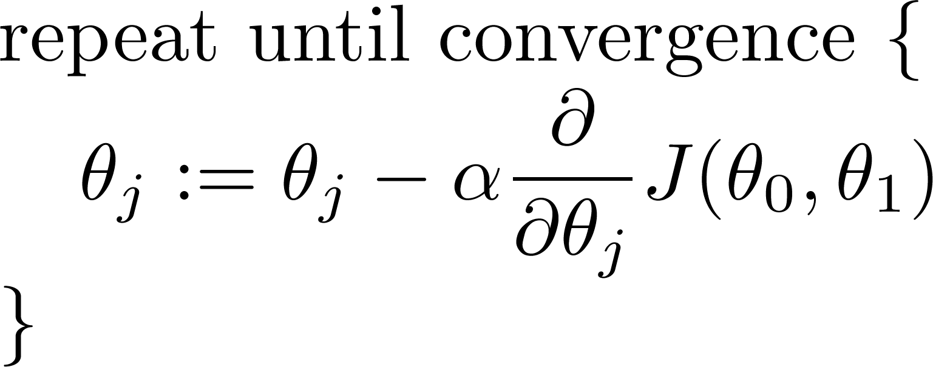

Gradient descent algorithm

Slide 33
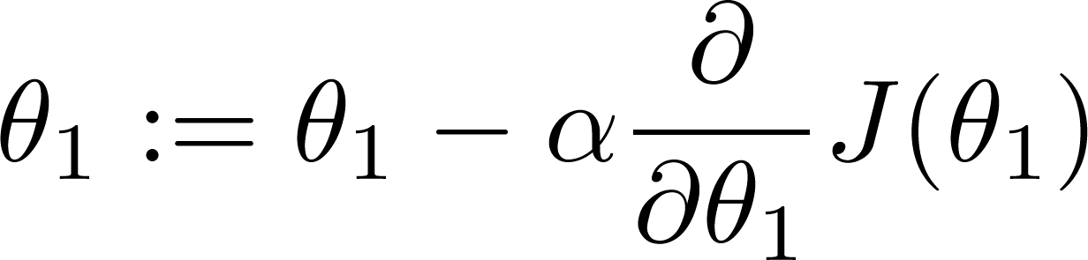
If α is too small, gradient descent can be slow.
If α is too large, gradient descent can overshoot the minimum. It may fail to converge, or even diverge.

Slide 34
Linear regression
Gradient Descent Algorithm for Linear Regression

Slide 35
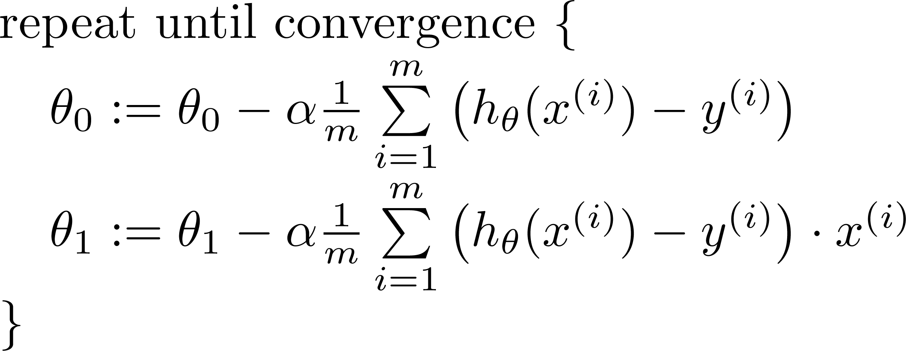

Gradient descent algorithm
update
and
simultaneously

Slide 36
Linear regression
Feature Scaling

Slide 37
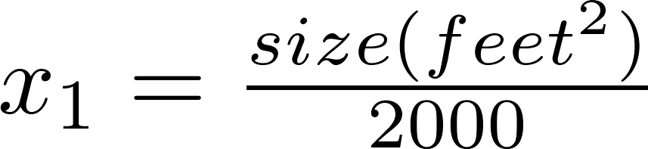


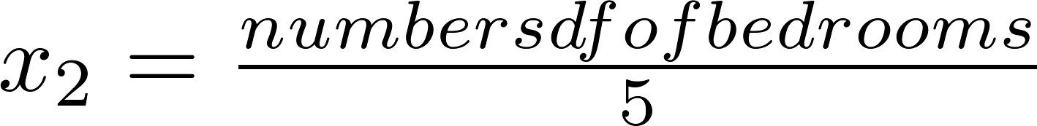



Feature Scaling
Idea: Make sure features are on a similar scale.
E.g. = size (0-2000 feet²)
= number of bedrooms (1-5)
size (feet²)
number of bedrooms

Slide 38



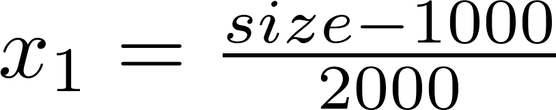
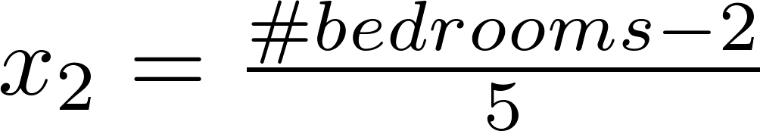
Mean normalization
Replace with to make features have approximately zero mean (Do not apply to ).
E.g.

Slide 39
Thank you

