Slide 1

Regularization
The problem of overfitting

Slide 2
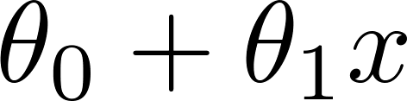
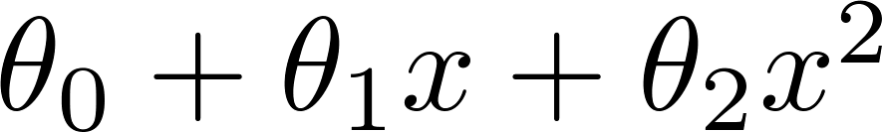
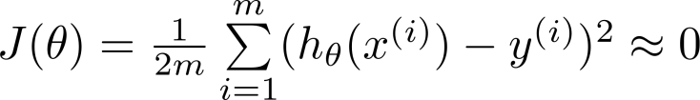
Example: Linear regression (housing prices)
Price
Price
Price
Size
Size
Size
Overfitting: If we have too many features, the learned hypothesis may fit the training set very well ( ), but fail to generalize to new examples (predict prices on new examples).

Slide 3


Addressing overfitting:
Options:
Reduce number of features.
Manually select which features to keep.
Model selection algorithm (later in course).
Regularization.
Keep all the features, but reduce magnitude/values of parameters .
Works well when we have a lot of features, each of which contributes a bit to predicting .

Slide 4
Regularization
Cost function

Slide 5


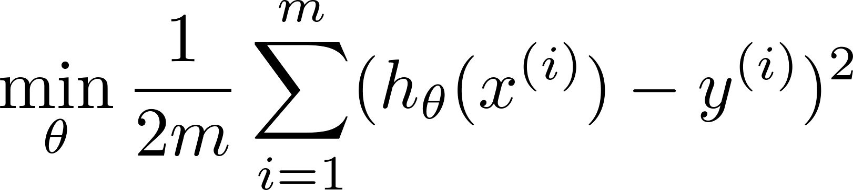
Intuition
Price
Price
Size of house
Size of house
Suppose we penalize and make , really small.

Slide 6
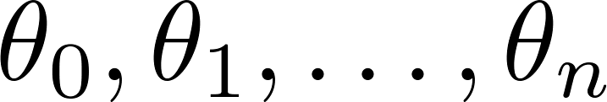
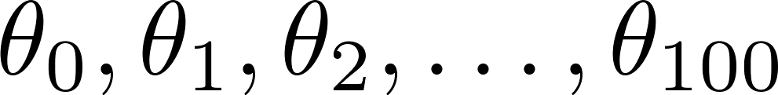
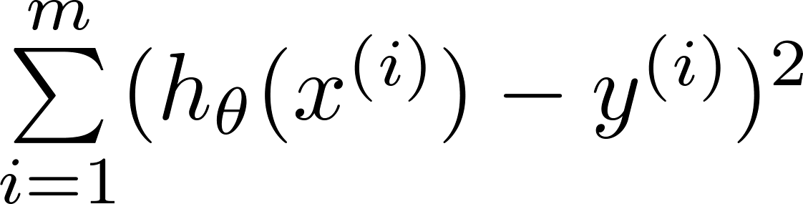
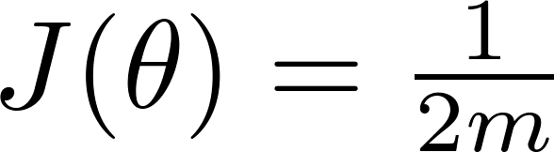
Regularization.
Small values for parameters
“Simpler” hypothesis
Less prone to overfitting
Housing:
Features:
Parameters:

Slide 7
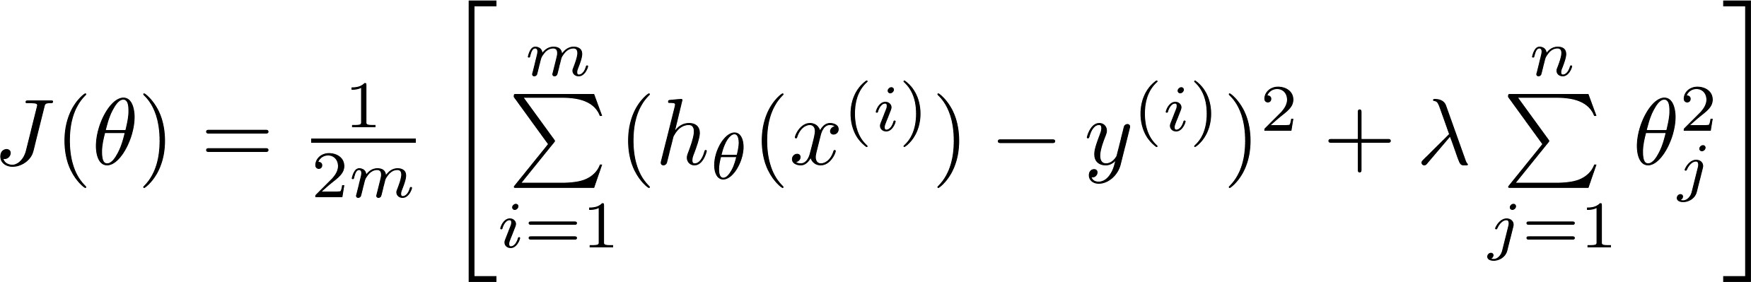
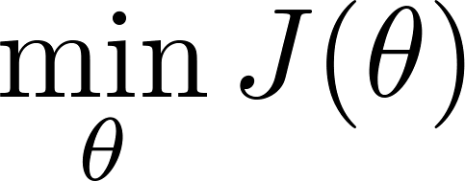
Regularization.
Price
Size of house

Slide 8


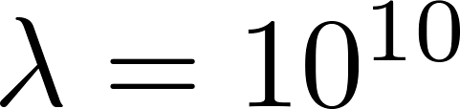
In regularized linear regression, we choose to minimize
What if is set to an extremely large value (perhaps for too large for our problem, say )?
Algorithm works fine; setting to be very large can’t hurt it
Algortihm fails to eliminate overfitting.
Algorithm results in underfitting. (Fails to fit even training data well).
Gradient descent will fail to converge.

Slide 9
In regularized linear regression, we choose to minimize
What if is set to an extremely large value (perhaps for too large for our problem, say )?
Price
Size of house

Slide 10
Regularization
Regularized linear regression

Slide 11
Regularized linear regression

Slide 12

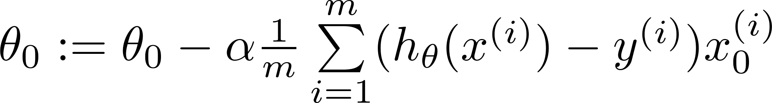
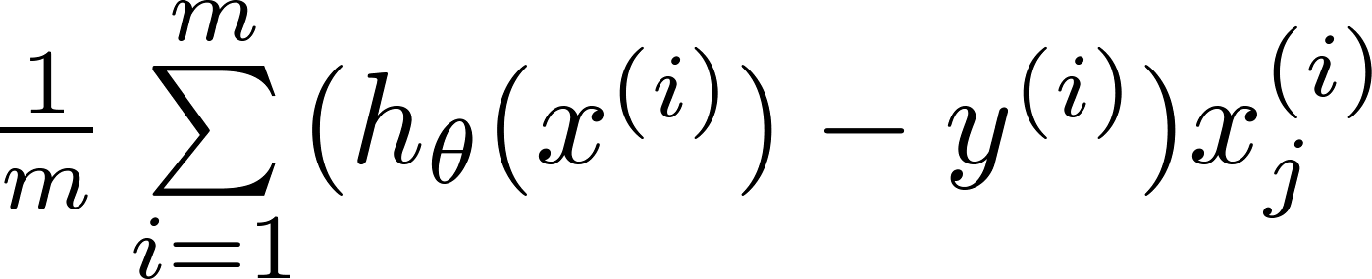
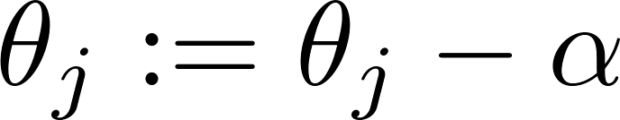


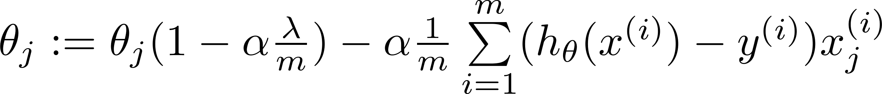
Gradient descent
Repeat

Slide 13
Regularization
Regularized logistic regression

Slide 14
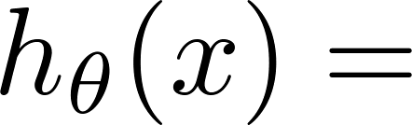
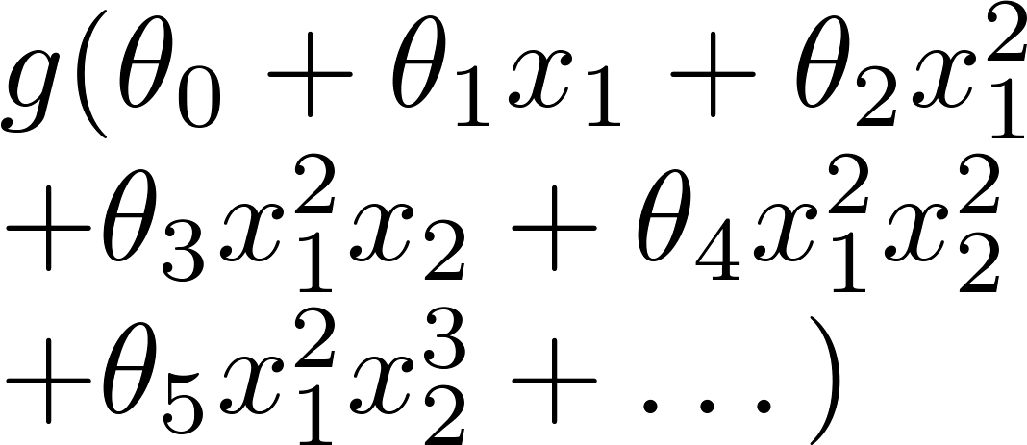
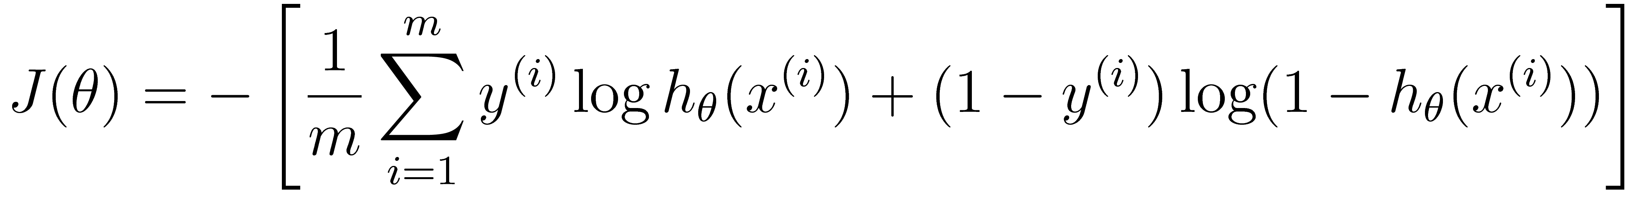
Regularized logistic regression.
x₂
x₁
Cost function:

Slide 15
Gradient descent
Repeat

Slide 16
Thank you

