Slide 1
Diabetes Prediction
Shiva Ramezani
Vedant Vartak
Group #10

Slide 2
Introduction
Diabetes is epidemic with potential of becoming a common problem for everyone in the future.
The International Diabetes Federation (IDF) predicts that 8.8% of the world’s population have diabetes. [1]
IDF estimates that the number of cases will rise to 642 million by 2040. [2]
Therefore, prediction is crucial to bring a curb on the rising number of cases.
Machine learning will help to predict and solve this problem

Slide 3
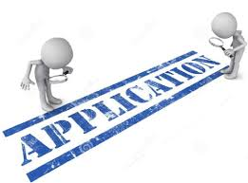
Application fields
Medical purposes - To know more about the patient and study the case of the patient in more detail.
Can be helpful to know if a person has diabetes or not which can save diagnosis time and would enable the patient to start treatment quickly.
Can be used to determine any upcoming trend regarding diabetes from the data with the help of prediction model

Slide 4

Research problems
Obtaining enough data is not easy since lot of the datasets were either small or incomplete with some of them being very old.
Accuracy improvement

Slide 5

Previous work
In one paper [3] preference was given to decision tree, random forest and linear regression. Their results showed over 96% accuracy for these algorithms which was a good score.
Next paper, [4] the data they used was obtained from Dyrad Digital Repository. The test accuracy they got was above 93% with XGB algorithm.
In another previous paper [5] named “Type 2 Diabetes Prediction using Machine Learning Algorithm” the authors made 8 different models using 8 different algorithms and compared the results at the end.

Slide 6
Previous work-continue
Pima indian dataset was used in most of the papers as it was easy to obtain.
Mostly supervised learning algorithms were used as they were easier to implement.
A lot of papers had predictions models with many different algorithms with all the results compared at the end.

Slide 7

Hypothesis /plans
Our plan is to utilize more complicated algorithms; Mostly unsupervised learning algorithms to check if it is possible to get higher accuracy levels than basic ones.

Slide 8

Dataset
Pima India Diabetes (PID) database was the dataset which we used and it was obtained from kaggle.com.
It included data of women, most of whichwere are at least 21 years of age.
The dataset has 2000 instance and 8 descriptive features.
The target feature has a binary value which indicates the patient has diabetes or not with 1 indicating the patient has diabetes.
[5]

Slide 9
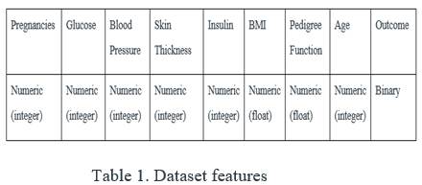
[6]

Slide 10
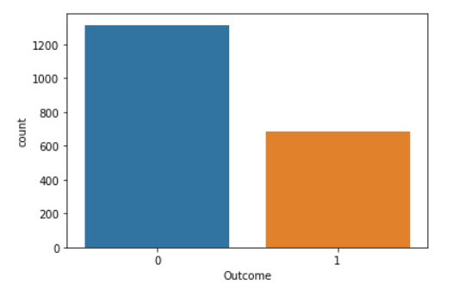
we can see the distribution of data based on the target feature. The ratio of non-diabetes to diabetes patients is 2 to 1.
Fig 1. Data distribution

Slide 11
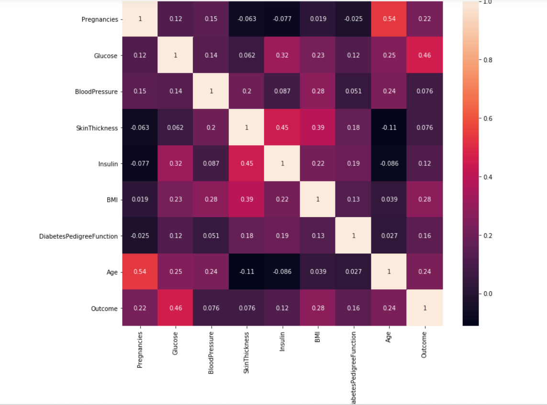
Here is the correlation matrix. As we can see the most correlated descriptive feature is the glucose level.
Fig 2. Correlation matrix

Slide 12
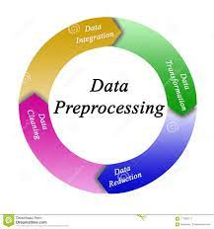
Preprocessing
The dataset had to be checked for NULL/NaN data and zero data and if any found, had to be removed.
Two types of scaling were used - Normalizer and Standard Scaler
Normalizer - Normalizing a vector consists of dividing data from the vector norm. It is used to obtain Euclidean distance of vector which is equal to a certain predetermined value through min-max normalization.
Standard Scaler - Features will be rescaled so that they have properties of a standard normal distribution with μ(mean) = 0 and σ = 1 (standard deviation). Standard score (z score) of the samples are calculated as follows-
z= x−μ / σ

Slide 13

Methodologies
Three different algorithms utilized in this project
Neural Networks
XGBoost
AdaBoost

Slide 14
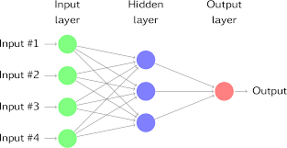
Neural Networks
Perfect for predicting illness occurrence
ANN are mathematical models that try to replicate the functions of the human brain and interconnections between them [7]
It fits a nonlinear correlation between input and output variables for high accuracy [8]

Slide 15
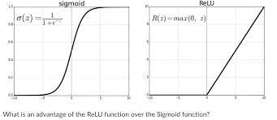
Activation functions utilized:
Sigmoid - It is a function that Receives input and translates the output values between 0 and 1
Relu (Rectified Linear Unit) - It is a function that outputs the input directly if its positive, otherwise, it will output zero. [9]
Optimizer:
Adam optimizer - Which is An optimization algorithm which can be used instead of the classical stochastic gradient descent procedure to update network weights iteratively in the training data.
We did the modeling with 50 epochs. Less number of epochs didnt give us good result. [9]

Slide 16
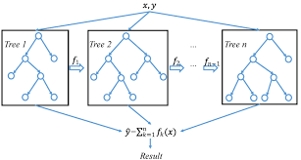
XGBoost
An effective supervised learning algorithm that delivers cutting edge outcomes in classification problems [10]
Resistant to outliers and automatic feature selection [10]
Gradient boosted decision trees designed for speed and performance. [11]
[10],[11]

Slide 17
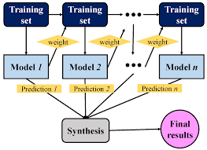
AdaBoost
AdaBoost combines many weak learners and turns them into a strong learner
Creates a forest of tree trunks instead of a tree. It is a tree stump that consists of one node and two leave [12]
No equal weight for all trees.
Stumps with more mistakes will play less role in the final decision
Order of stump creation is important [13]

Slide 18
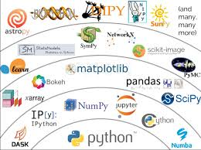
Tools:
Python programming language
Anaconda package mnager
Jupyter notebook
Python libraries:
Pandas
Numpy
Scikit learn
Seaborn
Matplotlib

Slide 19
Results

Slide 20
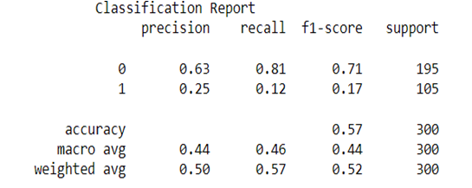
The preliminary result of Neural Network algorithm:
Test Accuracy: 0.57
Fig 6. Classification report of preliminary NN model

Slide 21
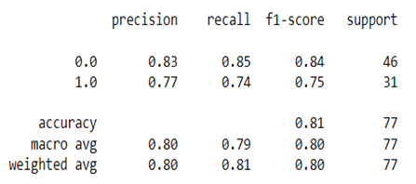
The modified result of Neural Network algorithm:
Test Accuracy: 0.81
Fig 7. Confusion matrix for neural network algorithm
Three-fold cross-value Score: 0.78

Slide 22
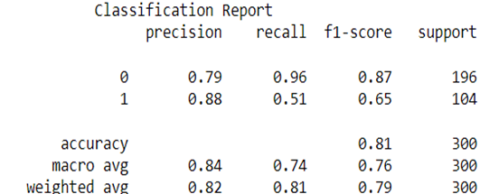
The result of XGB algorithm:
Test Accuracy: 0.81
Fig 9. Classification report of XGB model

Slide 23
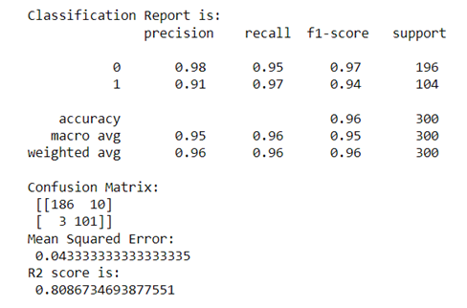
The result of ADAboost algorithm:
Test Accuracy: 0.96
MSR: 0.04
R2 score: 0.80
Fig 10. Classification report of AdaBoost model

Slide 24
Comparison of results
Algorithm | Test Accuracy
Neural Networks (Initial) | 0.57
Neural Networks (Modified) | 0.81
XGBoosting | 0.81
AdaBoosting | 0.96

Slide 25
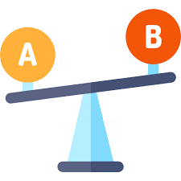
Contributions and comparisons
Our contribution to this topic was trying new algorithms which were not used in previous works.
The comparison of all algorithms that we utilized to do our contribution to the topic is:
Neural Network = XGB < AdaBoost

Slide 26
Discussion
Previous papers were using decision tree, random forest, linear regression algorithms to predict diabetes
They were easy to implement
Therefore, we decided to implement our model using algorithms which were not commonly seen in the research papers
Our main objective was to implement a complicated algorithm and try to obtain better result compared to basic algorithms

Slide 27
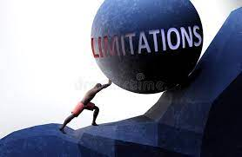
Limitations
Private data : Medical facilities which can be difficult to get as hospitals like to keep data of their patients private on the grounds of integrity.
Old data: The data obtained from hospitals can be old and may be missing a recent trend which may be a major factor in causing diabetes. Thus it is necessary to obtain the latest datasets of patients to stay up to date with recent trends which in turn will help to build a better model.

Slide 28
Future Work
We hope that in future our work can be developed further by other peers to build a prediction model having even better results and higher accuracy using different algorithms., specifically neural network to pursue our initial hypothesis.

Slide 29
Conclusions
Diabetes prediction using machine learning is effective
Our contribution is to utilize Neural networks, XGBoost and AdaBoost
Initial results were not matching our expectations, further tests saw an improvement in numbers.
The results showed, simple algorithms have better results compared to complicated ones which we utilized in this project.

Slide 30
Reference list
1. Thomas R. Einarson, Annabel Acs, Craig Ludwig, Ulrik H. Panton, Prevalence of cardiovascular disease in type 2 diabetes: a systematic literature review of scientific evidence from across the world in 2007–2017
2. Aishwarya Mujumdar, V Vaidehi, Diabetes Prediction using Machine Learning Algorithms, Procedia Computer Science, Volume 165, 2019, Pages 292-299
3. Tigga, Neha Prerna, and Shruti Garg. "Prediction of type 2 diabetes using machine learning classification methods." Procedia Computer Science 167 (2020): 706-716.
4. Sisodia, Deepti, and Dilip Singh Sisodia. "Prediction of diabetes using classification algorithms." Procedia computer science 132 (2018): 1578-1585.
5. M. K. Hasan, M. A. Alam, D. Das, E. Hossain and M. Hasan, "Diabetes Prediction Using Ensembling of Different Machine Learning Classifiers," in IEEE Access, vol. 8, pp. 76516-76531, 2020, doi: 10.1109/ACCESS.2020.2989857
6. Kaur, H. and Kumari, V. (2022), "Predictive modeling and analytics for diabetes using a machine learning approach", Applied Computing and Informatics, Vol. 18 No. 1/2, pp. 90-100. https://doi.org/10.1016/j.aci.2018.12.004
7. Li, Huixia PhD; Luo, Miyang MD; Zheng, Jianfei MD; Luo, Jiayou PhD; Zeng, Rong MPH; Feng, Na MPH; Du, Qiyun MD; Fang, Junqun MPH An artificial neural network prediction model of congenital heart disease based on risk factors, Medicine: February 2017 - Volume 96 - Issue 6 - p e6090

Slide 31
8. Maren A, Harston C and Pap R, Handbook of Neural Computing Applications. Academic Press, London (1990)
9. GÜCLÜ, Dunyamin, et al. “Application of Neural Network Prediction Model to Full-Scale Anaerobic Sludge Digestion.” Journal of Chemical Technology and Biotechnology (1986), vol. 86, no. 5, John Wiley & Sons, Ltd, 2011, pp. 691–98
10. Chen, T.; Guestrin, C. XGBoost: A scalable tree boosting system. In Proceedings of the 22nd ACM SIGDD Int Conf on Knowledge Discovery, San Francisco, CA, USA, August 2016; pp. 13–17
11. Cappon, G., Facchinetti, A., Sparacino, G., Georgiou, P., & Herrero, P. (2019). Classification of postprandial glycemic status with application to insulin dosing in type 1 Diabetes—An in silico proof-of-concept. Sensors, 19(14)
12. Chmielewski, Michal R., and Jerzy W. Grzymala-Busse. "Global discretization of continuous attributes as preprocessing for machine learning." International journal of approximate reasoning 15.4
13. Lee, Wei-Meng. Python Machine Learning. 1st edition, Wiley, 2019

Slide 32
THANK YOU ALL!

Slide 33

Q&A

