Slide 1
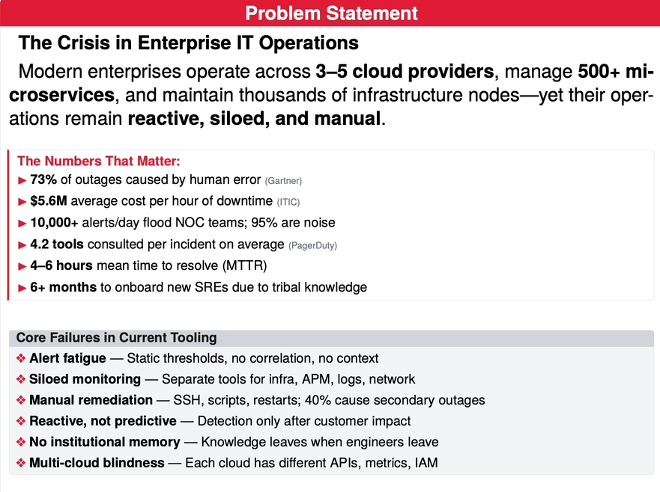

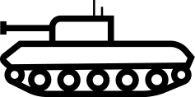
DYNAMIC IT OPERATIONS ORCHESTRATOR
AUTONOMOUS MULTI-AGENT AIOPS PLATFORM FOR SELF-HEALING ENTERPRISE INFRASTRUCTURE
Key Features
A2A Multi-Agent Orchestration
LangGraph + Google A2A protocol for autonomous inter-agent collaboration. Agents reason via LLM, delegate to domain specialists, learn from outcomes.
Predictive Causal Intelligence
LSTM/Transformer forecasting with 30-min horizon. Bayesian causal graphs model real dependencies moves from correlation to causation.
Blast-Radius-Aware Remediation
Simulates fix impact on dependency graph before execution. Canary rollout: 5% → 25% → 100% with auto-matic rollback on degradation.
Institutional Memory System
RAG + Vector DB captures every incident, fix, and outcome. Auto-generates runbooks from successful manual
fixes. Zero tribal knowledge loss.
Cloud-Agnostic Canonical Model
Unified “Compute/Storage/Network” abstraction across AWS, Azure, GCP. Same dashboard, same actions,
different providers
Proof of Concept
Team Name :- Tank Busters
Team Members:-
P.Shiva Santhosh
N.S.J.S.Dhanush
P.Shikhar
Ingestion
Corelation
Prediction
Analysis
Remediation
Report, Learn & Close
OpenTelemetry +
FluentBit
ML clustering
LSTM + Transformer
networks
Bayesian causal
inference
Canary rollout
Weaviate vector DB

Slide 2
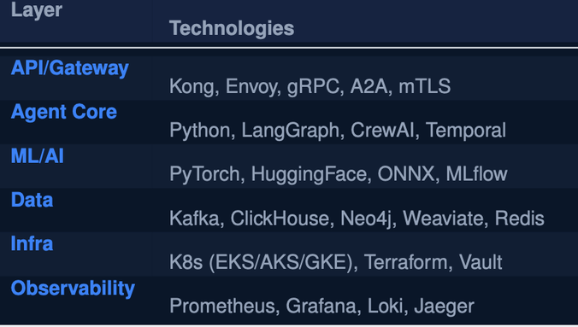
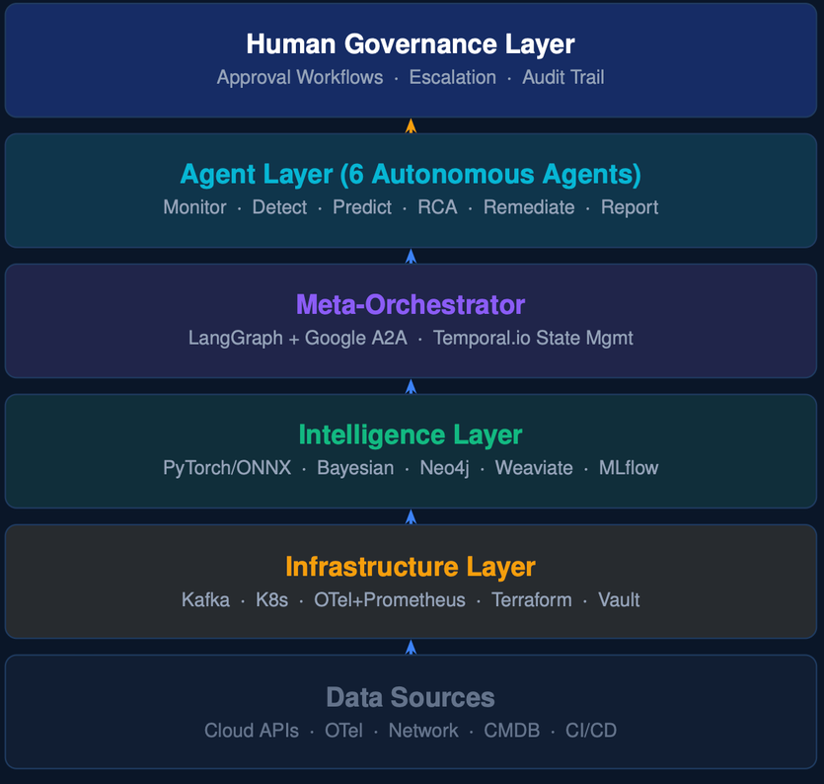
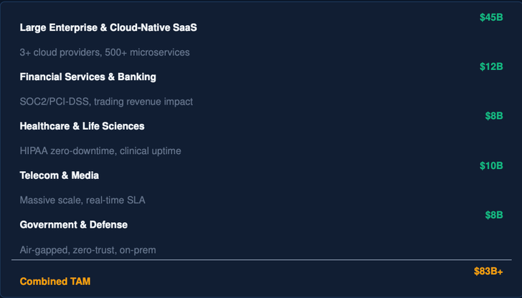
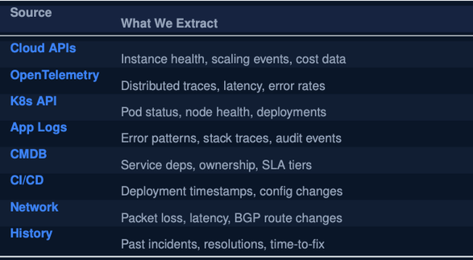
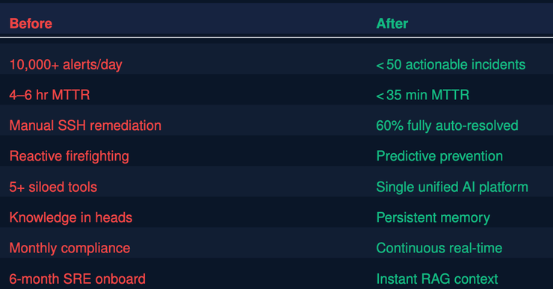
Technology Stack
System Overflow
Target Segments
Data Sources
Before vs After

