Slide 1
AWS IDENTITY AND ACCESS MANAGEMENT
Creating IAM Groups &
Assigning Permissions
A hands-on, screenshot-guided walkthrough of the AWS Management
Console — from opening IAM to assigning users their permissions.
Prepared for: AWS Console Walkthrough

Slide 2
OVERVIEW
What We'll Walk Through
IAM groups let you attach permissions once and apply them to many users — instead of managing policies per user. This deck follows one complete workflow end to end.
1
Open the IAM Console
2
Create User Groups
3
Attach Permission Policies
Navigate to the IAM dashboard from AWS services.
Set up “Developers” and “Admins” groups.
Assign AWS-managed policies to each group.
4
Create IAM Users
5
Assign Users to Groups
6
Review Best Practices
Add individual user identities to the account.
Map each user to the correct permission group.
Keep access secure, least-privilege, and auditable.
AWS IAM • Groups & Permissions
2

Slide 3
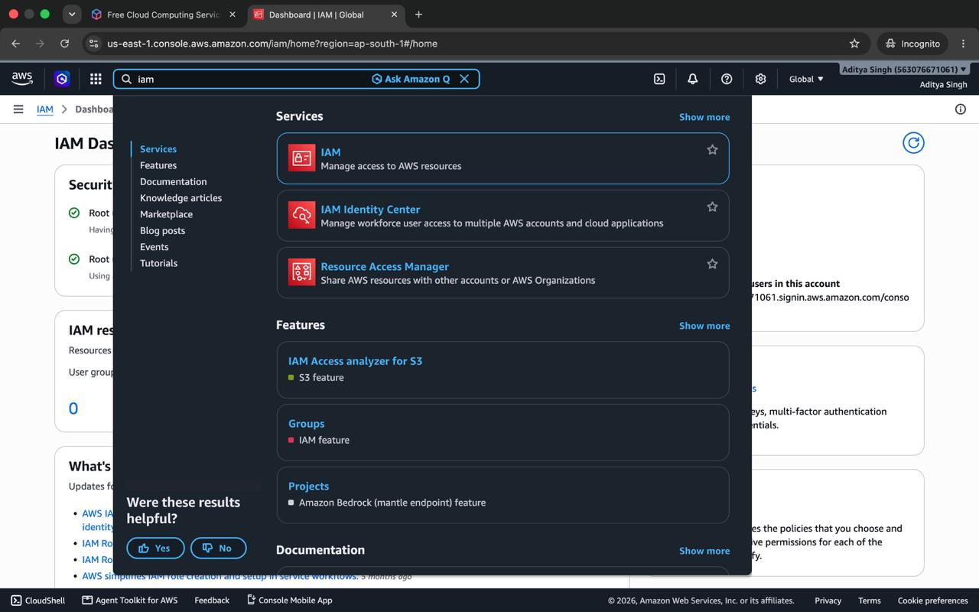
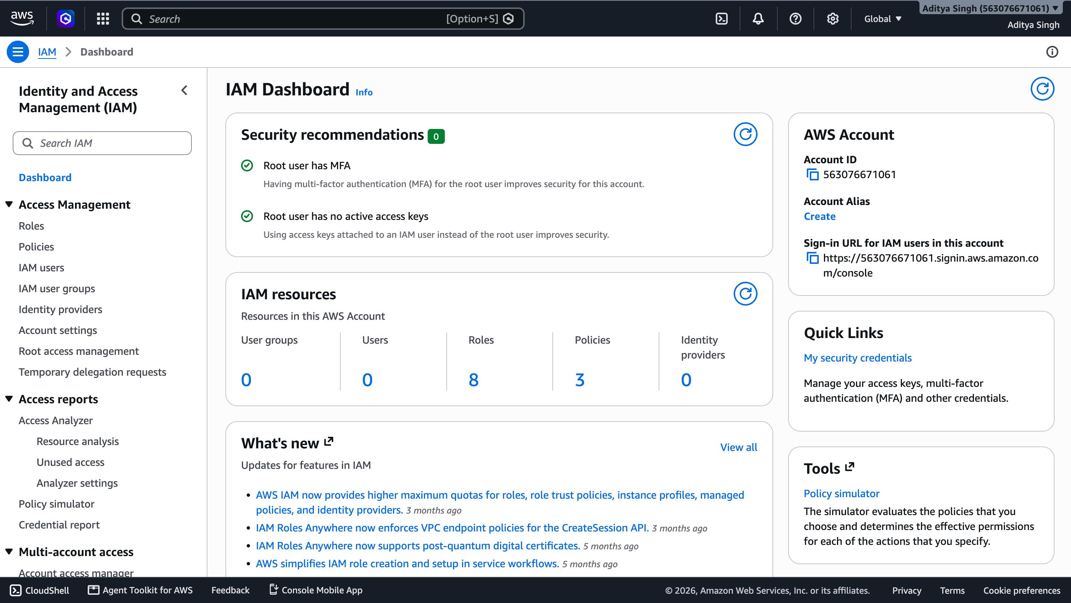
STEP 1
Access the IAM Console
Sign in to the AWS Management Console and search for “IAM” in the top navigation bar. Selecting the IAM service opens the IAM Dashboard, which summarizes account security status and resource counts.
Search
Dashboard
AWS IAM • Groups & Permissions
3

Slide 4
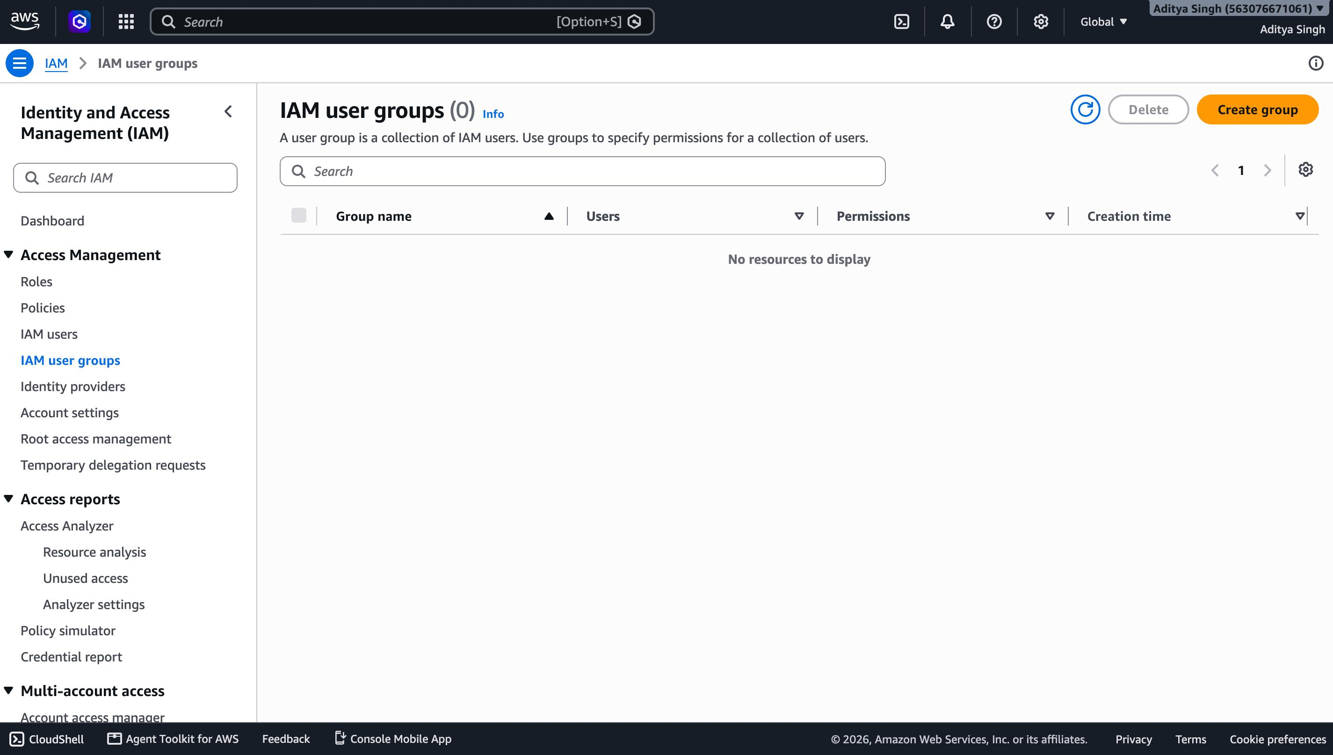
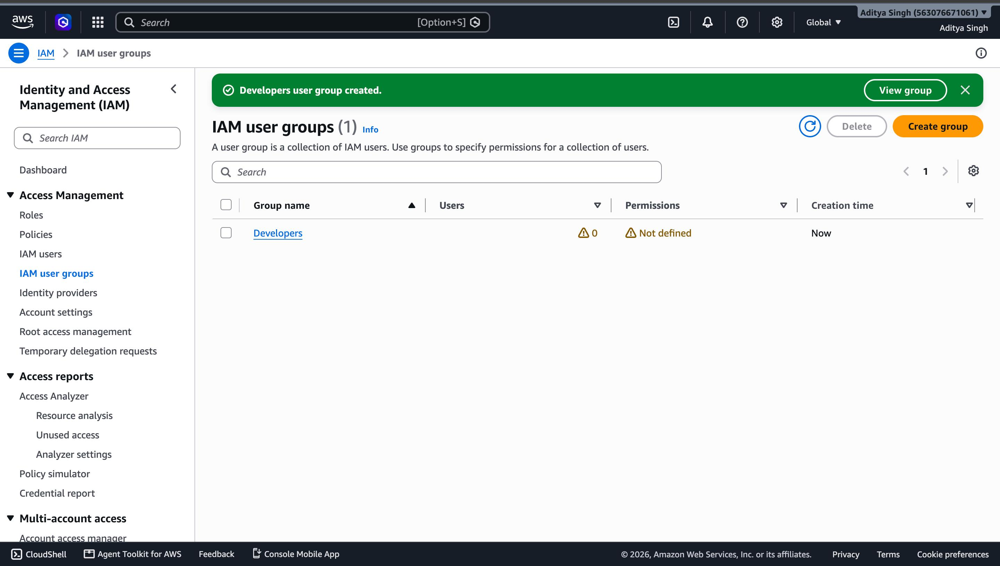
STEP 2
Create the “Developers” User Group
From IAM → User groups, the account starts with zero groups. Click Create group, name it Developers, and AWS confirms creation immediately.
Before
Created
AWS IAM • Groups & Permissions
4

Slide 5
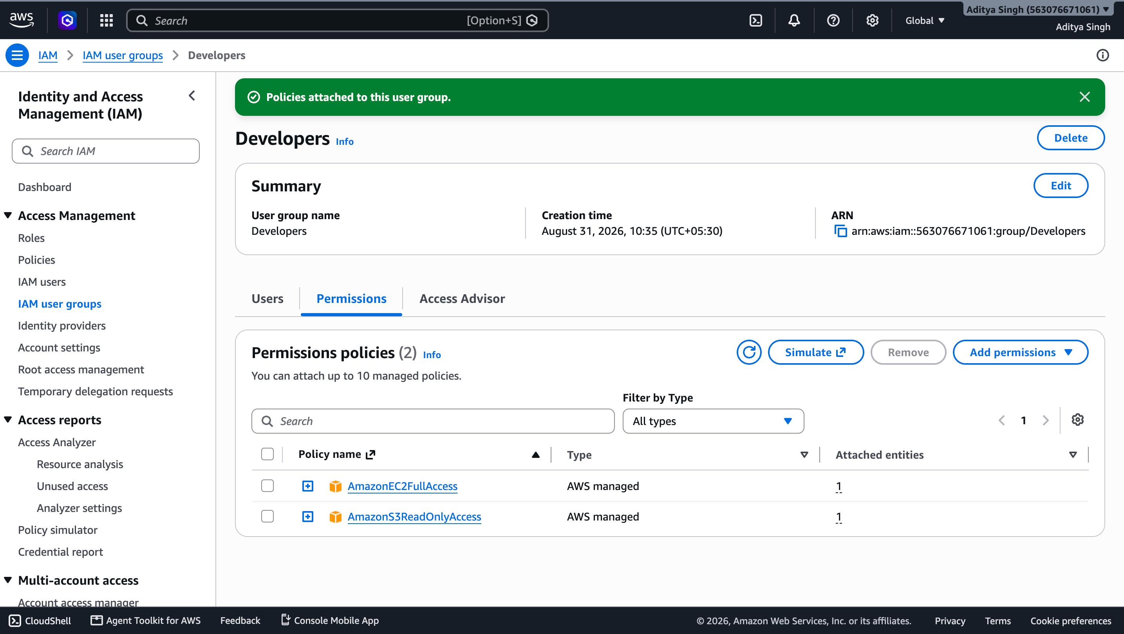
STEP 3
Attach Permissions to Developers
Policies attached
Console
AmazonEC2FullAccess
Full control over EC2 instances and resources.
AmazonS3ReadOnlyAccess
View and read objects across S3 buckets.
Any user later added to this group automatically inherits both policies — no per-user setup needed.
AWS IAM • Groups & Permissions
5

Slide 6
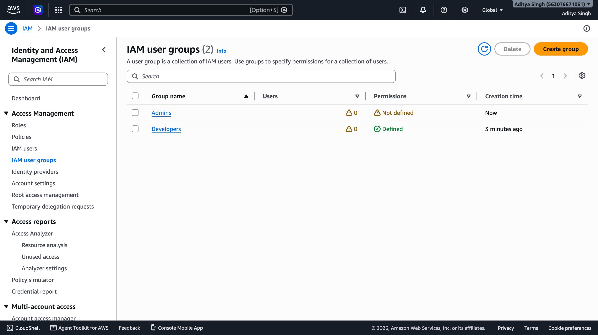
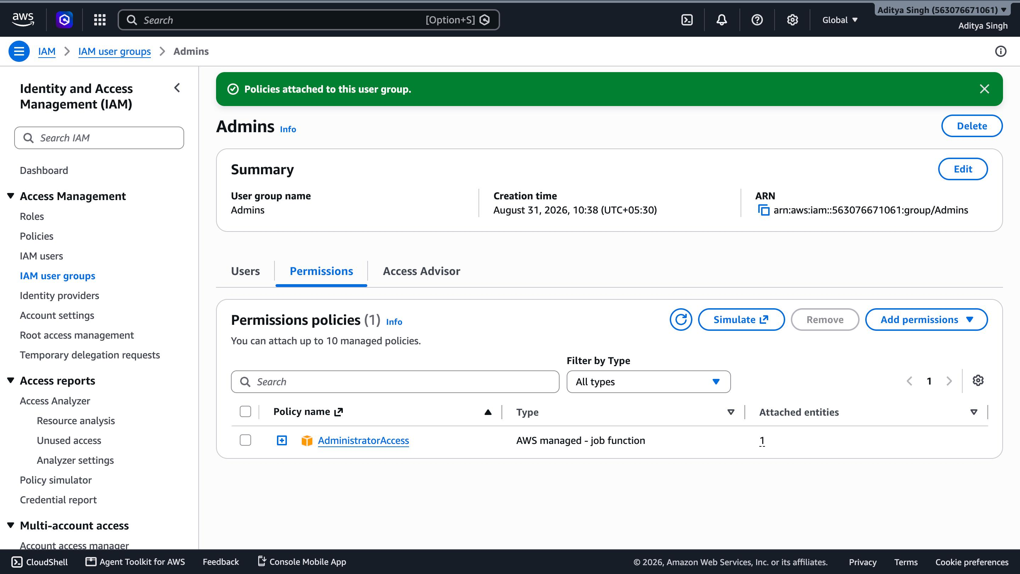
STEP 4
Create the “Admins” Group
A second group, Admins, is created the same way. The IAM user groups list now shows both groups, and AdministratorAccess is attached to Admins for full account privileges.
2 Groups
Admins
AWS IAM • Groups & Permissions
6

Slide 7
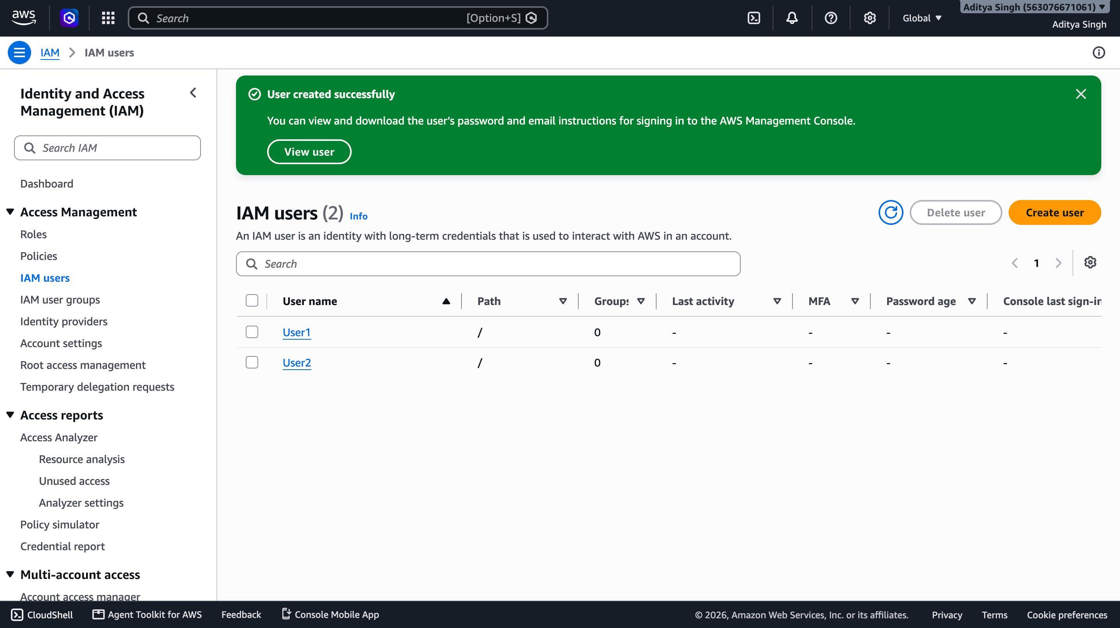
STEP 5
Create IAM Users
With groups and policies ready, individual IAM users are created next — User1 and User2 — each starting with zero group memberships until explicitly assigned.
2 Users
AWS IAM • Groups & Permissions
7

Slide 8
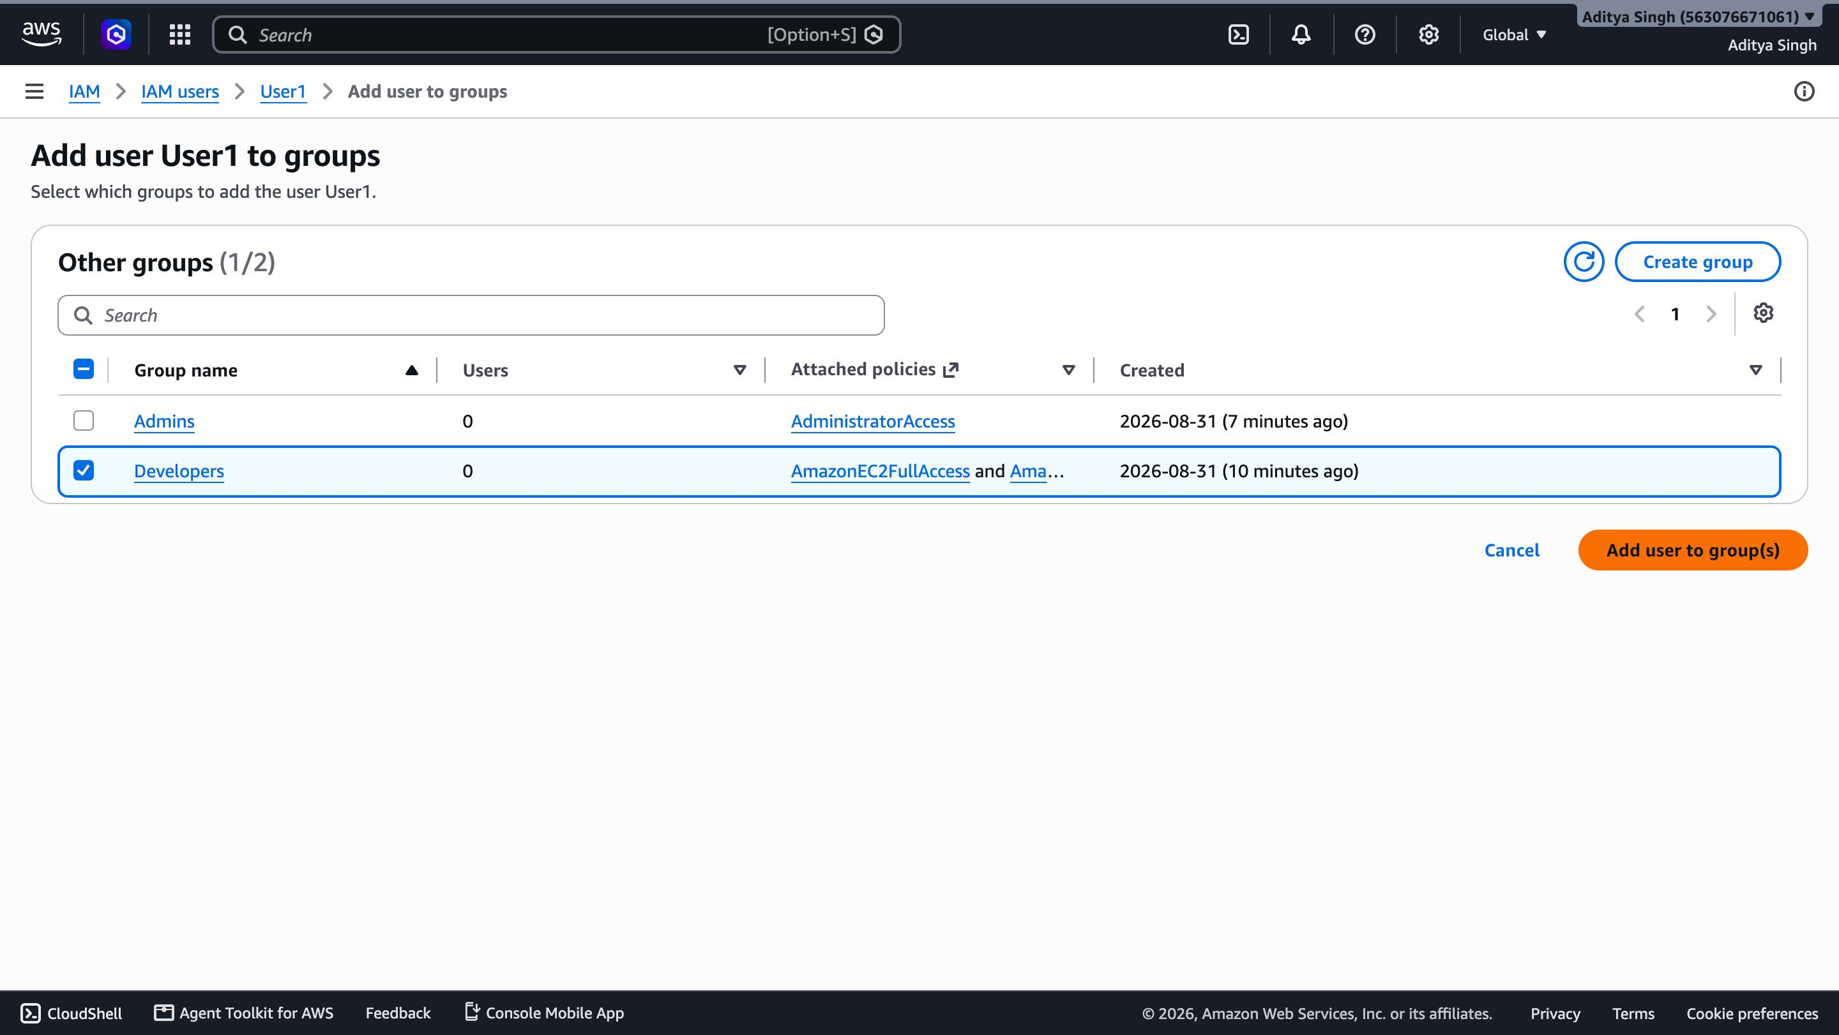
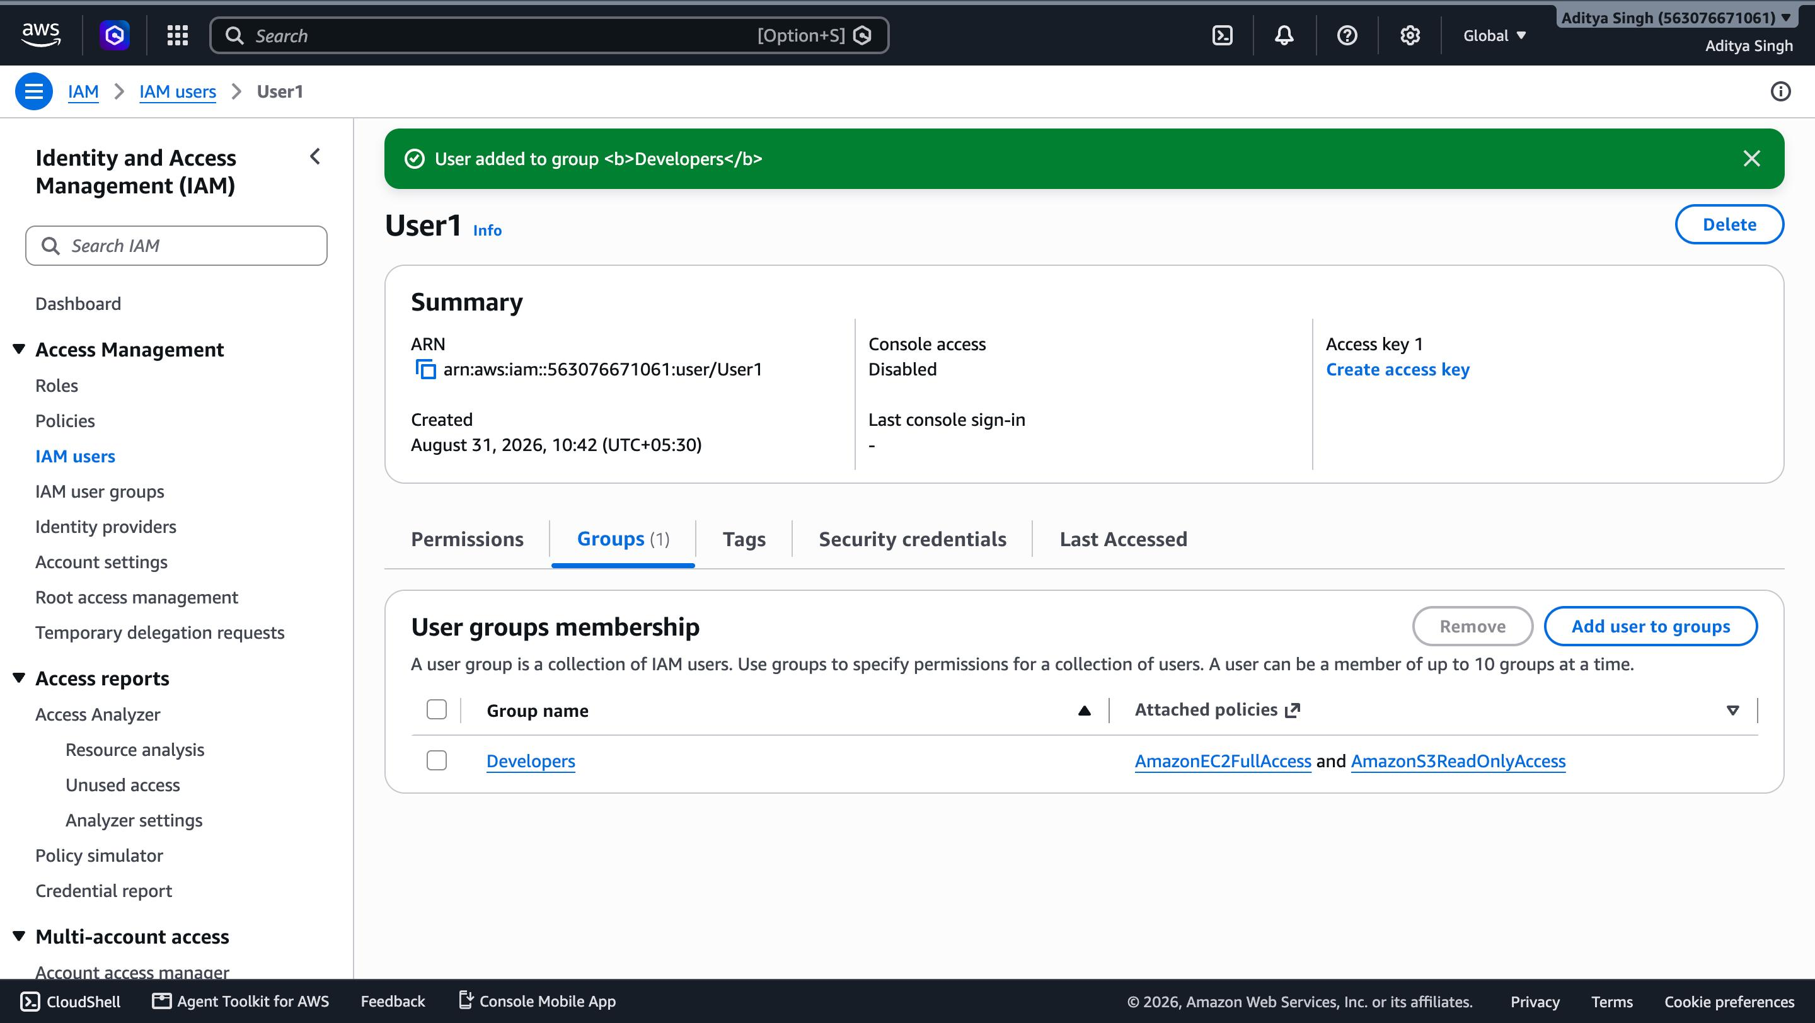
STEP 6
Assign User1 → Developers Group
On User1's Groups tab, select Add user to groups, check Developers, and confirm. User1 immediately inherits the group's EC2 and S3 permissions.
Select
Confirmed
AWS IAM • Groups & Permissions
8

Slide 9
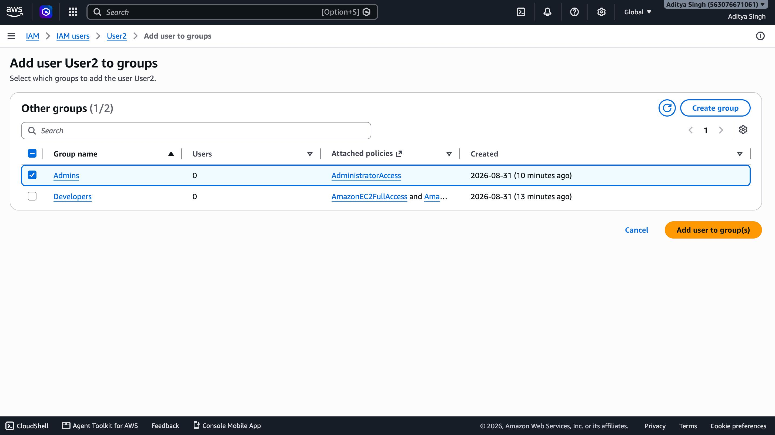
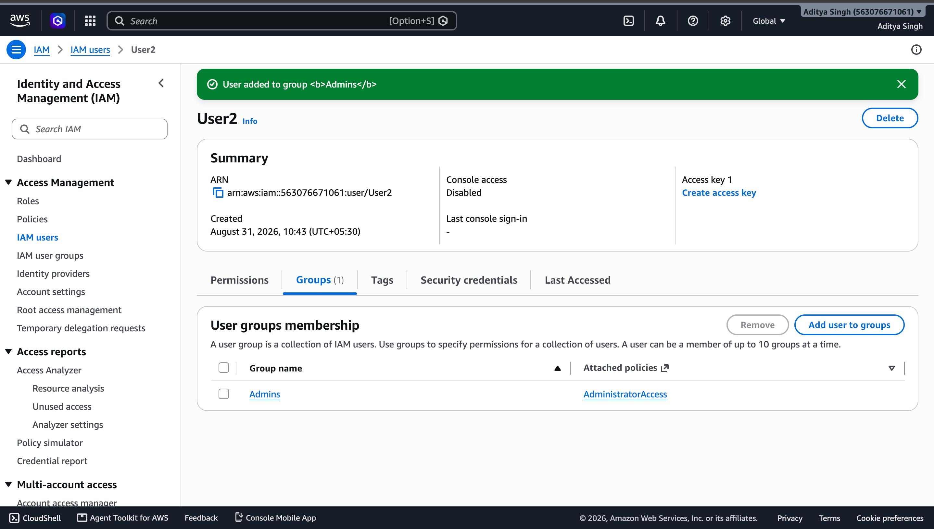
STEP 7
Assign User2 → Admins Group
The same flow applies to User2: check Admins on the Add user to groups screen. User2 now holds AdministratorAccess through group membership.
Select
Confirmed
AWS IAM • Groups & Permissions
9

Slide 10
RECAP
1
Group first, assign second
Group-Based
Access, Done
Right
Attach policies to groups, not individual users — it scales cleanly.
2
Apply least privilege
Give each group only the access its role actually needs.
Console → Groups → Policies → Users → Assignment
3
Use clear naming
Names like “Developers” and “Admins” keep audits simple.
4
Review regularly
Use Access Analyzer and the Policy Simulator to check unused access.
Thank you

