Slide 1
Bellabeat
Smart Device Usage Analysis
Marketing Strategy Recommendations for Bellabeat Time
Case Study | Ask · Prepare · Process · Analyze · Share · Act

Slide 2
01 — ASK
Business Task
This analysis examines FitBit fitness tracker data to uncover trends in how people use smart devices to track daily activity and sleep — and uses those insights to recommend marketing strategies for Bellabeat's Time smart watch.
1
What are some trends in smart device usage?
2
How could these trends apply to Bellabeat customers?
3
How could these trends influence Bellabeat's marketing strategy?

Slide 3
02 — PREPARE
Data Source & Credibility
FitBit Fitness Tracker Data — 33 users, April 12 – May 12, 2016. CC0 Public Domain, via Mobius (Kaggle).
Reliable
Original
Comprehensive
Current
Cited
Small sample (33 users); demographics unknown
Third-party survey data, not first-party Bellabeat/FitBit
Covers activity, sleep, steps, weight — missing age/gender
Collected 2016 — roughly a decade old
CC0 Public Domain, properly licensed via Kaggle/Mobius

Slide 4
03 — PROCESS
Data Cleaning & Completeness
Duplicates removed
3 duplicate rows found and removed from sleepDay_merged using SELECT DISTINCT
Date formats standardized
Two mixed date/time text formats parsed into clean DATETIME fields — zero data loss across 22,000+ rows
Completeness checked
Activity, steps, calories & intensity: 100% of users. Sleep: 73%. Weight: 24% (excluded from analysis)

Slide 5
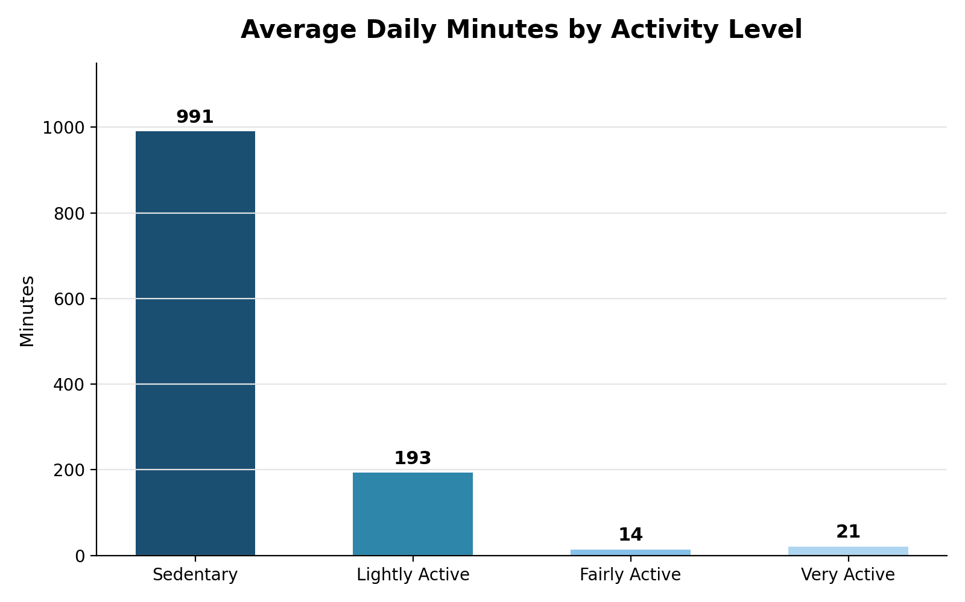
04 — ANALYZE
Finding 1 — Users Are Highly Sedentary
991 min
spent sedentary per day — about 16.5 hours
vs. just 35 minutes of real fairly/very active movement, and 7,638 average daily steps — below the 10,000 benchmark.
Takeaway: most users are everyday people, not athletes.

Slide 6
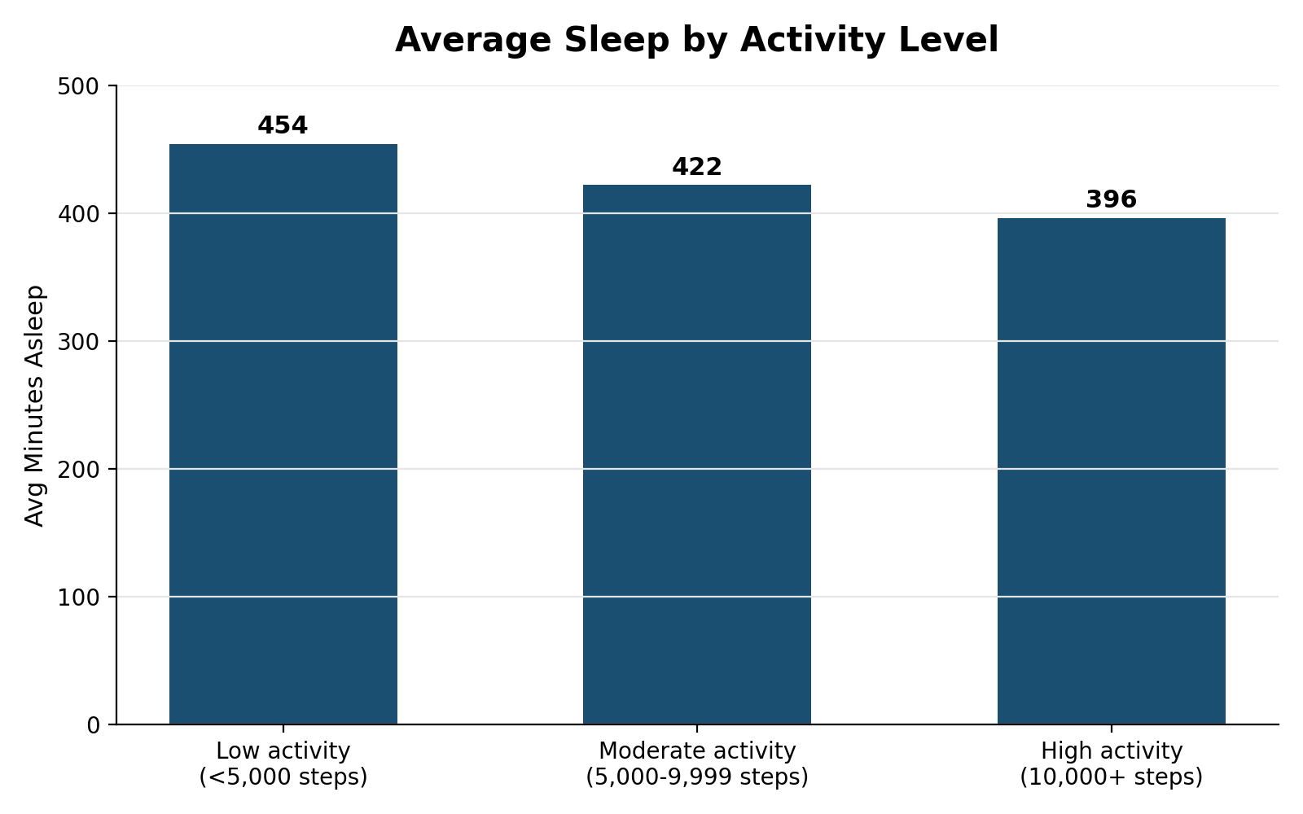
04 — ANALYZE
Finding 2 — More Active Users Sleep Less
−58 min
less sleep on high-activity days vs. low-activity days
Low activity (<5,000 steps): 454 min sleep
High activity (10,000+ steps): 396 min sleep
Takeaway: busier, active days leave less time to rest — a real trade-off worth surfacing to users.

Slide 7
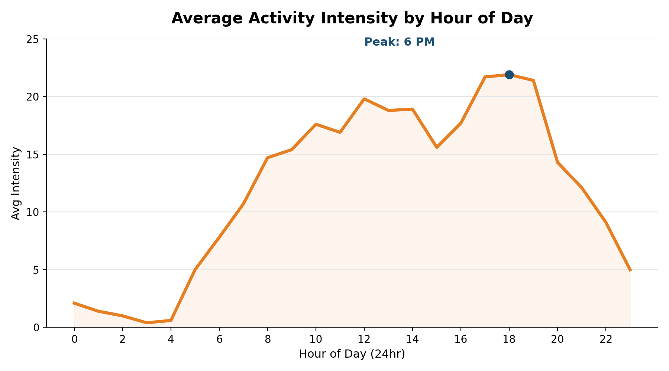
04 — ANALYZE
Finding 3 — Activity Peaks at 5–7 PM
6 PM
is the single most active hour of the day across all users
Intensity is lowest at 3–4 AM, climbs through the morning, plateaus in the day, and peaks sharply 5–7 PM.
Takeaway: this window is the best time to reach users.

Slide 8
05 — ACT
Recommendations for Bellabeat Time
1
2
3
Market Achievable, Everyday Movement
Promote Sleep + Activity Balance
Target the 5–7 PM Engagement Window
Position Time around gentle nudges (e.g., hourly stand-up reminders) rather than intense fitness metrics — most users aren't athletes.
Highlight Time's combined tracking, with wind-down notifications on high-activity days to help protect sleep.
Send a motivational nudge at 5 PM, an appreciation note at 7 PM, and surface membership promotions during this peak window.

Slide 9
06 — CONSIDERATIONS
Limitations
Small sample size (33 users) limits how confidently findings generalize.
Data is roughly a decade old (2016); habits and technology have likely shifted.
No demographic data (age, gender) — Bellabeat's core audience is women, but the sample's makeup is unknown.
Sleep data covers 73% of users and weight data only 24%, limiting confidence in those specific findings.

Slide 10
Thank You
Bellabeat Smart Device Usage Analysis | Prepared for the Bellabeat Executive Team

