Slide 1
Optimized Warehouse
Management of
Perishable Goods
For a
Food Delivery Company

Slide 2
TECH TYCOONS!
SPS_PRO_1602
Shivaani S.
Mahima M.

Slide 3
INTRODUCTION:
A warehouse is place for storing goods. It is used by manufactures, importers, exporters, transport businesses, wholesalers, etc. In this recent technological world, warehouse management system is a software application used for the efficient management of warehouses.

Slide 4
EXISTING PROBLEM:
A food delivery service has to deal with a lot of perishable raw materials which makes it all, the most important factor for such a company is to accurately forecast daily and weekly demand. Too much inventory in the warehouse means more risk of wastage, and not enough could lead to out-of-stocks - and push customers to seek solutions from your competitors. The replenishment of majority of raw materials is done on weekly basis and since the raw material is perishable, the procurement planning is of utmost importance.

Slide 5

Proposed Solution
Machine Learning Model to predict the demand of goods for the next few weeks.

Slide 6
WAREHOUSEIFY

Slide 7
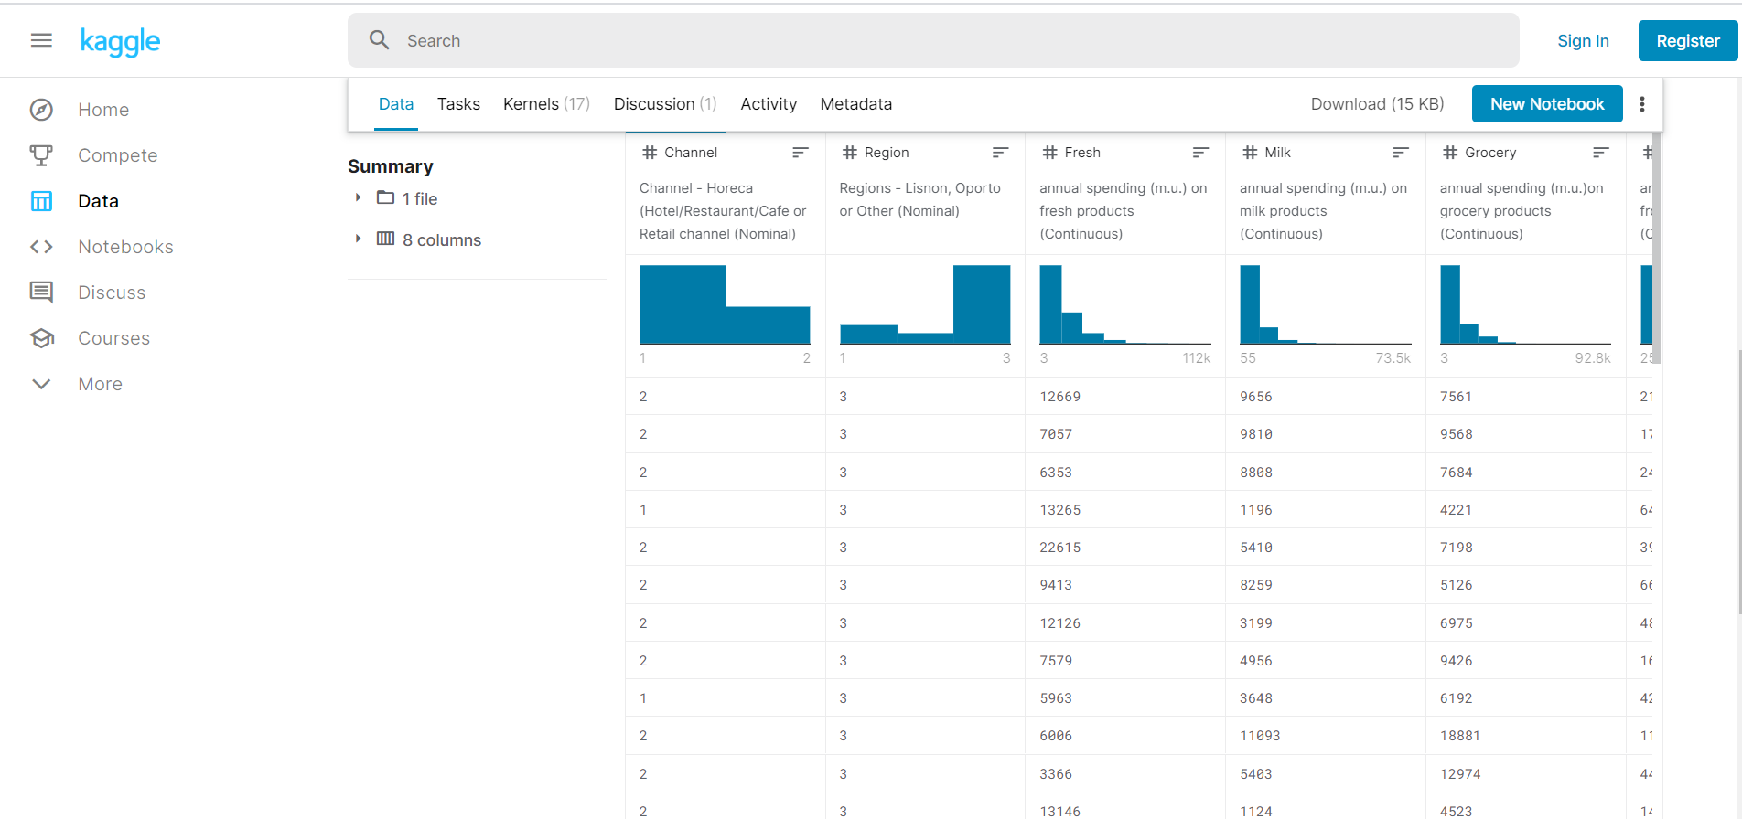

Slide 8
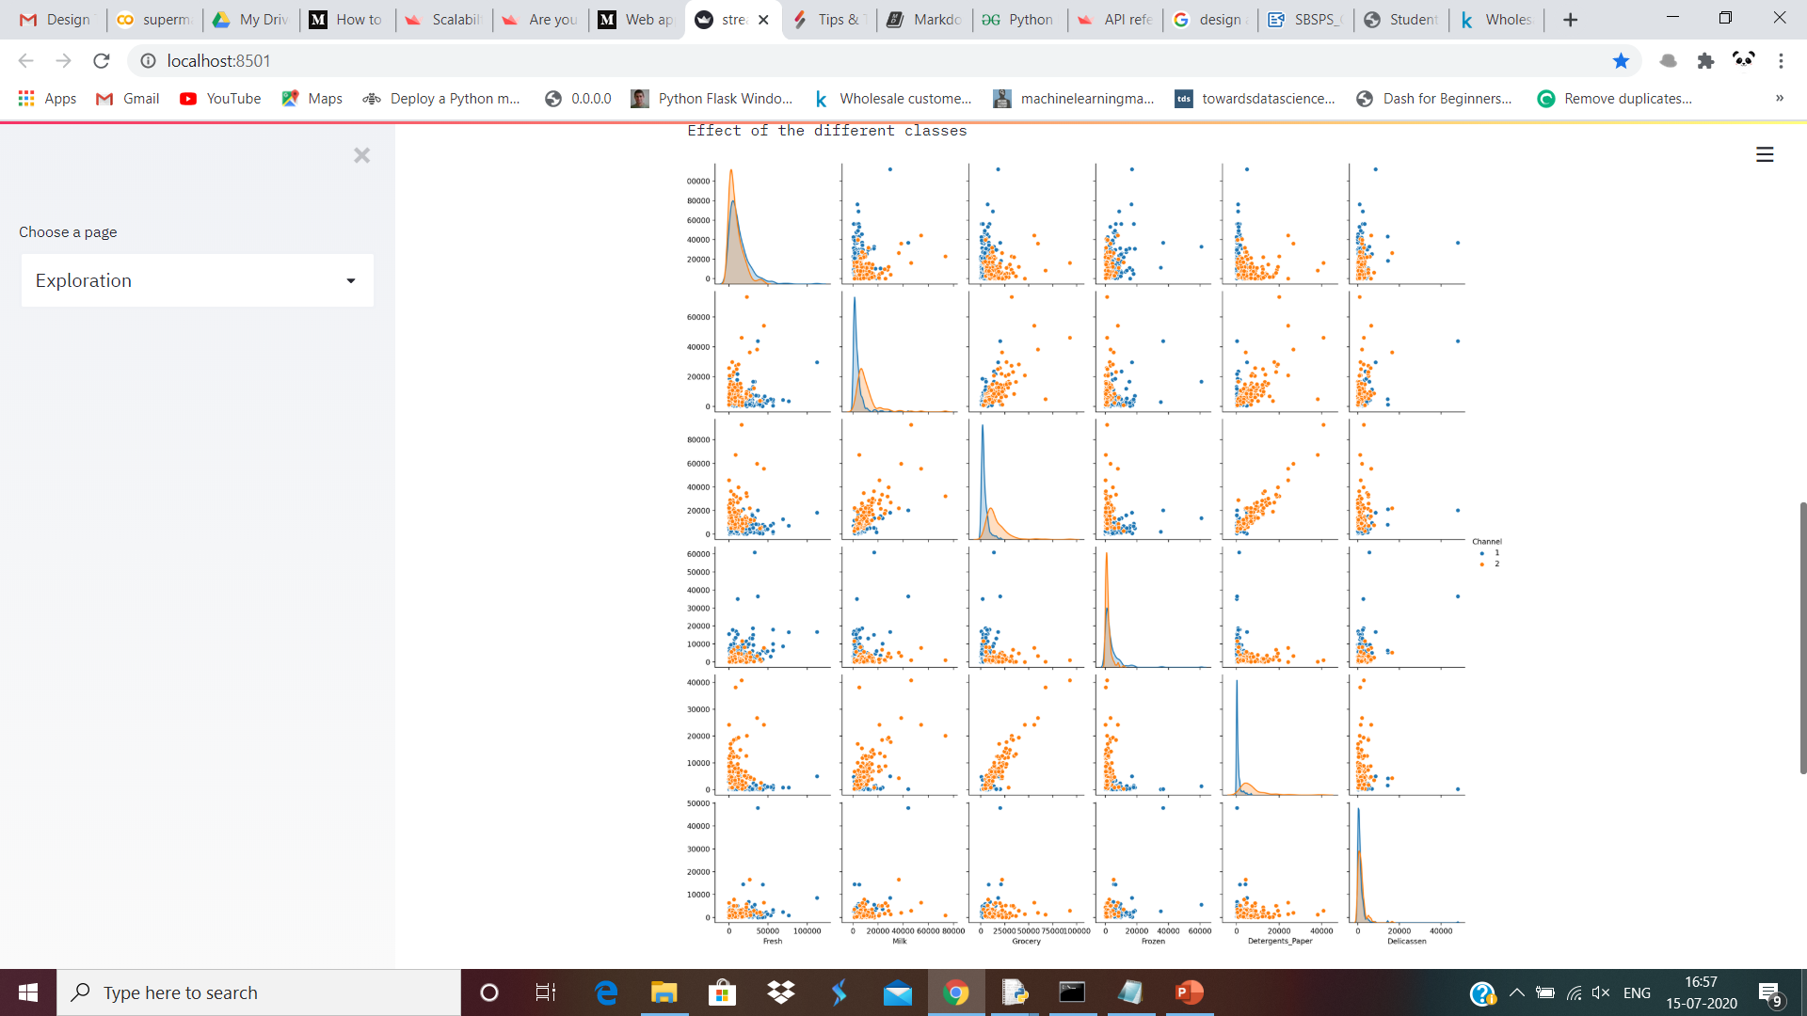

Slide 9
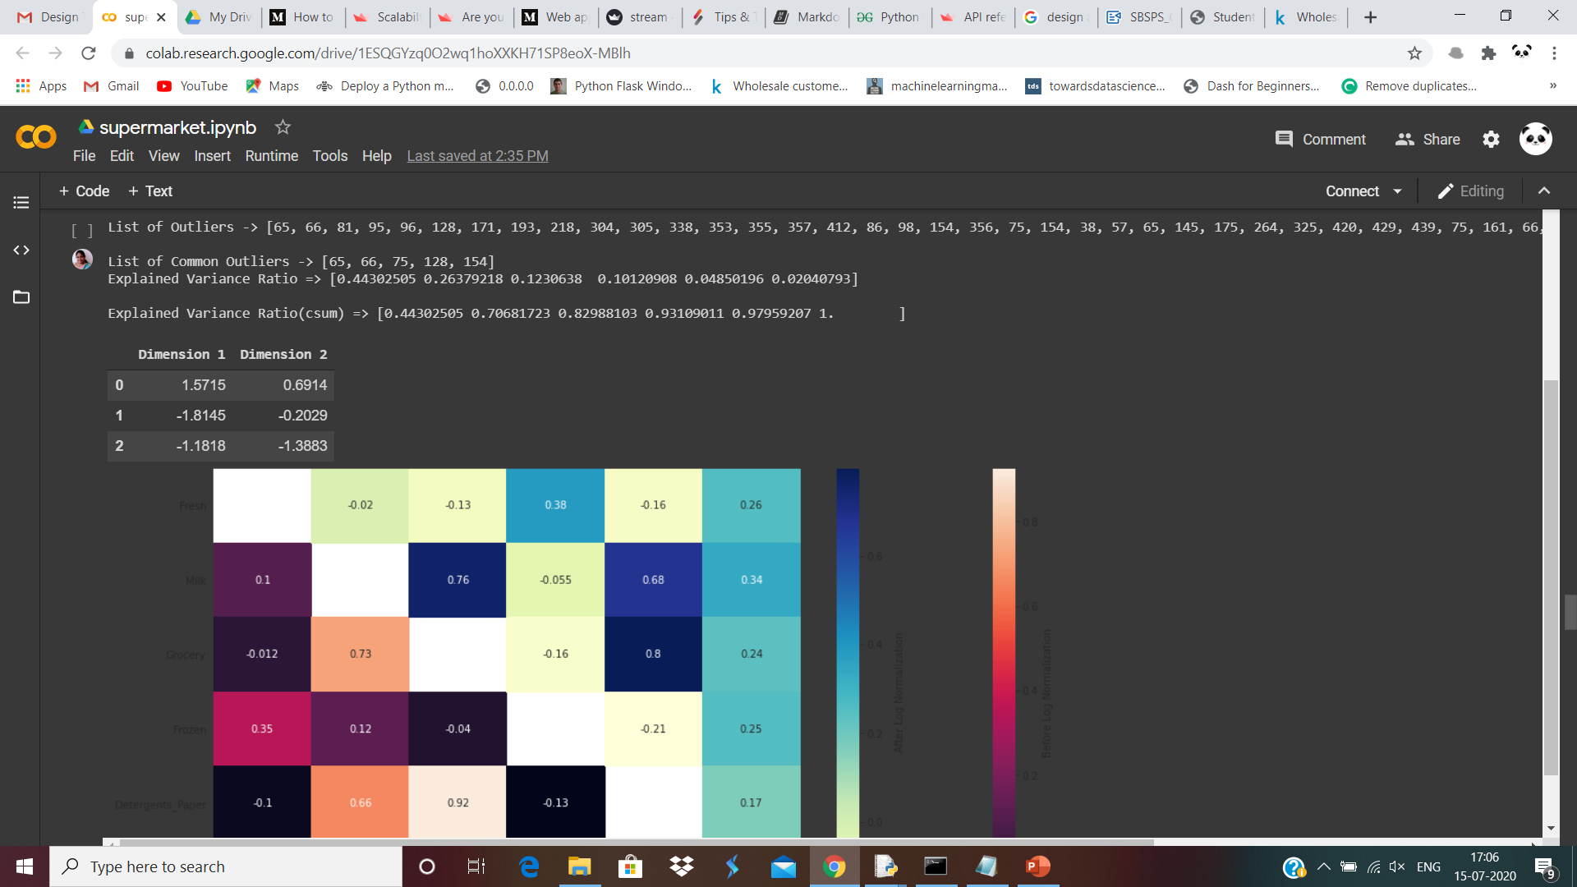

Slide 10
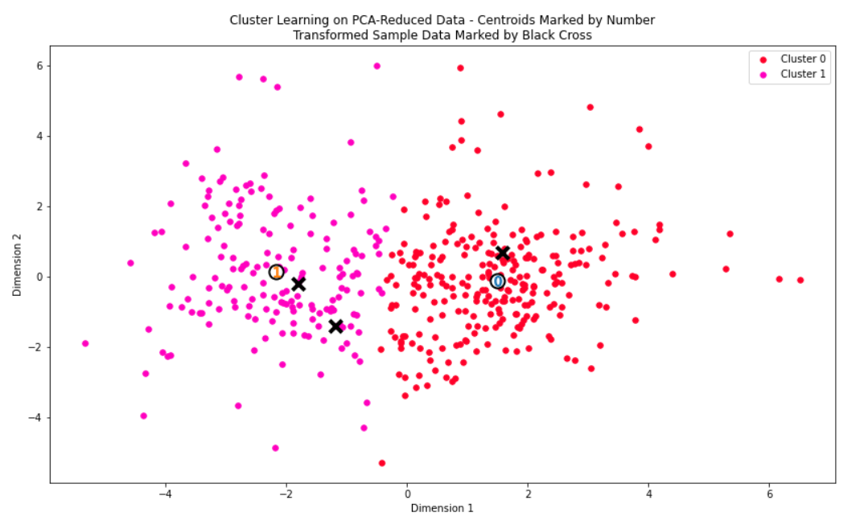

Slide 11
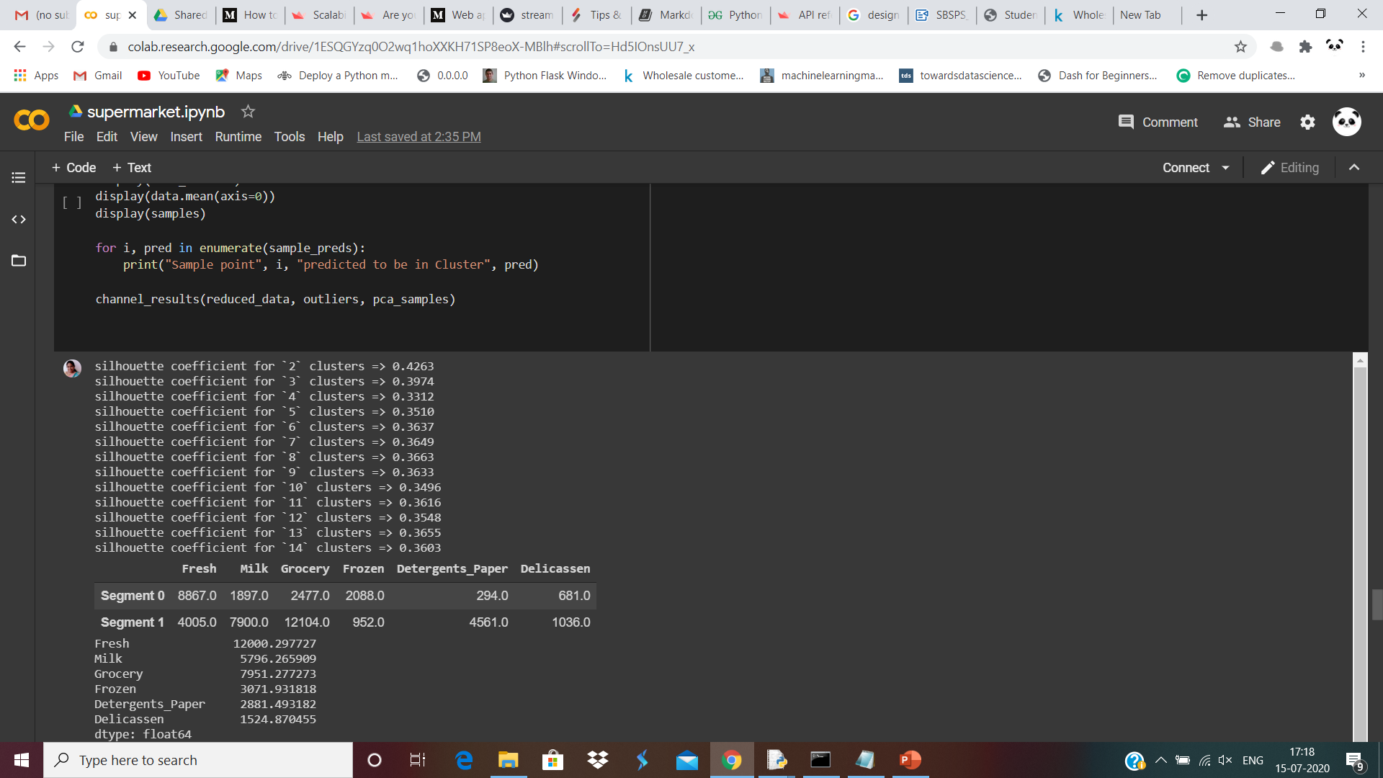
Silhouette Coefficient
The silhouette coefficient of a data measures, how similar it is to its assigned cluster ranging from -1 to 1.

Slide 12
Prediction!
From the given dataset, the following assumptions can be made:
➤ Segment 0 customers are purchasing more from the Fresh and Frozen products than the segment 1 customers.
➤ Segment 1 customers are purchasing more from the Detergents_Paper and Delicassen products than the segment 0 customers.
From each data point, the following predictions can be made:
➤ Sample 0: This customer purchased very less of Milk, Grocery, Detergents_Paper and definitely falls in Segment 0.
➤ Both Sample 1 and 2 : These customers purchased a lot of 'Milk', 'Grocery', 'Detergents_Paper' and falls in Segment 1.

Slide 13
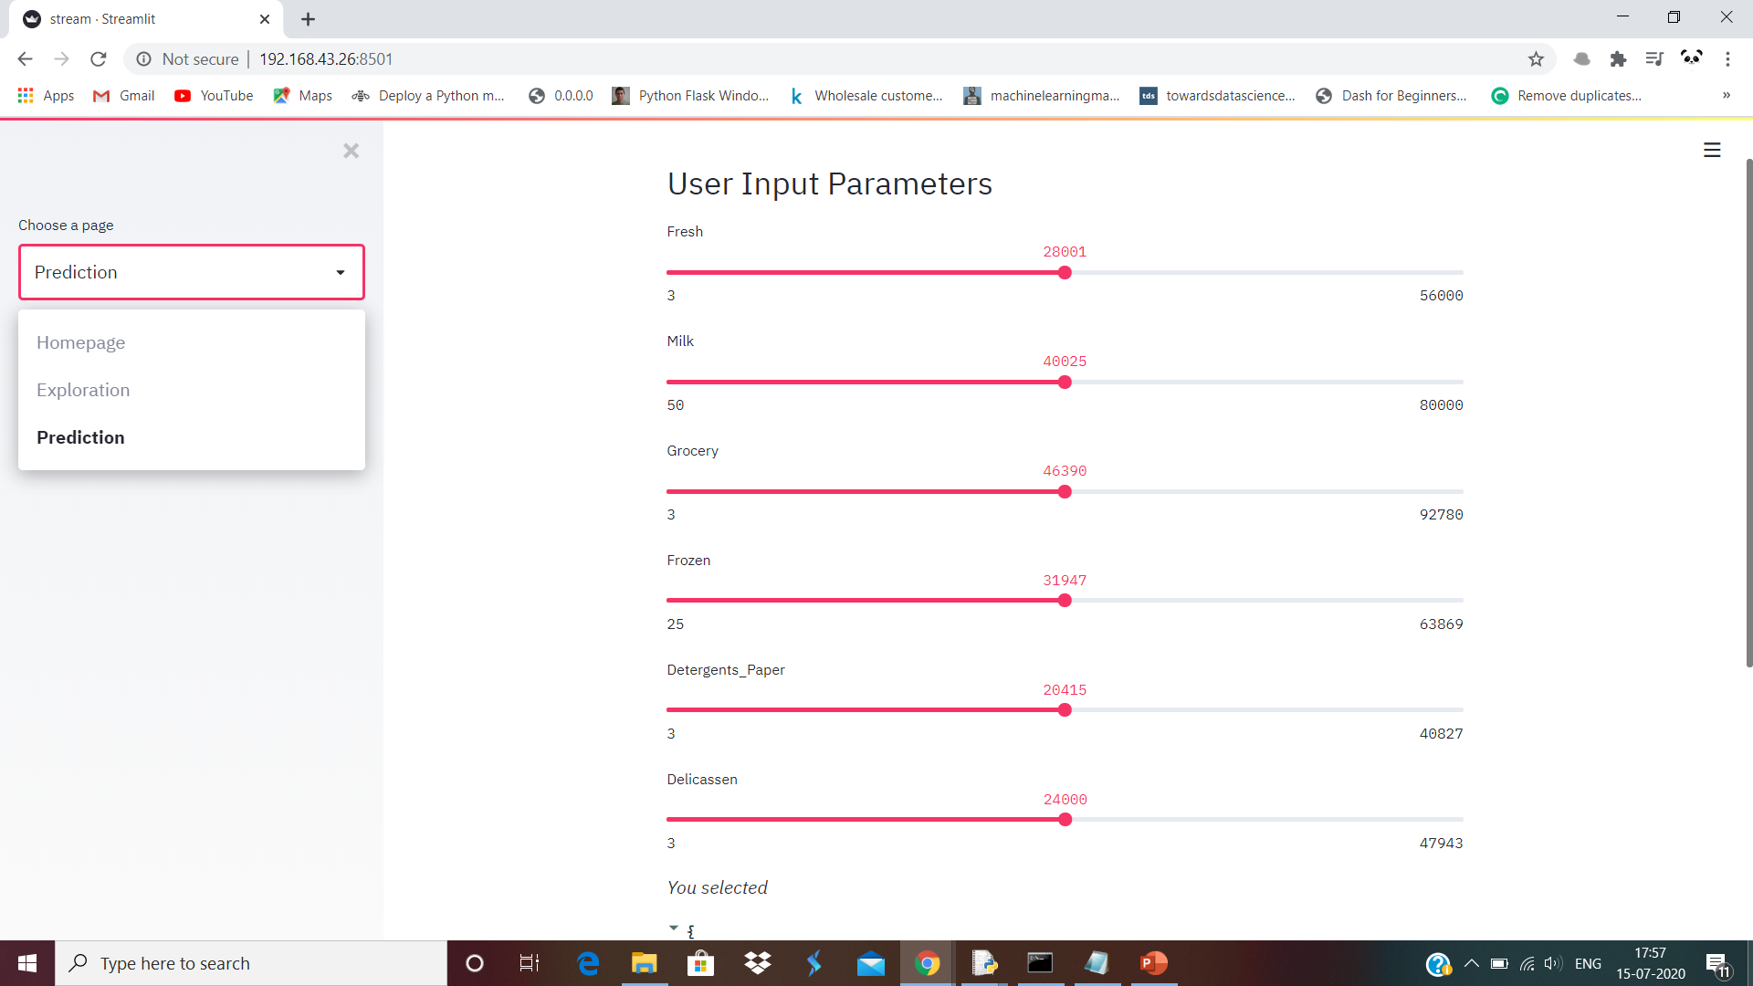

Slide 14

Thank You!

