Slide 1
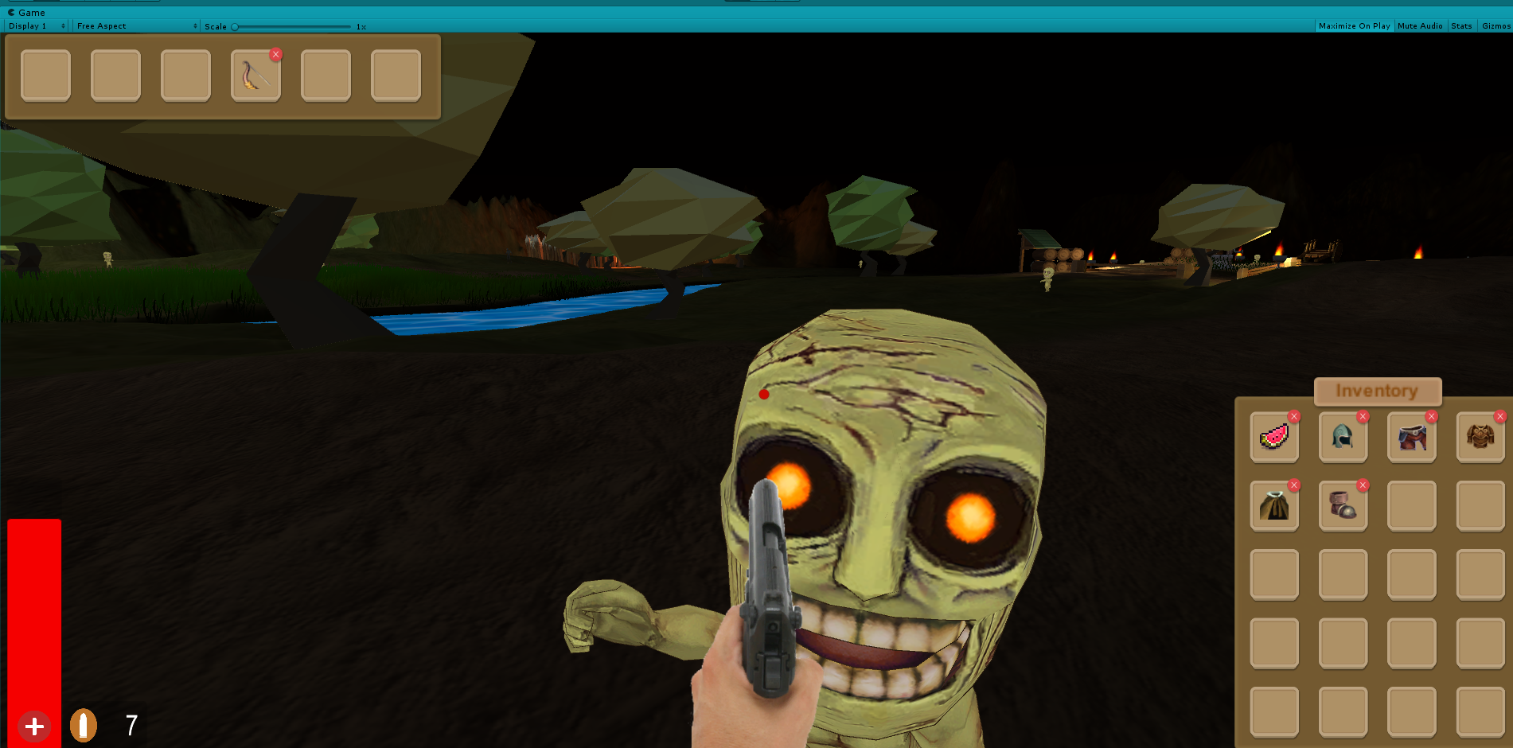
Zombie Survival Kit
Developed By
Group 6ix
Brian Jonatan
Mohammad Hussain
Shivaansh Prasann

Slide 2
Purpose and Background
Source: https://unitylist.com/p/f1s/Free-Survival-Zombie-Kit
The original project is called Free Survival Zombie Kit, which is an open source Unity3D project.
The purpose of this project is to create a basic foundation for aspiring game developers who want to create a First Person Zombie Survival game.

Slide 3
Scope
Character and Camera Movement
Item Pickups
Inventory System
Enemy Movement
Enemy combat
Sound effects
Melee and Ranged Combat
Day and Night Cycles

Slide 4
DEMO

Slide 5
Conclusion
Special Features
Qualities: Standardization and Usability, Separation of Concerns
Performance, Appearance and Reusability

Slide 6
Thank you for your time!
Questions?

Slide 7
Anticipated changes
We want to incorporate better looking, professional character models for our zombies.
The animation speeds will then have to be changed according to the new character models.
One thing we would like to add is templates for start and game over scenes.
We would like to use professional looking, animated models for the player’s weapons.

