Slide 1

Adaptive CPU Scheduling Using Predicted Burst Lengths
Operating System (BCSE303P) · Course Project – Review 3
Performance evaluation, comparison with existing systems, conclusion
Shivaansh Aggarwal (24BCE0883) · Devansh Sharma (24BCE0717)
Slot L15+L16 · Faculty: Dr. Anisha M. Lal
Notes:
Shivaansh: Good morning ma'am. I'm Shivaansh and this is Devansh. Our project is a CPU scheduler that predicts how long a program will run next and uses that prediction to decide which program runs and for how long. We built it in our own Python simulator and tested it across 660 runs.

Slide 2
Recap: the problem and our approach
The problem
1
Who runs next
P = predicted time left − β × time waited. Lowest P runs; ageing (β = 0.03) stops starvation.
FCFS ignores burst length: bursts 24, 3, 3 ms give a 17 ms average wait
SJF is optimal (3 ms) but needs the next burst length, which the OS does not know
Round Robin's quantum is fixed by hand and never revisited
Exponential averaging lags: bursts 2, 2, 2, 2, 60 give guesses 2, 31, 45.5
2
How long it runs
Quantum = 80th percentile of predictions × recent error ratio, every 50 decisions, kept in 1–100 ms.
Predictor
Gradient boosting on 12 features of each process's history: 14% lower error than exponential averaging on unseen processes.
Notes:
Shivaansh: The classical algorithms are static. FCFS gives 17 ms on the 24, 3, 3 example, SJF gives 3 ms but needs the future, Round Robin's quantum is fixed, and exponential averaging lags after a phase change. Devansh: our idea is to predict the next burst and use it twice: to choose who runs, with ageing, and to set the quantum from the 80% rule automatically.

Slide 3
Experimental setup
6
11
10
660
workload types
scheduler configurations
random seeds each
paired runs
Workloads (200 processes, 85% CPU load)
Schedulers and metrics
W1 CPU-bound · W2 I/O-bound · W3 interactive
W4 mixed (the realistic case)
W5 phase-changing · W6 overload (3× arrivals)
FCFS, SJF, SRTF, RR (2/5/10/20 ms), MLFQ, Oracle, ours
Average and worst-case waiting time, response time
Context switches, starvation, prediction error, % of oracle gap closed
Every scheduler runs on the same workloads (paired). Model trained and β tuned on separate seeds. Plus 400 ablation, sweep and switch-cost runs.
Notes:
Shivaansh: We ran 6 workload types, 11 schedulers and 10 seeds, 660 paired runs, so every scheduler sees exactly the same processes. The model and the ageing weight were tuned on separate seeds, so the results are not tuned to the test data.

Slide 4
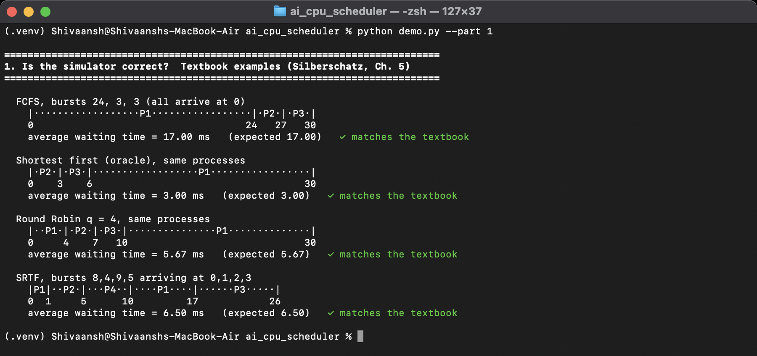
The simulator matches the textbook
FCFS (24, 3, 3)
17.00 ms
Shortest first
3.00 ms
Round Robin, q = 4
5.67 ms
SRTF (4 processes)
6.50 ms
All four match exactly
Real Terminal output of python demo.py --part 1
37 / 37
automated tests pass
Notes:
Devansh: Before any machine learning, we checked the simulator against the textbook: FCFS exactly 17, shortest first 3, Round Robin 5.67 and SRTF 6.5. All 37 tests pass, including that every scheduler gets the same total CPU time.

Slide 5
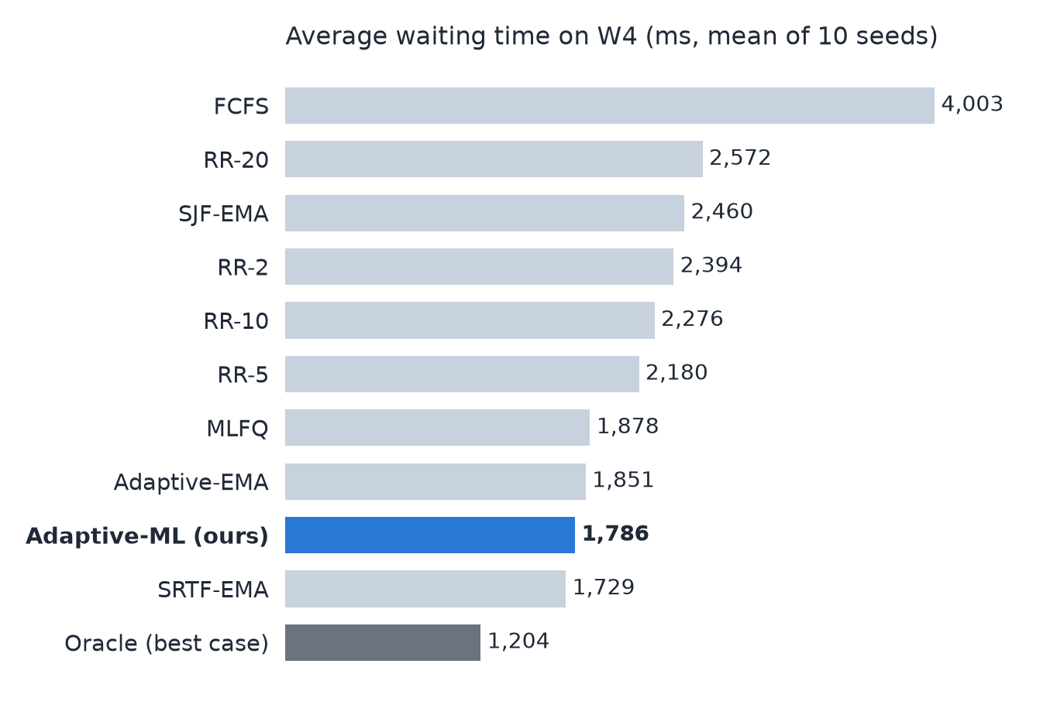
Mixed workload: 27% less waiting than SJF
−27.4%
average wait vs SJF-EMA, better on 10 of 10 seeds
54%
of the gap to the oracle (best possible case) closed
−61%
context switches vs RR-5, with faster response than RR-20
Notes:
Shivaansh: On the mixed workload over ten seeds, our scheduler waits 1,786 ms against 2,460 ms for SJF with exponential averaging, 27% less, and it is better on all ten seeds. It closes 54% of the gap to the oracle, which knows the future, and needs 61% fewer context switches than Round Robin with 5 ms.

Slide 6
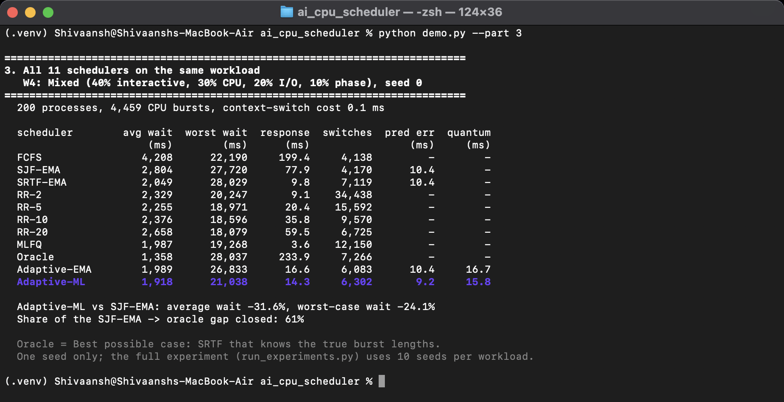
Live run: all 11 schedulers on one workload
1,918 ms
average wait (SJF-EMA: 2,804)
21,038 ms
worst-case wait (SJF-EMA: 27,720)
6,302
context switches (RR-5: 15,592)
9.2 ms
prediction error (EMA: 10.4)
Real Terminal output of python demo.py --part 3 (W4, seed 0, 200 processes)
Notes:
Devansh: This is the live demo. All 11 schedulers run on the same workload. Our scheduler, highlighted, waits about 1,900 ms against 2,800 for SJF, with a lower worst case and far fewer context switches than Round Robin.

Slide 7
Results across all six workloads
Workload | Avg wait vs SJF-EMA | Worst wait vs SJF-EMA | Seeds better | Mean quantum
W1 CPU-bound | −1.9% | −56% | 7 / 10 | 92 ms
W2 I/O-bound | +13.8% | +0.5% | 0 / 10 | 3.5 ms
W3 Interactive | +5.3% | −27% | 2 / 10 | 6.4 ms
W4 Mixed | −27.4% | −23% | 10 / 10 | 18 ms
W5 Phase-changing | −1.7% | −53% | 4 / 10 | 95 ms
W6 Overload | +2.6% | −2% | 2 / 10 | 14 ms
Where it helps
Where it does not
Mixed workloads, where short and long bursts compete. Ageing halves the worst-case wait on W1 and W5.
All-I/O work (+14%): tiny random bursts leave nothing to predict. Under overload, ageing drifts towards FCFS.
Notes:
Shivaansh: Across workloads, the clear win is the mixed workload, better on every seed. Ageing halves the worst-case wait on CPU-bound and phase-changing work. It is 14% worse on all-I/O workloads, where bursts are tiny and random, and level under overload.

Slide 8
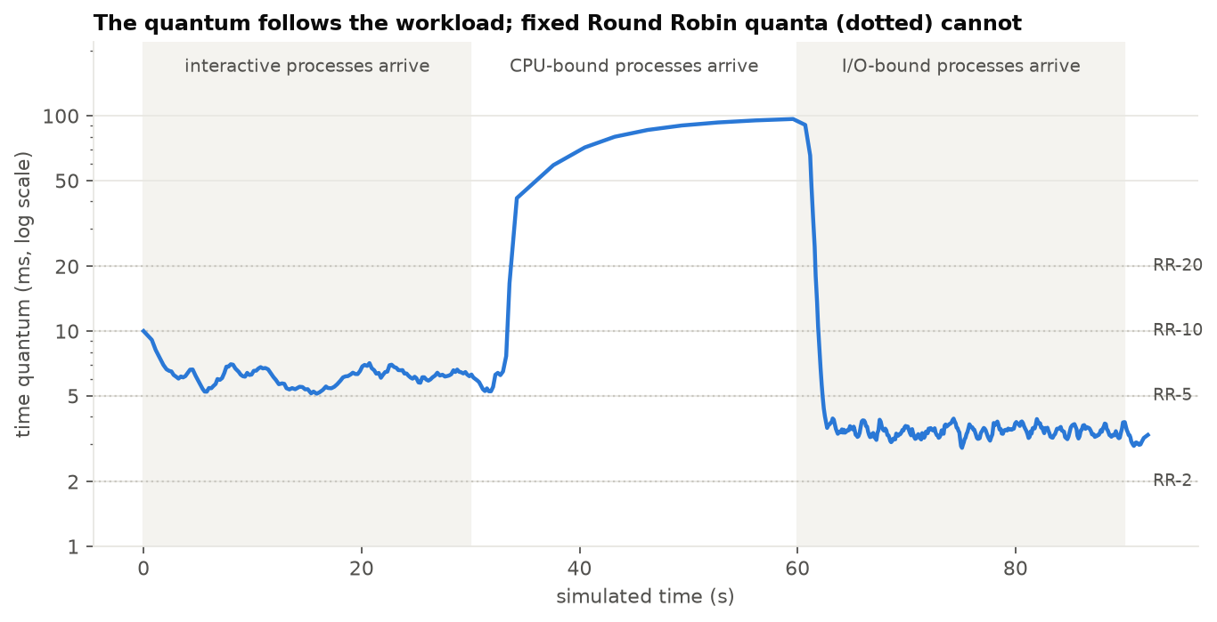
Why it works: adaptive quantum and ageing
Ablation on W5 (ms, mean of 10 seeds)
Variant | Avg | Worst
Full scheduler | 6,163 | 25,831
No ageing | 6,196 | 53,915
Fixed 10 ms quantum | 6,864 | 39,254
Prediction only | 6,325 | 53,593
Without ageing the worst case doubles
A fixed quantum costs 11% average, 52% worst
Better prediction alone gains only 5% on W4: the gain comes from using it twice
The quantum follows the workload: about 6 ms (interactive), close to 100 ms (CPU-bound), 3.5 ms (I/O-bound)
Notes:
Devansh: The quantum follows the workload, about 6 ms for interactive, close to 100 ms for CPU-bound and 3.5 ms for I/O-bound. Switching parts off shows that ageing controls the worst case, the adaptive quantum matters for long bursts, and prediction alone gives only 5%. The benefit comes from using the prediction twice.

Slide 9
Comparison with existing schedulers (W4)
Scheduler | Avg wait (ms) | Worst wait (ms) | Response (ms) | Switches | Ours vs this
FCFS | 4,003 | 19,407 | 240 | 3,962 | −55.4%
SJF-EMA | 2,460 | 23,766 | 71.3 | 3,977 | −27.4%
SRTF-EMA | 1,729 | 24,903 | 7.3 | 6,902 | +3.3%
RR-5 | 2,180 | 14,887 | 23.3 | 15,328 | −18.1%
RR-20 | 2,572 | 13,386 | 69.3 | 6,542 | −30.6%
MLFQ | 1,878 | 15,016 | 2.8 | 11,888 | −4.9%
Adaptive-ML (ours) | 1,786 | 18,388 | 15.4 | 5,933 | –
Lower average wait than every classical scheduler except SRTF
SRTF is 3% better on average but has a 35% higher worst case and more switches
MLFQ is close on average but needs twice the switches
Unlike dynamic-quantum RR papers, burst lengths are never assumed known
Mean of 10 seeds. Last column: our average wait relative to that scheduler.
Notes:
Shivaansh: Compared with the existing schedulers on the mixed workload, ours has the lowest average wait except SRTF, which is 3% better on average but has a 35% higher worst case and more switches. MLFQ comes close but needs twice the context switches. And unlike the dynamic-quantum papers we studied, we never assume burst lengths are known.

Slide 10
Conclusion and future work
Conclusion
Future work
Applying the textbook quantum rule automatically from live predictions works
27% less waiting on mixed workloads; worst case halved by ageing
Not a win everywhere: short random bursts gain nothing
The gain comes from using the prediction twice
Test on traces from real programs
Move the quantum controller into xv6
Replace the model with a small tree a kernel can afford
Load-aware ageing and multi-core scheduling
Thank you
Notes:
Shivaansh: To conclude, applying the textbook quantum rule automatically from predictions works: 27% less waiting on mixed workloads, and ageing halves the worst case. It does not help when bursts are short and random, and most of the gain comes from using the prediction twice. Next steps are real traces and moving the controller into xv6. Thank you, ma'am.

