Slide 1
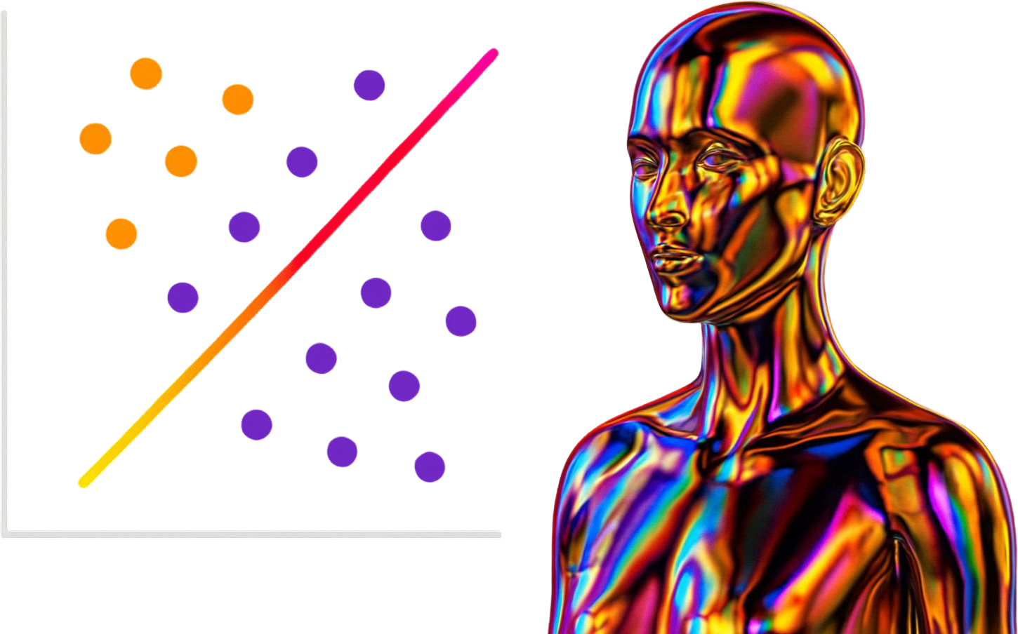
K NEAREST NEIGHBOUR
Wine Quality Classification
Team-11
Sri Sanjai - 25MBA0092
Shruthika - 25MBA0006
Shrikha - 25MBA0049
Shivaranjani - 25MBA0002
Sonu Srinath - 25MBA0096

Slide 2


MACHINE LEARNING
Machine Learning is a technique that allows computers to learn from data and make decisions without explicit programming. It works by identifying patterns in data and using them to make predictions.
This learning happens through the following steps:
Data Input
Algorithms
Model Training
Feedback Loop
Experience and Iteration
Evaluation and Generalization

Slide 3
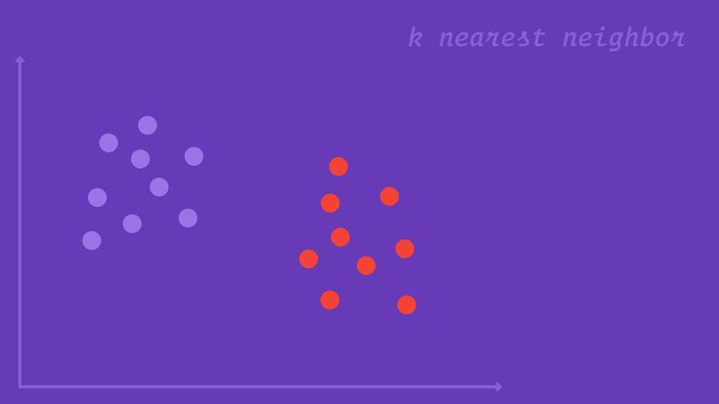
INTRODUCTION - KNN
Classifies data based on similarity with nearby data points
Uses distance metrics like to find nearest neighbors
Since KNN makes no assumptions about the underlying data distribution, it makes it a non-parametric and instance-based learning method.
K‑Nearest Neighbor (KNN) is a simple and widely used machine learning technique for classification and regression tasks. It works by identifying the K closest data points to a given input and making predictions based on the majority class or average value of those neighbors.

Slide 4
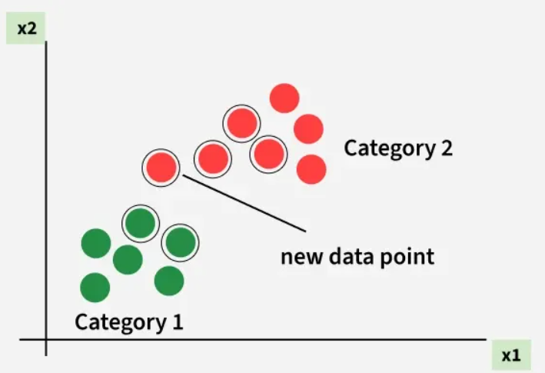
KNN
KNN assigns the category based on the majority of nearby points. The image shows how KNN predicts the category of a new data point based on its closest neighbours.
The green points represent Category 1 and the red points represent Category 2.
The new data point checks its closest neighbors (circled points).
Since the majority of its closest neighbors are red points (Category 2) KNN predicts the new data point belongs to Category 2.

Slide 5
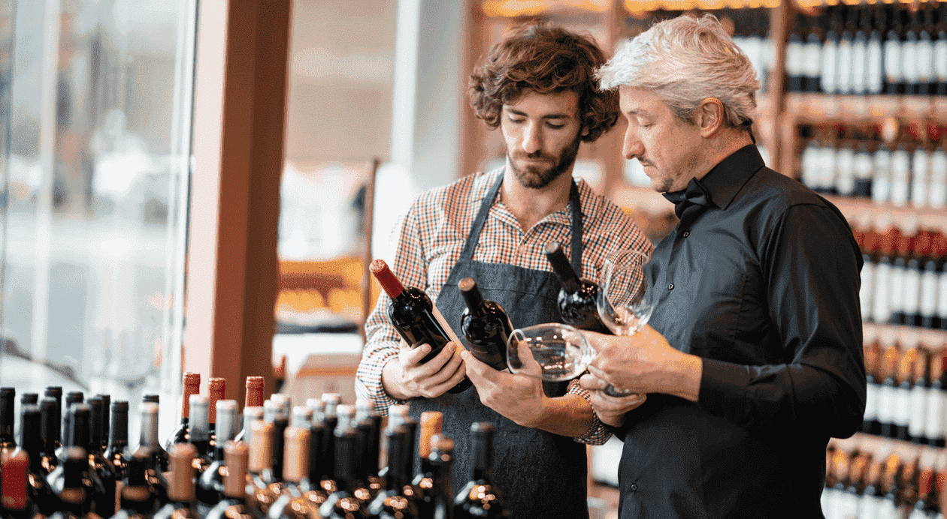
The wine industry is highly competitive, where consistent product quality is essential for:
Brand reputation
Customer satisfaction
Profitability
PROBLEM STATEMENT
Traditional quality assessment depends on human experts (sommeliers), which is:
Time-consuming
Subjective
Costly
This project aims to develop a predictive model using
K-Nearest Neighbors (KNN) to:
Classify wine quality as Good or Bad
Use physicochemical properties of wine
Business Objective:
To support wineries in improving quality control processes and ensuring consistent product standards using data-driven insights.

Slide 6

DATASET OVERVIEW
SOURCE:
Kaggle
Publicly available and widely used for Machine Learning tasks
DOMAIN CONTEXT:
Industry: Food & Beverage (Wine Production)
Type: Classification Problem
Goal: Predict wine quality using Chemical attributes
DATASET SIZE:
Contains 1500 rows(observation)
11 input features + 1 target variable (Quality)
VARIABLES (features):
Fixed acidity, Volatile acidity
Citric acid, Residual sugar
Chlorides, Alcohol
Free Sulfur dioxide, Total Sulfur dioxide
pH, Sulphates
density

Slide 7
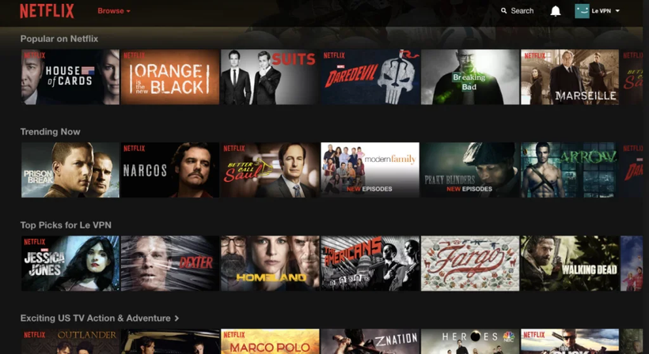
REAL-LIFE APPLICATION
KNN in Netflix / YouTube
Users represented as data points
Based on watch history and preferences
Finds similar users (nearest neighbors)
Recommends content watched by similar users
Enables personalized recommendations

Slide 8
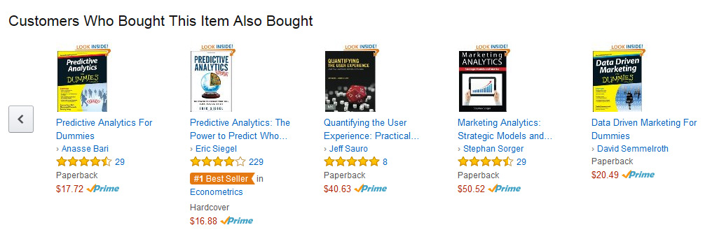
REAL-LIFE APPLICATION
KNN in E-commerce (Amazon)
Customers represented as data points
Based on purchase & browsing history
Identifies similar customers
Recommends products bought by others
Increases sales and user engagement

Slide 9
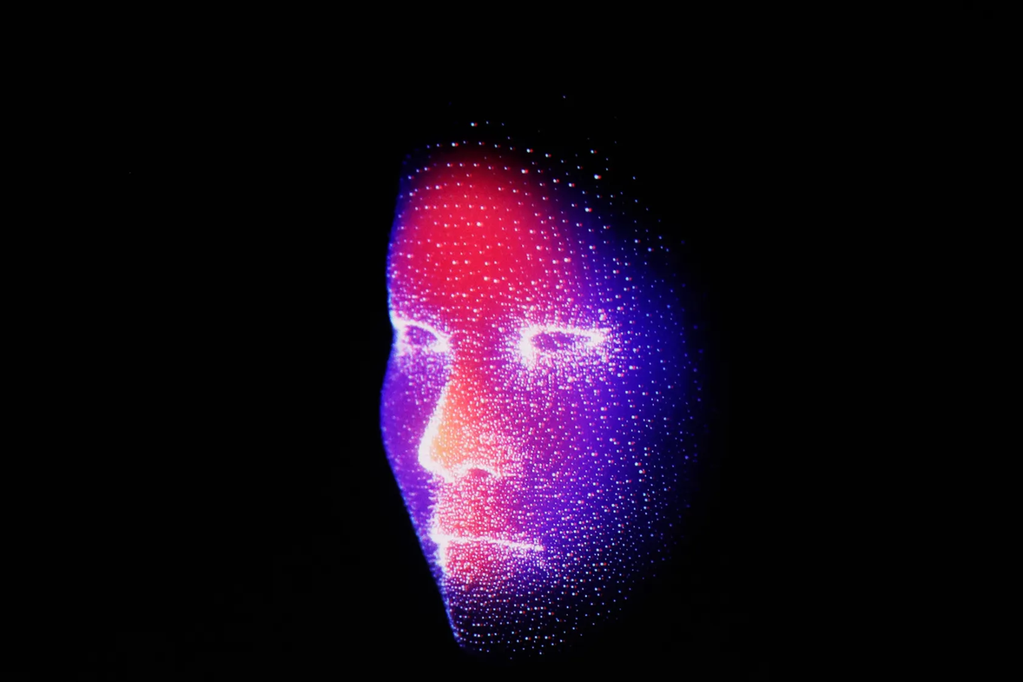
REAL-LIFE APPLICATION
KNN in Face Recognition
Converts face into numerical features
Stores known faces as data points
Compares new face with stored data
Finds closest match using KNN
Used in phone unlock and security systems

Slide 10
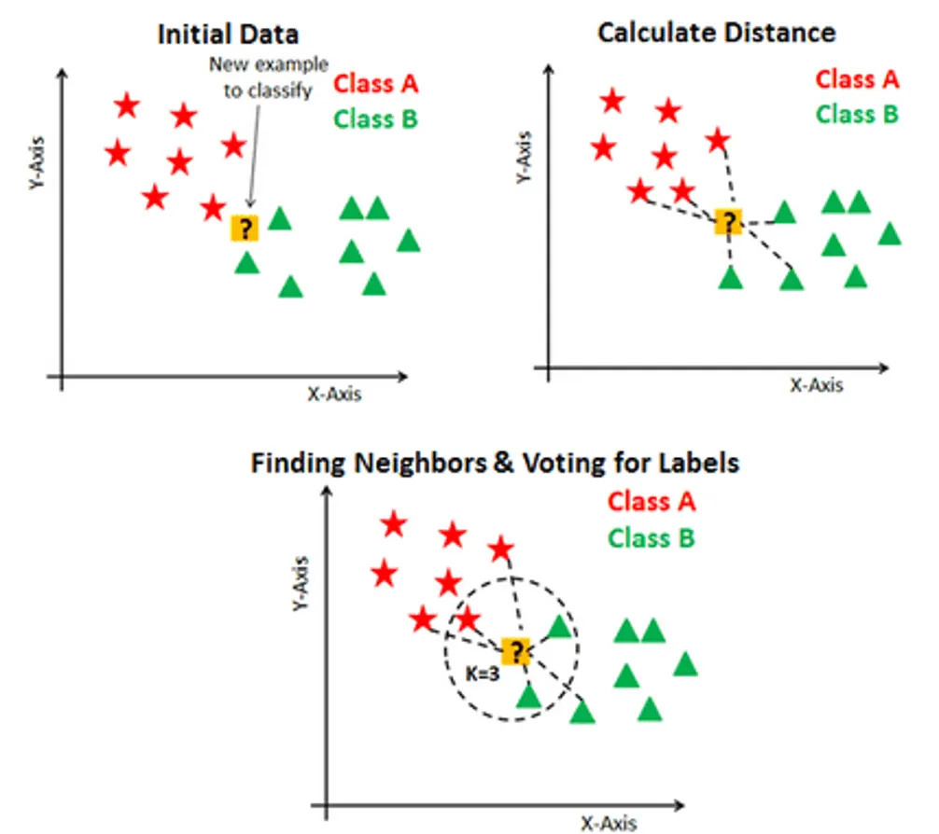
WORKFLOW OF KNN
Selecting the optimal value of K (using Cross-Validation)
K = Number of nearest neighbors used for prediction
Large K → Simpler model, may miss patterns
Small K → Sensitive to noise and outliers
Noisy data → Use larger K for stable predictions
K controls the balance between overfitting and underfitting
Calculating distance
For a new data point, calculate the distance from all existing data points. Comman method: Euclidean Distance
Finding Nearest Neighbors
Sort all distances in ascending order
Select the K closest data points
Majority Voting (Classification)
Count the classes of the K neighbors
Assign the class with the highest frequency
This process is called Majority Voting
Cross Validation:
A technique used to evaluate a model by splitting the data into multiple parts and testing it on different subsets. It ensures the model performs well on unseen data and is not dependent on a single train-test split.

Slide 11
WINE QUALITY CLASSIFICATION
USING PYTHON
Basic Library used in code:
Pandas
NumPy
seaborn
matplotlib
Scikit-learn (sklearn)
GridSearchCV
StandardScaler
cross_val_score
LabelEncoder

Slide 12
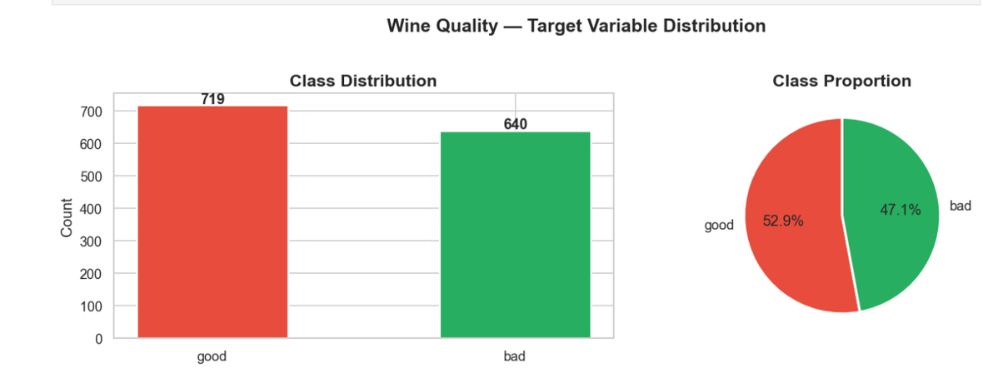
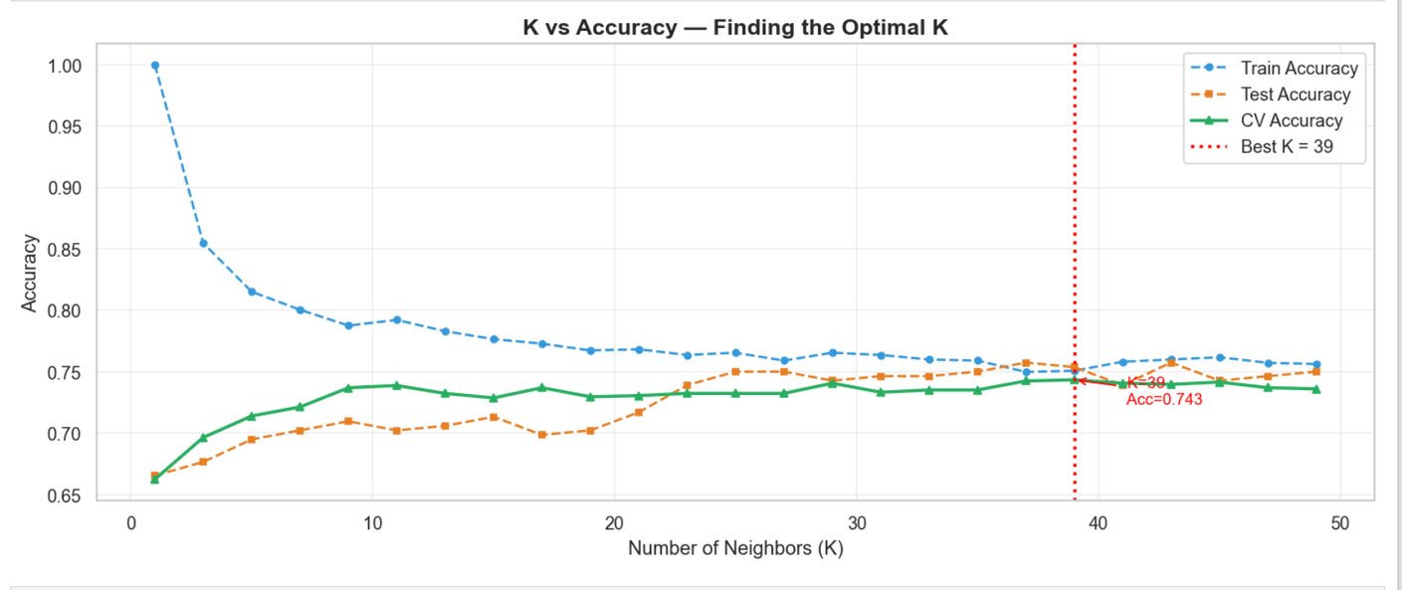
INTERPRETATION
Target Distribution
Finding the Best K value

Slide 13
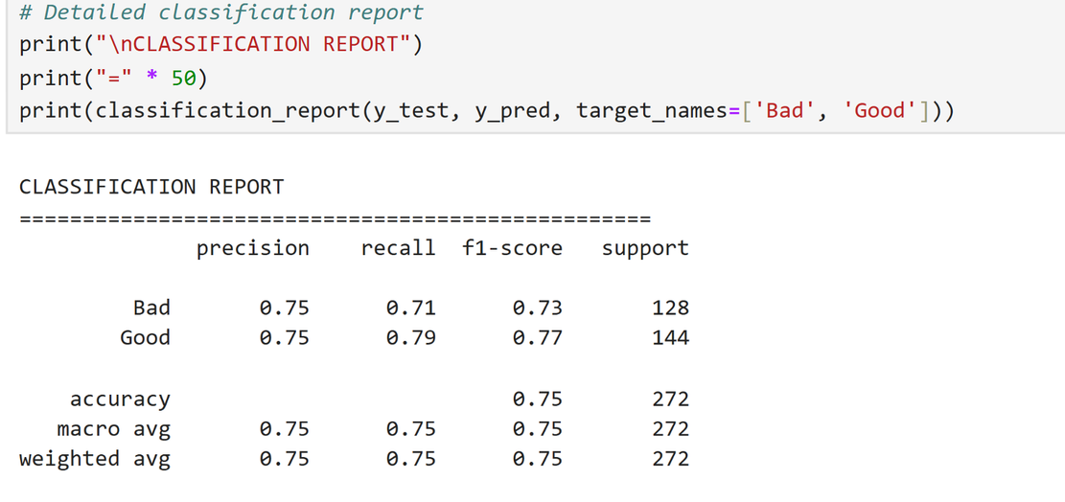
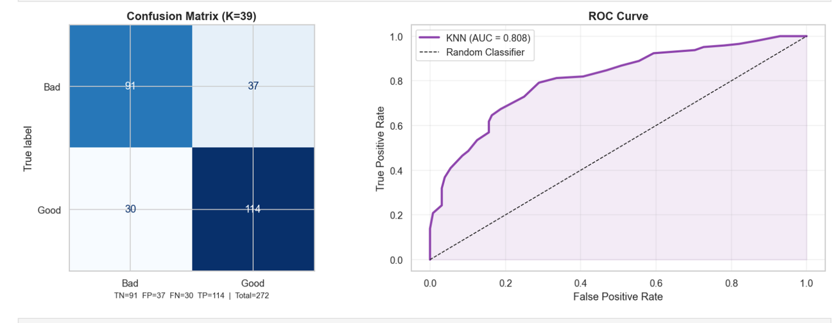
INTERPRETATION
Classsification Report
Confusion Matrix

Slide 14
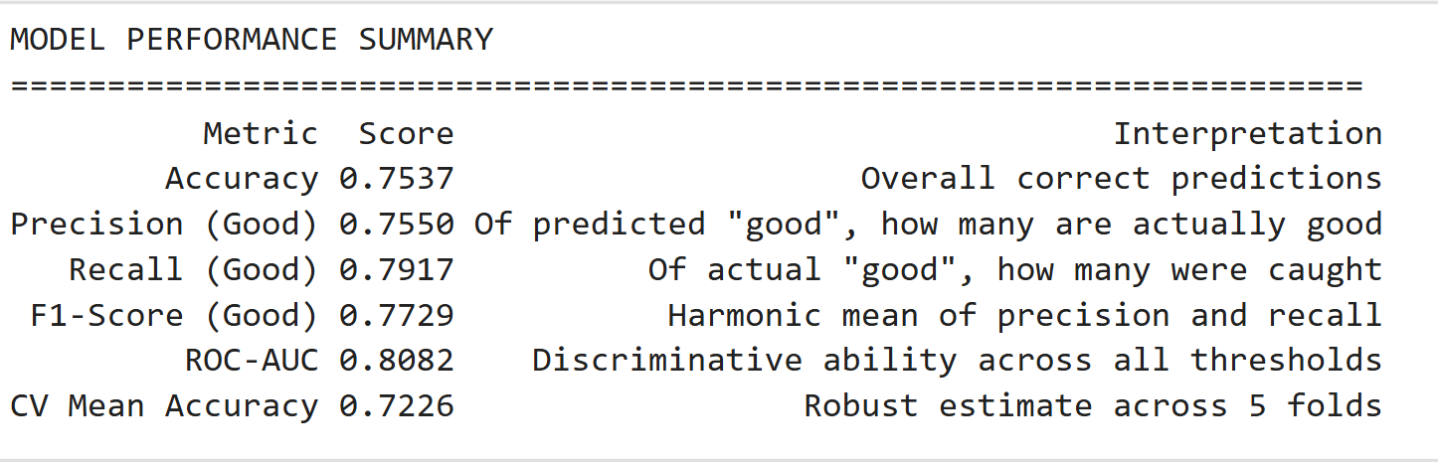
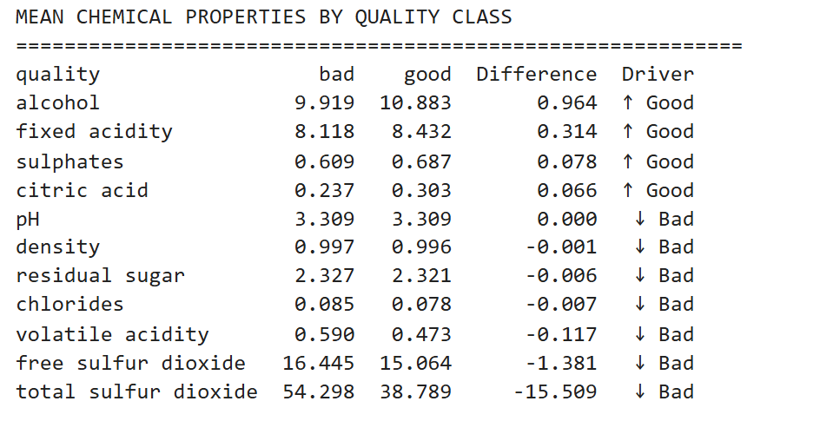
INTERPRETATION
Model Performance
Identification of best chemical properties

Slide 15
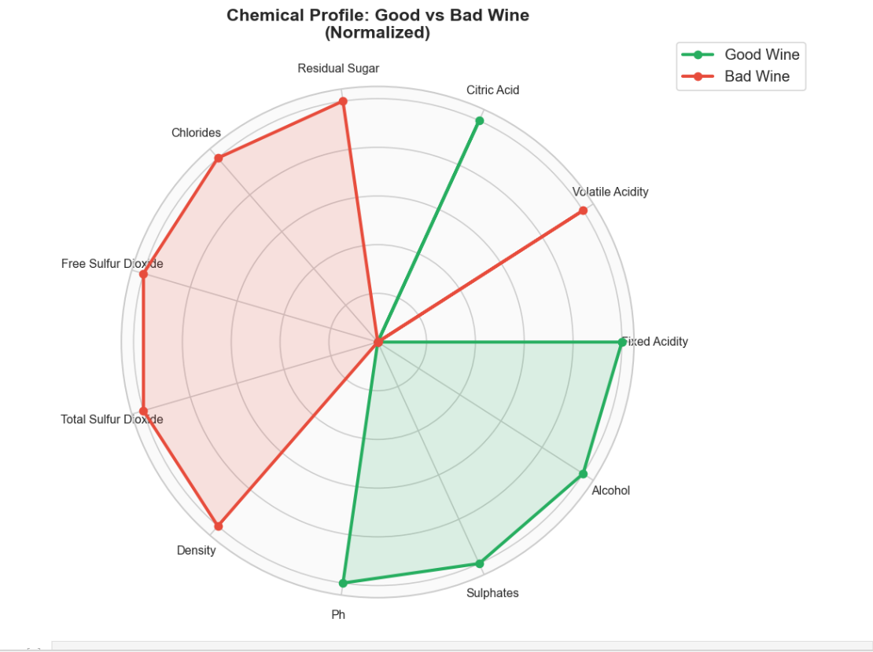
INTERPRETATION

Slide 16
BUSINESS INSIGHTS
Automated Quality Control
→ KNN model (~75% accuracy) can be used to predict wine quality before sale, reducing manual testing.
Key Quality Drivers Identified
→ Higher alcohol, sulphates, and balanced acidity improve quality, while high volatile acidity and sulfur reduce it.
Production Optimization
→ Insights help in adjusting chemical composition during fermentation to consistently produce better-quality wine.
Cost & Waste Reduction
→ Early detection of low-quality wine helps avoid packaging, storage, and market losses.
Better Pricing & Market Strategy
→ Enables segmentation into premium and low-tier products, improving revenue and brand positioning.

Slide 17

FUTURE ACTIONS
Key Strategies for Model Improvement
Feature Scaling (Crucial Step)
Dimensionality Reduction
Adding multi-class classification
Integration of multiple wine dataset

Slide 18
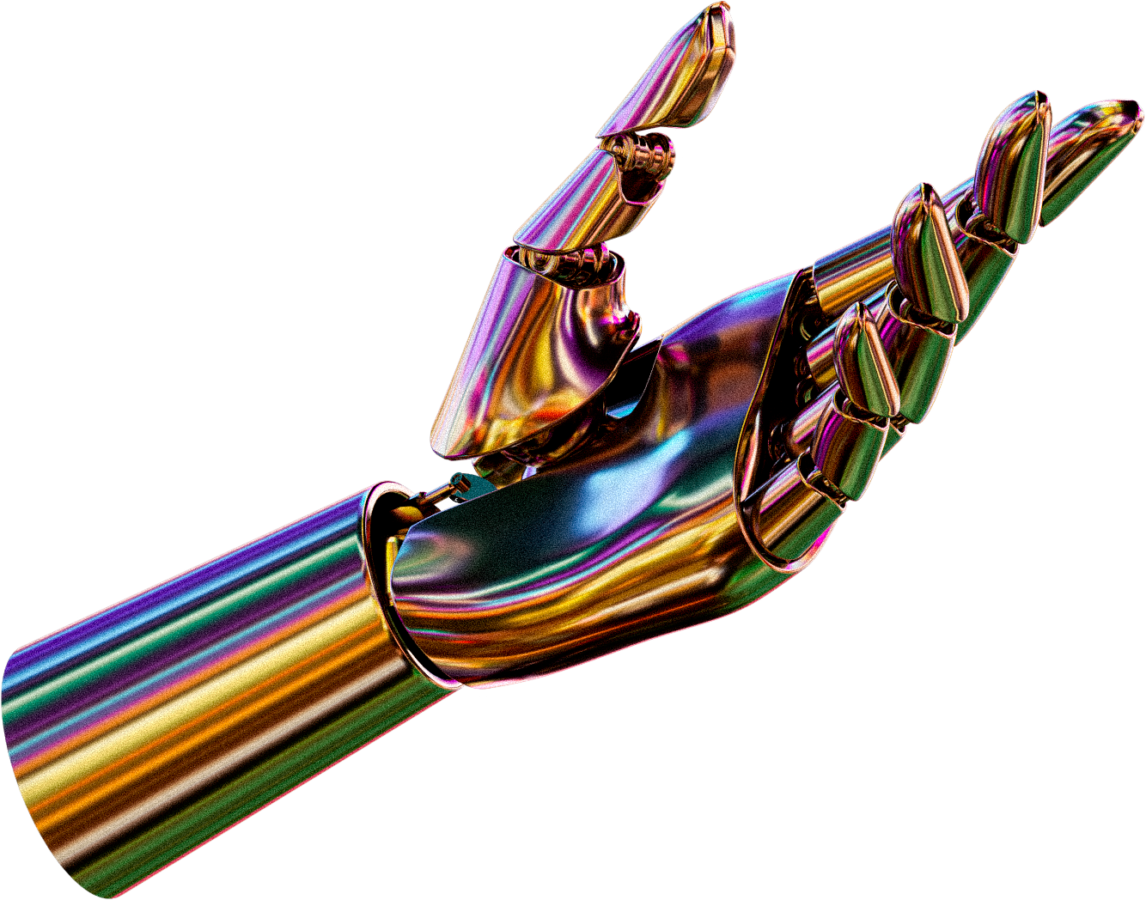
THANK YOU
Presented By: Olivia Wilson

