Slide 1
IMPROVING THE JOB SCHEDULING EFFICIENCY
Author : Shiva A(192224020)
3rd year
Saveetha School of engineering
SIMATS
Guide : Dr. Antony Joseph Rajan D
Assistant Professor
Saveetha School of engineering
SIMATS

Slide 2
AGENDA
ABSTRACT
LITERATURE SURVEY
PROPOSED METHOD
RESULT AND DISCUSSION
CONCLUSION
REFERENCE

Slide 3
abstract
Objective: Job scheduling using hadoop
Importance: Securing sensitive information is crucial for maintaining data privacy, organizational trust, and regulatory compliance.
Data Collection: Gathering data from various sources, including logs, user activities, and network traffic.
Technology stack: The technology stack includes Python, TensorFlow, and Elasticsearch for developing robust data leak detection systems.
Development Phases: Design, coding, testing, and deployment stages.
Conclusion:This system is crucial for safeguarding against the severe consequences of data leaks, ensuring data privacy, organizational trust, and compliance.

Slide 4
LITERATURE SURVEY
S NO. | B2B | SUPPLY CHAIN | ROI | E-COMMERCE
1 | Niu, D., et al. (2012). "A Dynamic Pricing Model for Cloud Resources Based on Geo-distributed Data Centers." IEEE Transactions on Services Computing, 5(4), 558-570. | Niu, D., et al. (2012). "A Dynamic Pricing Model for Cloud Resources Based on Geo-distributed Data Centers." IEEE Transactions on Services Computing, 5(4), 558-570. | Niu, D., et al. (2012). "A Dynamic Pricing Model for Cloud Resources Based on Geo-distributed Data Centers." IEEE Transactions on Services Computing, 5(4), 558-570. | Niu, D., et al. (2012). "A Dynamic Pricing Model for Cloud Resources Based on Geo-distributed Data Centers." IEEE Transactions on Services Computing, 5(4), 558-570.
2 | Zaman, S., & Grosu, D. (2013). "Combinatorial auction-based dynamic VM provisioning and allocation in clouds." IEEE Transactions on Parallel and Distributed Systems, 24(6), 1104-1113. | Zaman, S., & Grosu, D. (2013). "Combinatorial auction-based dynamic VM provisioning and allocation in clouds." IEEE Transactions on Parallel and Distributed Systems, 24(6), 1104-1113. | Zaman, S., & Grosu, D. (2013). "Combinatorial auction-based dynamic VM provisioning and allocation in clouds." IEEE Transactions on Parallel and Distributed Systems, 24(6), 1104-1113. | Zaman, S., & Grosu, D. (2013). "Combinatorial auction-based dynamic VM provisioning and allocation in clouds." IEEE Transactions on Parallel and Distributed Systems, 24(6), 1104-1113.
3 | Chen, C., & Maheshwari, P. (2012). "Priority-Based Scheduling in Cloud Computing." Proceedings of the 2012 IEEE International Conference on Cloud Computing. | Chen, C., & Maheshwari, P. (2012). "Priority-Based Scheduling in Cloud Computing." Proceedings of the 2012 IEEE International Conference on Cloud Computing. | Chen, C., & Maheshwari, P. (2012). "Priority-Based Scheduling in Cloud Computing." Proceedings of the 2012 IEEE International Conference on Cloud Computing. | Chen, C., & Maheshwari, P. (2012). "Priority-Based Scheduling in Cloud Computing." Proceedings of the 2012 IEEE International Conference on Cloud Computing.

Slide 5
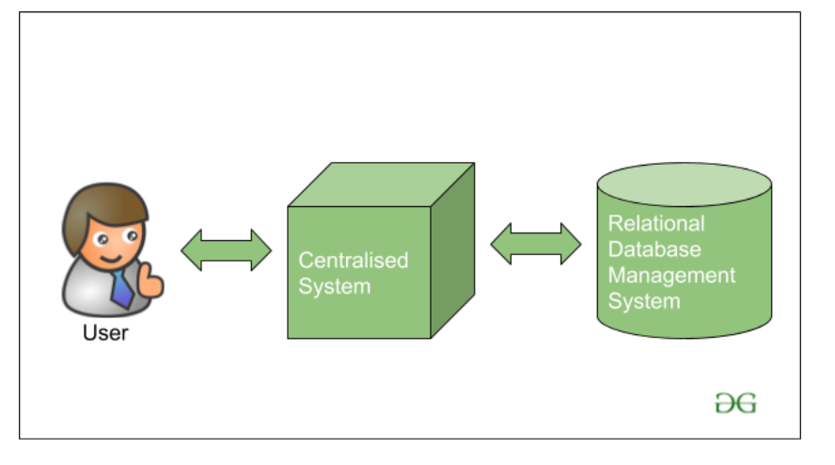
METHODOLOGY

Slide 6
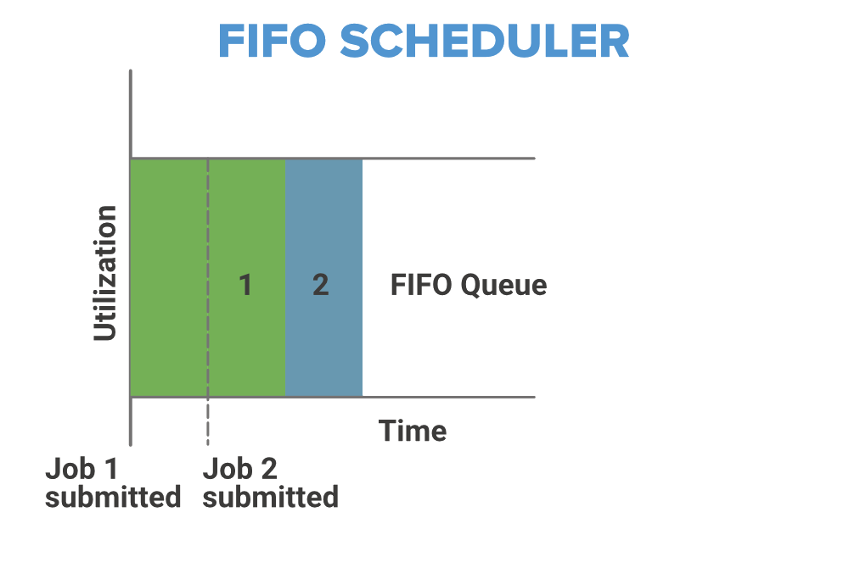
fifo scheduler

Slide 7
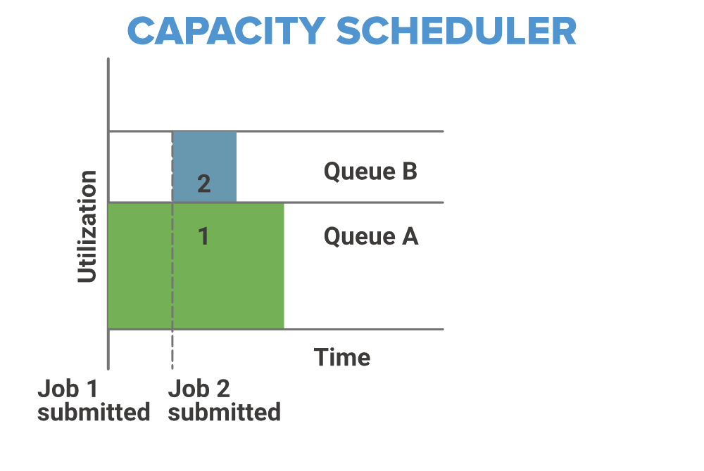
capacity schedulers

Slide 8
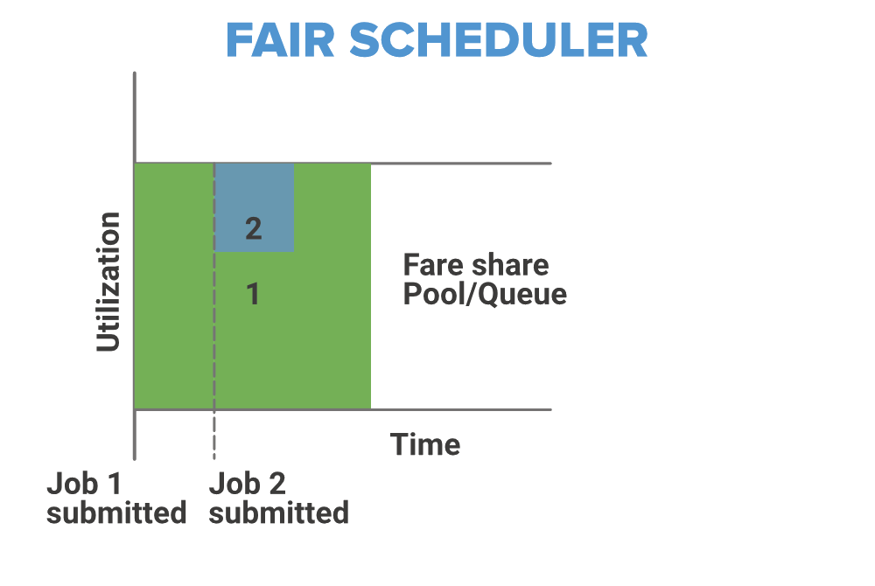
fair scheduler

Slide 9
methodology
Objectives
Collecting data
Training our model
Evaluation
Choose an metrics for comparing and check if it performs well
Preprocess the collectd dataset
Find an perfect training model for our dataset
Develop Algorithm
Set Up Hadoop Environment
Scheduling Algorithm

Slide 10
methods
Define Objectives
Scheduling Algorithm
develop algorithm
Set Up Hadoop Environment
evaluate
Clearly define your goals such as reducing job completion time, maximizing resource utilization, and improving overall cluster performance.
Decide whether to enhance an existing algorithm or design a new one based on your findings.
Establish metrics for success
Write the scheduling algorithm in Python, ensuring it effectively prioritizes and allocates resources to jobs based on predefined criteria
Configure a Hadoop cluster either locally using tools like Apache Ambari or on the cloud using services like AWS EMR.
Optimizing job scheduling efficiency in a Hadoop cluster through intelligent prioritization and resource allocation.

Slide 11
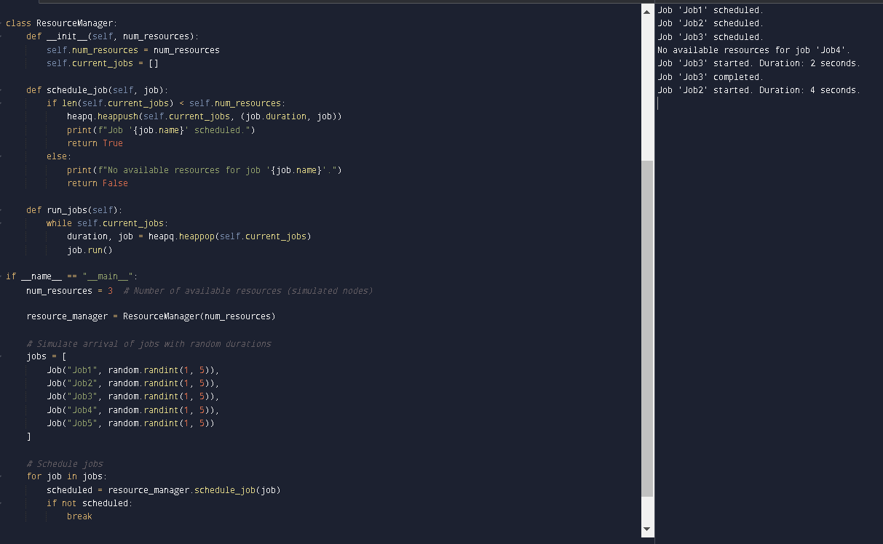
METHODOLOGY

Slide 12
HOw does it help in Machine learning ?
Faster Model Training: Speeds up data preprocessing and model training, accelerating the development of machine learning models.
Handling Big Data: Enables processing of large datasets and complex models efficiently, supporting scalable machine learning applications.
Better Resource Use: Maximizes use of computing resources, ensuring machine learning tasks get the necessary power when needed.
Lower Costs: Reduces expenses by optimizing resource usage, making machine learning initiatives more cost-effective.
Quick Data Preparation: Facilitates rapid data preprocessing, crucial for preparing datasets that improve machine learning model accuracy.

Slide 13
solution
Resource Underutilization: Maximizing cluster resource usage to reduce wastage.
Long Job Completion Times: Decreasing the time taken for job completion to enhance efficiency.
Inconsistent Cluster Performance: Improving stability and performance by balancing workloads.
High Operational Costs: Lowering expenses related to energy and hardware maintenance.
Scalability Challenges: Ensuring smooth scaling to handle increased data and demands

Slide 14
conclusion
Optimized resource allocation through intelligent scheduling algorithms improves cluster efficiency.
Reduced job completion times achieved by prioritizing job dependencies and optimizing task scheduling.
Enhanced cluster throughput by maximizing resource utilization across nodes.
Scalable solutions capable of managing diverse workloads and varying cluster sizes effectively.
Improved cost efficiency by minimizing idle resources and optimizing operational expenses.

Slide 15
future improvement needed
Implementation of machine learning algorithms to predict workload patterns and optimize job scheduling dynamically.
Integration of containerization technologies (e.g., Docker, Kubernetes) to further enhance resource isolation and efficient allocation.
Development of advanced scheduling policies considering real-time data availability and priority-based job execution.
Adoption of hybrid scheduling strategies combining batch processing with real-time job execution to optimize overall cluster utilization.

Slide 16
THANK YOU
Shiva A(192224020)

