Slide 1
HEALTHCARE INSURANCE
Claims & Fraud
Risk Analysis
A data-driven view of claims performance, financial exposure,
and potential fraud patterns
PRESENTATED BY
ARVIND REDDY
SHIVA CHARAN
HARSHITHA ODDI

Slide 2
Project Overview
01 Claims performance
02 Financial analysis
03 Fraud & risk
Understand claim volumes, claim amounts, approval and denial patterns.
Compare approved, denied and pending claim value and identify financial exposure.
Identify suspicious claims, assess risk segments and compare fraud with legitimate claims.
PROJECT GOAL
Build an interactive Power BI dashboard that helps stakeholders monitor healthcare claim activity, understand financial outcomes and focus investigation efforts on higher-risk patterns.
HEALTHCARE INSURANCE CLAIMS & FRAUD RISK ANALYSIS
02 / 10

Slide 3
Data & Analytical Approach
Data preparation
Data modeling
Visualization
Review fields, standardize categories, validate dates and amounts, and check missing or inconsistent values.
Create relationships and reusable measures for claim counts, financial totals, averages and rates.
Use KPI cards, time trends, bar charts, donut charts and summary tables to communicate findings.
ANALYSIS DIMENSIONS
• Claim status: Approved, Denied and Pending
• Claim type: Emergency, Inpatient, Outpatient and Routine
• Provider specialty and patient demographics
• Submission method and employment / marital status
• Fraud indicator, cluster label and monthly trend
HEALTHCARE INSURANCE CLAIMS & FRAUD RISK ANALYSIS
03 / 10

Slide 4
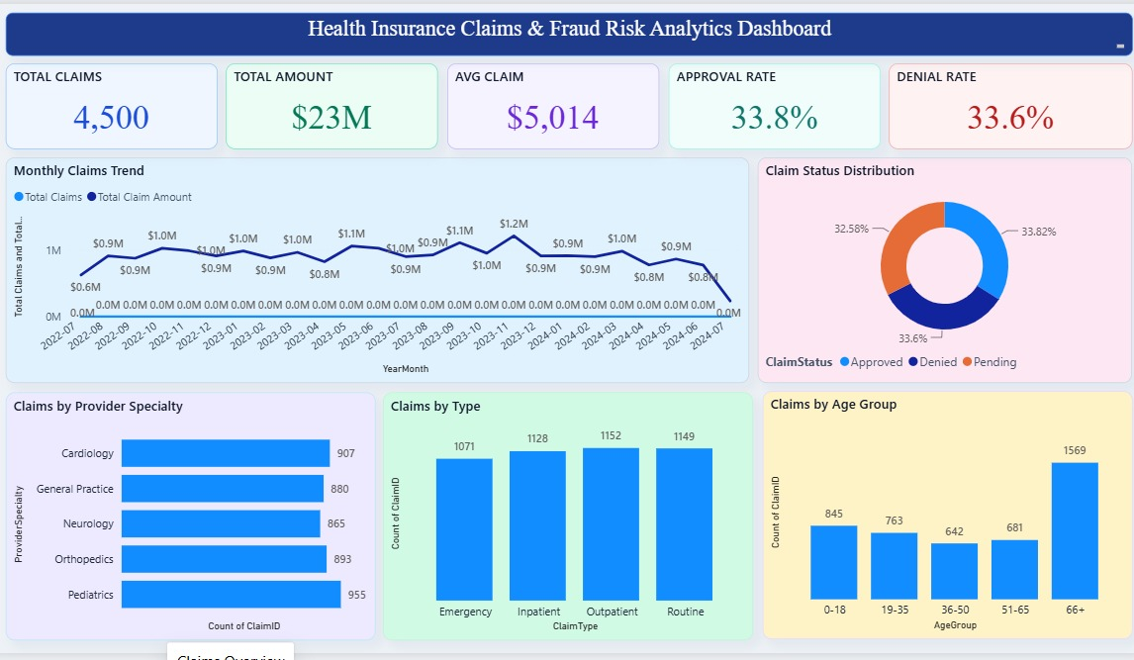
Dashboard 1 — Claims Overview
HEALTHCARE INSURANCE CLAIMS & FRAUD RISK ANALYSIS
04 / 10

Slide 5
Claims Overview — Key Indicators
4,500
$23M
$5,014
33.8%
33.6%
Total claims
Total claim amount
Average claim
Approval rate
Denial rate
What the overview reveals
• Claim volumes are distributed across Emergency, Inpatient, Outpatient and Routine services.
• Provider specialty and age-group views help compare where claims are concentrated.
• The monthly trend provides a way to monitor changes in claim count and total claim amount.
• Approval and denial rates should be tracked together with pending claims to understand the full claim lifecycle.
HEALTHCARE INSURANCE CLAIMS & FRAUD RISK ANALYSIS
05 / 10

Slide 6
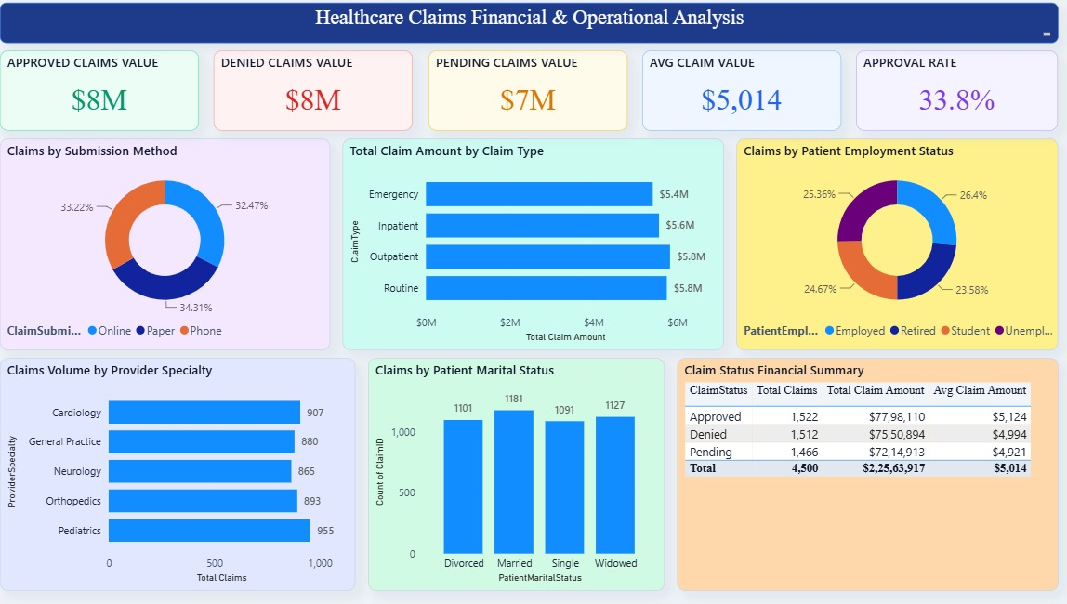
Dashboard 2 — Financial & Operational Analysis
HEALTHCARE INSURANCE CLAIMS & FRAUD RISK ANALYSIS
06 / 10

Slide 7
Financial Analysis — Key Takeaways
Approved value
Denied value
Pending value
Approximately $8M in approved claims, representing the accepted claim segment.
Approximately $8M in denied claims; review denial reasons and patterns to identify process improvements.
Approximately $7M remains pending; monitor aging and turnaround time to reduce unresolved exposure.
Operational questions to investigate
• Which claim types contribute the highest total claim amount?
• Do submission methods show different approval or denial outcomes?
• Are particular provider specialties associated with higher claim volumes or average claim values?
• Which pending claims require follow-up based on value and elapsed time?
HEALTHCARE INSURANCE CLAIMS & FRAUD RISK ANALYSIS
07 / 10

Slide 8
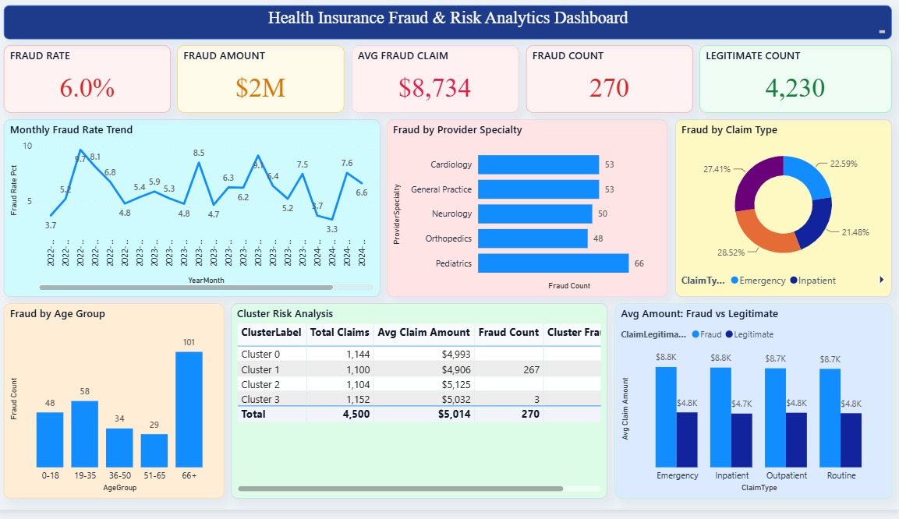
Dashboard 3 — Fraud & Risk Analysis
HEALTHCARE INSURANCE CLAIMS & FRAUD RISK ANALYSIS
08 / 10

Slide 9
Fraud & Risk — Findings and Interpretation
6.0%
$2M
$8,734
270
4,230
Fraud rate
Fraud amount
Average fraud claim
Fraud claims
Legitimate claims
Risk analysis highlights
• The dashboard flags 270 claims as potential fraud cases (6.0% of 4,500 claims).
• Fraud trends can be reviewed over time and segmented by provider specialty, claim type and age group.
• Cluster analysis can help compare groups with different claim volumes, average amounts and fraud counts.
• Potential flags should be validated through supporting documentation and a formal investigation before any claim decision.
HEALTHCARE INSURANCE CLAIMS & FRAUD RISK ANALYSIS
09 / 10

Slide 10
Conclusion & Next Steps
The dashboard brings claims, financial and fraud indicators into one reporting experience.
VALUE DELIVERED
• Faster visibility into claim volumes, status and financial value.
• Clearer comparisons across claim types, provider specialties and patient segments.
• Earlier identification of unusual patterns for targeted review.

Slide 11
THANK YOU

