Slide 1
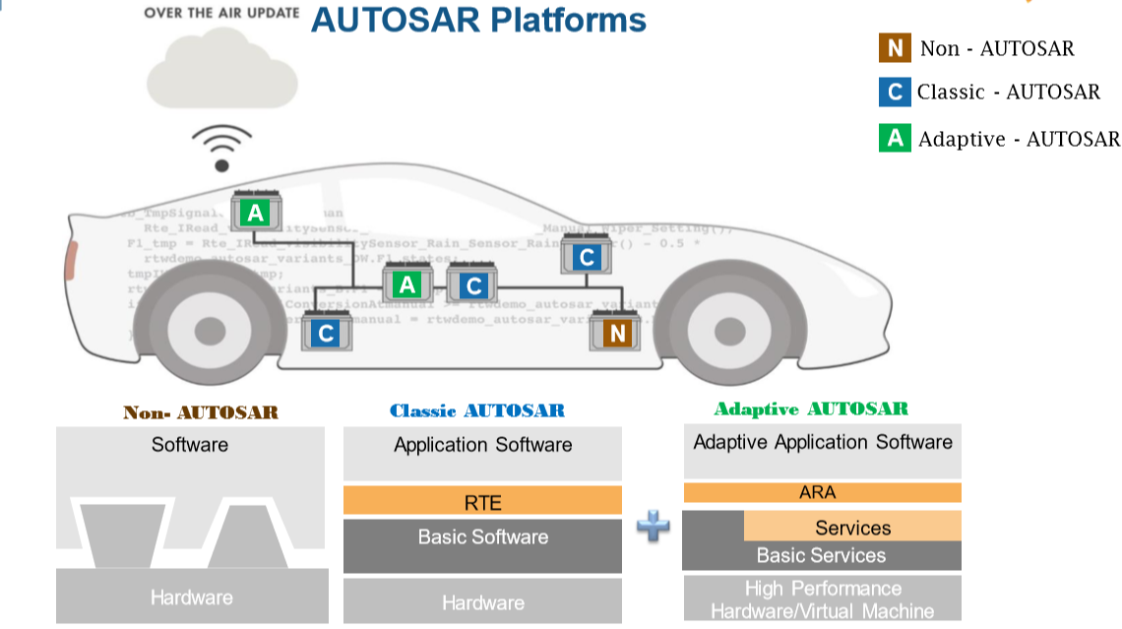

Slide 2
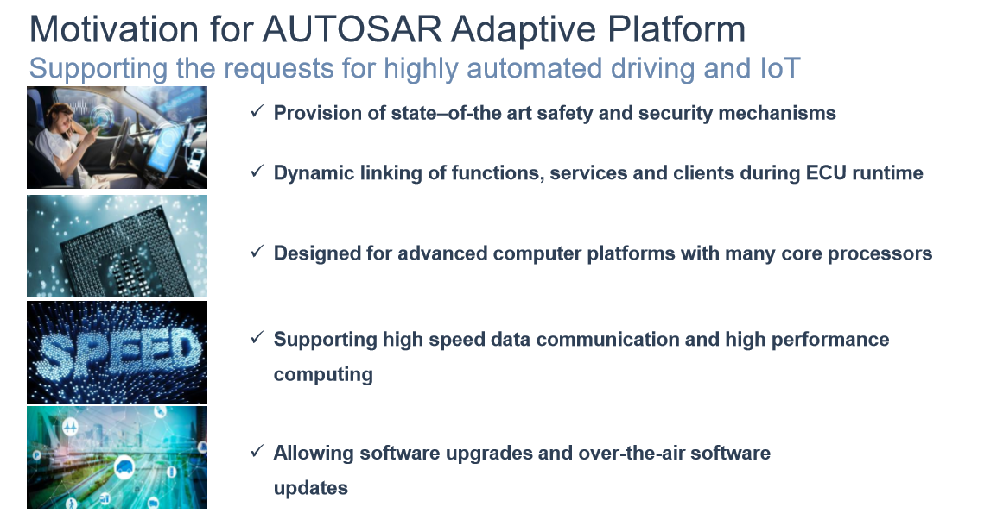

Slide 3
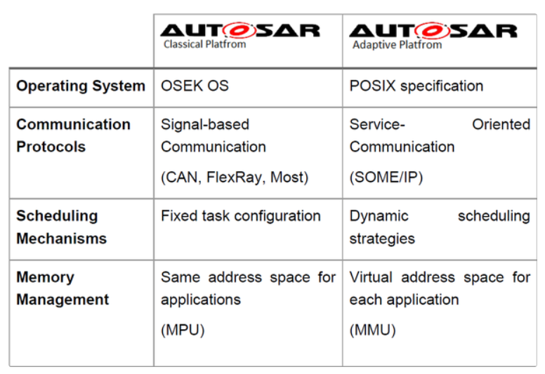

Slide 4
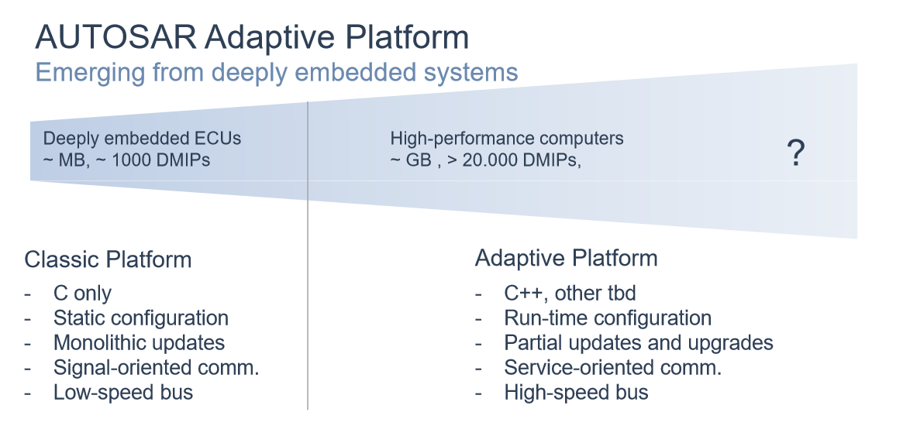

Slide 5
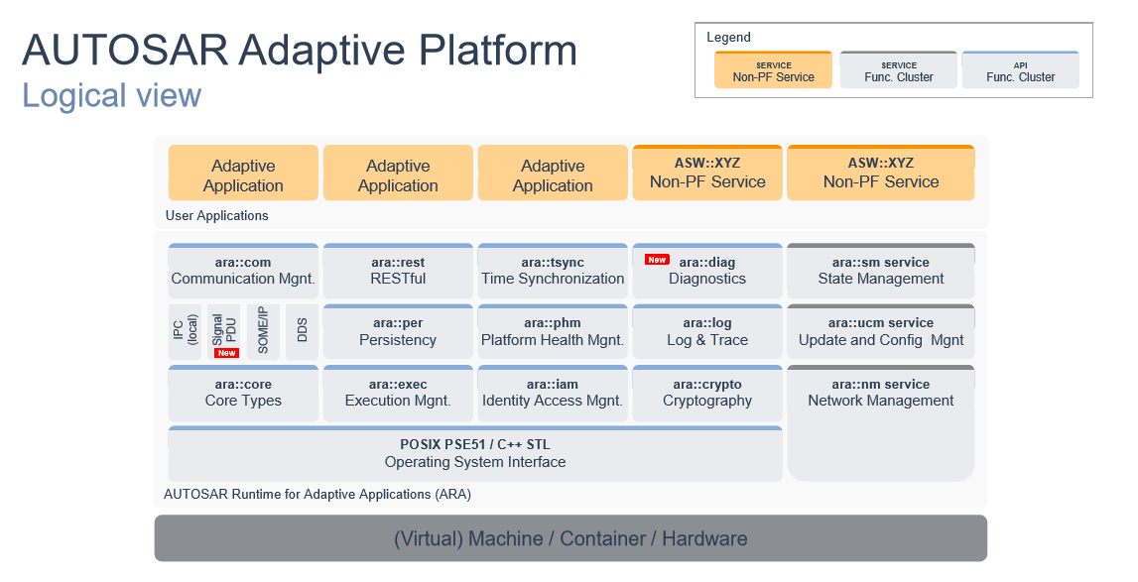

Slide 6
A last note about flexibility: We all know that state-of-the-art autonomous driving systems, especially in the context of sensor data processing, are developed on Linux systems. We need all the flexibility an operating system provides, including flexible memory allocation, thread handling, you name it. We don't want to – and probably cannot – forego this flexibility just because we have to compile our code for a specialized ECU operation system.
Because of this, the Adaptive Platform is based on a POSIX interface. By deploying their applications to an adaptive platform, developers can now exploit all the benefits of their beloved Linux.
That's something, isn't it?

Slide 7
SWS — Software Specification document. This is the actual software module API and non-functional specification where you can find all bits and pieces to start developing applications on top of the module.
RS — Requirements document. This document contains all functional requirements of the specific module. These documents are mostly used by companies providing implementation of the Adaptive Platform.
EXP — Explantory document. This is more human readable document describing the use of specific software module most likely with good examples. These documents are a very good starting point for newcomers.
TPS — Template Specification document. Describes the “Manifest” used in general or in some part of the Adaptive Platform. These documents are useful for understanding how things are modeled in the platform.
TR — Technical Report document. These documents contains technical information and are mostly referenced from other documents.

