Slide 1
Service Oriented Architecture & SOME/IP Protocol
by,
G.Shiva Kumar

Slide 2
AGENDA
What is Service Oriented Architecture
Service Oriented Architecture Example using SOME/IP
SOME/IP Protocol Introduction
SOME/IP Protocol Features
SOME/IP Service Interface & its elements
SOME/IP, SOME/IP-SD, SOME/IP -TP Message Formats
Pros and Cons of SOME/IP Protocol
SOME/IP Service Interface & Its Elements
Service Oriented Architecture
What is Service Oriented Architecture

Slide 3

What is Service Oriented Architecture
A Service Oriented architecture (SOA) is a Style of software design where services are provided to the other components by application components through a communication protocol over a network.
Communication , for which communication partners are generally not defined during design time , but dynamically discovered and bound during runtime.
Plug and play type communication

Slide 4
Service Oriented Architecture Example
Vehicle Ethernet Network
Multicast IP : 172.27.40.72
UDP Port: 1024
SERVICE INTERFACE_DP
{
Method : Image_process
Method Id: 272682
}
Offer service()
find service()
Required service found
SOME/IP
SOME/IP
APP1
{
---------
---------
image_process( )
{
-----
-----
}
}
ECU-1
Provided service instance (DP)
(ip:127.0.0.1
Transport protocol: tcp/udp
Port:1400)
Required service instance
(DP)
APP2
{
--------
--------
image_process( )
--------
--------
}
ECU-2
Subscribe/acknowledgement
Call → image_process ( )
unsubscribe

Slide 5
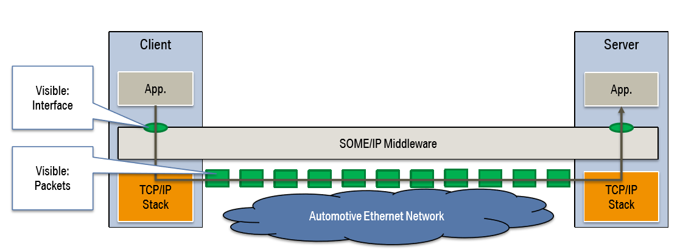
SOME/IP Protocol Introduction
SOME/IP is an Automotive/embedded Communication Protocol
SOME/IP Abbreviation is Scalable Service Oriented Middleware Over IP
Designed by BMW group 2011
SOME/IP is used for inter-ECU Client/Server Serialization
It relies on using Ethernet and TCP/IP
SOME/IP can be implemented on different Operating Systems(i.e. Autosar , GENIVI Linux and OSEK)
and Even Embedded Devices without Operating System.

Slide 6
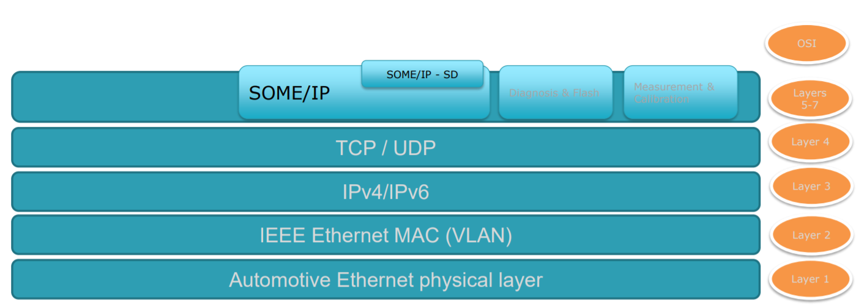
SOME/IP Protocol Introduction Continued ….
7. SOME/IP Protocol comes under the session and presentation layer of OSI network Model and Responsible for the following operations like Session establishment , maintenance and termination , translation, Encryption /Decryption, Compression.
Application, presentation ,session layers
Transport Layer
Network Layer
Datalink Layer
Physical Layer

Slide 7
SOME/IP Protocol Features
SOME/IP Provides Service Oriented Communication over a Network.
SOME/IP Provides Wide range of middleware features
serialization – transforming into and from on-wire Representation.
Remote Procedure Call (RPC) – implementing Remote Invocation of functions
Segmentation of udp messages – allowing the transport of large SOME/IP Messages over udp without need of fragmentation.
Service Discovery (SD)
Service Discovery is used to explicitly signal:
Status of Service Instances (available or not) as well as how to reach the service
Publish/Subscribe : Which Events/Fields does a client need?
This state is transported using cyclic messages carrying entries: Service: Find, Offer , and
StopOffer , Eventgroup: Subscribe, StopSubscribe, SubscribeAck, and SubscribeNack.

Slide 8
SOME/IP Service Interface & Its Elements
Service interface :
Port Interface that consists of a heterogeneous collection of methods ,events and fields.
Service Interface Name
Methods
Events
method_name()
event_name
…
Fields
field name
event
get()
set()
…
…
Service Interface = Type of service provider consisting of
Methods
Events
Fields
Server applications provide their data using a Service Interface Skeleton instance
Client applications use the server application by using a Service Interface Proxy instance
Proxys and Skeletons are transparently connected (intraprocess, interprocess, internetwork)

Slide 9
SOME/IP Service Interface Element : Event
Event :
A Uni-directional data transmission that is only invoked on changes or cyclically and is sent from producer of data to consumers
An Event Represents an update to a piece of data
Here X is the Data provided by Server and Required by Client , client Subscribed to get the updates for x
X=10
X=20
X=30
X
Client
Server
inform
inform
inform

Slide 10
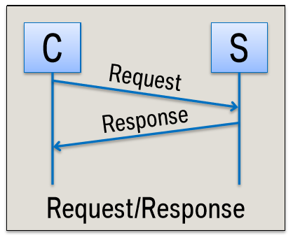
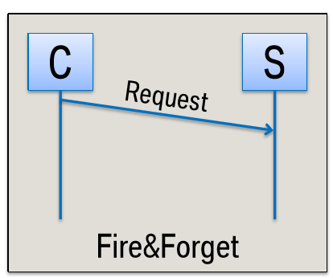
SOME/IP Service Interface Element : Method
Method :
A Method Represents a function that is executed by and in the scope of server on request od one or more Client(s).
Types of Method.
With response(Request/Response).
Without Response (Fire & Forget).

Slide 11
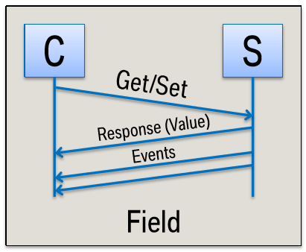
SOME/IP Service Interface Element : Method
Field :
A Field represents a Piece of data hosted by a server that is accessible to one or more client(s)
Via get and/or set accessors.
Elements of a Field
Setter (Method to set field value).
Getter (Method to set field value).
Notifier (Event to inform the new values on change of the field).

Slide 12
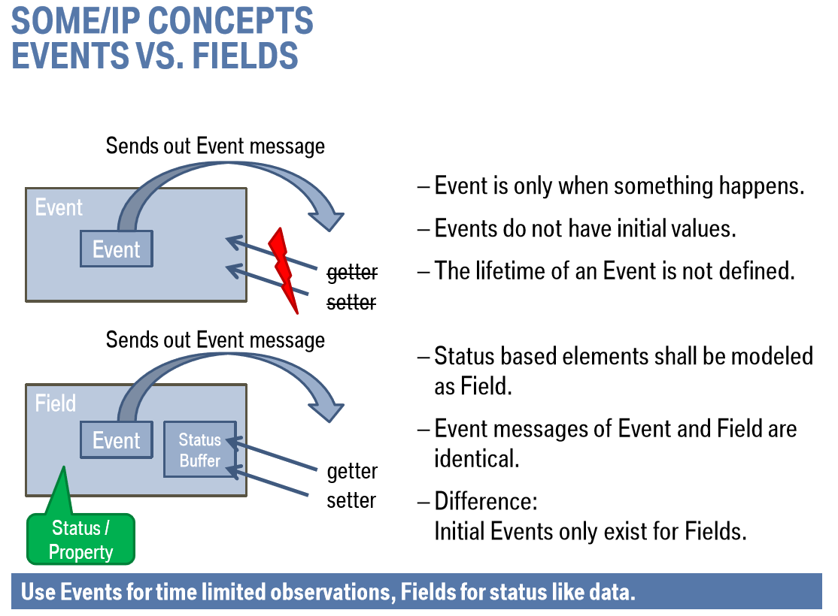
Events vs Fields

Slide 13
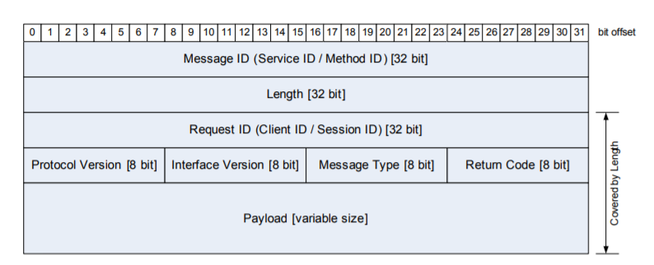
SOME/IP Message Format

Slide 14
SOME/IP Message Elements
Message ID [32 Bit]:
The message id is a 32 bit identifier that is used to identify the RPC call to a method of an application or to identify an event.
Structure of Message ID:
Length [32 Bit]:
Length field shall contain the length in Byte starting from Request ID/Client ID until the end of the SOME/IP Message.
Request ID [32 Bit]:
The Request ID allows a provider and Subscriber to differentiate multiple parallel uses of the same metod ,event, getter or setter.
The Client ID is the unique identifier for the calling client inside the ECU . The Client ID allows an ECU to Differentiate calls from multiple clients to the same method.
The session ID is a Unique identifier chosen by the Subscribers for each call . The Session ID allows a Subscriber to differentiate multiple calls to the same method.

Slide 15
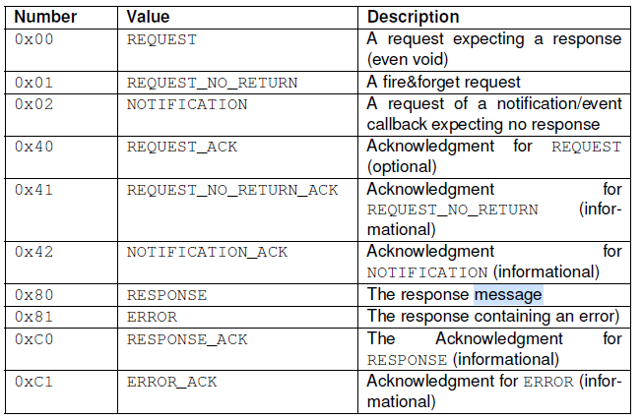
SOME/IP Message Elements Continued …
Protocol Version [8 Bit]:
Protocol Version shall be an 8 bit Field containing the SOME/IP protocol version.
Interface Version [8 Bit]:
Interface Version Shall be an 8bit field that contains the Version of the Service Interface
Message Type [8 Bit]:
The Message Type field is used to differentiate different types of messages and shall contain the following values as shown in Table

Slide 16
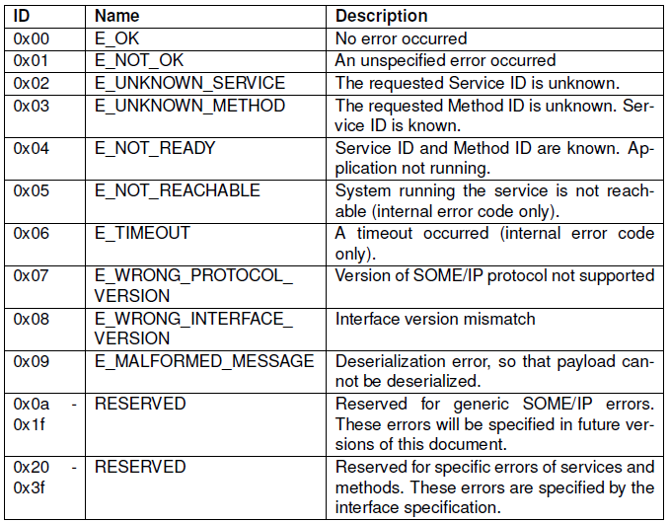
SOME/IP Message Elements Continued …
Return Code [8 Bit]:
The Return Code Shall be UINT8 and used to signal whether a request was Successfully processed.
For Simplification of the header layout , every message transports the field Return code as 0X00.

Slide 17
SOME/IP Message Elements Continued …
Payload:
The size of the SOME/IP payload field depends on the transport protocol used.
With UDP the SOME/IP Payload shall be between 0 to 1400 bytes.
The limitation to 1400 bytes is needed in order to allow for future changes to protocol stack.
Since TCP Supports Segmentation of Payloads , larger sizes are automatically Supported.

Slide 18
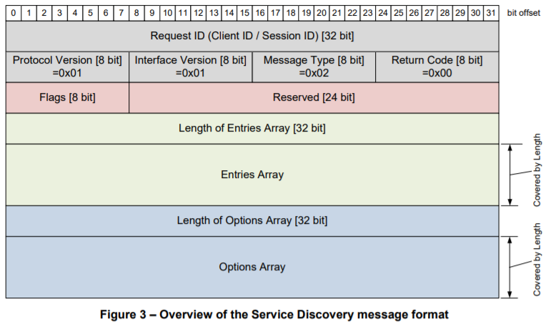
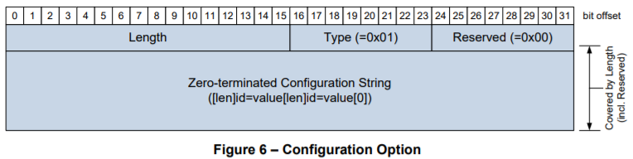
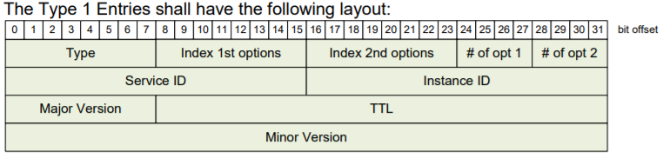
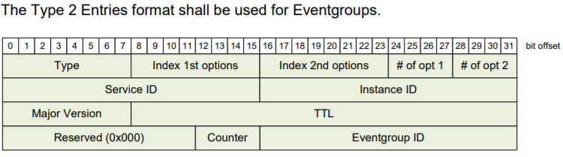


SOME/IP-SD Message Format & its Elements.
When SOME/IP-SD find or offer service instances or handles subscriptions this is done by so called entries , which are transported in the entry array of the SOME/IP-SD Message

Slide 19
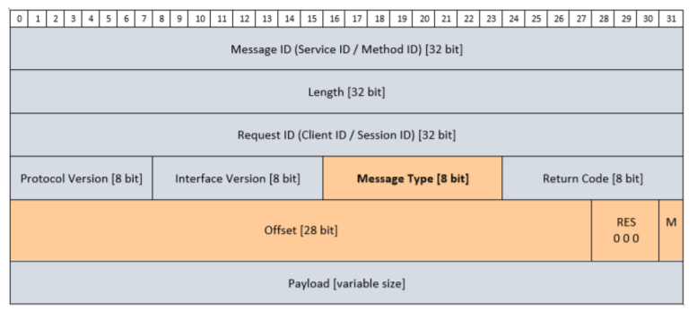
SOME/IP-TP Message Format
The UDP binding of SOME/IP can only transport SOME/IP messages that fit directly into an IP packet. If larger SOME/IP messages need to be transported over UDP (e.g. of 32 KB) the SOME/IP Transport Protocol (SOME/IP-TP) shall be used.

Slide 20
SOME/IP Pros & Cons
Pros and Cons
SOME/IP Supports a high data rate.
SOME/IP has low transportation overhead.
The initiation time of SOME/IP is notably short.
SOME/IP Suitable for driver assistance and infotainment systems.
Simple, better maintainability, and modular design.
But still complex for hard real time systems like motor control or brakes.

Slide 21
Thank you

