Slide 1
Machine Learning-based Occupancy Estimation for energy conservation in buildings
By Shivaji Ganesh.

Slide 2
Introduction
In buildings, a large chunk of energy is spent on HVAC and lighting systems.
Recent studies have shown that occupant information (e.g., number, presence, behavior, activities) is a major input for control approaches in energy efficient buildings.
Studies have demonstrated energy can be saved upto 30% in buildings where the occupancy pattern was known.
Supervised machine learning models are used to gain inference about occupancy count from the deployed sensor nodes in the room.

Slide 3
Requirements
Hardware: Windows Laptop
Software & Application: Jupiter
Technology used: Python using data pre-processing, training, data framing using matplotlib's, comparing data sets using KNN algorithm.

Slide 4
Research Objectives
There are some features which show a change when occupancy count changes like co2, temperature etc. So, we are using data of those features to coach the model. We are using data collected by co2, temperature, humidity sensors. and that we have classified the state of room into 4 types.
Data preprocessing techniques to switch the data into well organized manner.
The performance comparison in terms of estimation accuracy and F1 score is noted for various ML algorithms.

Slide 5
Issues to be addressed
To accurately estimate the number of occupants in a room using non-intrusive sensors to design power efficient buildings.
Previous works are done to count people using cameras(privacy issues).
Overcoming user identification or privacy violation

Slide 6



Hardware sensors & IoT Devices
Internet
Data aggregation
storage
visualisation
Wifi interface
gateway
(node mcu)
Processing & analytics
Co2 level
humidity
Number of occupants
Sensors data
Temp.
Real time occupancy estimation

Slide 7
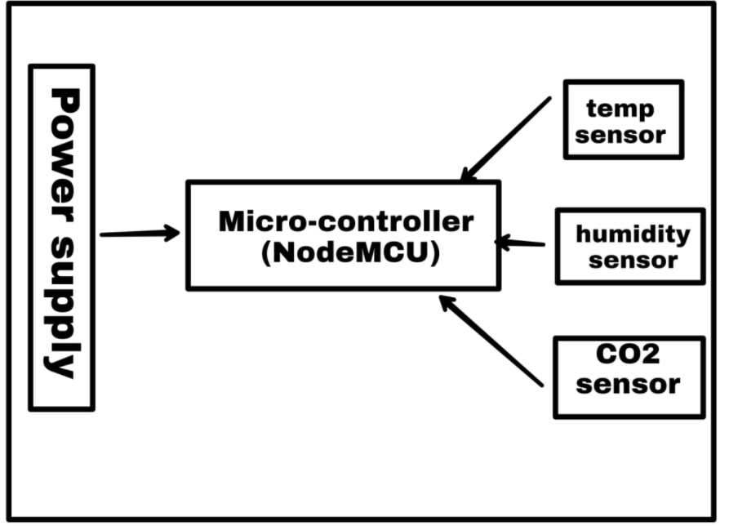
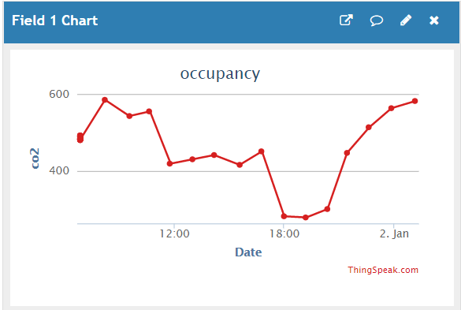
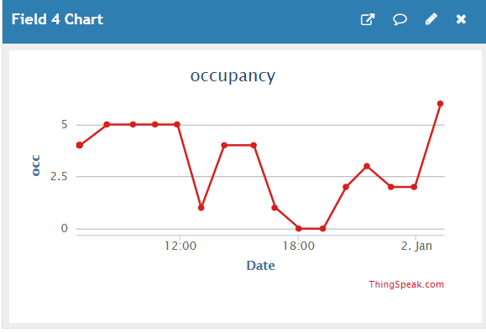
Methodology
Phase-1: Constructing sensor node
(sensors used – co2, temp, humidity
Micro-controller – Node MCU).
Phase-2: Collecting data from sensors and pushing into cloud.

Slide 8
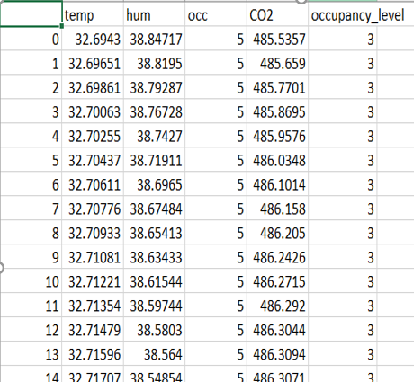
Phase-III : Data Pre-processing (Dataset Construction)
A few seconds of variation was present between the arrival times of packets of different nodes. We merged the time-stamps within a given time frame into a common vector.
Feature vectors with missing data were simply deleted.
The manually logged ground truth of occupancy count
was appended
levels:
0 : Empty(0)
1 - 2 : Low(1)
3 - 4 : Fair(2)
5 - 6 : High(3)

Slide 9



Phase-IV : Machine Learning Algorithms
Support Vector Machine
Decision Trees
Naive Bayes
DT
KNN
SVM
RF
NB
K-Nearest Neighbours
Random Forest
Supervised

Slide 10
Results
Algorithm | Accuracy | F1-score
KNN | 87.12 | 86.86
SVM | 80.7 | 80.2
Decision Trees | 84.55 | 84.4
Random Forest | 85.1 | 84.9
Naïve Bayes | 60 | 59
Different algorithms were applied on the data and metrics were noted.
KNN performed better among all.
Naïve Bayes is comparatively low.
KNN is tested for various k’s and finally k=22 gave highest accuracy.

Slide 11
Practical Applications
This model can be used within indoor places automating HVAC systems.
When space is empty , doesn’t need to turn ON the Appliances. The energy can be conserved by deactivating them.
This solution can also be implemented by large buildings which wastes large amount of energy on HVAC systems.

Slide 12
References
T. Vafeiadis et al., "Machine Learning Based Occupancy Detection via the Use of Smart Meters," 2017 International Symposium on Computer Science and Intelligent Controls (ISCSIC), Budapest, Hungary, 2017, pp. 6-12, doi: 10.1109/ISCSIC.2017.15.
A. P. Singh, V. Jain, S. Chaudhari, F. A. Kraemer, S. Werner and V. Garg, "Machine Learning-Based Occupancy Estimation Using Multivariate Sensor Nodes," 2018 IEEE Globecom Workshops (GC Wkshps), Abu Dhabi, United Arab Emirates, 2018, pp. 1-6, doi: 10.1109/GLOCOMW.2018.8644432.
Schwee, Jens Hjort; Johansen, Aslak; Jørgensen, Bo Nørregaard; Kjærgaard, Mikkel Baun; Mattera, Claudio Giovanni; Sangogboye, Fisayo Caleb; et al. (2019): Room-level occupant counts and environmental quality from heterogeneous sensing modalities in a smart building. Springer Nature. Dataset. https://doi.org/10.6084/m9.figshare.9959417.v1

Slide 13
Thank You

