Slide 1
KMIT — KESHAV MEMORIAL INSTITUTE OF TECHNOLOGY
Department of Computer Science & Engineering · Milestone – I
Explainable AI-Based Melanoma Detection
Using Vision Transformers, MedSAM, RAG and LLM-Based Clinical Report Generation
TEAM
G1362
MEMBERS
Ch. Monish · N. Sai Ramanuja · I. Shubham · V. Shiva · K. Subhash
MENTOR
Dr. K. Bhargavi
DEPARTMENT / BATCH
CSE, KMIT · Batch KR24 · AY 2026–2027
Explainable AI-Based Melanoma Detection
Notes:
Welcome the panel. Introduce team G1362, your mentor Dr. K. Bhargavi, and state the project title clearly. Frame it in one line: an explainable AI system that not only detects melanoma but explains its reasoning like a dermatologist would.

Slide 2
SECTION 2 · PROBLEM STATEMENT
Problem Statement
Melanoma is the most dangerous form of skin cancer — timely diagnosis significantly improves survival, but traditional visual diagnosis is subjective and inconsistent.
WHY EXPLAINABILITY MATTERS HERE
Clinicians must justify a biopsy/referral decision — a bare label isn't defensible evidence.
Explanations grounded in real medical literature (not just model confidence) build trust.
Interpretability is the specific gap this project targets, building on the CEFM base paper's explainability-first design.
Deep-learning classifiers now reach expert-level accuracy, but their black-box nature undermines clinician trust and limits real clinical adoption.
Even accurate predictions give no clinically meaningful reasoning — clinicians see a label, not the evidence behind it.
Existing explainable approaches (saliency maps, eye-tracking studies) show where a model looked, but rarely why a finding is clinically significant.
There is no established pipeline that pairs accurate classification/segmentation with evidence-grounded, dermatologist-style written explanations.
!
Explainable AI-Based Melanoma Detection
Notes:
Emphasize that black-box accuracy is not enough for clinical adoption — trust requires clinically-grounded explanations, not just a confidence number. This motivates every downstream design choice.

Slide 3
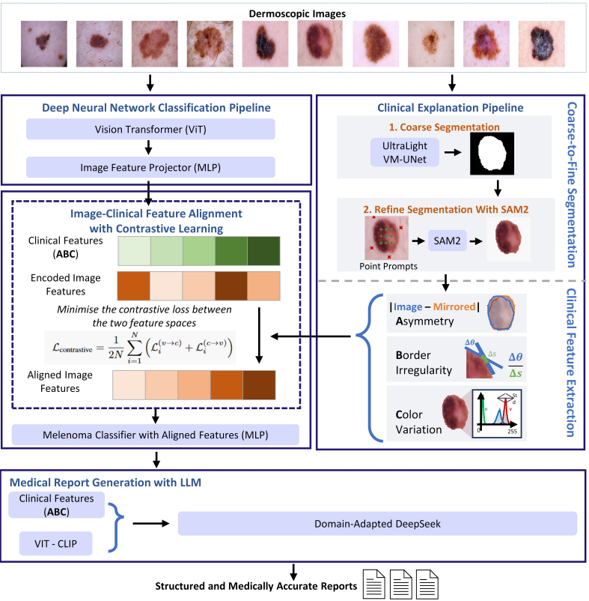
SECTION 3 · BASE PAPER/ RESEARCH REFERENCE
Base Paper — CEFM
Explainable Melanoma Diagnosis with Contrastive Learning and LLM-based Report Generation
Zheng et al. | December 2025
Proposes CEFM (Cross-modal Explainable Framework for Melanoma) to address the lack of interpretability in high- performing Al models, which often act as black boxes and are difficult for clinicians to interpret and trust.
CEFM connects visual image features with clinically meaningful ABC features to make melanoma predictions more interpretable.
Workflow: Image -> ViT > Image Features Lesion > Segmentation > ABC -> Contrastive Learning Classification + Report
Results: 92.79% Accuracy | 0.961 AUC | 4.6/5 Expert Interpretability
Limitation: CEFM focuses on ABC and excludes Differential Structures (D) because fine-grained expert annotations are difficult to obtain.

Slide 4
SECTION 3 · BASE PAPER/ RESEARCH REFERENCE
Literature Survey – Key findings
RESEARCH GAP
High classification performance
Limited clinically grounded explainability
Incomplete clinical assessment
ABCDE-based assessment remains uncommon
Limited segmentation evaluation Few studies assess lesion-segmentation quality
Limited evidence grounding
Few end-to-end systems connect prediction with traceable clinical reasoning
Observations drawn from the 22 papers reviewed (2022–2026)
Dataset trend:
HAM10000 and ISIC variants dominate the benchmark datasets across the literature.
Clinical criteria
ABCD is most common (5 papers), ABCDE appears in 2, and ABC in 1; most remaining studies do not explicitly use clinical criteria.
Explainability
Only 2 of 22 papers explicitly foreground explainability; most focus primarily on accuracy/AUC.
Segmentation
Segmentation quality is rarely evaluated; none of the reviewed papers report Dice/IoU.
OUR RESEARCH GAP
End-to-end, explainable and evidence-grounded ABCDE melanoma assessment
Explainable AI-Based Melanoma Detection
Notes:
This slide is the researcher-analysis payoff of the survey — not a repeat of the table. Emphasize the segmentation-metric gap (no reviewed paper reports Dice/IoU) as part of the motivation for rigorous evaluation in this project.

Slide 5
SECTION 3 · BASE PAPER/ RESEARCH REFERENCE
Project Statement
ABSTRACT
Title : Explainable AI-Based Melanoma Detection
Main statement
We propose an explainable AI-based melanoma detection framework that extends the base CEFM approach from ABC-based assessment toward a complete ABCDE assessment, with precise lesion segmentation and evidence-grounded clinical reporting.
Goal
Accurate melanoma detection with clinically interpretable ABCDE-based explanations.
Key Improvements
ABCDE assessment instead of ABC
MedSAM for precise lesion segmentation
RAG + LLM for evidence-supported clinical reports
Expected Outcome
Prediction + ABCDE assessment + supporting evidence + interpretable medical report
Explainable AI-Based Melanoma Detection
Notes:
Cover the abstract and end users together — six distinct user categories show this isn't a single-purpose tool.

Slide 6
SECTION 4 · PROPOSED SOLUTION
ABCDE Clinical Features
A
Asymmetry
One half of the lesion doesn't match the other.
Shape-symmetry analysis on the MedSAM mask.
B
Border
Irregular, notched or blurred edges vs. a smooth border.
Contour-irregularity computation on the mask boundary.
C
Color
Uneven pigmentation / multiple colors within the lesion.
Color-channel variance analysis across the segmented region.
D
Diameter
Lesion size — larger diameter raises clinical suspicion.
Measured from the mask using pixel-to-mm calibration (a scale/reference object is recommended at upload).
E
Lesion size gradually increases over time
Evolution
Evolution of size overtime- repeated inspection in uniform intervals
Explainable AI-Based Melanoma Detection
Notes:
Full form: A=Asymmetry, B=Border, C=Color, D=Diameter. Be ready to explain the panel note on differential-structure/Evolving exclusion confidently — it's a scoping decision, not an oversight.

Slide 7
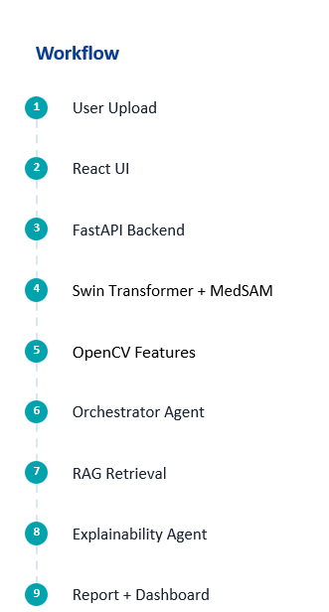
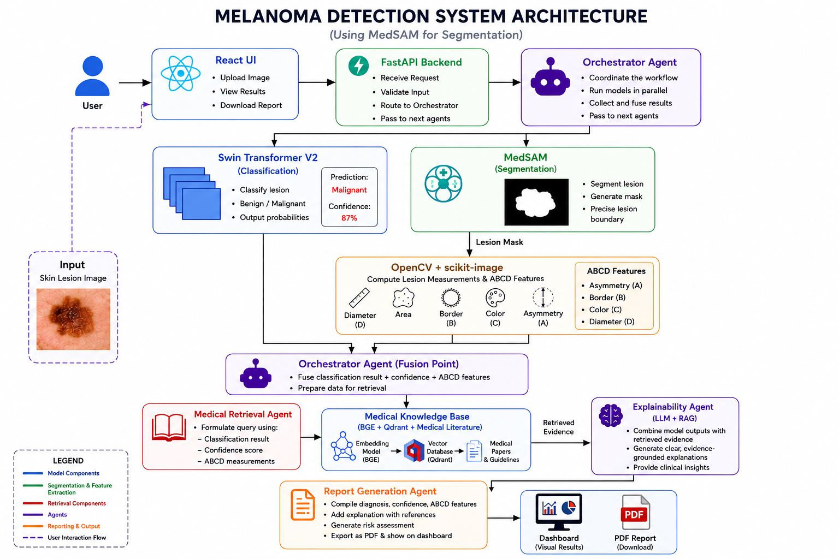
SECTION 4 · PROPOSED SOLUTION
Proposed Solution — System Architecture

Slide 8
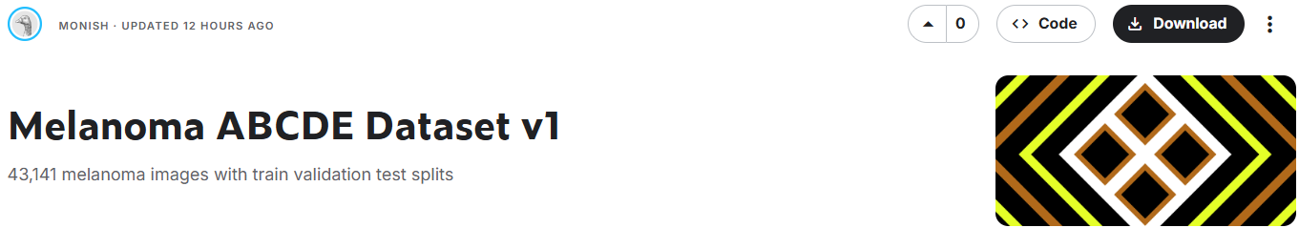
SECTION 5 · DATASET DETAILS
Datasets To Be Used
ISIC 2018
ISIC 2020
PURPOSE: Lesion Segmentation
PURPOSE: Melanoma Classification
Expert-annotated ground-truth masks
Coarse-to-fine segmentation training
Benchmark for UltraLight VM-UNet-style models
Large-scale dermoscopic image collection
Binary classification: benign vs. malignant
Official validation (n≈573) / test (n≈714) splits
Dataset to be used:
Curated dataset designed to extend melanoma analysis with Diameter (D) and Evolution (E) features.
ISIC 2018 supplies expert-annotated masks for training the segmentation stage; ISIC 2020 provides the large-scale, high-quality images used for melanoma classification.
Explainable AI-Based Melanoma Detection
Notes:
ISIC 2018 for segmentation (has masks), ISIC 2020 for classification (larger, high-quality images) — don't mix up their purposes.

Slide 9
SECTION 6 · PROJECT INPUTS & WORKFLOW
Functional Requirements
FR1
Upload Image
FR2
Lesion Segmentation
FR3
Melanoma Classification
Accepts a dermoscopic lesion image (JPEG/PNG/JPG) as system input.
MedSAM generates a precise lesion boundary mask from the uploaded image.
Swin Transformer V2 predicts benign/malignant with a confidence score.
FR4
ABCD Feature Extraction
FR5
Medical Knowledge Retrieval
FR6
Explainable AI
OpenCV + scikit-image compute Asymmetry, Border, Color and Diameter from the mask.
RAG retrieves relevant medical literature/guidelines via BGE embeddings + Qdrant.
Explainability Agent combines model outputs with retrieved evidence into a clear rationale.
FR7
Clinical Report Generation
FR8
Dashboard
FR9
PDF Report Download
Report Generation Agent compiles diagnosis, ABCD features, evidence and risk assessment.
Interactive visual results (classification, mask, features, explanation) for the clinician.
Exports the generated clinical report as a downloadable PDF.
Explainable AI-Based Melanoma Detection
Notes:
Walk through FR1-FR9 in pipeline order. Be ready for the panel to ask why ABCD Feature Extraction (FR4) is named ABCD and not ABC — reference the ABCD slide's panel note.

Slide 10
SECTION 6 · PROJECT INPUTS & WORKFLOW
Non-Functional Requirements
NON-FUNCTIONAL REQUIREMENTS
Accuracy
Reliability
Explainability
Scalability
Fast Inference
Maintainability
Security
Availability

Slide 11
SECTION 6 · PROJECT INPUTS & WORKFLOW
Methodology — Stage by Stage
Stage | Input | What Happens | Output | Why It Matters
Preprocessing | Raw dermoscopic image | Validate format/quality via FastAPI | Clean, validated image | Ensures downstream models receive a usable input
Segmentation | Validated image | MedSAM generates lesion boundary mask | Binary lesion mask | Precise boundary is required for reliable ABCD measurement
Classification | Validated image | Swin Transformer V2 predicts class | Benign/Malignant + confidence | Primary diagnostic signal
Feature Extraction | Lesion mask | OpenCV + scikit-image compute A/B/C/D | ABCD feature values | Clinically-grounded features for explainability
Orchestration (Fusion) | Classification + mask + ABCD | Orchestrator Agent fuses all signals | Unified case summary | Single consistent record for retrieval/reporting
RAG Retrieval | Case summary | Medical Retrieval Agent queries Qdrant via BGE embeddings | Relevant medical evidence | Grounds explanation in real literature, reduces unsupported claims
Explainability | Case summary + evidence | Explainability Agent (LLM+RAG) synthesizes rationale | Evidence-grounded explanation | Bridges model output to clinical reasoning
Report Generation | Explanation + case data | Report Generation Agent compiles structured report | Dashboard view + PDF | Delivers a clinician-usable, referenceable output
Explainable AI-Based Melanoma Detection
Notes:
This table is the panel-defense reference for methodology — know the WHAT/WHY for every row cold.

Slide 12
SECTION 6 · PROJECT INPUTS & WORKFLOW
Input Requirements & System Outputs
INPUT — Dermoscopic Skin Lesion Image
OUTPUTS
Capture one lesion only, fully visible
Good lighting; avoid shadows/reflections
Clear, high-resolution image
Camera directly above the lesion
Avoid filters, blur, hair/bandages
Include a scale/reference object for diameter
Previous images welcome, for evolution analysis
Classification (Benign / Malignant)
Probability / Confidence Score
Segmented Lesion Mask
ABCD Feature Values
Evidence-Grounded Explanation
Generated Clinical Report
Interactive Dashboard
Downloadable PDF Report
Supported formats: JPEG · PNG · JPG
No output is a bare number — every result is paired with an explanation and supporting evidence.
Explainable AI-Based Melanoma Detection
Notes:
Stress that image-quality guidelines (lighting, reference object) directly affect downstream segmentation and Diameter measurement accuracy.

Slide 13
SECTION 7 · TARGET USERS / STAKEHOLDERS
Target Users & Key Stakeholders
TARGET USERS
D
Dermatologists
H
Hospitals
C
Clinics
Review AI findings and use explanations for clinical decision support.
Support scalable AI-assisted melanoma screening and clinical workflows.
Provide accessible AI-assisted lesion assessment for clinical practice.
R
Medical Researchers
S
Medical Students
P
Patients — Decision-Support Only
Use the system and outputs for melanoma AI research and analysis.
Learn melanoma assessment, clinical features, and explainable AI.
Receive decision support and understandable information — not a diagnosis.
KEY STAKEHOLDERS
D
Dermatologists / Clinicians
P
Patients
H
Hospitals & Clinics
R
Medical Researchers
Provide clinical expertise and validate medically meaningful outputs.
Benefit from clearer, evidence-supported information for decision support.
Enable adoption and integration into healthcare workflows.
Evaluate, improve, and extend the system for medical AI research.
T
Project Development Team
F
Project Mentor / Faculty
K
Academic Institution (KMIT)
A
Healthcare / Clinical Administrators
Develop, integrate, test, and maintain the complete system.
Guide the project's technical, research, and academic direction.
Provides the academic environment and institutional support.
Oversee implementation, usability, governance, and operational adoption.
Explainable AI-Based Melanoma Detection
Notes:
Cover the abstract and end users together — six distinct user categories show this isn't a single-purpose tool.

Slide 14
SECTION 8 · PROPOSED DEPLOYMENT PLAN
Deployment Architecture
FRONTEND
BACKEND
FUTURE DATABASE
FUTURE STORAGE
Vercel
Railway
MongoDB Atlas
Cloudinary
planned
planned
DEPLOYMENT FLOW
User
›
Vercel
›
Railway
›
AI Models
›
Report
›
Dashboard
Cloud-native deployment keeps the model-serving backend decoupled from the presentation layer, enabling independent scaling of inference workloads and rapid CI/CD iteration. MongoDB Atlas and Cloudinary are planned additions for persistence and media storage as the project matures beyond Milestone I.
Explainable AI-Based Melanoma Detection
Notes:
Frontend/backend are live (Vercel/Railway); database/storage are explicitly future additions — keep this distinction clear if asked what's actually implemented.

Slide 15
SECTION 8 · PROPOSED DEPLOYMENT PLAN
Novelty of Our Work
Base Paper (CEFM)
ViT classification + segmentation + ABC contrastive alignment + CLIP + DeepSeek LLM report. 92.79% accuracy, AUC 0.961.
↓
Identified Limitations
ABC only (no explicit Diameter); explanations grounded solely in learned contrastive alignment, not external evidence; single-stage pipeline.
↓
Our Extensions
MedSAM segmentation; ABCDE (adds Diameter and Evolution); RAG-grounded evidence retrieval via Qdrant; 4-agent orchestrated architecture; FastAPI + React deployment.
↓
Our Novel Contribution
An agentic, retrieval-grounded extension of CEFM that pairs precise segmentation and full ABCD clinical features with RAG-sourced medical evidence for LLM-generated, evidence-traceable clinical reports.
Note: Vision Transformers, MedSAM, RAG and LLMs are established technologies — the novelty claimed here is their specific integration for evidence-grounded melanoma reporting, not the individual components.
Explainable AI-Based Melanoma Detection
Notes:
This is the most important slide for panel defense. Be explicit: the individual technologies (ViT, MedSAM, RAG, LLM) are NOT novel — the specific integration for evidence-grounded melanoma reporting is the contribution.

Slide 16
SECTION 9 · EXPECTED OUTPUTS & RESULTS
Evaluation Metrics — Planned Evaluation
Accuracy
Precision
Recall
Proportion of lesions correctly classified overall.
Of predicted-malignant cases, how many truly are.
Of actual malignant cases, how many are caught.
F1 Score
Sensitivity
Specificity
Balances precision and recall in one number.
Ability to correctly flag true melanoma cases.
Ability to correctly clear benign lesions.
AUC
Dice Score
IoU
Overall separability across all thresholds.
Overlap between predicted and true lesion mask.
Strictness-adjusted mask overlap ratio.
Explainable AI-Based Melanoma Detection
Notes:
Metrics are planned, not achieved — do not imply any of these numbers exist yet for this project.

Slide 17
SECTION 10 · CONCLUSION & FUTURE SCOPE
Melanoma detection needs both accuracy and clinician trust — black-box predictions alone aren't enough.
Building on the CEFM base paper's ViT + contrastive-alignment + LLM pipeline, this project extends it with MedSAM segmentation, full ABCDE clinical features, RAG-grounded evidence retrieval and a 4-agent orchestrated architecture.
The result is a system designed to pair accurate classification/segmentation with evidence-traceable, clinically meaningful explanations — deployed via a FastAPI + React stack.
Evaluation on ISIC 2018 and 2020 (Accuracy, Sensitivity, Specificity, AUC, Dice, IoU, etc.) is planned as the next milestone.
Explainable AI-Based Melanoma Detection
Notes:
Summarize problem → gap → solution → contribution in under a minute; this is your closing pitch before Q&A.

Slide 18
SECTION 10 · CONCLUSION & FUTURE SCOPE
Future Scope
1
2
3
Mobile Application
Real-time Clinical Integration
Multi-Disease Detection
4
5
6
Federated Learning
FHIR Integration
Cloud Deployment
7
8
9
Patient History Integration
Voice-Enabled Reports
Advanced Explainable AI
Explainable AI-Based Melanoma Detection
Notes:
These are directions beyond Milestone I — don't imply any are in progress unless asked and confirmed.

Slide 19
SECTION 10 · CONCLUSION & FUTURE SCOPE
Learning Outcomes
AI in Medical Field
Swin Transformers
MedSAM Segmentation
Computer Vision
Problem Solving
Research Paper Reading
FastAPI
React
RAG
Model Evaluation
Prompt Engineering
Large Language Models
Cloud Deployment
IEEE Paper Writing
Team Collaboration
This project spans medical AI research, full-stack engineering, modern LLM/RAG techniques, cloud deployment, and academic skills like IEEE paper writing.
Explainable AI-Based Melanoma Detection
Notes:
Use this to show the breadth of skills developed — useful if the panel asks about individual contributions.

Slide 20
Thank You
Questions?
Explainable AI-Based Melanoma Detection Using Vision Transformers, MedSAM, RAG and LLM-Based Clinical Report Generation
Team G1362
Notes:
Thank the panel, invite questions on architecture, dataset choices, or the explainability approach — including the ABCD scoping decision.

