Slide 1
TEAM: BRAINY BUNCH
• Domain : Web /App Developement
• problem Statement code: WD-02
• problem Statement Title: Surplus to Serve Bridging Restaurants And NGOs For Efficient Food Redistribution.
• Team Leader name :Sanjana Umesh Kashid
• Institute Name : HIRASUGAR INSTITUTE OF TECHNOLOGY NIDASOSHI, BELAGAVI 591236

Slide 2
Key Features Of Our SurplusServe Application :
Surplus to Serve is a platform that connects businesses with surplus food to local charities and food banks, ensuring that excess food is redistributed efficiently to those in need.
User Registration: Easy Sign-up for Businesses And Charities
Surplus Listing : Restaurants, community kitchen, Food Bank can surplus
Food Items
Matching Algorithm : Automatically matches surplus with nearby charities based on proximity and need.
Notifications: Real-time alerts to charities about available surplus.
Target Audience: Restaurants, supermarkets, caterers, food banks, and charities.
Market Research: Trends in food donation and waste reduction. Competitive Analysis: Comparison with similar platforms, emphasizing our unique features and local focus.
Summary: Surplus to Serve aims to reduce food waste and hunger through a tech-driven platform connecting surplus food with those in need. Platform used: Figma
PURPOSE OF USING FIGMA
Real-time Collaboration: Figma enables simultaneous editing and commenting, fostering seamless teamwork without version control issues. Accessible Anywhere: As a cloud-based platform, Figma allows users to access and work on designs from any device with an internet connection. Powerful Prototyping: With built-in prototyping features, Figma simplifies the creation of interactive prototypes for user testing and design validation.
Design System Support: Figma facilitates the creation and management of design systems and component libraries, ensuring consistency and efficiency across projects.

Slide 3
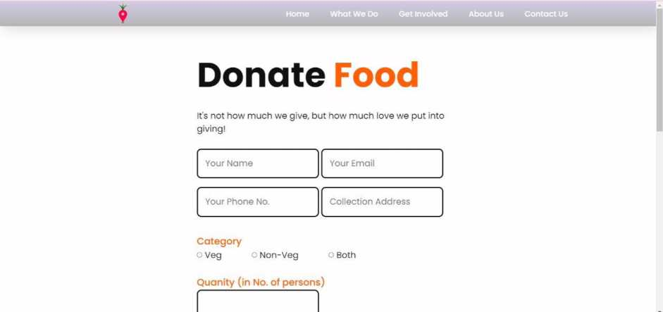
C O File C/Users/Admin/OneDrive/Desktop/Workspace/SurplusServe-main/index-html
Home What We Do Get Involved About Us Contact Us
SurplusServe
"If you're throwing away food, you're throwing away life." -Anthony Bourdain

Slide 4
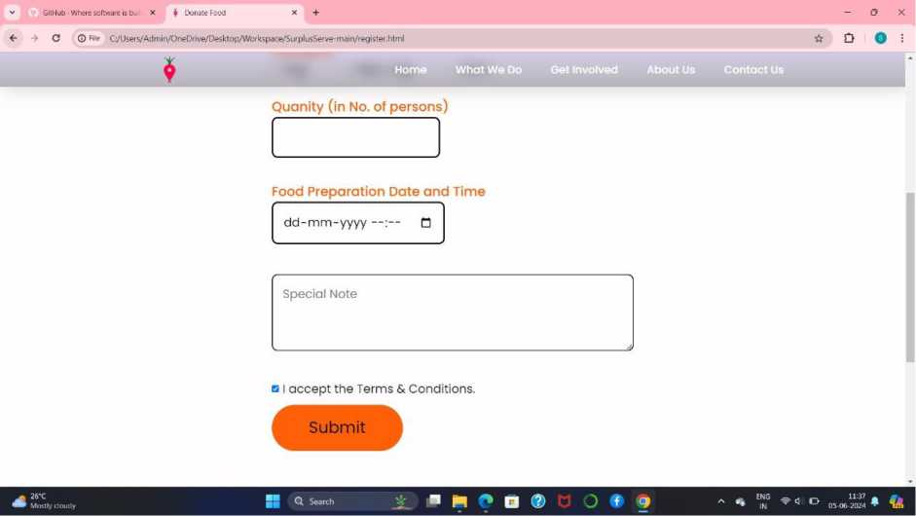
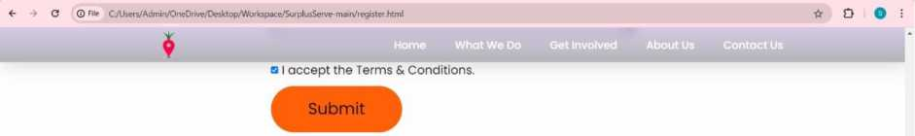
Quick Links | Connect
Donate | O0QOO®0
About Us
Contact Us | Copyright 6 2024 SurplusServel All Rights Reserved

