Slide 1

Supply Chain Data Integration
Transforming disparate data into actionable insights for optimized operations.

Slide 2

Project Overview: Supply Chain Data Integration System
1
2
3
Project Name
Goal
Key Tools & Technologies
Supply Chain Data Integration System
Connect, process, and visualize critical supply chain data from diverse sources to enhance decision-making.
Python 🐍, Google BigQuery ☁️, Streamlit 📊, Looker Studio 📈

Slide 3
Core Objectives & Deliverables
Seamless Data Integration
Extract and integrate transactional data from Excel (Global Superstore) and product information from a mock API (Fake Store).
Dynamic Inventory Simulation
Develop a daily simulation model for inventory stock levels, reflecting real-world fluctuations and demand.
Robust Data Transformation
Implement comprehensive data cleaning and transformation processes to ensure data quality and consistency.
Centralized Data Warehousing
Establish a scalable data warehouse in Google BigQuery for efficient storage and retrieval of all processed data.
Actionable Business Dashboards
Build intuitive dashboards for visualizing key supply chain metrics, enabling stakeholders to derive insights effortlessly.

Slide 4
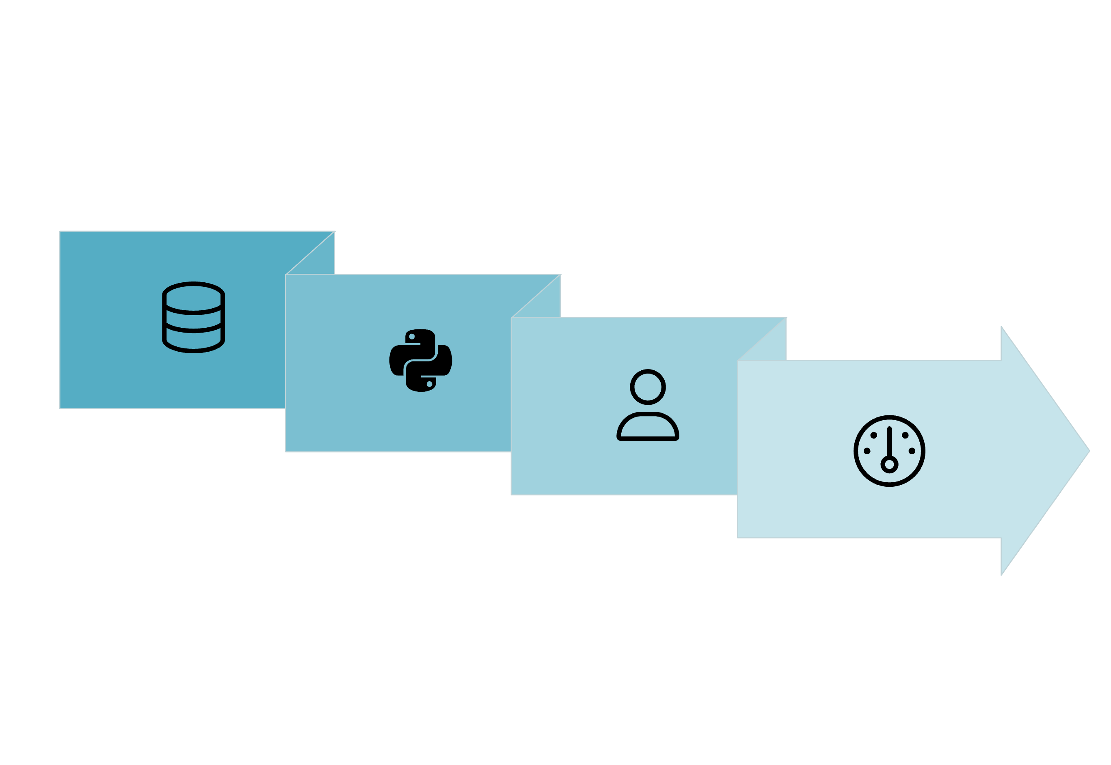




Project Architecture: A Unified Data Flow
Python ETL Scripts
Dashboards
Data Collection
BigQuery Warehouse
This architecture ensures a streamlined flow from raw data ingestion to insightful visualizations, fostering a single source of truth for supply chain operations.

Slide 5
Structured for Success: Folder & Code Organization
Our project adheres to a clear, modular folder structure designed for:
supply_chain_project/├── data/ # Excel and CSV files├── src/ # Python ETL scripts├── bigquery/ # BigQuery loaders & schema├── dashboard/ # Streamlit app└── service_account.json # GCP authentication
Clarity: Easy navigation and understanding of project components.
Reusability: Promoting efficient development and maintenance.
Scalability: Supporting future expansions and integrations.
Maintainability: Simplifying debugging and updates.

Slide 6




Comprehensive Data Extraction & Integration
Our data pipeline meticulously extracts, simulates, and unifies diverse datasets for a holistic view of the supply chain.
Source Data Ingestion
API-Driven Product Enrichment
Read and parse essential sheets from the "Global Superstore" Excel workbook: Orders, Returns, and People.
Fetch detailed product information dynamically from the "Fake Store" API to enrich our dataset.
Inventory Level Simulation
Unified CSV Exports
Programmatically simulate 30 days of inventory stock levels using Python, accounting for various operational scenarios.
Clean, combine, and export processed data into normalized CSV files: orders.csv, inventory.csv, and returns.csv, ready for warehousing.

Slide 7
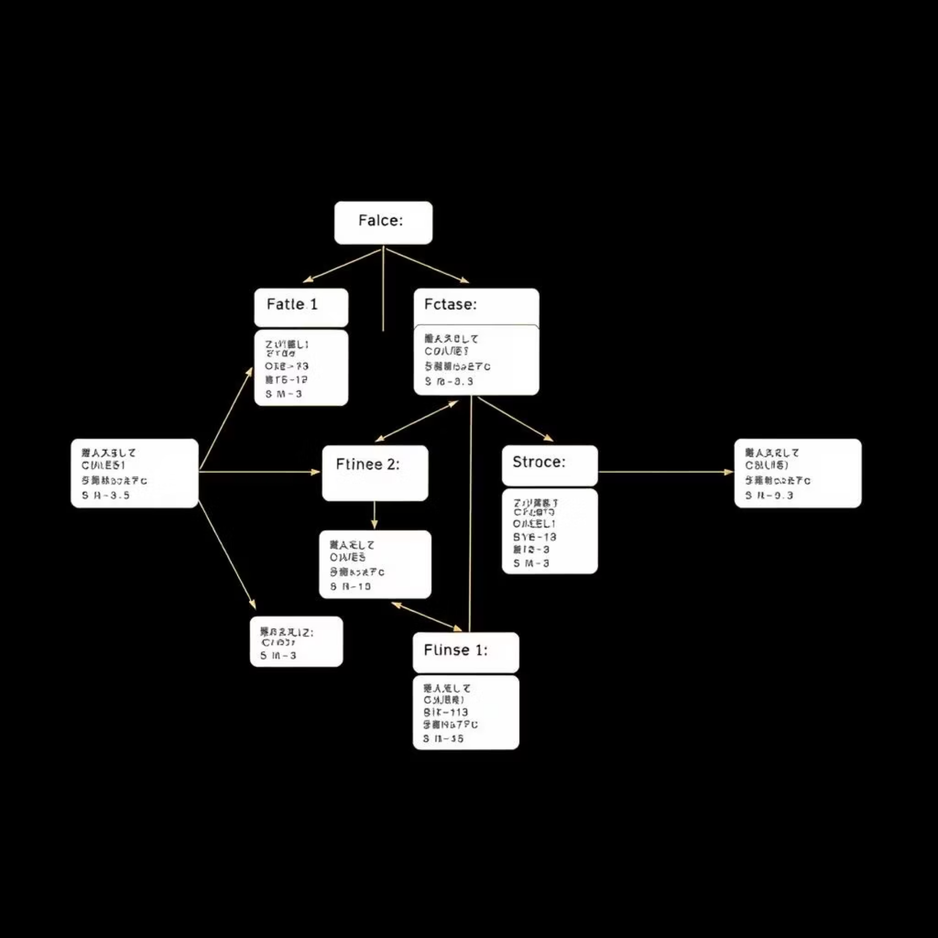
Optimized Data Storage: Star Schema in BigQuery
Implementing a Star Schema in BigQuery revolutionizes our data querying and reporting capabilities.
Fact Tables 📘
fact_orders: Captures core transactional data (order_id, product_id, sales, quantity, discount, profit, shipping_cost, order_date_id, ship_date_id).
fact_inventory: Records daily stock levels and associated costs (inventory_level, price, stock_date_id).
Dimension Tables 📗
dim_product: Contains detailed product information (product_id, name, category, sub_category).
dim_customer: Stores customer and geographical details (customer_id, name, segment, country, city, state, postal_code, region).
dim_date: Provides comprehensive calendar data for time-based analysis (date_id, full_date, day_of_week, month, quarter, year).
Strategic Advantages
Facilitates simpler queries and complex analytical operations.
Ensures faster report generation and dashboard loading times.
Promotes clean relationships between data elements, reducing redundancy and improving data integrity.

Slide 8



Key Metrics & KPIs: Driving Business Intelligence
Our system calculates essential metrics to provide a clear picture of supply chain performance.
1
2
Average Lead Time
Total Sales Analysis
Measures efficiency from order placement to shipment, identifying bottlenecks.
Aggregated sales data by product and category for strategic insights.
3
4
Inventory Trends
Future Scope Metrics
Visualizes inventory levels over time, optimizing stock management.
Planned for integration: Order Cycle Time, Inventory Turnover, and Fill Rate.

Slide 9
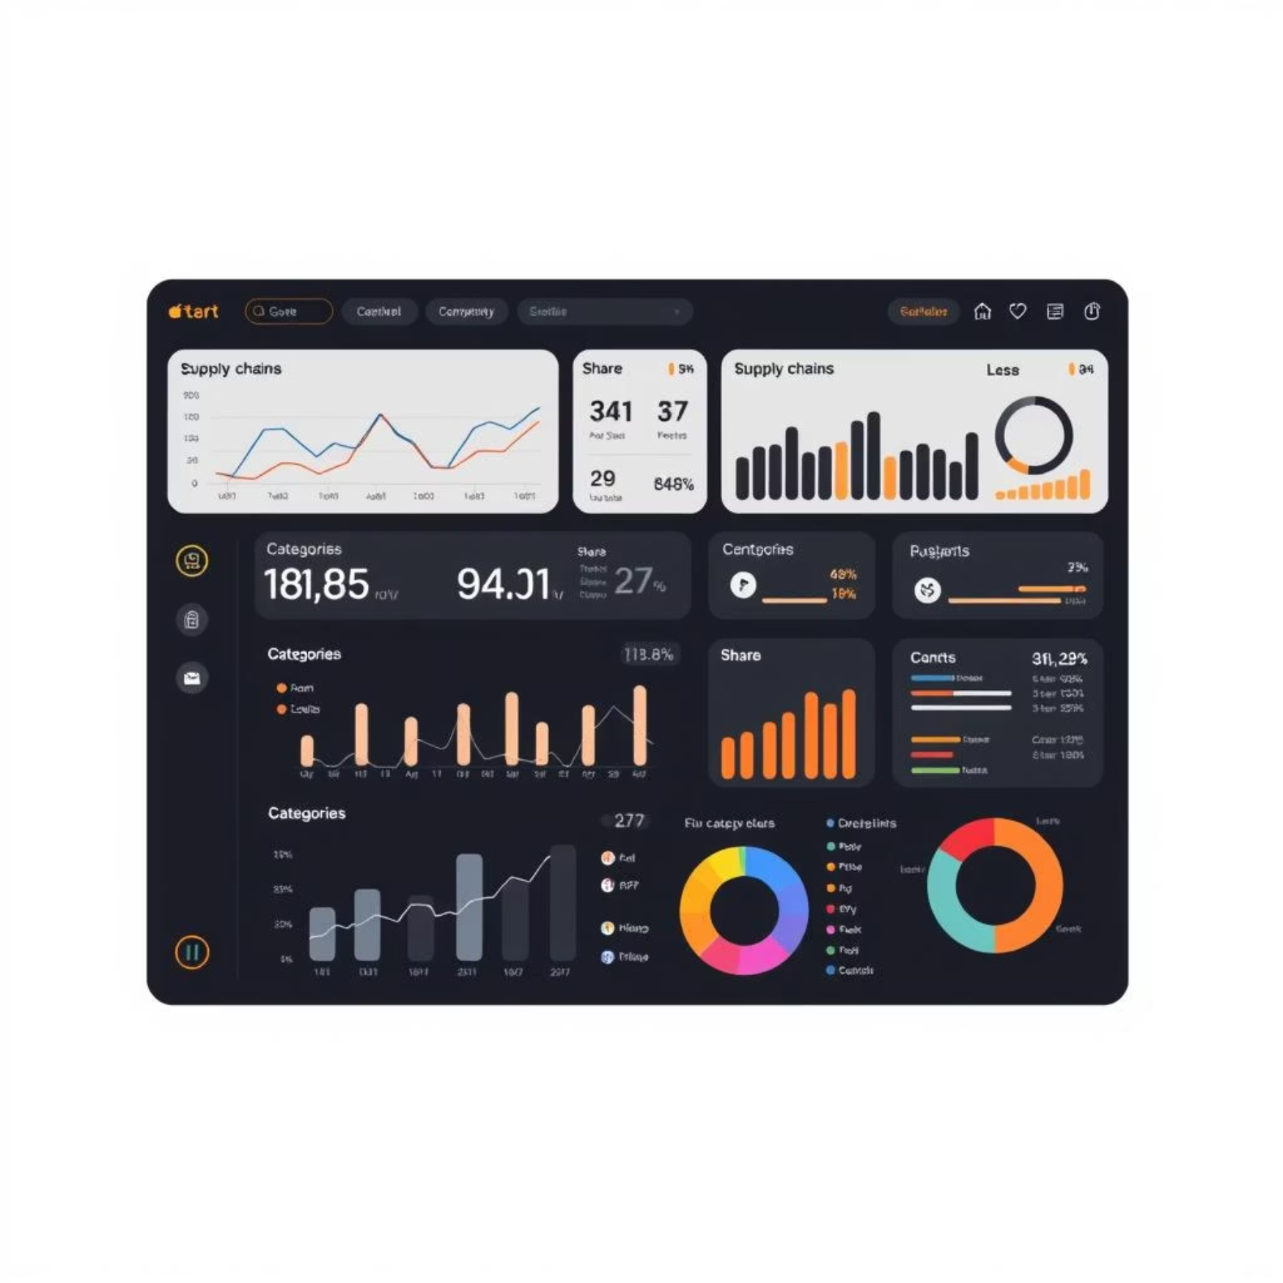
Intuitive Dashboards: Streamlit & Looker Studio
Our dashboards transform complex data into interactive, easy-to-understand visualizations, empowering quick decision-making.
Key Performance Indicators (KPIs)
Interactive Filters
Total Orders: Volume of transactions.
Region: Filter data by geographical area.
Total Sales: Overall revenue generated.
Product: Drill down into specific product performance.
Average Inventory: Mean stock levels over a period.
Category: Analyze sales by product category.
Visualizations
Line Charts: Illustrate trends in sales and stock over time.
Bar Charts: Compare sales performance across categories and countries.
Pie Charts: Display category share of total sales.

Slide 10
Project Status & Strategic Next Steps
Excel + API Connection
Established robust connections for data ingestion.
✅ Complete
Data Transformation
Implemented cleaning and structuring scripts.
✅ Complete
BigQuery Tables
Successfully created and populated star schema tables.
✅ Complete
Dashboards Built
Developed interactive dashboards in Streamlit & Looker Studio.
✅ Complete
Alerts/Monitoring
Setup for real-time performance and anomaly detection.
⚠️ Next
Vendor Analytics
Integration of vendor performance metrics for supply chain optimization.
⚠️ Next
Automated Scheduling
Implementation of automated data pipeline execution.
🔄 Future Scope

