Slide 1
Dialysis of Patients
Group 5

Slide 2

Group 5
Shiva Kumar
Sachin Shetty
Rohit Toskar
Rajesh

Slide 3








Index
Final Conclusion : Conclusion.
Dashboards : Excel, Tableau, Power BI.
KPI 1 : Number of Patients across various summaries.
KPI 6 : Average Payment Reduction Rate.
KPI 2 : Profit Vs Non – profit Stats.
KPI 5 : No of Category Text as Expected.
KPI 3 : Chain Organizations w.r.t Total Performance Score as no score.
KPI 4 : Dialysis Stations Stats.

Slide 4
KPI 1 : Number of Patients across various summaries.
Key Findings
Highest Patient Count : The "Number of Patient Months in Serum Phosphorus Summary" boasts the highest number of patients, with a total of 5,717,945.
Lowest Patient Count: The "Number of Patients in nPCR Summary" holds the lowest number of patients, totaling 980.

Slide 5
Index
Final Conclusion : Conclusion.
Dashboards : Excel, Tableau, Power BI.
KPI 1 : Number of Patients across various summaries.
KPI 6 : Average Payment Reduction Rate.
KPI 2 : Profit Vs Non – profit Stats.
KPI 5 : No of Category Text as Expected.
KPI 3 : Chain Organizations w.r.t Total Performance Score as no score.
KPI 4 : Dialysis Stations Stats.

Slide 6
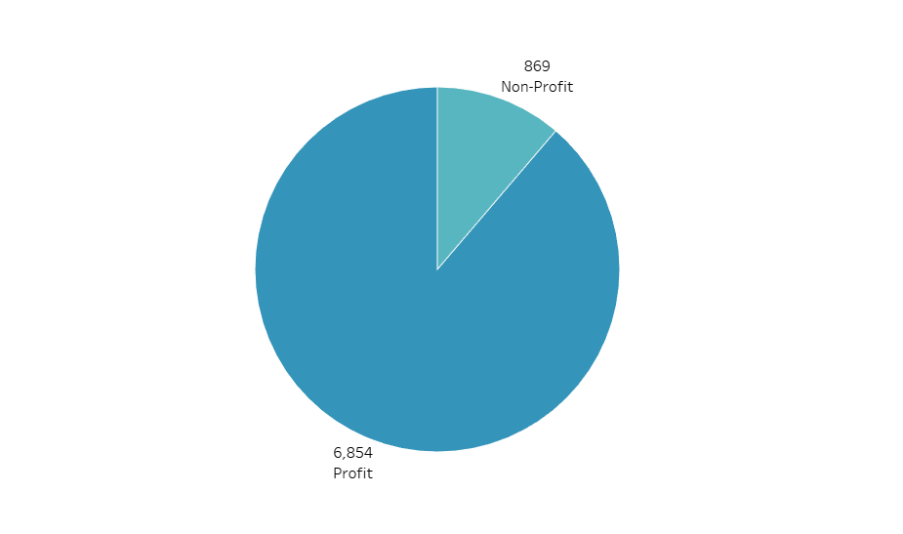

KPI 2 : Profit Vs Non - Profit Stats.
Key Findings
Profit count & percentage : Profit count is 6854 and 88.75%
Non-profit count & percentage : Non-profit count is 869 and 11.25%

Slide 7
Index
Final Conclusion : Conclusion.
Dashboards : Excel, Tableau, Power BI.
KPI 1 : Number of Patients across various summaries.
KPI 6 : Average Payment Reduction Rate.
KPI 2 : Profit Vs Non – profit Stats.
KPI 5 : No of Category Text as Expected.
KPI 3 : Chain Organizations w.r.t Total Performance Score as no score.
KPI 4 : Dialysis Stations Stats.

Slide 8
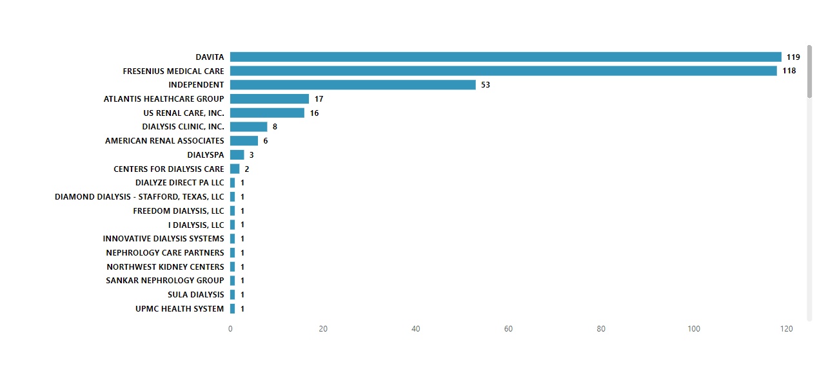
KPI 3 : Chain Organizations w.r.t Total Performance Score as no score.
Key Findings
Chain Organization with Maximum Non-Scored Performance: These two chain organizations, DaVita with 119 and Fresenius Medical Care with 118, hold the highest number of non-scored facilities.
Total : Total Count of no score is 369.

Slide 9
Index
Final Conclusion : Conclusion.
Dashboards : Excel, Tableau, Power BI.
KPI 1 : Number of Patients across various summaries.
KPI 6 : Average Payment Reduction Rate.
KPI 2 : Profit Vs Non – profit Stats.
KPI 5 : No of Category Text as Expected.
KPI 3 : Chain Organizations w.r.t Total Performance Score as no score.
KPI 4 : Dialysis Stations Stats.

Slide 10
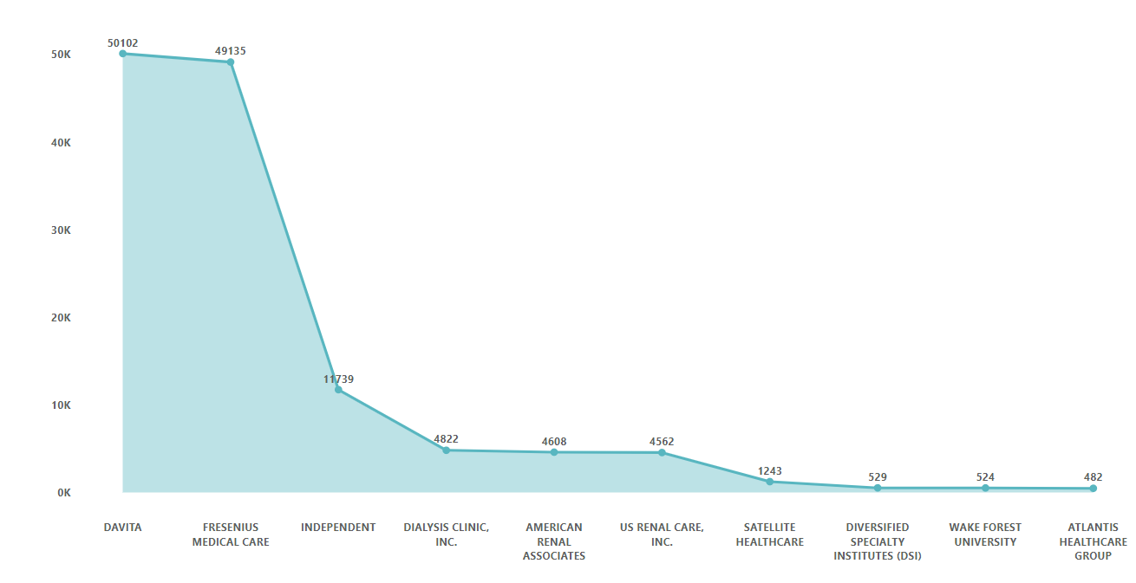
KPI 4 : Dialysis Stations Stats
Key Findings
Top Dialysis Station: According to this visual DaVita has the highest number of dialysis stations at around 50,102.
Total : The total number of dialysis stations is around 55,328.

Slide 11
Index
Final Conclusion : Conclusion.
Dashboards : Excel, Tableau, Power BI.
KPI 1 : Number of Patients across various summaries.
KPI 6 : Average Payment Reduction Rate.
KPI 2 : Profit Vs Non – profit Stats.
KPI 5 : No of Category Text as Expected.
KPI 3 : Chain Organizations w.r.t Total Performance Score as no score.
KPI 4 : Dialysis Stations Stats.

Slide 12
KPI 5 : No of Category text as Expected.
Key Findings
PPPW category text
Maximum : The text description for the Patient hospitalization category text contains the maximum number of expected values.
Minimum : The text description for the SWR category text contains the minimum number of expected values.
Patient Transfusion category text
Patient hospitalization category text
Patient Transfusion category text
Patient Infection category text
Fistula Category text
SWR category text

Slide 13
Index
Final Conclusion : Conclusion.
Dashboards : Excel, Tableau, Power BI.
KPI 1 : Number of Patients across various summaries.
KPI 6 : Average Payment Reduction Rate.
KPI 2 : Profit Vs Non – profit Stats.
KPI 5 : No of Category Text as Expected.
KPI 3 : Chain Organizations w.r.t Total Performance Score as no score.
KPI 4 : Dialysis Stations Stats.

Slide 14
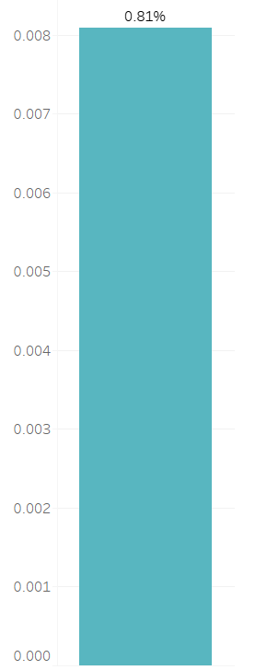
KPI 6 : Average payment reduction rate.
Key Findings
Average payment reduction rate : Average payment reduction rate is 0.81%.
This is the calculated average payment reduction rate.

Slide 15
Index
Final Conclusion : Conclusion.
Dashboards : Excel, Tableau, Power BI.
KPI 1 : Number of Patients across various summaries.
KPI 6 : Average Payment Reduction Rate.
KPI 2 : Profit Vs Non – profit Stats.
KPI 5 : No of Category Text as Expected.
KPI 3 : Chain Organizations w.r.t Total Performance Score as no score.
KPI 4 : Dialysis Stations Stats.

Slide 16
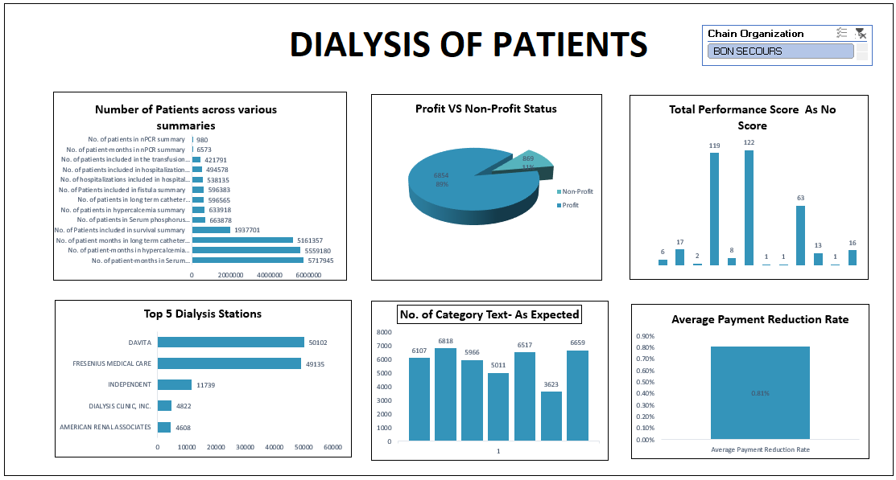

Dashboards : Excel, Tableau, Power BI.
Patient Transfusion category text
Patient hospitalization category text
Patient Transfusion category text
Patient Infection category text
Fistula Category text
SWR category text
PPPW category text

Slide 17
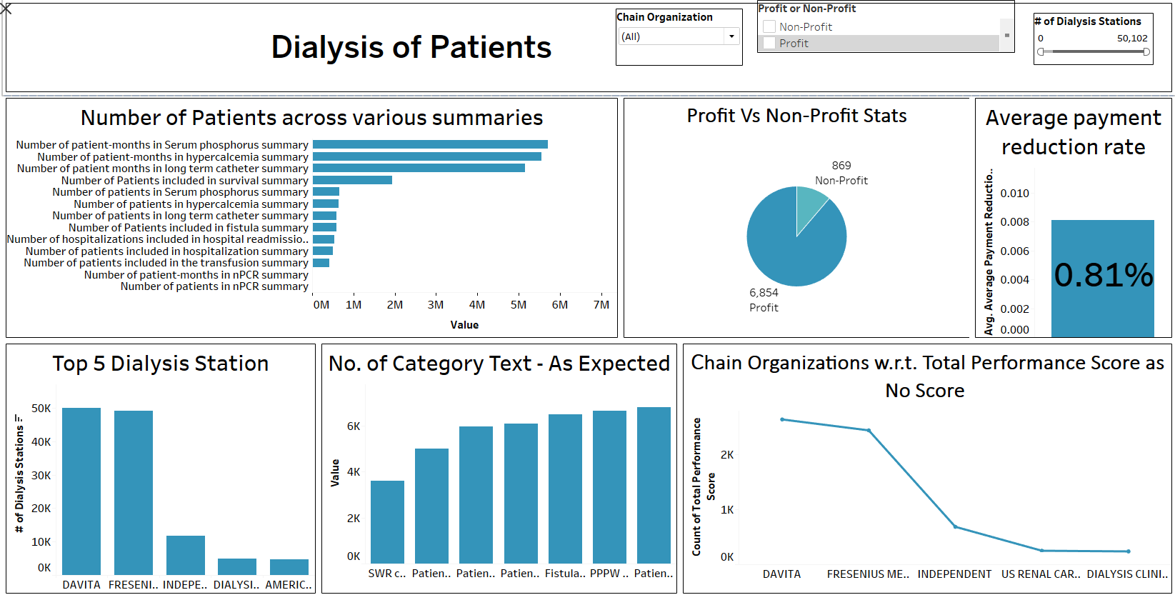
5717945
5559180
1937701
5161357
663878
633918
596565
596383
538135
494578
421791
6573
980
50102
49135
6108
6517
6659
6818
2633
5966
2435
5011
3623
11739
686
4822
4608
252
240

Slide 18
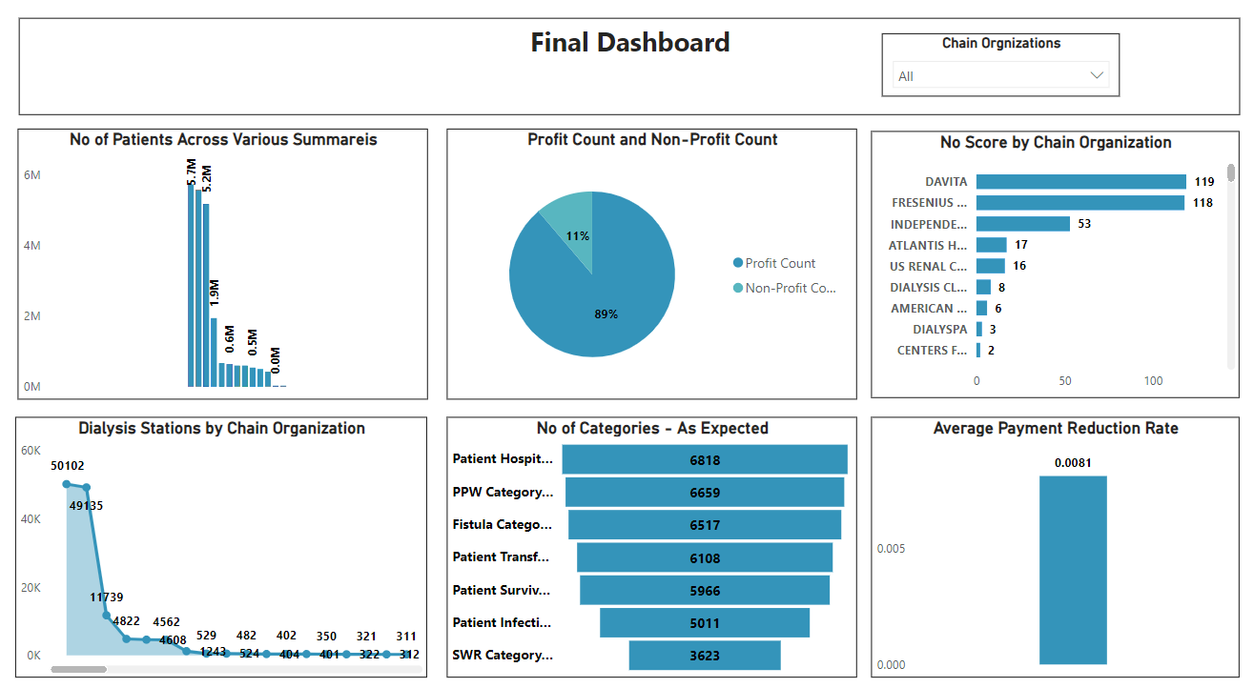

Slide 19
Index
Final Conclusion : Conclusion.
Dashboards : Excel, Tableau, Power BI.
KPI 1 : Number of Patients across various summaries.
KPI 6 : Average Payment Reduction Rate.
KPI 2 : Profit Vs Non – profit Stats.
KPI 5 : No of Category Text as Expected.
KPI 3 : Chain Organizations w.r.t Total Performance Score as no score.
KPI 4 : Dialysis Stations Stats.

Slide 20
Final Conclusion : Conclusion.
Prioritize high-mortality patients : Focus resources on improving survival rates for the largest patient group.
Balance profit and care : Ensure profit-generating services don't neglect improvement in DaVita and Fresenius. Investigate if lower performance correlates with lower profitability.
Target DaVita and Fresenius : Investigate reasons behind low patient experience scores and implement specific improvement plans.
Optimize resources in DaVita : Even with low-scoring facilities, DaVita seems profitable. Analyze resource allocation across DaVita's network for efficiency and effectiveness improvements.
Monitor financial health : Regularly track payment reduction rates and consider broader financial monitoring to ensure sustainability.

Slide 21
THANK YOU
Source : WWW.24Slides.com

