Slide 1

PROJECT
PRESENTATION
NLP Emails
Notes:
Links:
https://www.pexels.com/photo/photo-of-person-holding-black-tablet-3734641/

Slide 2
Madishetti Rajashekar Project Guide
Bapuram Pallavi Project Coordinator
Rathan Nayaka C Team Member
Megha Kulakarni Team Member
Shiva Kumar Team Member
Prajwal Babu Team Member
Adwaith Mp Team Member
Swati Ramniranjan Team member
Dheeraj Team Member
Project Team Structure:
Notes:
Links:
https://www.pexels.com/photo/photo-of-person-holding-black-tablet-3734641/

Slide 3
Business Objective:
- Inappropriate emails would demotivates and spoil the positive environment that would lead to more attrition rate and low productivity and Inappropriate emails could be on form of bullying, racism, sexual favoritism and hate in the gender or culture, in today’s world so dominated by email no organization is immune to these hate emails.
-The goal of the project is to identify such emails in the given day based on the above inappropriate content.
Notes:
Links:
https://www.pexels.com/photo/photo-of-person-holding-black-tablet-3734641/

Slide 4

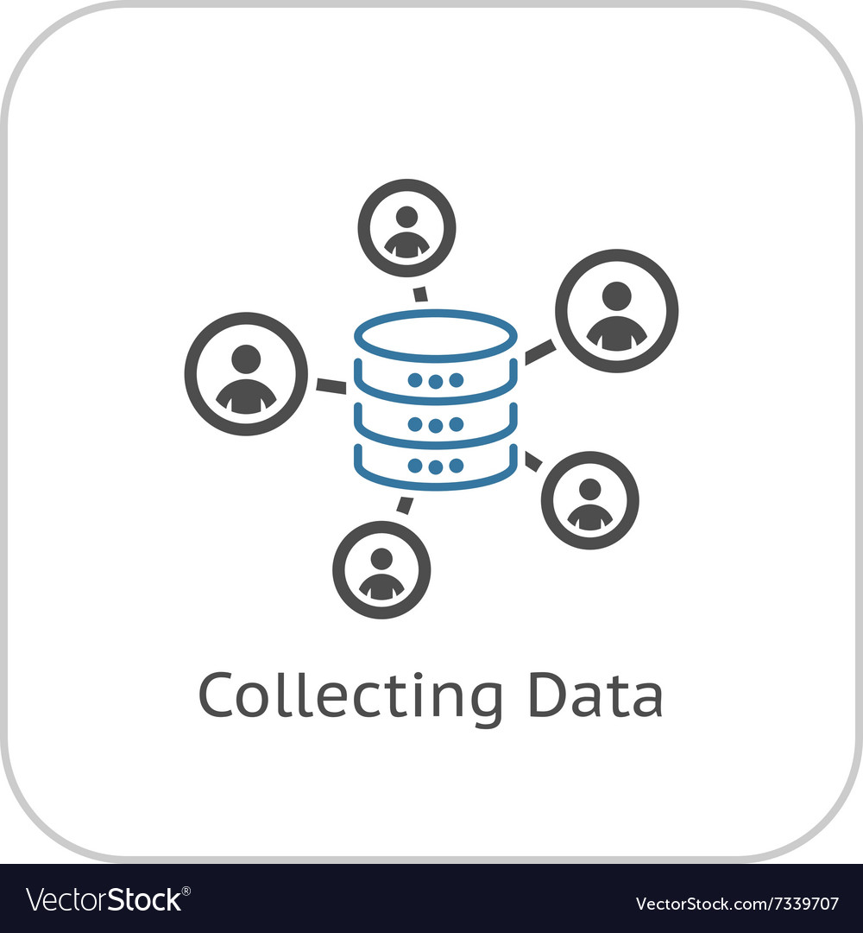
Roadmap to Complete the Project
Evaluation of all models and Feedback
Prediction on new data by deployment
Final presentation
Vectorization & Model Building
Data cleaning or Text preprocessing
Exploratory data analysis
Collect the data and understand the data
Notes:
Links:
https://unsplash.com/photos/fzOITuS1DIQ

Slide 5
Action plan:
Sl. No | Stage | Description | Responsibility | Target date | Status | Remarks
1 | Frame the problem or understand the business objective | What problem are we trying to solve with NLP? What are the business objectives for using NLP? | All | 25th Oct | Closed
2 | Collect the data and understand the data | What data do we need to solve the problem? Where can we get this data? How can we understand the data? | All | 27th Oct | Closed
3 | Exploratory data analysis | What are the main characteristics of the data? What are the trends and patterns in the data? | All | 31st Nov | Closed
4 | Data cleaning or Text preprocessing | Clean the data to remove noise and inconsistencies. Preprocess the data to put it in a format that can be used by the NLP model. | All | 31st Nov | Closed
5 | Vectorization & Model Building | Select the appropriate NLP model for the task. Train the model on the preprocessed data. | All | 3rd Nov | Closed
6 | Evaluation of all models and Feedback | Evaluate the performance of the model on a held-out test set. Select the best model based on the evaluation results. | All | 14th Nov | Closed
7 | Prediction on new data by deployment | Deploy the model to production and use it to make predictions on new data. | All | 14th Nov | Closed
8 | Final presentation | Present the findings and recommendations to the stakeholders. | All | 18th Nov | Closed
Notes:
Links:
https://unsplash.com/photos/fzOITuS1DIQ

Slide 6
Data Collection & Overview
Name of the data set : emails.csv
Shape of the Data set (48076, 5)
Data types & Unique Values
Subject:# | Column Name | D type | U Values
0 | Unnamed: 0 | int64 | 48076
1 | filename | object | 48076
2 | Message-ID | object | 48076
3 | content | object | 23420
4 | Class | object | 2
Duplicates Values 0
Null Values/missing values 0
Shape of the Data set (48076, 5)
Notes:
Links:
https://unsplash.com/photos/fzOITuS1DIQ

Slide 7
Dataset Cleaning
Removed Unwanted columns/Features
Removed columns: Index_No, File_name, Messiage_id)
Removed Duplicates
Shape of the data before (48076, 2) Shape of the data After (24656, 2)
.
Final Data set
Column | D type | U Values
content | object | 23420
Class | object | 2
Notes:
Links:
https://unsplash.com/photos/fzOITuS1DIQ

Slide 8
Text Preprocessing
Tokenization
Stop word removal
Lemmatizing
Removing unwanted spaces
Removing URLs
Removing special characters
Removing unwanted spaces
Dropping Null values
Removing duplicate values
Shape of data(22811, 2)
Transforming to lowercase
Removing numeric values
Removing punctuations
Notes:
Links:
https://unsplash.com/photos/fzOITuS1DIQ

Slide 9
EDA - Calculated statistics
Average sentence length 1182.187
Number of unique words
Most frequent words
Notes:
Links:
https://unsplash.com/photos/fzOITuS1DIQ

Slide 10
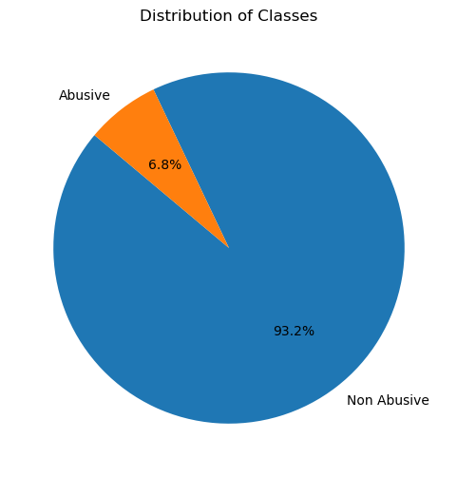
EDA - Data Visualization- Class distribution
Notes:
Links:
https://unsplash.com/photos/fzOITuS1DIQ

Slide 11
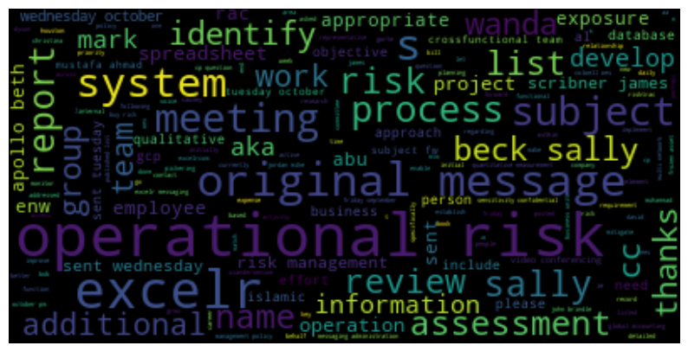
EDA - Data Visualization- World Cloud
Notes:
Links:
https://unsplash.com/photos/fzOITuS1DIQ

Slide 12
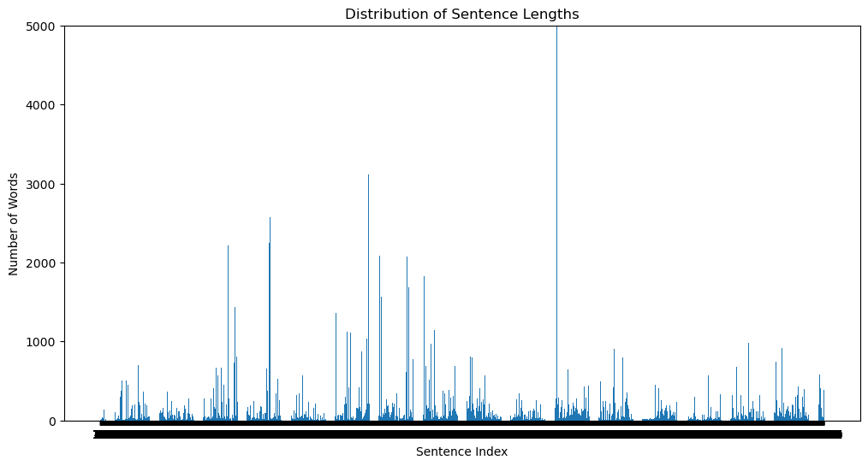
EDA - Data Visualization- Mail wise No.of words
Notes:
Links:
https://unsplash.com/photos/fzOITuS1DIQ

Slide 13
EDA
Sentiment Analysis
Topic Modelling
Part-of-Speech (POS) Tagging
Assign a sentiment score to each email.
Identify key topics within the emails.
Categorize words into their respective parts of speech.
Notes:
Links:
https://unsplash.com/photos/fzOITuS1DIQ

Slide 14
Vectorization
Independent variable
TF-IDF (term frequency-inverse document frequency) vectorization to convert final text tokens data into numerical features
Dependent variable
Encoded the target variable(classes) using label encoding
Shape of the data after vectorization (22811, 117893)
Abusive – 0
Non-abusive - 1
Notes:
Links:
https://unsplash.com/photos/fzOITuS1DIQ

Slide 15
Model Building & Evaluation
Split the test data and
Cross fold method (CV=5)
Model training on Train data
Model Evaluation Aaccuracy Scores
Model prediction on test data
Models Selection
Notes:
Links:
https://unsplash.com/photos/fzOITuS1DIQ

Slide 16
Model Building & Evaluation
S.No | Model Name | Accuracy Score
1 | XG Boost Classifier | 96.40%
2 | Gradient Boosting Classifier | 95.93%
3 | Support vector Classifier | 95.80%
4 | Logistic regression | 95.44%
5 | AdaBoost Classifier | 95.29%
6 | Random Forest Classifier | 95.10%
7 | Decision Tree Classifier | 95.08%
8 | K-Nearest neighbours | 93.91%
9 | Multinomial NB | 93.24%
Presented accuracy scores for each model.
XG Boost Classifier is the best-performing model for deployment.
Notes:
Links:
https://unsplash.com/photos/fzOITuS1DIQ

Slide 17
Model Deployment with Streamlit
Import pre-trained TF-IDF vectorizer and XGBoost model on Streamlit local host
Create user interface for email content input
Display prediction results
Load pre-trained TF-IDF vectorizer and selected model
Implement text preprocessing functions in streamlit app
Create interactive Streamlit web app on Streamlit local host
Deploy XGBoost model with highest accuracy
Notes:
Links:
https://unsplash.com/photos/fzOITuS1DIQ

Slide 18
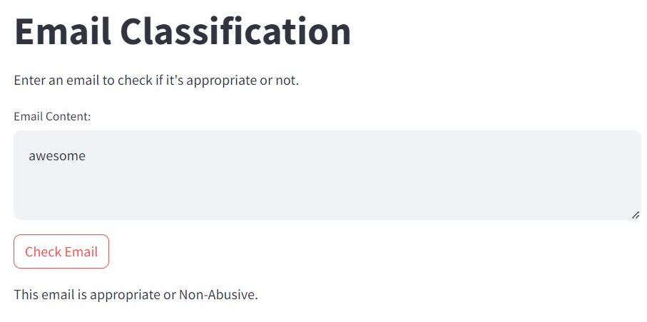
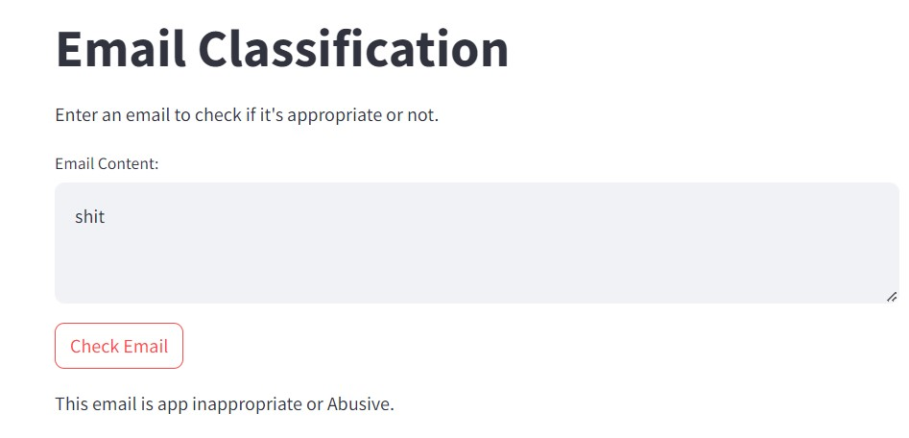
A
Model Deployment with Streamlit
Non-Abusive
Abusive
Sample prediction results snapshots from localhost
Notes:
Links:
https://unsplash.com/photos/fzOITuS1DIQ

Slide 19
Thank you
Notes:
Links:
https://unsplash.com/photos/fzOITuS1DIQ

