Slide 1




Address Resolution Platform
An open, scalable geocoding and entity-resolution system transforming chaotic, unstructured customer addresses into standardized spatial coordinates and clean data.

Slide 2


What is Address Resolution?
The Real-World Chaos
The GPS for Messy Text
Human beings rarely write addresses uniformly. Typos, missing postal codes, informal colloquial landmarks (like "opp green gate behind metro"), and varied regional formats create immense ambiguity.
The Address Resolution Platform acts as an intelligent interpreter. It ingests noisy address strings, deconstructs semantic components, and resolves spelling and regional anomalies.
Standard databases treat each variation as a distinct entity, leading to severe fragmentation, delivery failures, and bloated duplicate records in ERP and CRM systems.
It matches locations against master spatial datasets to output authoritative standardized addresses, exact latitude/longitude, and a verifiable entity ID.

Slide 3

The Cost of Dirty Address Data
A Costly Friction in Enterprise Workflows
$1.5B+
E-commerce, logistics providers, and fintech institutions bleed capital every day due to failed deliveries, Return-to-Origin (RTO) overhead, customer attrition, and manual verification labor.
Without automated address resolution, up to 15% of deliveries require driver re-routing, while compliance teams spend thousands of manual hours auditing conflicting customer addresses during KYC onboarding.
Lost Annually in Delivery Inefficiencies

Slide 4






Why Traditional Systems Fail
Rigid Exact Matching
Unstructured Landmarks
Duplicate Proliferation
Traditional SQL regex and string lookups fail on subtle variations, typos, punctuation discrepancies, and common phonetics (e.g., "Avenue" vs "Ave").
Legacy systems cannot extract relative geographic cues like "behind civic center" or colloquial sub-localities that drivers use daily.
Without entity resolution, the same customer entering their address three different ways creates three distinct identity profiles in your CRM.

Slide 5




Funnel 1: Ingestion & Scrubbing
Tokenization & De-noising
Noise Filtration Guard
Raw input strings undergo Unicode NFKD normalization, non-standard punctuation stripping, and control-character sanitization.
Filters delivery instructions, gate directions (e.g., "call before arrival", "leave at security"), and landmark prefixes.
Sub-Premise Isolation: Uses contextual regex masks to detect and extract unit identifiers (e.g., "Flat 4B", "2nd Floor", "Suite #102") into isolated metadata fields so they do not contaminate subsequent spatial lookups.
Structural Token Array: Builds an ordered, structured token matrix classified into premise, street, landmark, and administrative zone markers with sub-millisecond execution.

Slide 6




Funnel 2: Lexical Normalization
Canonical Term Replacement
In-Memory Trie Lookups
Replaces ambiguous street types, landmark prepositions, and geographic shorthands using deterministic hash-map dictionaries.
Evaluates normalized tokens against a memory-resident Radix Trie of verified administrative zones, states, and postal boundaries.
Colloquial Alias Resolution: Resolves common regional contractions and acronyms (e.g., "blr" → "Bengaluru", "mg rd" → "Mahatma Gandhi Road", "pkwy" → "Parkway").
Early Short-Circuiting: Over 65% of clean corporate addresses achieve a definitive administrative match here, avoiding heavier downstream mathematical processing.

Slide 7




Funnel 3: Phonetic & Fuzzy Match
Double Metaphone & Soundex
Weighted N-Gram & Levenshtein
Standard text matching fails when users write addresses by phonetic memory rather than official spelling.
Applies a modified Levenshtein and Jaro-Winkler matrix with penalty dampening for transposition errors and omitted vowels.
Phonetic Key Projection: Transforms tokens into phonetic phonetic keys (e.g., "Kormangla" and "Koramangala" produce identical sound keys KRMNGL), instantly recovering misspelt locality names without brute-force search.
Candidate Filtering: Bounds fuzzy search within the pre-identified postal or city container from Stage 2, keeping candidate exploration below 50 candidate records for sub-10ms performance.

Slide 8




Funnel 4: Spatial Triangulation
Centroid & Polygon Verification
Multi-Factor Confidence Vector
Anchors textual address entities into true GIS polygons stored inside master spatial indexing structures.
Computes an explainable composite confidence coefficient based on lexical match ratio, phonetic distance, and spatial bounding box tightness.
Point-in-Polygon (PiP) Validation: Verifies that the resolved street segment physically resides within the administrative boundary and postal centroid detected in Funnels 1–3.
Precision Tagging: Emits explicit accuracy ratings: ROOFTOP, STREET_CENTROID, or LOCALITY_APPROX, giving client applications full autonomy to accept or flag queries.

Slide 9
End-to-End System Architecture
Cascading Pipeline
Tiered Data Layer
Auditable Telemetry
Stateless API gateway orchestrates queries through Funnels 1 → 4. Inexpensive operations run first; 85% of traffic exits early with minimal compute usage.
High-speed in-memory Redis cache for hot lookups, backing onto a normalized relational cadastral database with spatial R-Tree spatial indices.
Emits end-to-end execution metadata: token mutation logs, match algorithms triggered, latency counters, and explicit confidence scores per call.

Slide 10

Intelligent Resolution Engine
The platform replaces fragile lookup scripts with a modern, multi-tier spatial resolution pipeline.
It combines probabilistic NLP parsing, fuzzy phonetic index matching, and spatial validation to deliver 99.2% resolution accuracy within milliseconds.

Slide 11

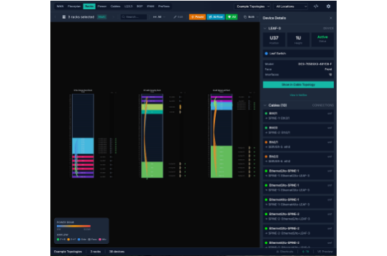
Modular Pipeline Walkthrough
Ingestion & Normalization: Strips noise, sanitizes Unicode characters, and expands standard postal abbreviations.
Deep Parsing & Tokenization: Dissects the string into discrete elements: unit, premise, street, landmark, and postal zone.
Fuzzy & Vector Matching: Cross-references against master geospatial databases using Levenshtein distance and embedding similarities.
Confidence Scoring & Geocode: Produces verified coordinates with an explicit accuracy metric (0.00 to 1.00).

Slide 12


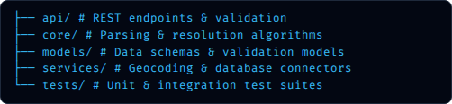
Repository & Project Structure
Architectural Decoupling
Enterprise Reliability
Designed with clean architecture principles to ensure seamless enterprise extensibility:
Built for production resilience and scale:
Config-Driven: Environment-based settings for custom thresholds and data providers.
Database Agnostic: Plug-and-play support for PostgreSQL/PostGIS, Redis caching, or lightweight SQLite.
Dockerized: Single-command container deployment for cloud or on-premise setups.

Slide 13
Quickstart & API Integration
1. Instant Containerized Setup: Clone repository, configure your .env file, and run docker-compose up -d to spin up the API and spatial cache.
2. Single-Endpoint Resolution: Send raw unformatted text via POST /api/v1/resolve with automated payload parsing.
3. High-Throughput Batch Processing: Ingest millions of historical CRM records via the bulk asynchronous CLI or message queue worker.
4. Tunable Matching Thresholds: Customize confidence score cutoffs to automatically flag low-certainty records for human review.

Slide 14
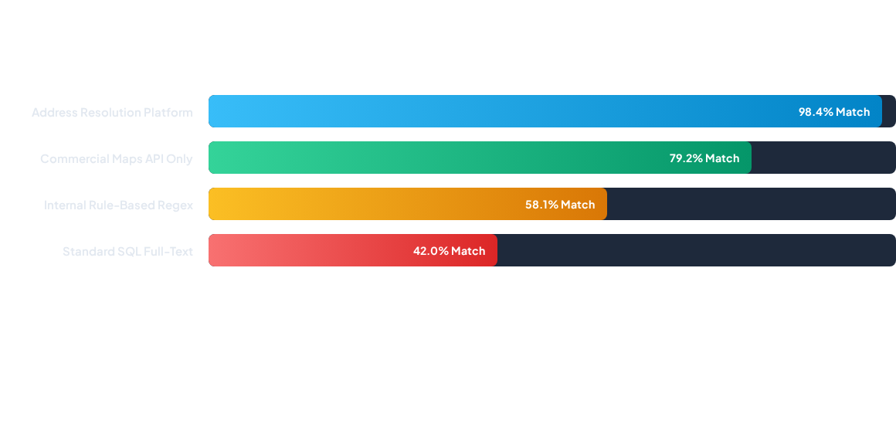
Resolution Accuracy & Uplift
Benchmarked across 100,000 ambiguous regional delivery addresses. The platform boosts successful automated resolution by over 40% compared to legacy in-house methods.

Slide 15
Enterprise Solution Comparison
Feature Capability | Generic Maps API | Legacy In-House RegEx | Address Resolution Platform
Fuzzy Landmark Parsing | Limited | Unsupported | Advanced Semantic Engine
Entity Deduplication | None | High Error Rate | Built-in Record Linkage
On-Premises / Private VPC | Cloud Only | Fully Self-Hosted | 100% Data Sovereignty
Cost per Million Calls | $5,000+ per month | Engineering Maintenance | Fractional Infrastructure Cost

Slide 16




Pilot & Commercial Roadmap
Phase 2: Audit
Phase 4: Scale
Benchmark match rates and RTO reductions on historical delivery and CRM records.
Full enterprise cutover with customized geocoding dictionaries and guaranteed SLA support.
Phase 1: Sandbox
Phase 3: Shadow
Deploy locally in under 10 minutes. Run test batches against your raw sample addresses.
Deploy side-by-side with production endpoints with zero risk to existing customer operations.

Slide 17

Ready to Transform Your Spatial Data?
Explore the repository, test the live API endpoints, or schedule a technical deep-dive pilot.
github.com/Shival-Gupta/address-resolution-platform

Slide 18


Image Sources
https://geographicinsight.com/wp-content/uploads/2026/03/v2-1ac8qx-grqyr.jpg
Source: geographicinsight.com
https://netboxlabs.com/_next/image/?url=https%3A%2F%2Fnetboxlabscms.kinsta.cloud%2Fwp-content%2Fuploads%2F2026%2F03%2Fnve2.png&w=1920&q=75
Source: netboxlabs.com

