Slide 1
Recall and Precision
Recall
Precision
Recall@K: what it means
Did the system find the right answer within its top K results?
For each query: if the correct document appears in top-K -> hit, else -> miss
Recall@K = total hits / total queries
How this project computes it
Each query and its expected answer are embedded into the same vector space using CLIP
The top-K vectors retrieved from the database are compared against the answer embedding
If any retrieved vector is semantically close enough to the expected answer -> counted as a hit
This captures the same idea: did the retrieval surface something equivalent to the correct answer?
Precision@K: what it means
Of everything the system retrieved, how much of it was actually relevant?
For each query: relevant results in top-K / total results in top-K
Precision@K = relevant hits / K
How this project computes it
Every retrieved vector is compared against the answer embedding using cosine similarity
Each vector scoring above the threshold is counted as relevant
Precision = relevant vectors / total retrieved vectors
This captures the same idea: out of everything surfaced, how much of it was actually useful?
Recall asks: did we find the right answer?
Precision asks: was what we returned worth returning?

Slide 2
Database | Index | Recall | Precision
Milvus | HNSW | 0.922 | 0.312
Milvus | DiskANN | 0.907 | 0.327
Milvus | IVF | 0.919 | 0.302
Qdrant | HNSW | 0.923 | 0.299
Chroma | HNSW | 0.931 | 0.316
No of queries: 1000
Recall: Did the system find the right answer within its top K results?
Precision: Of everything the system retrieved, how much of it was actually relevant?

Slide 3
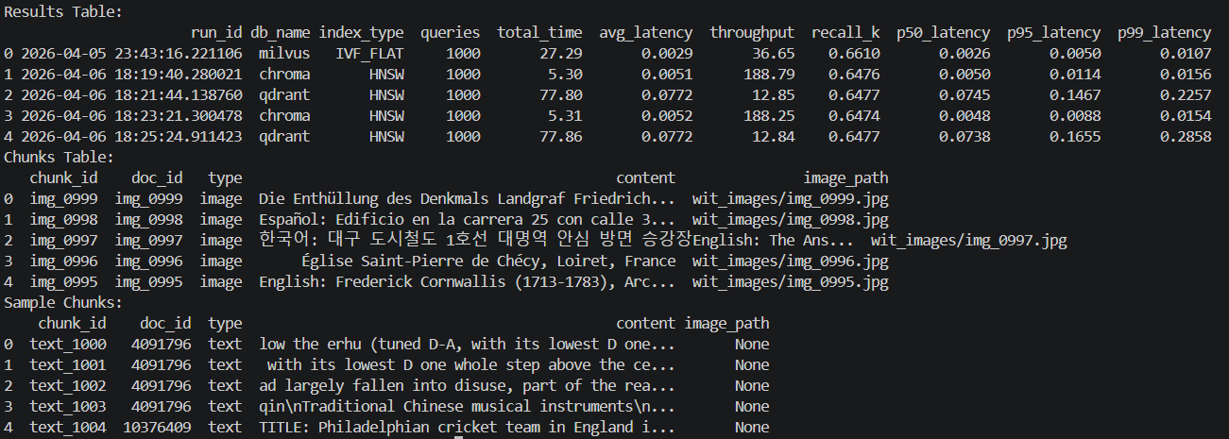
DuckDB Integration
chunks table
results table
What Was Done
Column | Type
run_id | TIMESTAMP
db_name | VARCHAR
index_type | VARCHAR
queries | INTEGER
total_time | DOUBLE
avg_latency | DOUBLE
throughput | DOUBLE
recall_k | DOUBLE
Connected pipeline to DuckDB
Chunks stored in the db
(both image and text)
Embeddings saved to filesystem so they can be reused for all vdb which reduces total time to align with latency
Separate results DB created for run-level benchmarking metrics
Column | Type
chunk_id | VARCHAR
doc_id | VARCHAR
type | VARCHAR
content | VARCHAR
image_path | VARCHAR

Slide 4
DuckDB & Latency Percentiles
Why DuckDB
Latency Percentiles Added
Zero server setup: Single file, runs on HPC without any daemon or container.
Fast analytical queries across benchmark runs.
Scales with dataset: Handles millions of rows as vectors grow to 1M+ vectors.
Redis : in-memory, eats RAM at large scale, needs a server
MinIO : object storage not row storage, overkill here
RocksDB : no SQL, cannot run analytical queries
Previously only avg_latency was stored. Averages may hide spikes and give a false picture under load.
p50 (Median): Typical query speed for a normal user.
p95 (95th percentile): Slow but not an extreme outlier.
p99 (Tail latency): Worst-case, matters most for real-world deployments.

Slide 5
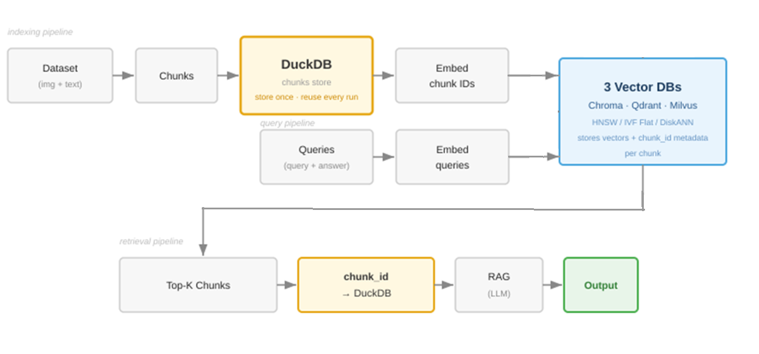
Duckdb added Architecture

Slide 6

In Progress & Next Steps
IN PROGRESS
Adding Simple RAG Display
What's Next
Adding lightweight RAG so retrieved chunks feed into a model and produce a readable answer, purely for visualization, not core benchmarking.
Query -> Top-K Chunks -> Prompt + Context -> Generated Answer
chunk_id from vector DB results points back to the original chunks-text and image in DuckDB, the RAG display uses the top-k retrieved to make a meaningful answer.
Model used: google/flan-t5-base
3 queries are sampled for display
chunk_id is stored as vector DB metadata at insert time, so it can fetch the original content at query time.
DB Scaling: Run benchmarks at 100K and 1M vectors on the WIT dataset on HPC
Visualization: Add latency and recall graphs to compare DBs and index types
Final Report: Full IEEE format paper with complete results and analysis

Slide 7
Multimodal Recall Evaluation of CLIP with Query Pipeline
Dataset Lane
Query Lane
Why recall was added
Existing metrics (latency, throughput) do not capture result correctness
Needed a way to evaluate if retrieved chunks are actually relevant
Choice of similarity method
Used cosine similarity on CLIP embeddings
Same embedding space as retrieval → ensures consistency
Avoids introducing a separate model that may bias evaluation
How similarity is computed
Query is converted to CLIP text embedding
Retrieved Top-K chunks already have embeddings
Compute cosine similarity between query and each chunk
Higher similarity → higher relevance
Why this approach
Lightweight and scalable for large query sets
Works for both text and image retrieval
Keeps evaluation aligned with actual retrieval behavior
Text & Image Input
Wiki dataset and (WIT)
Text Input + Answers
Queries & answer chunks
CLIP Encoder
Image+text → embedding
Text Embedder
Text/ans → text embedding
Vector Database
Both image & text embeddings stored together
Top-K Retrieval
K nearest vectors to query
Cosine Similarity ★
sim(query_vec, chunk_vec) — ranks retrieved chunks
Recall@K
Relevant chunks found in top-K / all relevant

Slide 8
Benchmarking Table
Database | Index | Avg Latency (s) | Throughput (q/s) | Total Time (s) | Recall
Milvus | HNSW | 0.0048 | 111.51 | 8.97 | 0.922
Milvus | DiskANN | 0.0073 | 90.58 | 11.04 | 0.907
Milvus | IVF | 0.0068 | 96.89 | 10.32 | 0.919
Qdrant | HNSW | 0.0046 | 117.09 | 8.54 | 0.923
Chroma | HNSW | 0.0050 | 109.65 | 9.12 | 0.931
Latency: time for a single query
Throughput: no.of query per second
No of queries: 1000
Recall: correct results

Slide 9
Benchmarking Table
Database | Index | Avg Latency (s) | Throughput (q/s) | Total Time (s)
Chroma | HNSW | 0.0036 | 85.78 | 11.66
Qdrant | HNSW | 0.0167 | 40.15 | 24.91
Milvus | IVF_Flat | 0.0062 | 68.95 | 14.5
Latency: time for a single query
Throughput: no.of query per second
No of queries: 1000

Slide 10
Completed this week
To be done
1. Explored options to add images:
Text & image in different vector spaces vs. same vector space
diff. model vs. same embedder
Hybrid approach: convert images to text
Extract directly from Wikipedia, or explore Wikimedia Commons
HF datasets: MS COCO, Conceptual Captions, LAION
2. Decided to go with WIT (Wikipedia Image Text) and sampled 1000 images with metadata:
• image_id
• article_id
• Caption
3. Added new embedding model, CLIP, which transforms text & images to vectors:
Both text & image vectors in same vector space
Match images to existing 1,000 Wikipedia articles when scaling
RAG Integration: Add Retrieval-Augmented Generation system. Evaluate open-source LLMs (LLaMA 3, Mistral 7B, Gemma 2B/7B).
Dataset Scaling: Expand dataset beyond 1000 articles. Increase query set beyond 1000.
Data Storage Optimization: Optimize storing & accessing dataset via database.
Notes:
__,Microsoft, Alibaba
Meta, Apache, Google

Slide 11
Completed this week
To be done
Migration:
Migrated project to IU Research Desktop (RED) Linux VM environment.
Milvus:
Integrated Milvus into modular pipeline, with milvus_lite and milvus standalone
Milvus Algo:
Retrieval flow with HNSW and DiskANN indexing configurations.
Encoder Expansion: Test alternate encoders (BGE-large, E5-large, GTE-base).
RAG Integration: Add Retrieval-Augmented Generation system. Evaluate open-source LLMs (LLaMA 3, Mistral 7B, Gemma 2B/7B).
Multimodal Exploration: Investigate adding images to dataset. Explore alternate query inputs/types.
Dataset Scaling: Expand dataset beyond 1000 articles. Increase query set beyond 1000.
Data Storage Optimization: Optimize storing & accessing dataset via database.
Notes:
__,Microsoft, Alibaba
Meta, Apache, Google

Slide 12
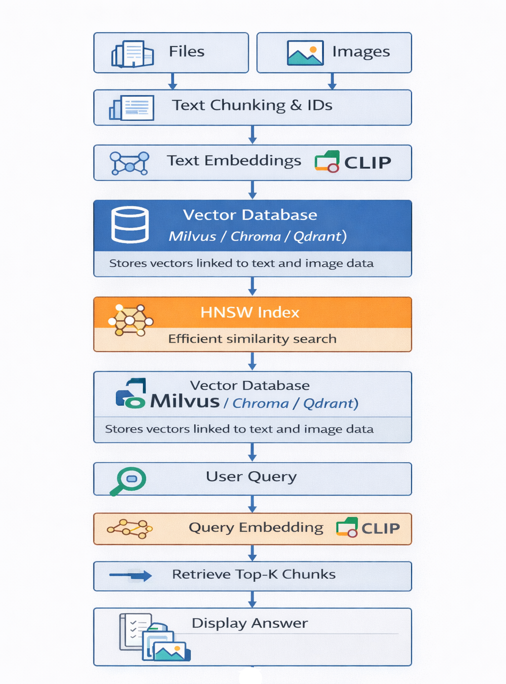

Slide 13
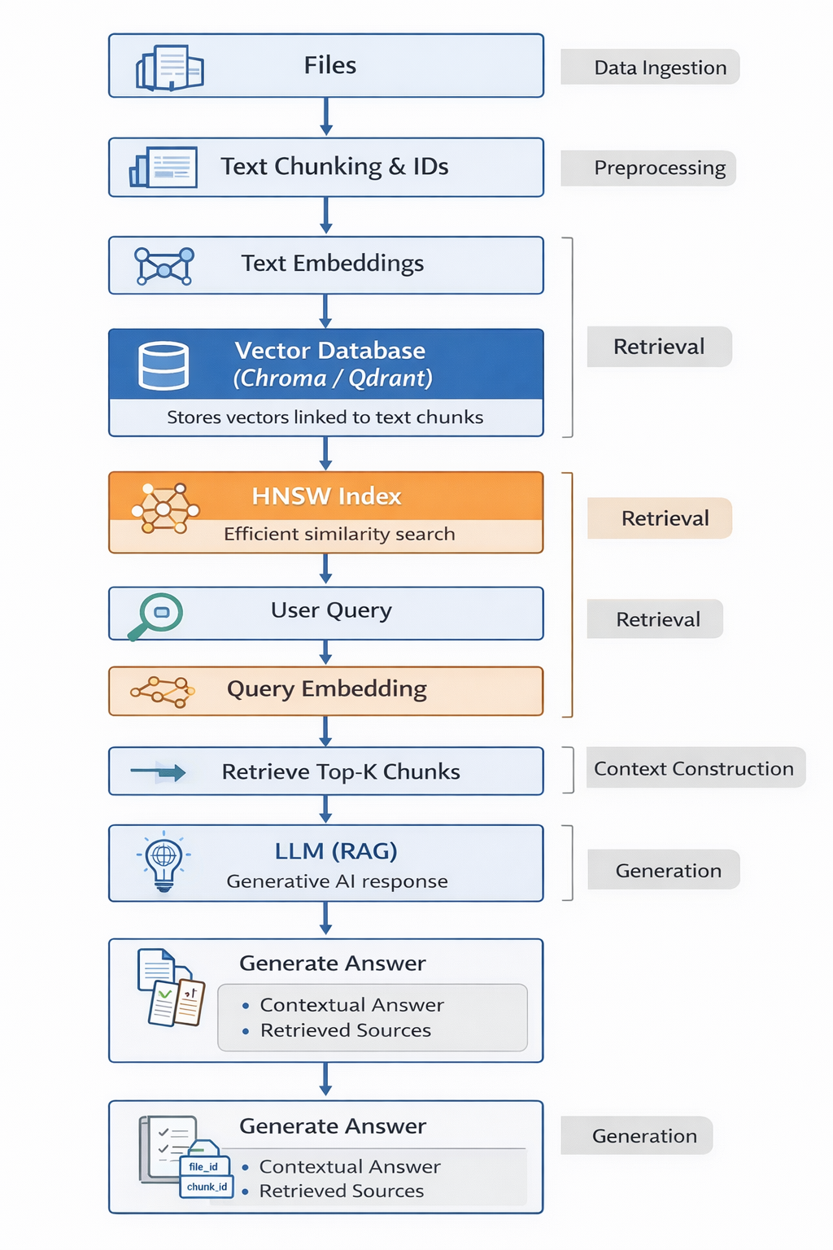
Updated Pipeline with
proposed RAG system

Slide 14
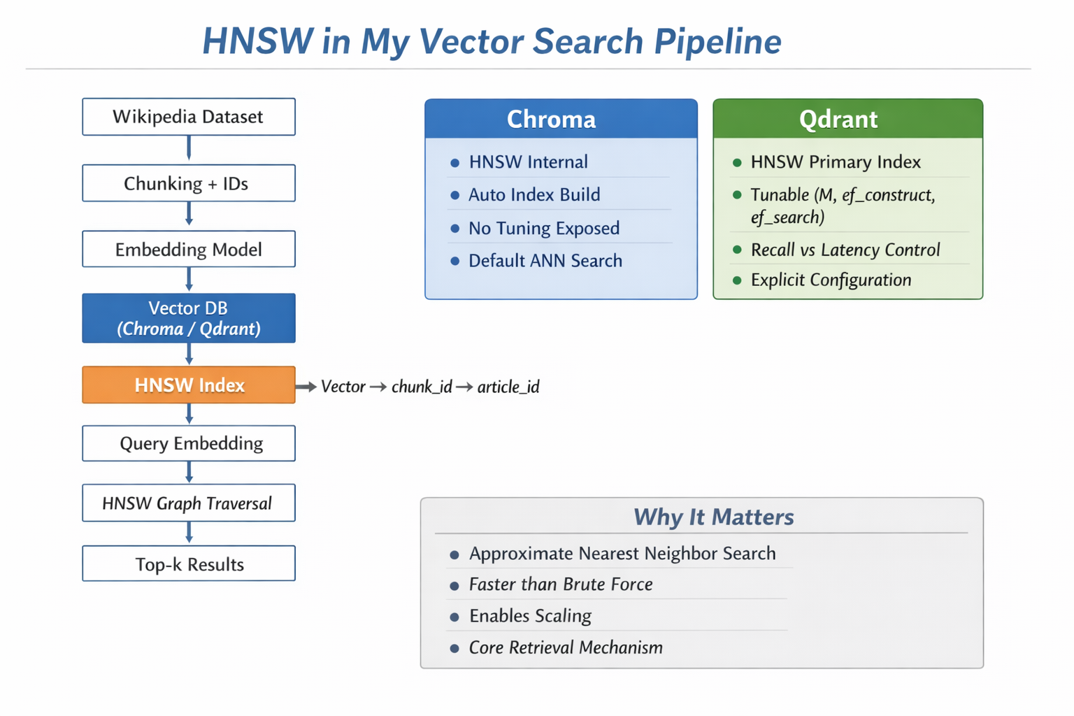
HNSW | DiskANN
HNSW is not a full database by itself, but a vector indexing algorithm used inside many vector databases to perform fast approximate nearest neighbor search. | DiskANN is an ANN indexing algorithm designed for large-scale vector search, especially when the dataset is too large
Chroma, Qdrant, Milvus, Pinecone | Milvus, FAISS
When using HNSW in vector databases like Qdrant, Milvus, or Pinecone, you usually tune:
• M → Number of connections per node
Higher M = better recall but more memory usage
• ef_construction → Controls index build quality
Higher value = better accuracy, slower indexing
• ef_search → Controls search accuracy
Higher value = better recall, slightly slower queries
These parameters allow you to balance speed, memory, and accuracy.

Slide 15
