Slide 1
Benchmarking Table
Database | Index | Avg Latency (s) | Throughput (q/s) | Total Time (s)
Chroma | HNSW | 0.0036 | 85.78 | 11.66
Qdrant | HNSW | 0.0167 | 40.15 | 24.91
Milvus | IVF_Flat | 0.0062 | 68.95 | 14.5
Latency: time for a single query
Throughput: no.of query per second
No of queries: 1000

Slide 2
Completed this week
To be done
1. Explored options to add images:
Text & image in different vector spaces vs. same vector space
diff. model vs. same embedder
Hybrid approach: convert images to text
Extract directly from Wikipedia, or explore Wikimedia Commons
HF datasets: MS COCO, Conceptual Captions, LAION
2. Decided to go with WIT (Wikipedia Image Text) and sampled 1000 images with metadata:
• image_id
• article_id
• Caption
3. Added new embedding model, CLIP, which transforms text & images to vectors:
Both text & image vectors in same vector space
Match images to existing 1,000 Wikipedia articles when scaling
RAG Integration: Add Retrieval-Augmented Generation system. Evaluate open-source LLMs (LLaMA 3, Mistral 7B, Gemma 2B/7B).
Dataset Scaling: Expand dataset beyond 1000 articles. Increase query set beyond 1000.
Data Storage Optimization: Optimize storing & accessing dataset via database.
Notes:
__,Microsoft, Alibaba
Meta, Apache, Google

Slide 3
Completed this week
To be done
Migration: Migrated project to IU Research Desktop (RED) Linux VM environment.
Milvus: Integrated Milvus into modular pipeline, with milvus_lite and milvus standalone
Milvus Algo: Retrieval flow with HNSW and DiskANN indexing configurations.
Encoder Expansion: Test alternate encoders (BGE-large, E5-large, GTE-base).
RAG Integration: Add Retrieval-Augmented Generation system. Evaluate open-source LLMs (LLaMA 3, Mistral 7B, Gemma 2B/7B).
Multimodal Exploration: Investigate adding images to dataset. Explore alternate query inputs/types.
Dataset Scaling: Expand dataset beyond 1000 articles. Increase query set beyond 1000.
Data Storage Optimization: Optimize storing & accessing dataset via database.
Notes:
__,Microsoft, Alibaba
Meta, Apache, Google

Slide 4
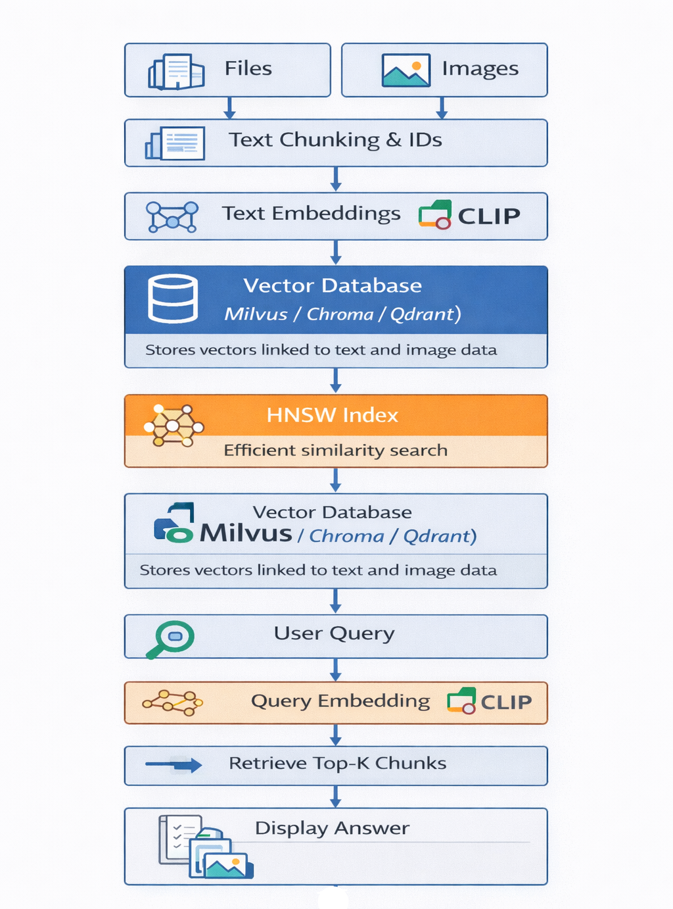

Slide 5
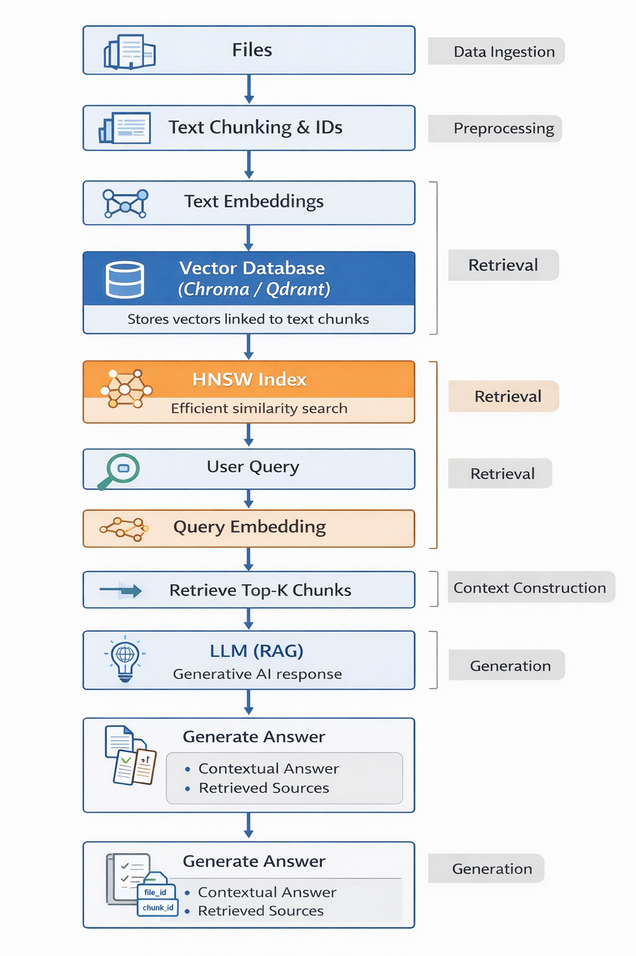
Updated Pipeline with proposed RAG system

Slide 6
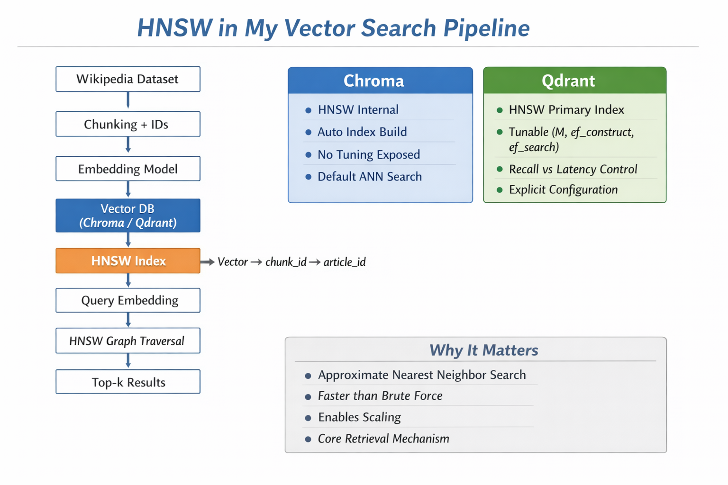
HNSW | DiskANN
HNSW is not a full database by itself, but a vector indexing algorithm used inside many vector databases to perform fast approximate nearest neighbor search. | DiskANN is an ANN indexing algorithm designed for large-scale vector search, especially when the dataset is too large
Chroma, Qdrant, Milvus, Pinecone | Milvus, FAISS
When using HNSW in vector databases like Qdrant, Milvus, or Pinecone, you usually tune: • M → Number of connections per node Higher M = better recall but more memory usage • ef_construction → Controls index build quality Higher value = better accuracy, slower indexing • ef_search → Controls search accuracy Higher value = better recall, slightly slower queries These parameters allow you to balance speed, memory, and accuracy.

Slide 7
