Slide 1

YaFoo
Food for every journey.
Food for every destination.
Order along your route, or order directly to your office, corporate campus, home, hotel or any destination.
DEMO APP READY
MUMBAI FIRST
TWO ORDERING MODES
Powered by SHiV.AI
Notes:
[Sources] Visual adapted from the founder-provided YaFoo presentation. Business modes and demo-app status provided by the founders. [/Sources]

Slide 2
YaFoo
THE EVERYDAY GAP
Delivery apps stop where movement begins
A sharp use case, a clear user and a repeatable daily habit.
TIME LOST
THE TARGET USER
Detours, queues and uncertain preparation times.
YaFoo converts the route itself into the delivery address.
Urban commuters
who cannot wait.
POOR ACCESS
Fresh meals are hard to coordinate mid-journey.
01
Order before departure
Office-goers, students and frequent travellers navigating trains, metro lines and congested roads.
HIGH FRICTION
02
Match ETA with prep
Traditional delivery is designed for fixed locations.
03
Pick up without delay
Static address ≠ moving customer
Notes:
[Sources] Problem framing and target-user description adapted from the founder-provided presentation. [/Sources]

Slide 3
YaFoo
THE OPPORTUNITY
One platform, two high-frequency needs.
YaFoo serves customers while moving and after arriving, with flexible food access for commuters, offices and recurring meal users.
ON THE WAY
AT DESTINATION
Food synchronized with the journey
Built for office routines and repeat meals
YaFoo recommends restaurants along the customer’s route and aligns preparation with arrival time for fast, low-friction pickup.
Employees can order to offices, corporate campuses, homes, hotels or any selected address, without an active journey.
Pickup hubs as growth points
Monthly meal plans with savings
Hubs support order collection and create visible marketing touchpoints for restaurants and partner businesses.
Choose recurring lunch or tiffin plans, schedule delivery days and receive plan-based discounts for repeat orders.
Route-aware discovery • ETA-matched pickup
Recurring plans • Flexible fulfilment
Notes:
[Sources] Business modes, pickup-hub marketing role and monthly meal-plan concept provided by the founders. [/Sources]

Slide 4
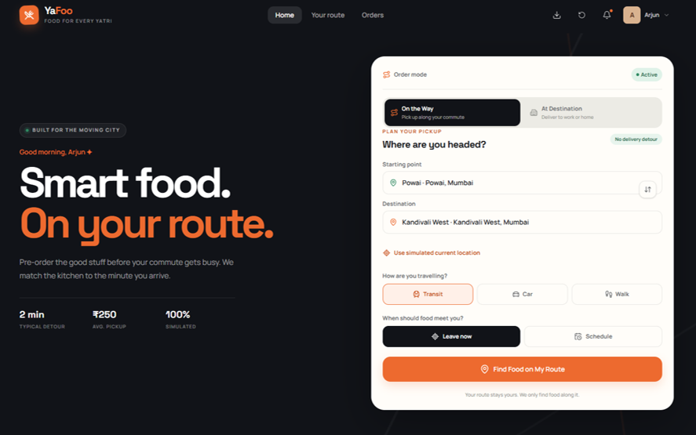
YaFoo
PRODUCT READINESS
The demo app is ready to show.
The core experience can be demonstrated today and converted into a Mumbai pilot.
01
Choose the mode
Switch between “On the way” and “At destination”.
02
Select food and timing
Compare location, food-ready time, ETA and fulfilment options.
03
Pick up or receive
Self-pickup, restaurant delivery or delivery partner.
READY FOR LIVE DEMO
Notes:
[Sources] Visual adapted from the founder-provided YaFoo presentation. Demo-app readiness and product flow provided by the founders. [/Sources]

Slide 5
YaFoo
AI CAPABILITIES
A meal experience that learns, adapts and guides.
SHiV.AI intelligence can personalize discovery, simplify customization and support healthier food decisions.
Preference intelligence
Food customization
Calorie tracker
Learns cuisine, spice, dietary and budget preferences from interactions and repeat orders.
Recommends compatible swaps, portions and add-ons based on availability and user needs.
Tracks estimated calories across meals, daily goals and recurring office plans.
Discover smarter • Customize confidently • Track consistently
Notes:
[Sources] AI capability direction provided by the founders. Calorie values should be presented as estimates unless verified nutrition data is integrated. [/Sources]

Slide 6
YaFoo
MUMBAI LAUNCH
Start narrow, learn fast, then scale.
Build density across commuter corridors and destination-based accounts.
0–3 MONTHS
4–8 MONTHS
9–12 MONTHS
Prove
Densify
Expand
Launch the demo app, onboard restaurants and validate two transit clusters.
Add offices, corporate campuses, home users and repeat-order programs.
Scale winning Mumbai corridors and destination clusters.
Revenue model
Restaurant commission
Convenience fee
Corporate plans
Sponsored discovery
Core
Per order
B2B/B2E
Partners
Notes:
[Sources] Mumbai-first plan and revenue model are founder planning assumptions. [/Sources]

Slide 7
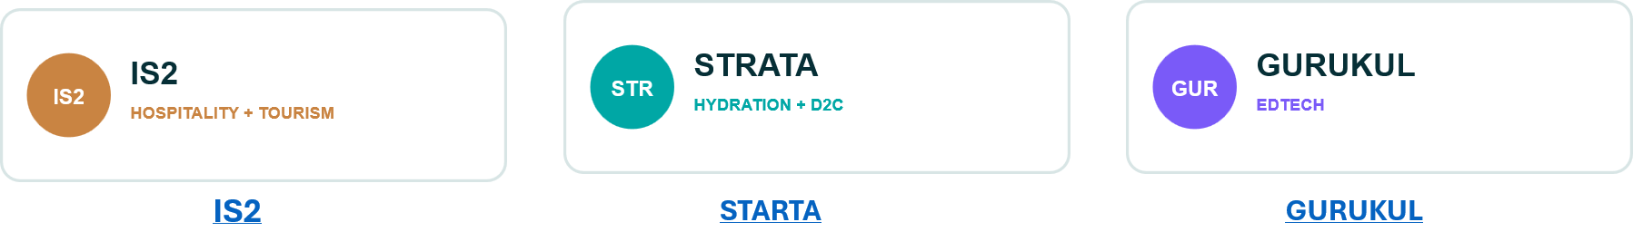
YaFoo
COMPANY ARCHITECTURE
YaFoo is a SHiV.AI initiative, led as a distinct venture.
Clear ownership, shared technology capability and a portfolio of delivered digital products.
PARENT COMPANY
SHIV.AI INITIATIVE
SHiV.AI • Shivam
YaFoo • Ganesh
Technology, AI, shared platforms and venture enablement.
IS2
STARTA
GURUKUL
Shared capability
Distinct YaFoo ownership. Proven cross-industry delivery.
Notes:
[Sources] SHiV.AI: https://www.shivai.co.in/ YaFoo: https://yafoo.in/ IS2 Hospitality & Tourism: https://www.is2hospitality.shivai.co.in/ Strata Hydration: https://www.stratahydration.com/ Gurukul: https://www.gurukul.shivai.co.in/ Ownership and initiative structure provided by the founders. [/Sources]

Slide 8
YaFoo
COMPANY ARCHITECTURE
YaFoo is a SHiV.AI initiative, led as a distinct venture.
Clear ownership, shared technology capability and a portfolio of delivered digital products.
PARENT COMPANY
SHIV.AI INITIATIVE
SHiV.AI • Shivam
YaFoo • Ganesh
Technology, AI, shared platforms and venture enablement.
IS2
STARTA
GURUKUL
Shared SHiV.AI capability. Distinct YaFoo ownership. Proven cross-industry delivery.
Notes:
[Sources] SHiV.AI: https://www.shivai.co.in/ YaFoo: https://yafoo.in/ IS2 Hospitality & Tourism: https://www.is2hospitality.shivai.co.in/ Strata Hydration: https://www.stratahydration.com/ Gurukul: https://www.gurukul.shivai.co.in/ Ownership and initiative structure provided by the founders. [/Sources]

Slide 9
THE PARTNERSHIP ASK
Help YaFoo launch and prove Mumbai.
THE PROOF
We are seeking the ecosystem support required to turn a ready demo into a focused, measurable pilot.
✓
Live commuter corridors
✓
Corporate destination accounts
Incubation & mentorship
Sharpen the operating model, customer validation and city-scale playbook.
✓
Repeat meal ordering
Strategic partnerships
Connect restaurants, offices, pickup hubs and delivery ecosystems.
✓
Proven unit economics
Pilot-launch support
Enable a controlled Mumbai launch and demonstrate repeat usage.
YaFoo makes food available wherever the customer is available.
yafoo.in | shivai.co.in
Notes:
[Sources] Partnership requirements and pilot objectives provided by the founders. No funding amount is stated on this slide. [/Sources]

