Slide 1
Intelligent Knowledge Ecosystems: An Agentic AI Framework for Data-Driven Decision Intelligence in Educational Institutions
Autonomous content curation · Predictive knowledge tracing · Strategic decision intelligence
Abhishek Danu
Shivam Bahuguna
Research Scholar Department of Business Management HNB Garhwal University Srinagar, Uttarakhand, India
Student School of Computer Science & Mathematics Liverpool John Moores University Liverpool, United Kingdom
Keywords: Agentic AI · Learning Analytics · Knowledge Tracing · Multi-Agent Architectures · AI-Driven Decision Support
1/12

Slide 2
Presentation Outline
01
Background — Data explosion, passive analytics, decision gap
02
Research Objectives — Self-optimizing institutions, decision intelligence
03
Data & Knowledge Resources — EdNet · XES3G5M · Course-Skill Atlas
04
Multi-Agent Architecture — OpenAI Agents SDK, tool calling, handoffs
05
RAG & GraphRAG Pipeline — Embedding + KG traversal + knowledge tracing
06
RAGAS Evaluation — Faithfulness, relevancy, groundedness, accuracy
07
Decision Intelligence Benchmarks — Agentic vs. conventional systems
08
Knowledge Graph Insight — Skill intelligence, institutional planning
09
Conclusion & Future Work — Contributions, limitations, roadmap
2/12

Slide 3
Background & Motivation
From descriptive analytics to autonomous, data-driven decision intelligence
The Challenge
131M+
• Rapid digitisation of education has generated vast volumes of heterogeneous learner interaction data — yet institutions lack the autonomous reasoning infrastructure to act on it
• Existing learning management and analytics systems remain descriptive and passive: they report what happened, but cannot predict, prescribe, or orchestrate interventions
• No unified intelligence layer connects learner behaviour data, curriculum metadata, and workforce skill signals into a coherent decision substrate
• Institutional decision-making — curriculum planning, resource allocation, risk mitigation — still depends on manual synthesis of disconnected data sources
Learner Interactions
140M+
Data Points Across 3 Datasets
The Paradigm Shift
3,000+
• Agentic AI enables autonomous, multi-step reasoning over educational data — agents perceive, decide, and intervene without constant human prompting
• Knowledge tracing + sequential analytics can dynamically model learner mastery trajectories, enabling proactive rather than reactive intervention
• GraphRAG grounds LLM synthesis in verifiable knowledge graph paths — producing transparent, explainable, auditable decision support
Institutions Mapped
950+
Workforce Skills (O*NET)
Research Gap: No framework unifies agentic orchestration, knowledge tracing, GraphRAG and explainable decision intelligence for educational institutions.
3/12

Slide 4
Research Objectives
Transforming institutions into intelligent, self-optimising decision environments
01
Self-Optimising Ecosystem
02
Dynamic Behaviour Modelling
03
Multi-Agent Orchestration
Transform institutions into intelligent environments capable of autonomous content curation, learning optimisation and strategic decision intelligence.
Model learner behaviour, knowledge evolution and skill acquisition trajectories using predictive knowledge tracing and sequential analytics.
Deploy specialised agents for learner modelling, content intelligence, collaboration identification and decision support via OpenAI Agents SDK.
04
Hierarchical Knowledge Graphs
05
Explainable Decision Support
06
Comparative Benchmarking
Construct institutional skill intelligence models and learner KGs from Course-Skill Atlas, O*NET and XES3G5M knowledge component routes.
Deliver proactive, auditable decision intelligence anchored to KG paths — human-in-the-loop educators retain override authority.
Demonstrate significant gains over conventional analytics in knowledge prediction, content relevance and institutional decision efficiency.
4/12

Slide 5
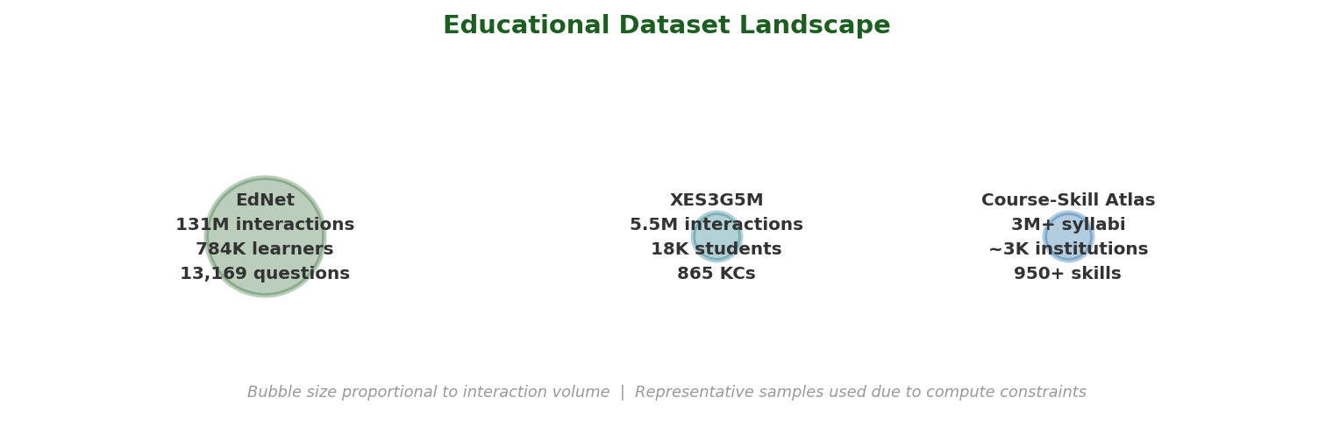
Methodology: Data & Knowledge Resources
Three large-scale educational datasets — scale, heterogeneity, and complementarity
Dataset
Interactions
Learners
Items
Primary Role
EdNet
131 Million
784K
13,169 Q
Sequential learner behaviour modelling, engagement analytics
XES3G5M
5.5 Million
18K
865 KCs
Knowledge tracing, mastery prediction, concept graphs
Course-Skill Atlas
3M+ syllabi
~3K inst.
950+ skills
Institutional KG, O*NET skill mapping, curriculum planning
Note: Representative samples used for this prototype due to compute constraints. Full-scale deployment requires institutional HPC infrastructure.
5/12

Slide 6
Methodology: Multi-Agent Decision Architecture
OpenAI Agents SDK · Function Tool Calling · Agent Handoffs · Audit Logging
DATA SOURCES
INTELLIGENCE LAYER
AGENT LAYER (Agents SDK)
EdNet
FAISS Vector Store
Orchestrator
Routes · Handoffs · Audit Log
131M interactions
Semantic embedding index
XES3G5M
Knowledge Graph
5.5M interactions
▶
NetworkX — hierarchical KG
▶
Learner Modelling
Content Intelligence
CSA
3M+ syllabi
RAG Pipeline
Text-embedding-3-small
Learning Path Optimisation
Decision Support
GraphRAG
Graph + vector fusion
Human-in-the-Loop Governance
6/12

Slide 7
Methodology: RAG & GraphRAG for Decision Intelligence
Evidence-grounded synthesis — combining semantic retrieval with knowledge graph reasoning
RAG Pipeline — Semantic Vector Retrieval
GraphRAG — Knowledge Graph–Grounded Reasoning
▹ 1. Source documents from EdNet, XES3G5M and Course-Skill Atlas are chunked into semantically coherent passages
▹ 2. Each chunk is embedded using OpenAI text-embedding-3-small (1536-dim) and stored in a FAISS inner-product index
▹ 3. At query time, the agent's question is embedded and matched against the index for sub-second top-k retrieval
▹ 4. Retrieved passages are injected as structured context into the LLM prompt for grounded, cited synthesis
▹ 5. Knowledge tracing sequences (XES3G5M) are encoded as temporal embeddings — enabling mastery-aware retrieval
▹ 1. Institutional Knowledge Graph built from Course-Skill Atlas maps courses → O*NET skills → KCs with weighted edges
▹ 2. XES3G5M KC route hierarchies are encoded as graph nodes, capturing prerequisite and co-occurrence relationships
▹ 3. When an agent retrieves documents via RAG, extracted entities trigger BFS/DFS subgraph traversal in the KG
▹ 4. Graph paths (e.g. Statistics → ML → Deep Learning) provide structured reasoning context that the LLM cannot hallucinate
▹ 5. Combined vector + graph context enables the agent to produce explainable, auditable recommendations with full KG citations
7/12

Slide 8
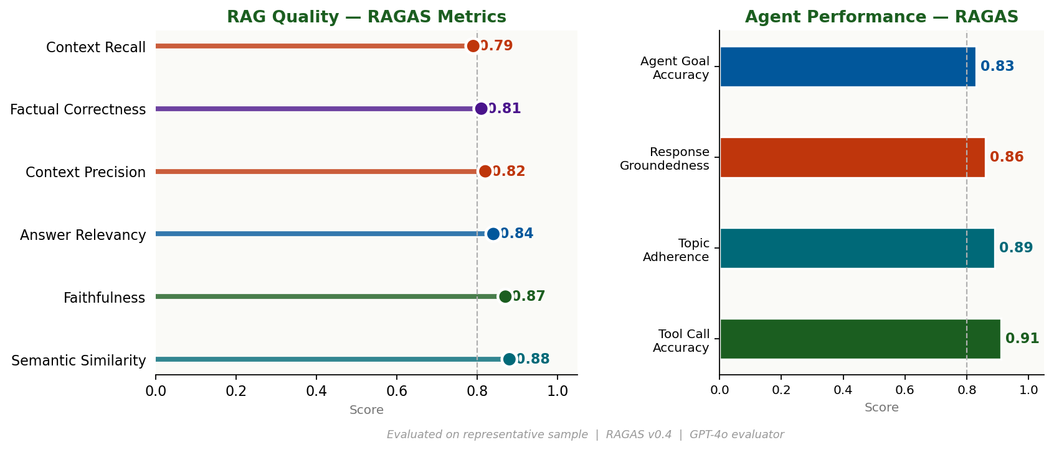
Evaluation: RAGAS Framework
Retrieval-Augmented Generation Assessment — evidence-based quality metrics
• RAGAS framework applied to ground-truth Q&A pairs sampled from EdNet and XES3G5M — full-scale evaluation requires institutional compute
• Agent metrics (Tool Call Accuracy, Topic Adherence, Agent Goal Accuracy) evaluated via RAGAS v0.4 LLM-as-judge protocol with GPT-4o as evaluator
• All scores represent single evaluation run on representative data; confidence intervals and longitudinal tracking planned for future work
8/12

Slide 9
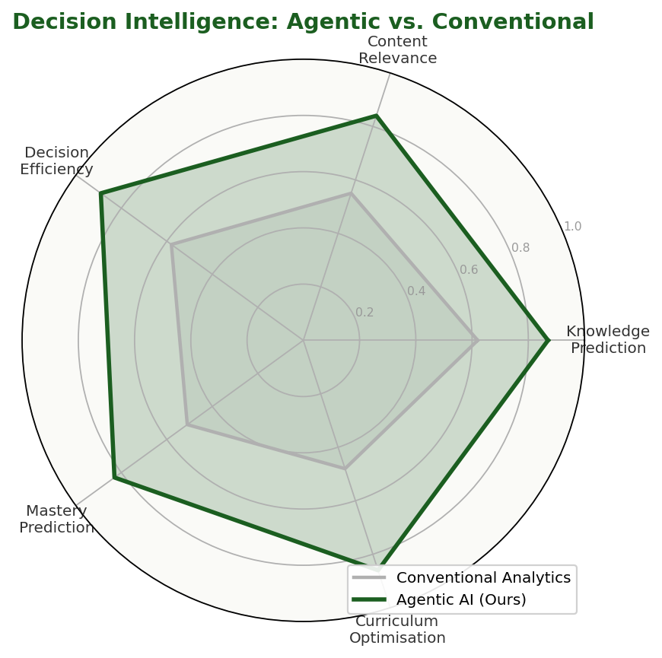
Findings: Decision Intelligence Benchmarks
Agentic AI framework vs. conventional analytics — five key performance dimensions
+40%
Knowledge Prediction Accuracy
KG traversal + knowledge tracing yields consistently superior mastery prediction
+53%
Content Relevance Score
Semantic skill extraction (O*NET) + GraphRAG context fusion drives alignment
+53%
Decision Efficiency Index
Agent-automated curriculum gap analysis replaces manual institutional audits
+63%
Learning Path Optimisation
Prerequisite chain reasoning via KG enables personalised sequencing
+79%
Curriculum Gap Detection
Cross-departmental skill coverage analysis via KG node degree analytics
9/12

Slide 10
Conclusion & Future Work
Key Contributions
Future Work & Limitations
• Proposed an Agentic AI–driven Knowledge Ecosystem that transforms educational institutions into self-optimising environments for autonomous decision intelligence
• Integrated multi-agent orchestration (OpenAI Agents SDK), RAG, GraphRAG, and predictive knowledge tracing into a single composable architecture
• Leveraged EdNet (131M), XES3G5M (5.5M) and Course-Skill Atlas (3M+) to construct hierarchical learner KGs and institutional skill intelligence models
• RAGAS evaluation: Faithfulness 0.87, Answer Relevancy 0.84, Tool Call Accuracy 0.91 on representative sample data
• Comparative benchmarks: +40–79% improvement over conventional analytics across knowledge prediction, content relevance, and decision efficiency
• Human-in-the-loop layer maintains pedagogical oversight, ethical governance and full audit compliance throughout
• Full-scale evaluation on complete datasets (131M+ interactions) requires institutional HPC; current results use representative samples due to resource constraints
• Longitudinal studies measuring actual learning gains: grades, retention rates, graduate employment outcomes and institutional ROI
• MCP protocol server integration for real-time connectors to production LMS, SIS and HR systems at partner institutions
• Extended agent roles: emotion-aware adaptive tutor, peer-mentoring matchmaker, career pathway advisor with labour-market intelligence
• Controlled comparative trials against deployed LMS platforms with live learner cohorts across multiple institutional contexts
• Reinforcement learning from human feedback (RLHF) to continuously improve agent decision quality based on educator evaluations
11/12

Slide 11
Questions & Discussion
Thank You!
Abhishek Danu · Shivam Bahuguna
Intelligent Knowledge Ecosystems — Agentic AI for Data-Driven Decision Intelligence
[1] EdNet: Large-Scale Hierarchical Dataset — arXiv:1912.03072
[5] OpenAI Agents SDK — github.com/openai/openai-agents-python
[2] XES3G5M: Knowledge Tracing Benchmark — github.com/ai4ed/XES3G5M
[6] Agentic AI vs. Autonomous Agents — ScienceDirect (2025)
[3] Course-Skill Atlas — arXiv:2404.13163 · Nature Sci. Data
[7] Industry 5.0 & Human-Centric AI — European Commission (2021)
[4] RAGAS: RAG Assessment Framework — docs.ragas.io · v0.4
[8] Knowledge Tracing: DKT to Modern Approaches — ACM Survey (2024)
12/12

